Slide 1



The development of PCRs:
a voice from the field.
ON-LINE WEBINAR – 11th September 2023
Anna Bortoluzzi
anna.bortoluzzi@mappinglca.com
https://www.mappinglca.com/home/

Slide 2
A voice from the field…
It is a pleasure to share with you my team's experience of over 10 years of developing PCRs alongside The International EPD system.
In this presentation I would like to share with you my journey as a PCR Moderator, which started in 2011.
To understand the role of a PCR Moderator from a practical point of view, I suggest you follow me through the following steps:
  review the basics of the role, just to make sure we don't get lost,
  scroll through a list of PCR Moderator reference tools and methods,
  share little tricks and lessons learned in the field as a PCR Moderator,
  discuss the value of participating in PCR development in the role of PCR Moderator,
  e...finally, I would like to share something personal about my role as PCR Moderator.
The development of PCRs: a voice from the field.
© 2023 MA.P.P.IN.G.LCA – ALL RIGHTS RESERVED
2

Slide 3
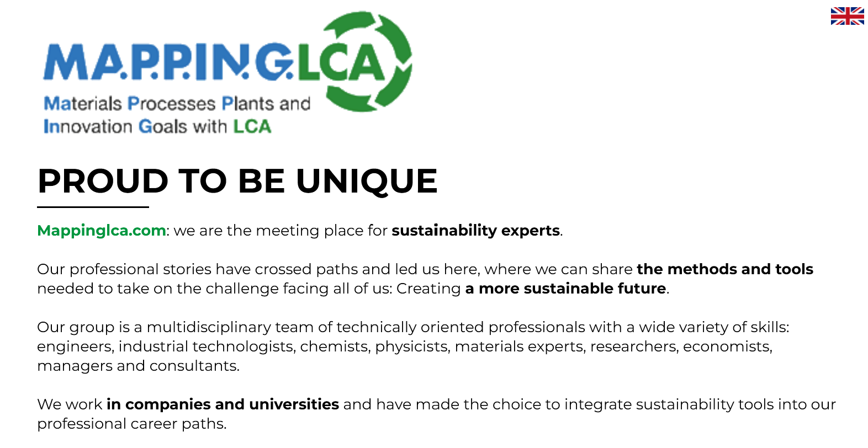

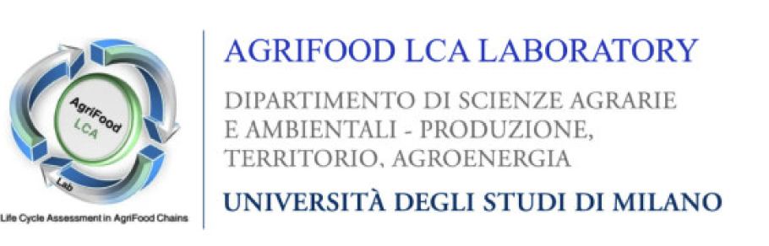

PROUD TO BE UNIQUE
SPECIALIST
IN ADDED VALUE
AND NEAR FUTURE
https://www.mappinglca.com/home/
How to use LCA for business and environmental communication
© 2023 MA.P.P.IN.G.LCA – ALL RIGHTS RESERVED
3

Slide 4
Back to basic…
The development of PCRs: a voice from the field.
© 2023 MA.P.P.IN.G.LCA – ALL RIGHTS RESERVED
4

Slide 5
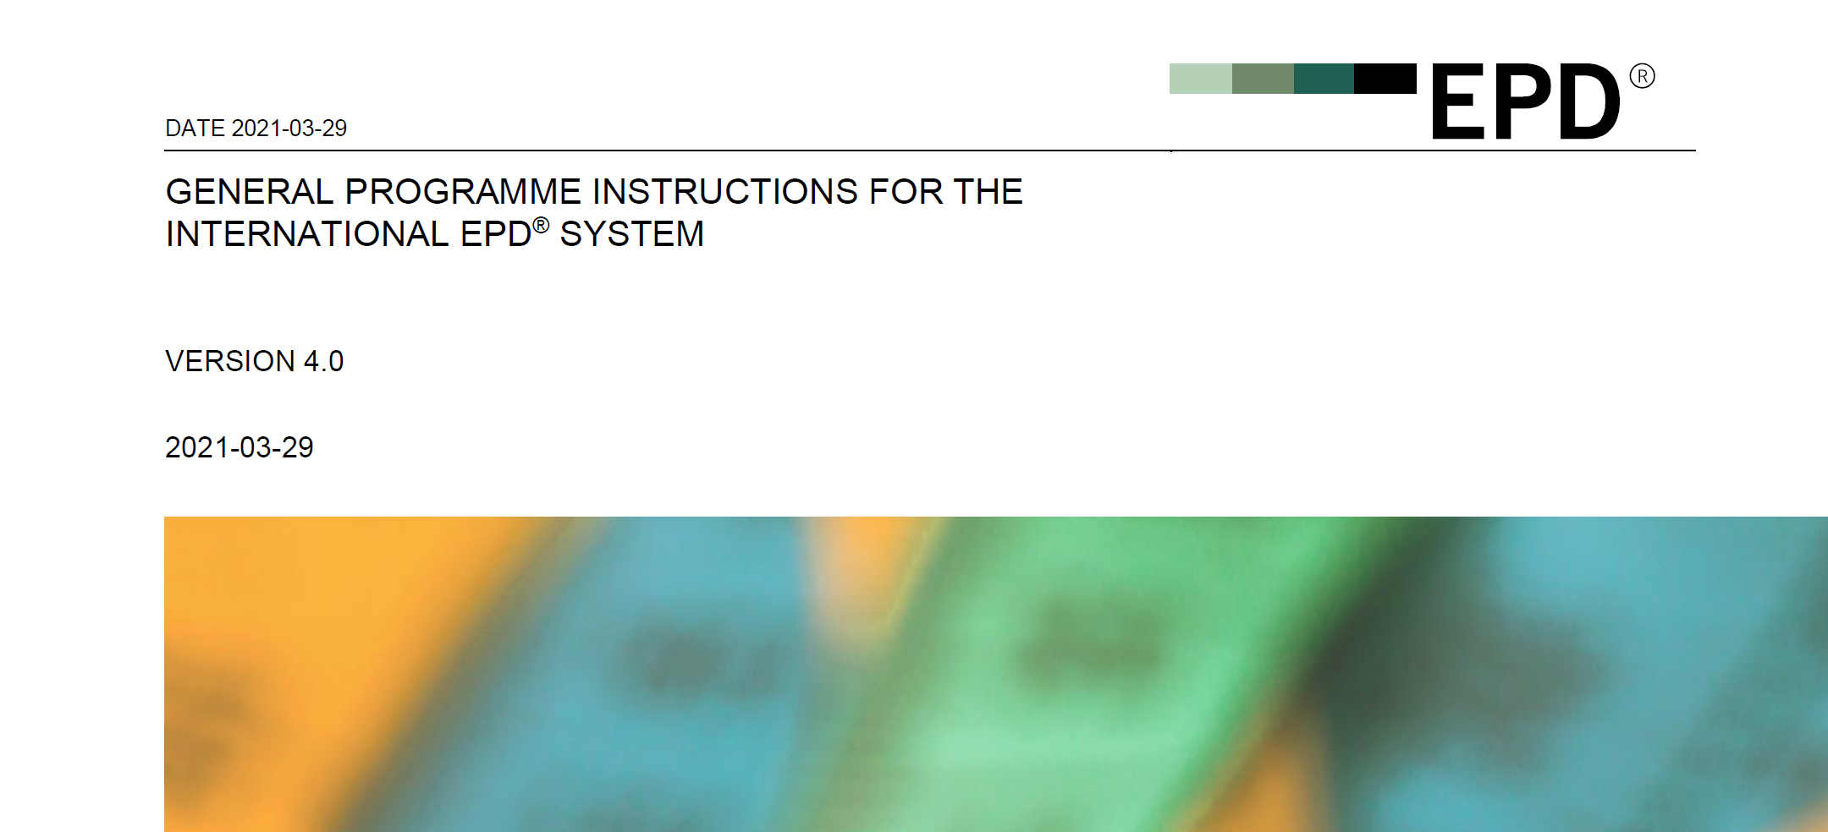
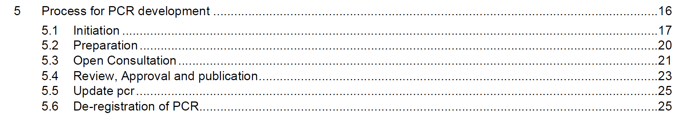
Back to basic…
The process for developing PCRs according to the GPIs of the International EPD system
The development of PCRs: a voice from the field.
© 2023 MA.P.P.IN.G.LCA – ALL RIGHTS RESERVED
5

Slide 6


Back to basic…
  3.2 ROLES IN PCR DEVELOPMENT
  3.2.1 SECRETARIAT AND TECHNICAL COMMITTEE
  PCR development is guided and overseen by the Secretariat to ensure that the process follows the requirements in ISO 14025, the GPI, and other relevant standards or PCR harmonisation initiatives. The Technical Committee acts as the PCR review panel. For more information about these roles, see Section 3.1.
  3.2.2 PCR MODERATOR
  The PCR Moderator has a number of tasks related to the development of the PCR primarily:
  ▪ to lead and be responsible for the overall preparation of the draft PCR by the PCR Committee,
  ▪ to invite LCA/EPD/PCR experts, industry experts, and other relevant stakeholders to take part in the development of the PCR as part of the PCR Committee,
  ▪ to promote collaboration between PCR Committee members and seek contributions from them,
  ▪ to act as the contact person for the PCR Committee,
  ▪ to submit a time plan for PCR development to the Secretariat and inform the Secretariat of any changes to the time plan during the development,
  ▪ to inform the Secretariat about relevant industry and trade publications or forums where PCR development should be announced,
  ▪ to propose the scope of product category and identify relevant codes in the UN CPC scheme,
How many tasks?
The development of PCRs: a voice from the field.
© 2023 MA.P.P.IN.G.LCA – ALL RIGHTS RESERVED
6

Slide 7
Back to basic…
  ▪ to propose stakeholders to be invited to the open consultation as part of the PCR stakeholder consultation group,
  ▪ to act as contact person for stakeholders in the open consultation process,
  ▪ to collect and respond to stakeholder comments,
  ▪ to lead the updating of the draft PCR based on comments received during the open consultation, make a summary of comments accepted and rejected (and their rationale), and submit these documents to the Secretariat,
  ▪ to lead the updating of the draft PCR based on the PCR review, make a summary of the comments and suggested changes accepted and rejected (and their rationale), and submit these documents to the Secretariat,
  ▪ to alert stakeholders involved in the process about the outcome of the work and the publication of the PCR,
  ▪ to remain as the contact person during the time when the PCR is being used on the market for, e.g. collecting suggestions for improvement in upcoming revisions. In case this is not possible, the PCR Moderator shall contact the Secretariat and may suggest another person capable of taking over the duties.
  ▪ to start the updating phase of the PCR at least six months before the end of its current validity.
How many tasks?
The development of PCRs: a voice from the field.
© 2023 MA.P.P.IN.G.LCA – ALL RIGHTS RESERVED
7

Slide 8

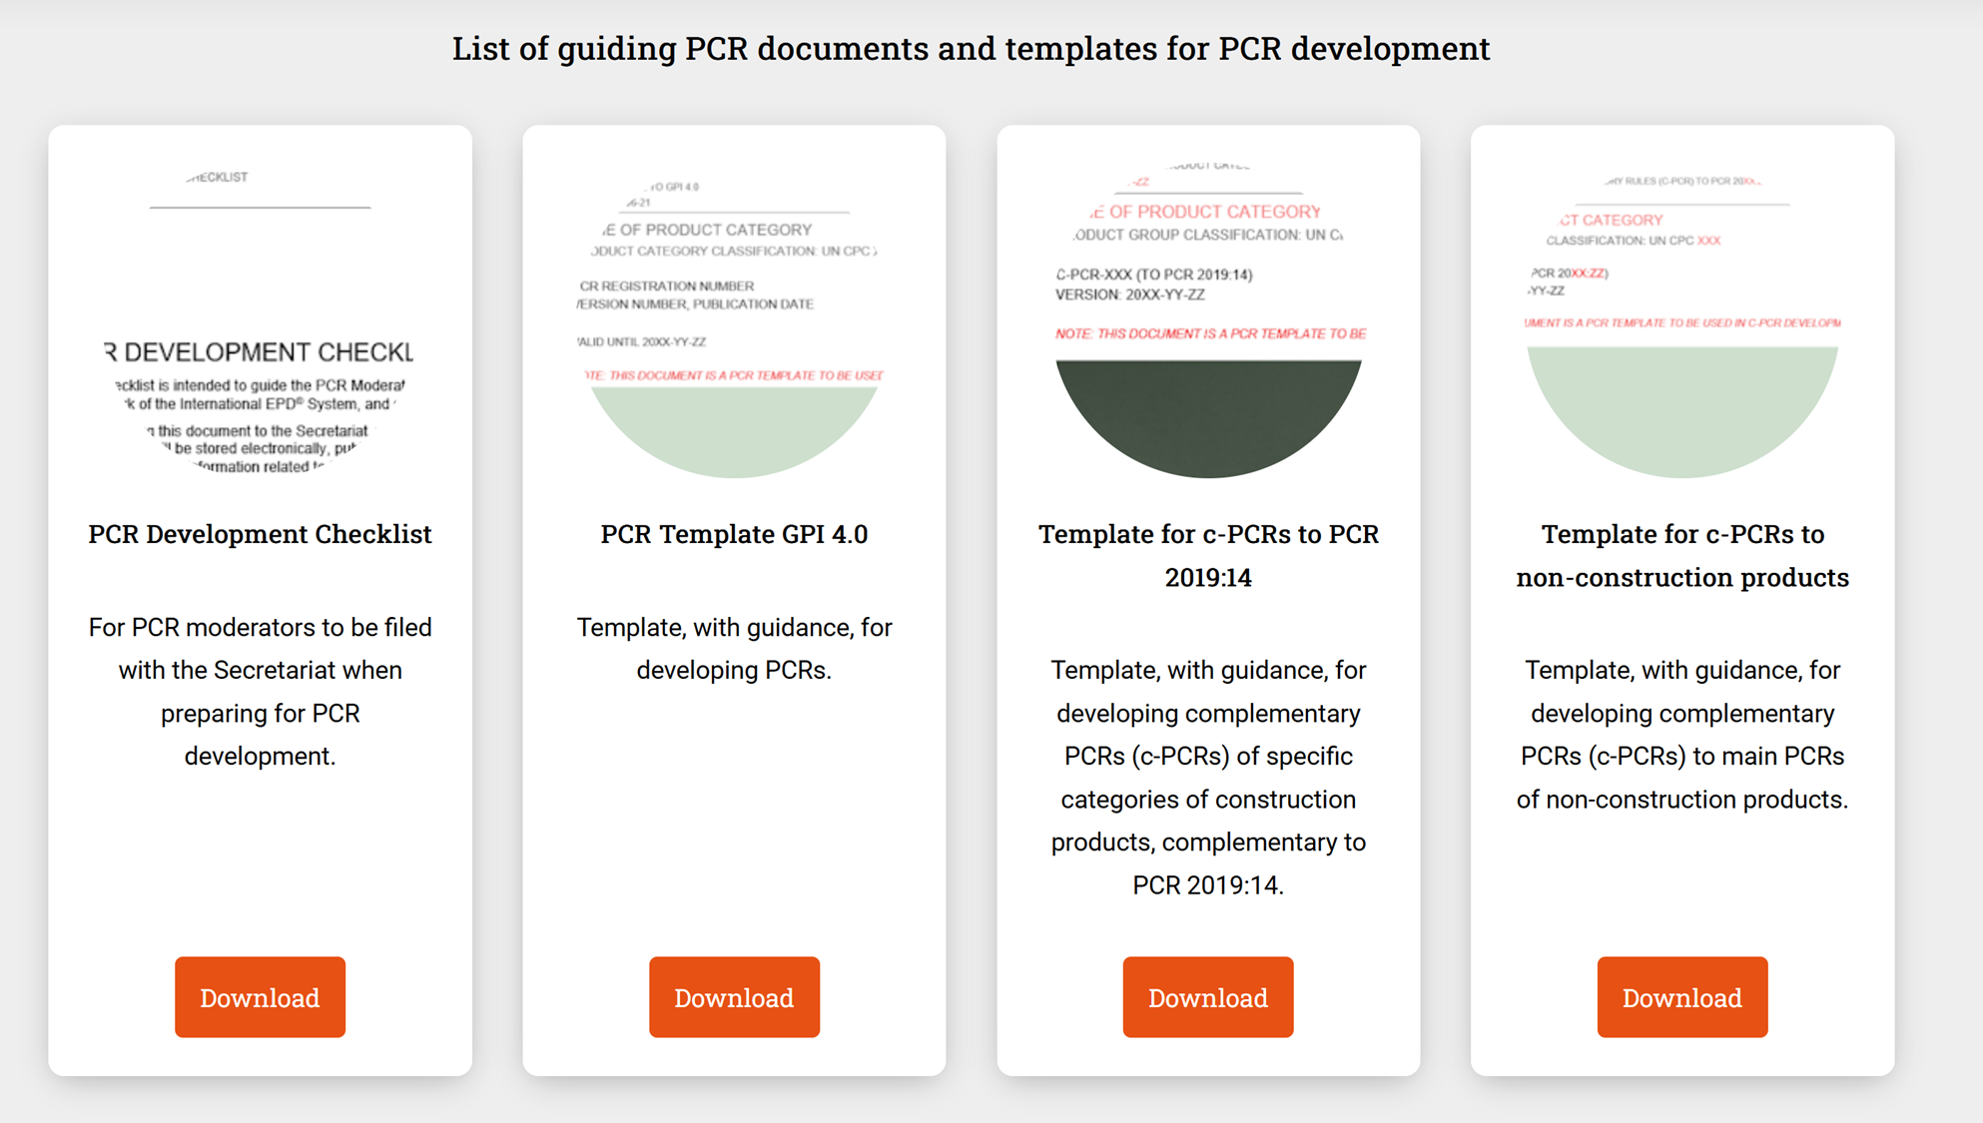
Back to basic…
  3.2.3 PCR COMMITTEE
  The PCR Committee is a group of interested parties tasked by the Secretariat with drafting and finalizing the PCR. The task of the PCR committee is to define the product category and develop the respective PCR. PCR stakeholder consultation group
  The PCR stakeholder consultation group comprises those stakeholders invited to provide feedback on the draft PCR during the open consultation. Their role is to read and provide comments on the draft PCR during the open consultation.
The development of PCRs: a voice from the field.
© 2023 MA.P.P.IN.G.LCA – ALL RIGHTS RESERVED
8

Slide 9
reference tools and methods
The development of PCRs: a voice from the field.
© 2023 MA.P.P.IN.G.LCA – ALL RIGHTS RESERVED
9

Slide 10

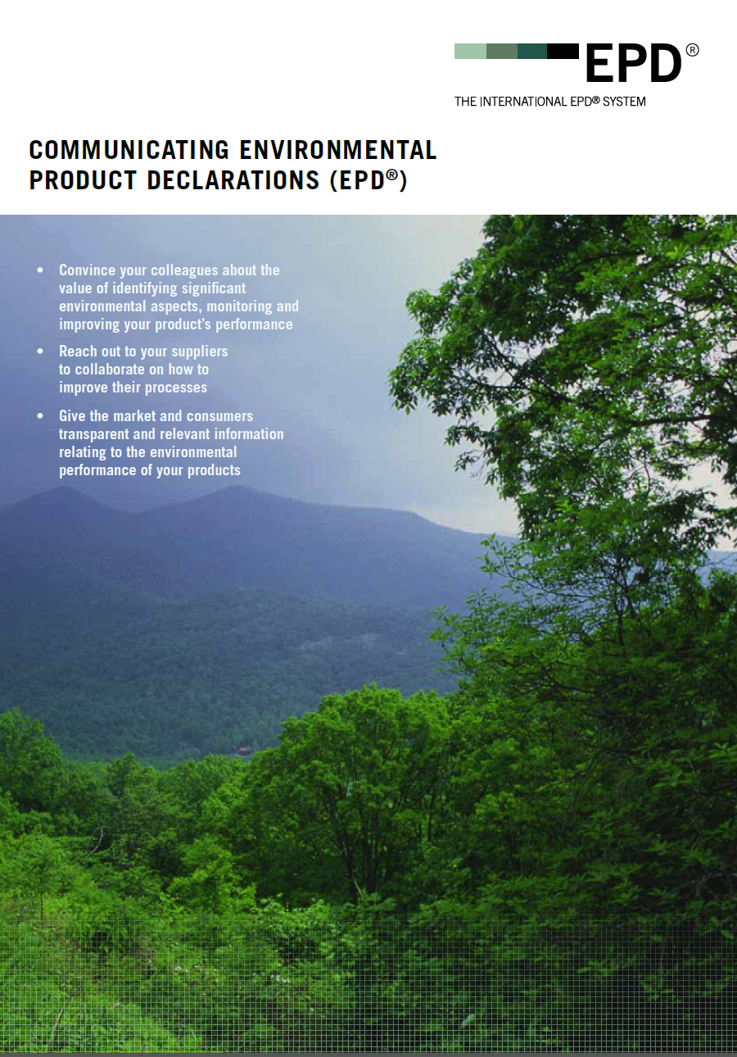
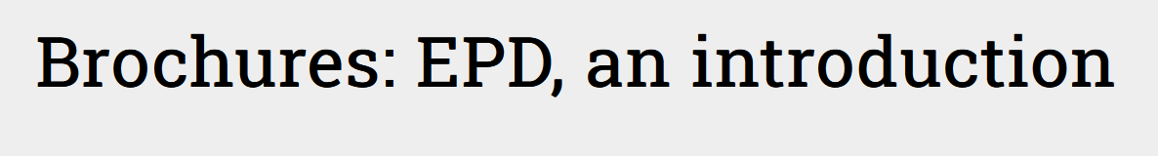
reference tools and methods
The development of a PCR requires a focus on
… goals.
International EPD System brochures are useful to remind PCR Committee members of the goals PCR must enable users to achieve.
The PCR must provide valuable support to organisations wishing to develop EPDs that meet the goals set out in the brochures.
The PCR must also clearly support verifiers appointed to carry out EPD verification.
The development of PCRs: a voice from the field.
© 2023 MA.P.P.IN.G.LCA – ALL RIGHTS RESERVED
10

Slide 11

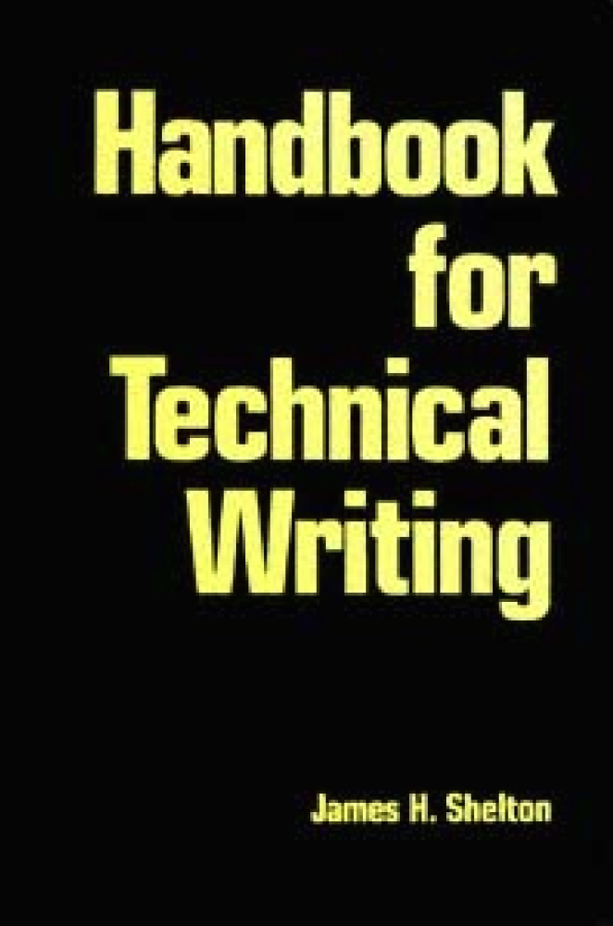
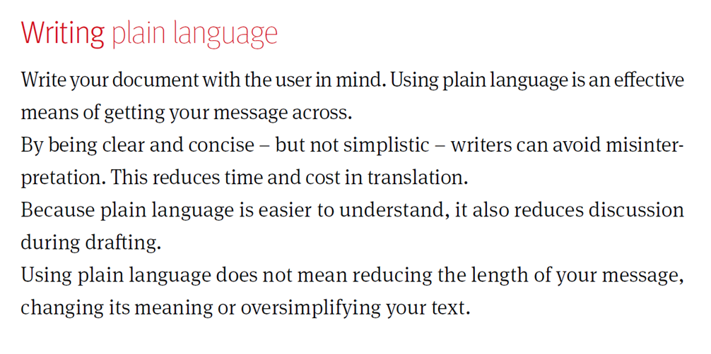
reference tools and methods
https://www.iso.org/sites/directives/current/part2/index.xhtml
The development of a PCR requires the management of … language and writing.
The development of PCRs: a voice from the field.
© 2023 MA.P.P.IN.G.LCA – ALL RIGHTS RESERVED
11

Slide 12
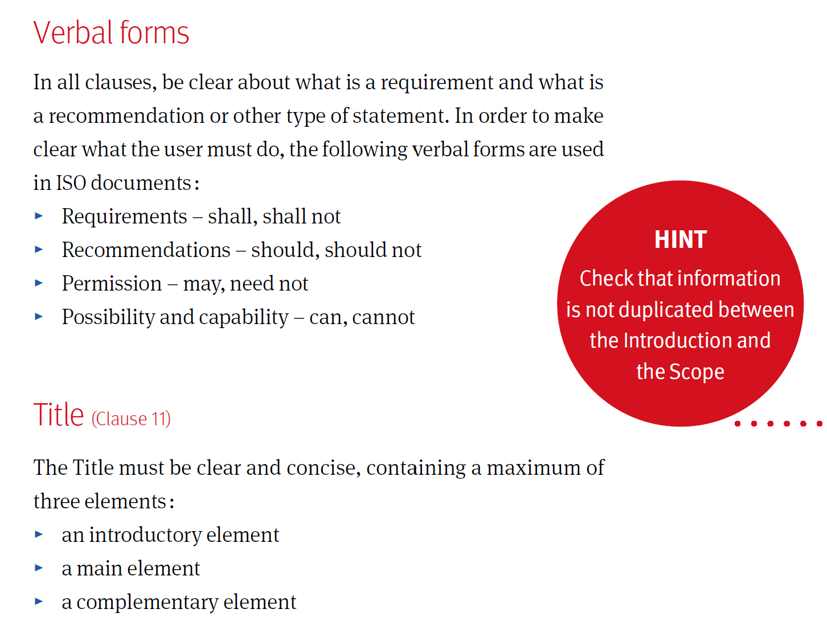
reference tools and methods
The development of PCRs: a voice from the field.
© 2023 MA.P.P.IN.G.LCA – ALL RIGHTS RESERVED
12

Slide 13
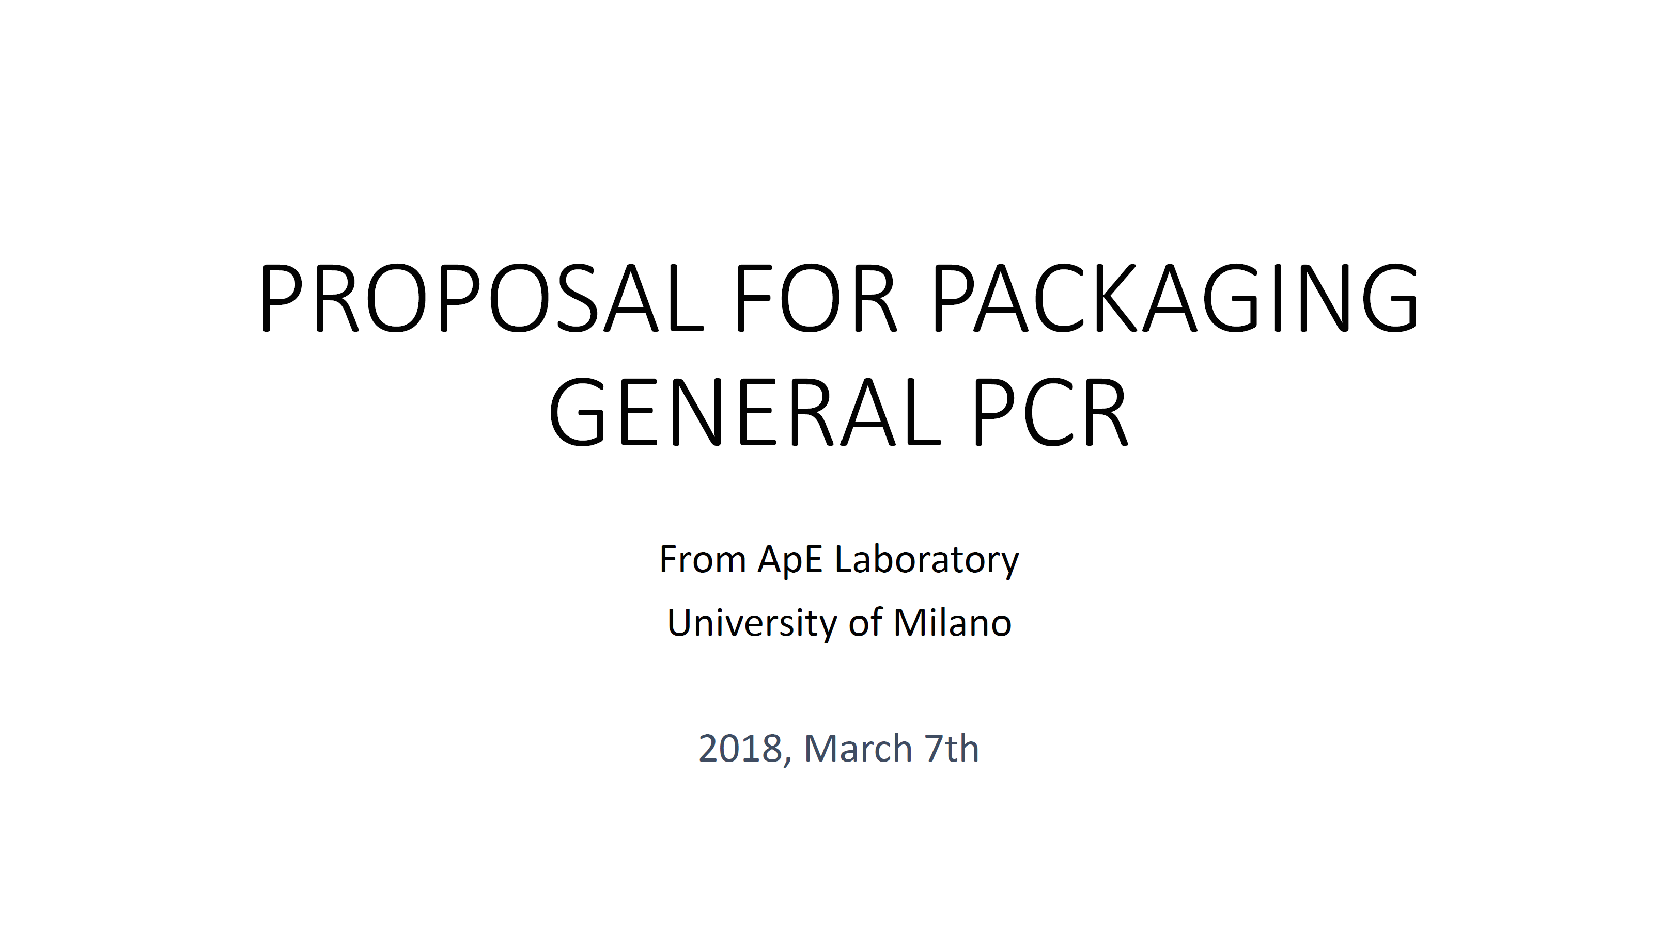
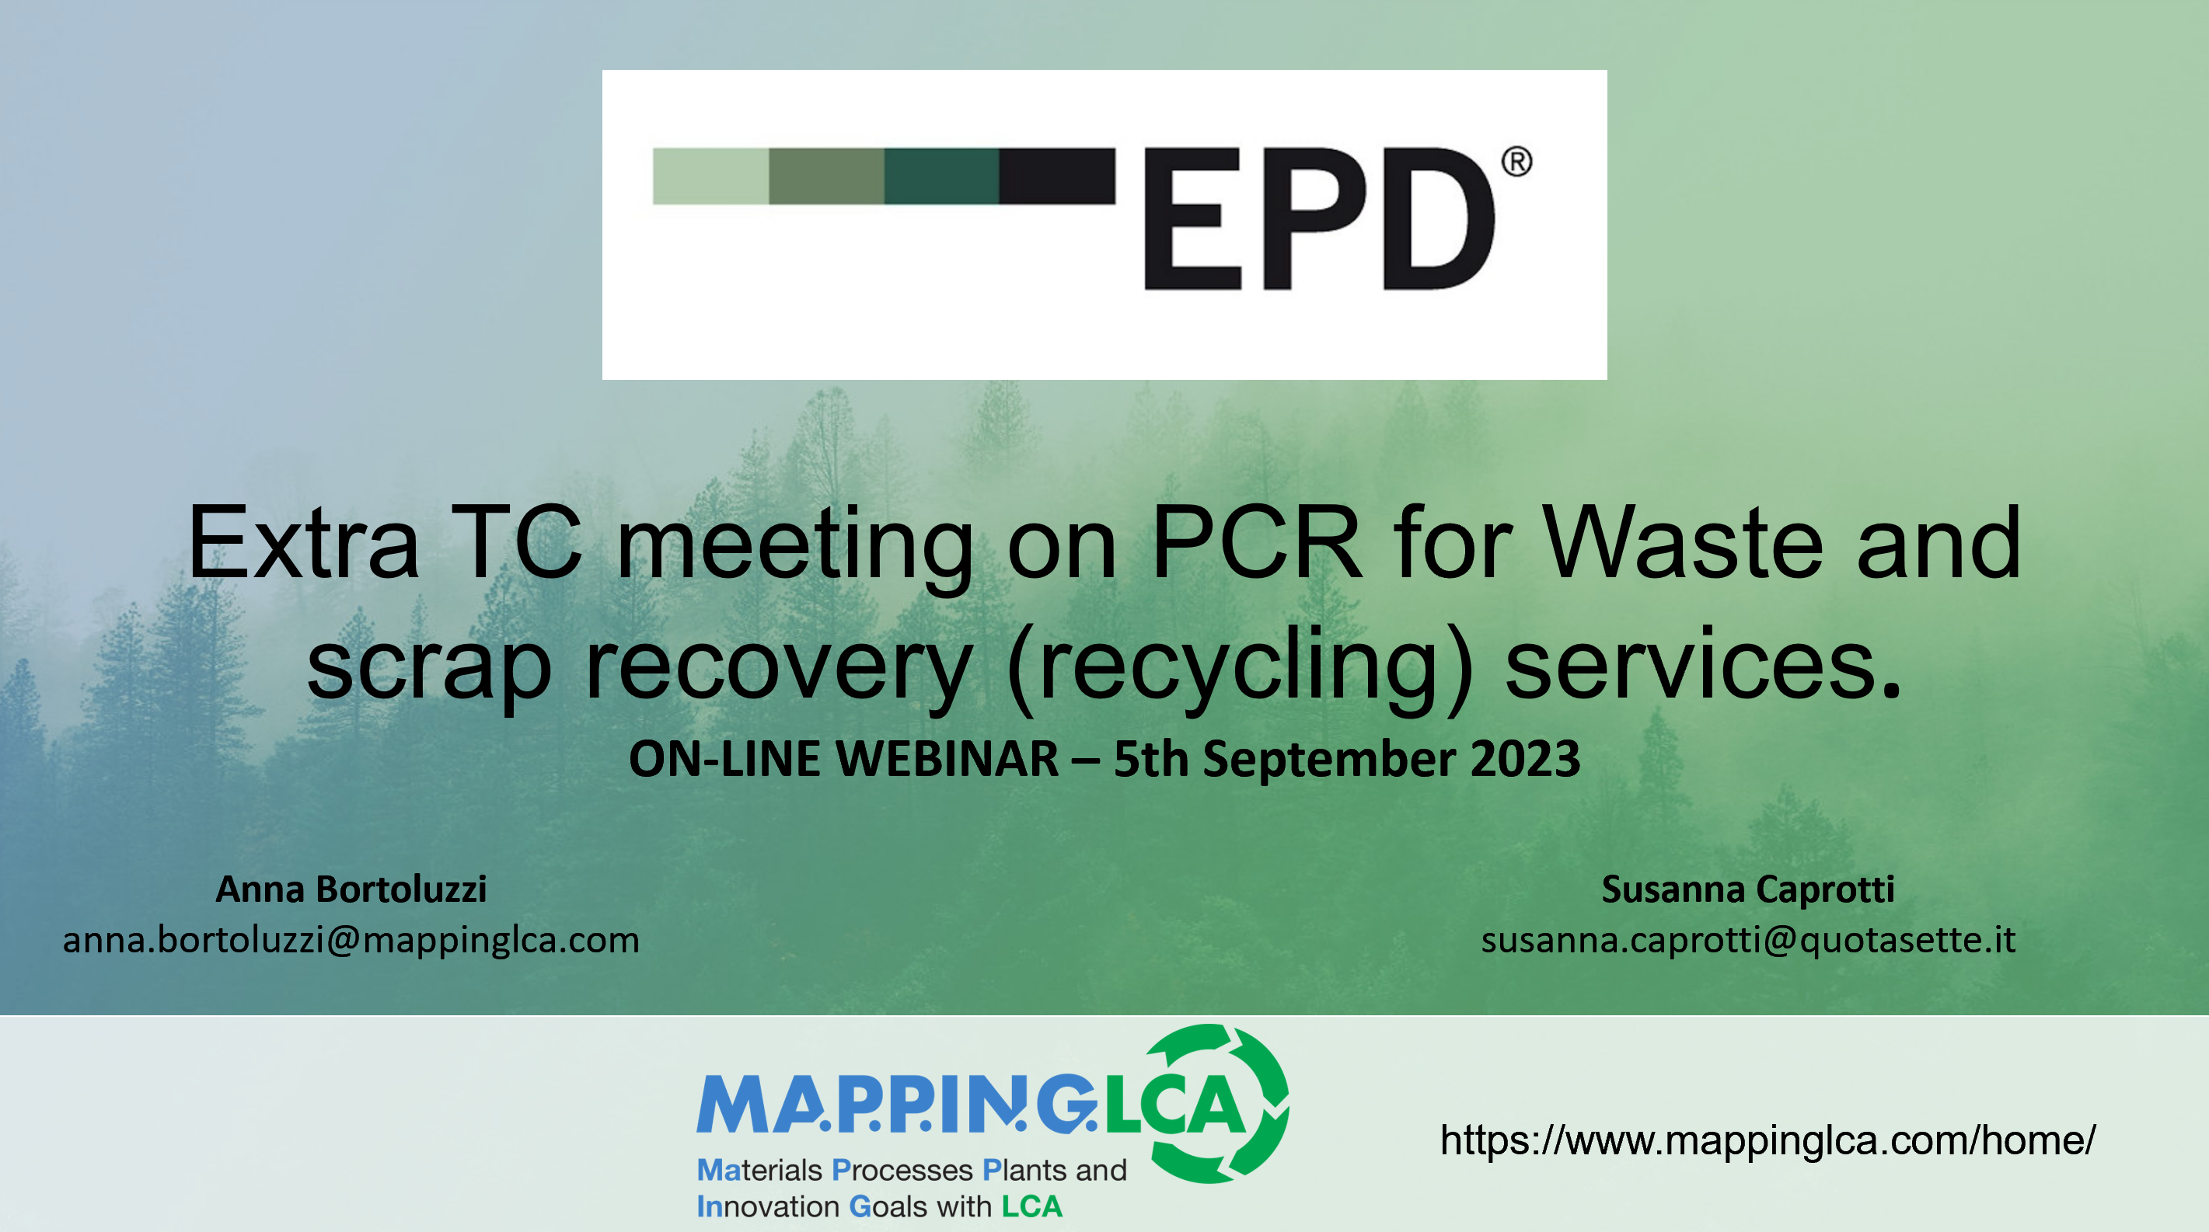
reference tools and methods
The development of a PCR requires the management of … structure and content.
A good way to proceed is to create a PCR structure that does not follow the template chapters, but only the key principles you want to develop.
The structure with the key principles is very helpful in keeping the whole team focused on the objectives. It can also be used to share with the Technical Committee the content that will be developed in detail in the PCR.
The development of PCRs: a voice from the field.
© 2023 MA.P.P.IN.G.LCA – ALL RIGHTS RESERVED
13

Slide 14
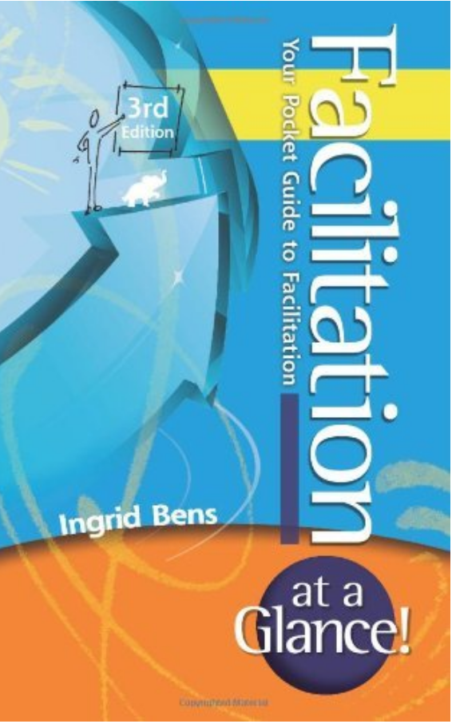
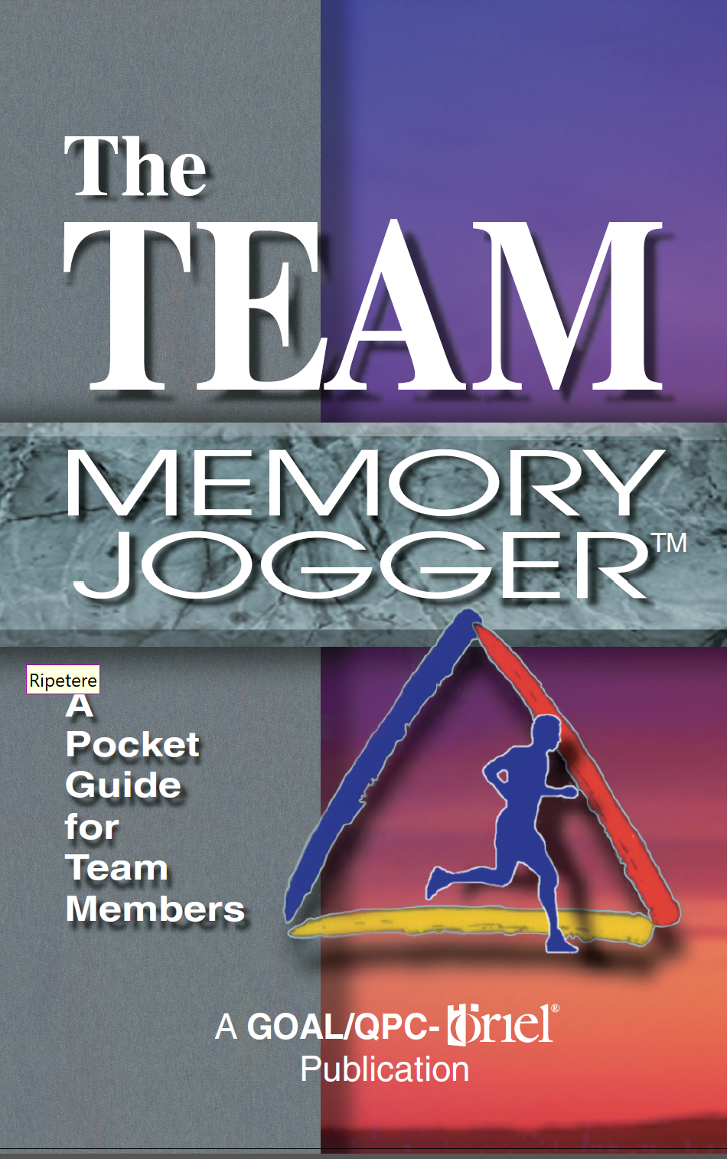
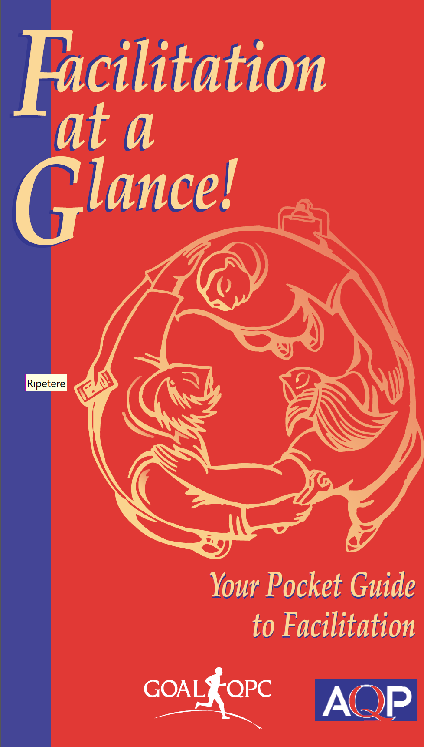
reference tools and methods
The development of a PCR requires the management of … a team.
When building the team (PCR Committee), you need to assess the skills of the participants. For the development of PCRs you need both good technical skills and good LCA skills. Skills analysis should be a structured process.
To manage the team, you need techniques to involve people. Valuing people and their skills is the real secret of good work.
NOTE: you do not need to specialise in coaching to lead your group effectively. Facilitation techniques are easy to learn and equally effective in the role of a PCR Moderator.
The development of PCRs: a voice from the field.
© 2023 MA.P.P.IN.G.LCA – ALL RIGHTS RESERVED
14

Slide 15
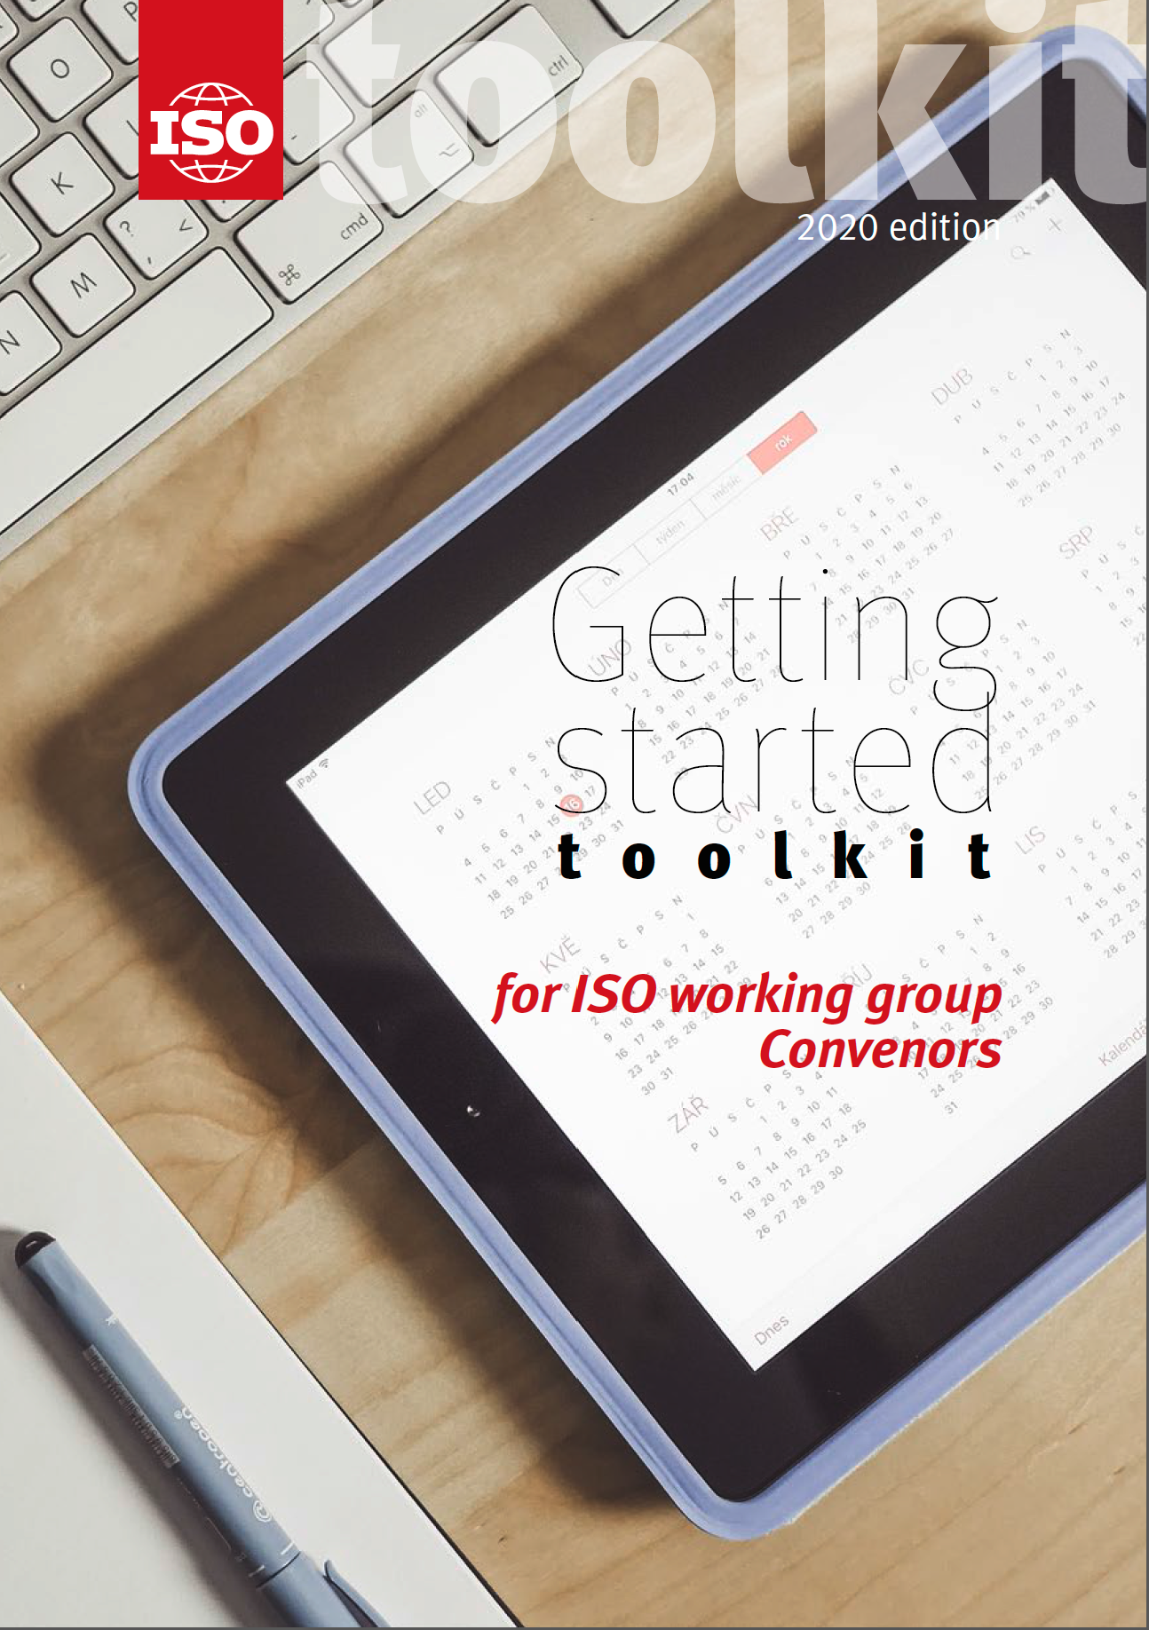
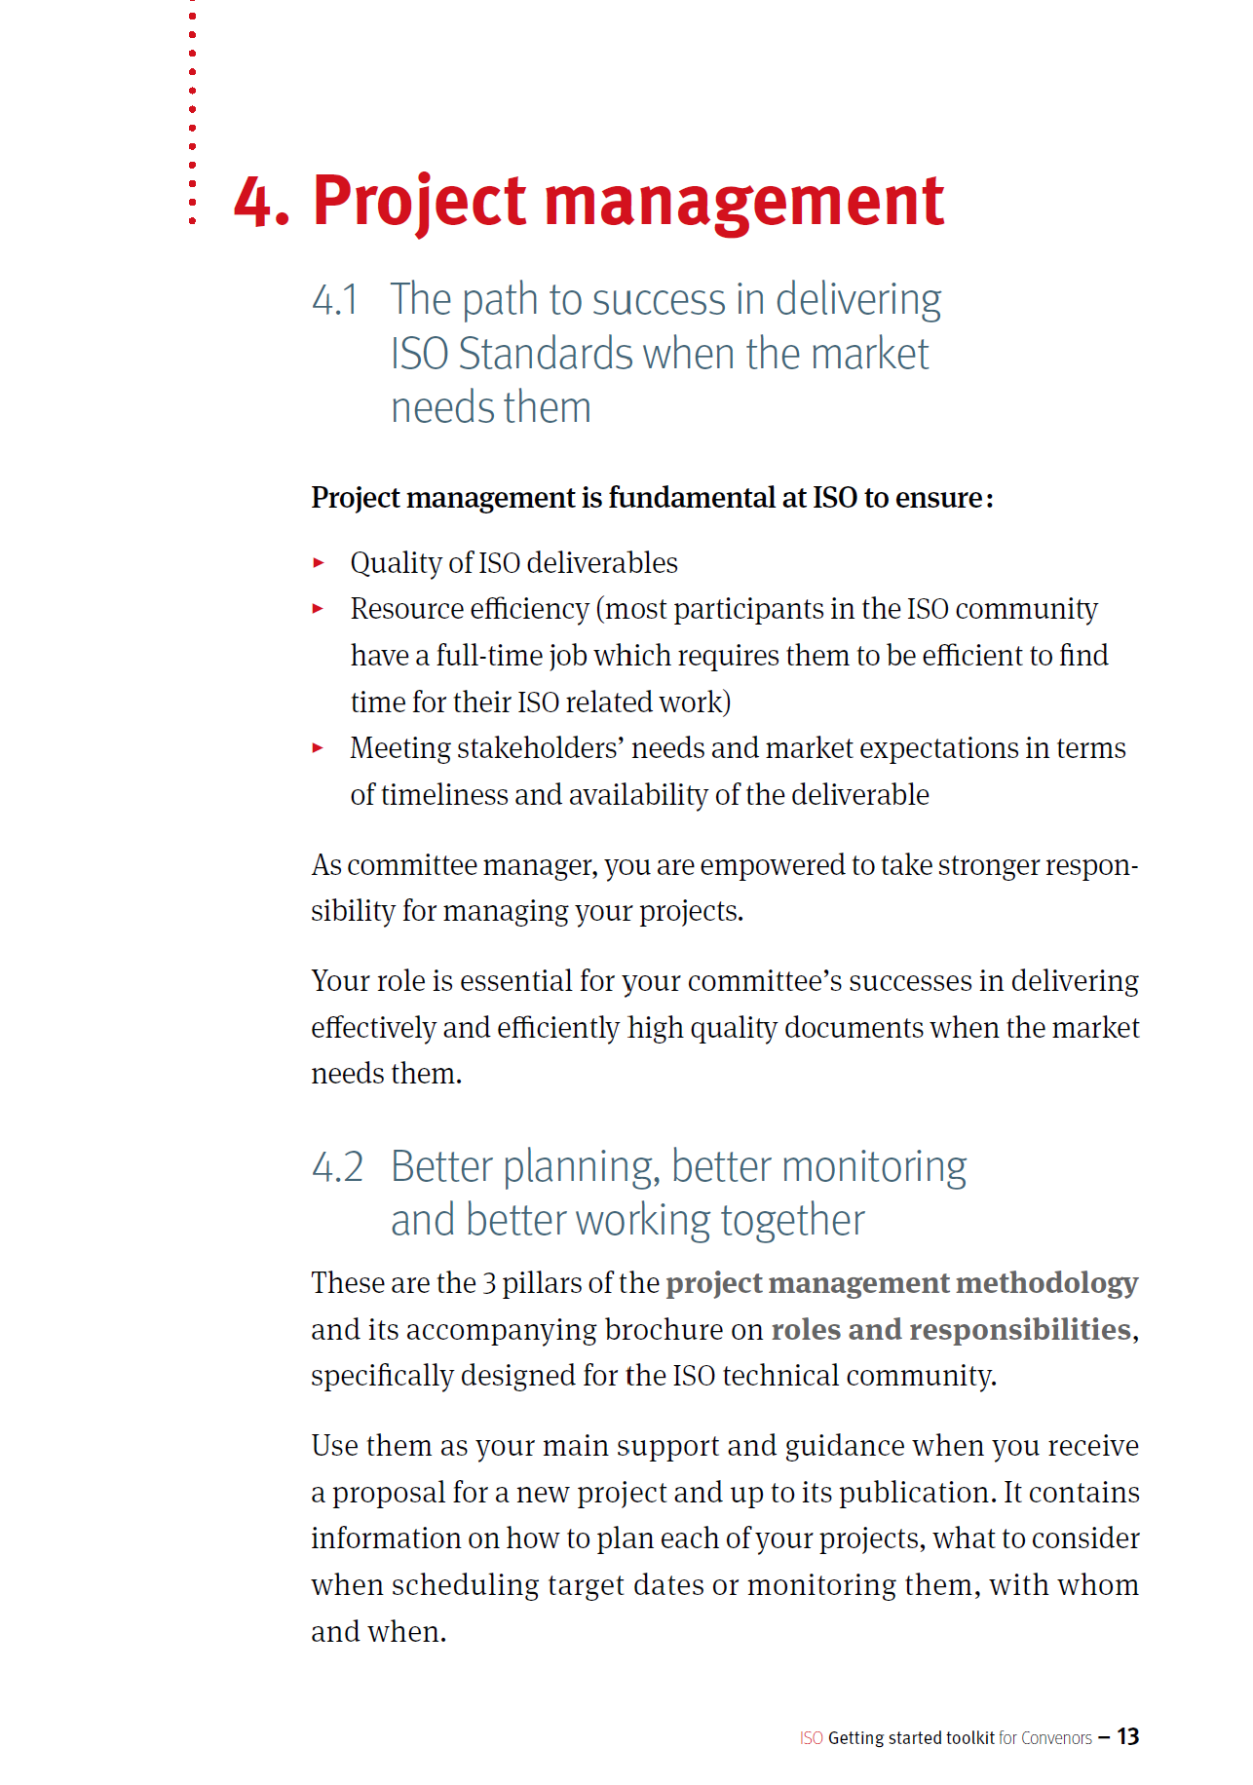
reference tools and methods
The development of a PCR requires the management of … time.
The worst enemy of the PCR Moderator is time!
Nobody ever has enough time, and PCR development requires a lot of it.
For this aspect, I can give you two pieces of advice:
try to get things right the first time
“to start later in order to arrive earlier”
The development of PCRs: a voice from the field.
© 2023 MA.P.P.IN.G.LCA – ALL RIGHTS RESERVED
15

Slide 16
little tricks and lessons learned
The development of PCRs: a voice from the field.
© 2023 MA.P.P.IN.G.LCA – ALL RIGHTS RESERVED
16

Slide 17
little tricks and lessons learned
Take care of your team.
It can sometimes be useful to split the team into two to reduce the workload.
An experienced but small team can take over the task of preparing drafts based on templates and thus work more efficiently.
Periodically, the PCR Committee meets as a whole and continues to develop the PCR based on the drafts prepared by the expert team.
A little trick:
When the draft PCR, usually in Word, goes through many changes and comments, it becomes unreadable. To make the writing process faster and more linear, we use a little trick: we highlight in yellow the parts that have already been discussed and are ready for approval, while we highlight in blue the parts that have been outlined but not yet discussed. You immediately realise how long it will take to complete the work as this document scrolls before your eyes.
The development of PCRs: a voice from the field.
© 2023 MA.P.P.IN.G.LCA – ALL RIGHTS RESERVED
17

Slide 18
little tricks and lessons learned
Use the project validation approach.
If you have a close-knit group of experts, you can choose one to participate in the initial drafting phase and then stay on the sidelines.
This colleague will be invaluable in the final stage of approval of the text by the PCR Committee, as he or she can play a critical role.
This is to apply the concept of project validation to the development of PCRs: "Confirmation, through the provision of objective evidence, that the particular requirements for a specific intended use or application have been met. [SOURCE: ISO 9000:2015, 3.8.13].
A little trick:
The reference group of experts in PCR development becomes a very important resource to achieve a good level of performance in writing, both in terms of time and content. It is important to use a multidisciplinary approach in the composition of this reference group..
The development of PCRs: a voice from the field.
© 2023 MA.P.P.IN.G.LCA – ALL RIGHTS RESERVED
18

Slide 19
little tricks and lessons learned
Business and market thinking.
The organisation that will develop the PCR-based EPD operates in a specific market and wants to invest resources to support its business.
When writing the PCR, it is good to consider competitive factors and establish requirements that allow companies to compete fairly.
The PCR also needs to take into account the requirements of legislators and other stakeholders that relate to community values, such as NGOs.
A little trick:
Legislators and NGOs are rarely represented in the PCR Committee. Their absence can be compensated for by simulation activities in the project validation phase. For example, one can ask the PCR Committee: what if...
The development of PCRs: a voice from the field.
© 2023 MA.P.P.IN.G.LCA – ALL RIGHTS RESERVED
19

Slide 20
little tricks and lessons learned
Do not go into the field without adequate skills.
The skills of the PCR Committee members are a critical factor.
The skills most often underestimated are technical skills, but they provide important guarantees in the definition of PCR requirements.
If you do not have sufficient technical skills in your PCR Committee, add them.
A little trick:
If your team does not seem homogeneous in terms of technical or LCA skills, provide free training. It is always worthwhile.
The development of PCRs: a voice from the field.
© 2023 MA.P.P.IN.G.LCA – ALL RIGHTS RESERVED
20

Slide 21
little tricks and lessons learned
When you explore new territory ...
If you are developing a PCR in an area where the LCA approach is innovative, take precautions.
Keep up to date with legislation and technical standards and develop the definition section in the PCR.
Especially for PCRs with global validity, always try to refer to the state of the art shared by different countries through existing standardisation.
A little trick:
When dealing with innovative topics for the LCA approach, it is very useful to include an introductory chapter in the first part of the PCR. If the topic is new, the users of the PCR are likely to be new to LCA and the introduction will help them find their way around and avoid misunderstandings.
The development of PCRs: a voice from the field.
© 2023 MA.P.P.IN.G.LCA – ALL RIGHTS RESERVED
21

Slide 22
The value of pcr development
The development of PCRs: a voice from the field.
© 2023 MA.P.P.IN.G.LCA – ALL RIGHTS RESERVED
22

Slide 23
The value of pcr development
The role of PCR development is clear to all, as standards development creates value by sharing technical knowledge and contributing to the evolution of the state of the art.
In the LCA field in particular, the development of PCRs makes it possible to apply the Life Cycle Thinking approach to a wide variety of sectors, thus contributing to the improvement of environmental sustainability.
What is the value of being a PCR Moderator?
It is a role that allows you to take a holistic view of the problems.
It is a role that promotes the sharing of technical and scientific content with both PCR Committee participants and the wider expert community.
It is a role that will allow you to continue to grow and develop as a professional.
And finally... writing a PCR with a team is always the great adventure!
The development of PCRs: a voice from the field.
© 2023 MA.P.P.IN.G.LCA – ALL RIGHTS RESERVED
23

Slide 24
Something personal…
The development of PCRs: a voice from the field.
© 2023 MA.P.P.IN.G.LCA – ALL RIGHTS RESERVED
24

Slide 25
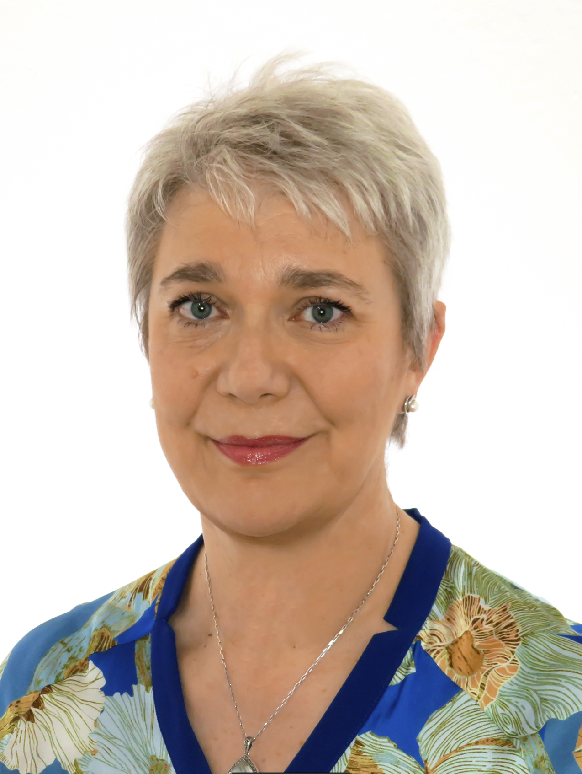
Something personal …
Anna Bortoluzzi, ICMCI qualified management consultant, works mainly in the field of innovation projects. She holds a degree in chemistry and is a materials technologist, with extensive experience in industrial plant management and statistical analysis.
Since 2006, she has worked as an expert in Life Cycle Analysis (LCA) in international projects and in the development of PCR (Product Category Rules). For twenty years she was a contract professor on environmental sustainability issues at the University of Milan.
Today she is founder and partner of the MAPPING LCA platform and responsible for the packaging eco-design sector.
The development of PCRs: a voice from the field.
© 2023 MA.P.P.IN.G.LCA – ALL RIGHTS RESERVED
25

Slide 26
Something personal …
What my short biography does not say is that my journey of more than 10 years in the role of PCR Moderator is a very personal one.
In playing the role, I have built a tailor-made suit out of my personal skills and feel particularly comfortable with it.
In fact, I started writing standards and test methods very early in my professional life, back in 1992.
As a materials expert in the automotive sector, I then began to facilitate numerous design teams. It was for this reason that I took a master's degree in business coaching, which has been very helpful in the management of teams.
What I have shared with you today is a very personal journey.
Every PCR Moderator has one and I invite you to discover yours!
Good work to all of you!
The development of PCRs: a voice from the field.
© 2023 MA.P.P.IN.G.LCA – ALL RIGHTS RESERVED
26

Slide 27

ONLY ONE EARTH
Thank you for the attention
https://www.mappinglca.com/home/

