Slide 1

PCR & PCR development process
@ PCR webinar, 2023-10-11
Notes:
I’m very happy to see so many here today, and to talk about PCRs and how to develop PCRs!

Slide 2




International EPD System / EPD International AB
The first EPD programme in the world, founded in Sweden in 1997
We are proud inventors of the EPD and the PCR
Since 2014, a fully-owned subsidiary to the non-profit organization IVL Swedish Environmental Research Institute
We offer registration and publication services for Environmental Product Declarations (EPD) according to ISO 14025
Global EPD Programme with licensees represented in all major markets and continents
We want to make quality EPD services as credible, accessible and affordable as possible.
Any organization, no matter its size, location and industry has the right to publish EPDs in a sensible, simple and affordable way
Gustav Sandin
LCA & PCR Manager
gustav.sandin@environdec.com
EPD International AB
www.environdec.com
Notes:
The

Slide 3
Agenda
What are product category rules (PCR)?
How is a PCR developed?
What methodological questions to consider in PCR development?

Slide 4
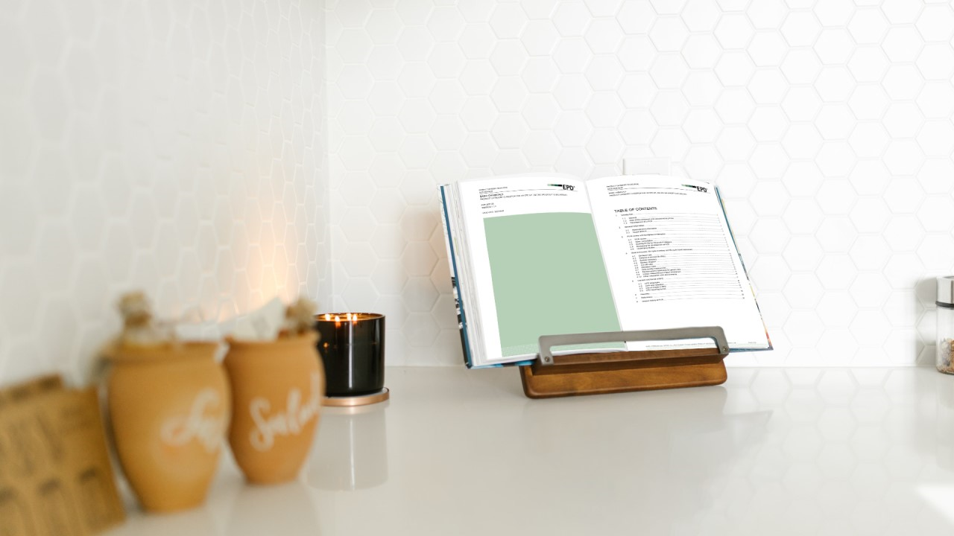
What are product category rules (PCR)?
A document that provides the rules for developing an EPD for a specific product category:
  LCA calculation rules
  EPD content
A supplement to the General Programme Instructions (GPI)
  It should not repeat the general rules on LCA and EPD content
  Only specifications, additions and deviations are included
  Shorter PCRs as of GPI version 5 – published in 2024
PCRs and GPI are the cookbooks in the PCR kitchen
Notes:
There needs to be a PCR to develop an EPD

Slide 5
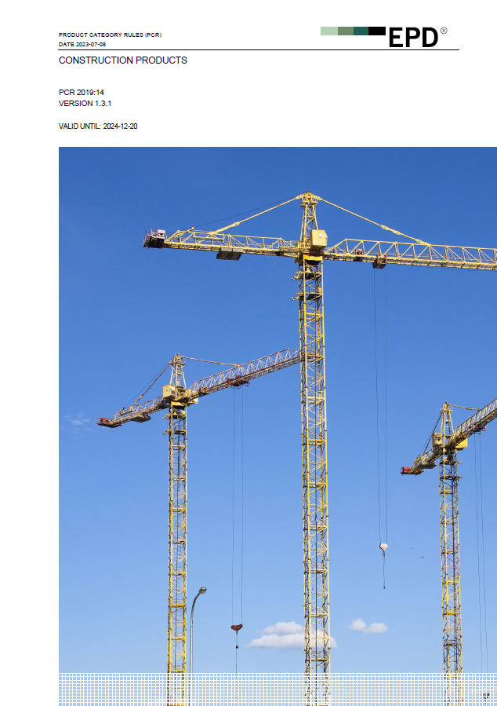
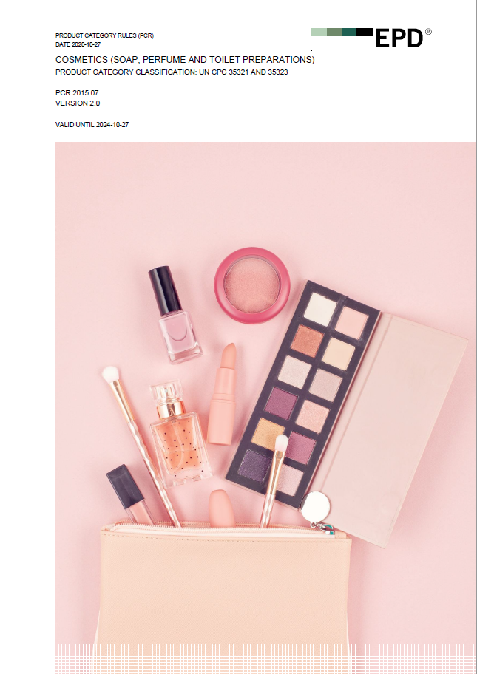
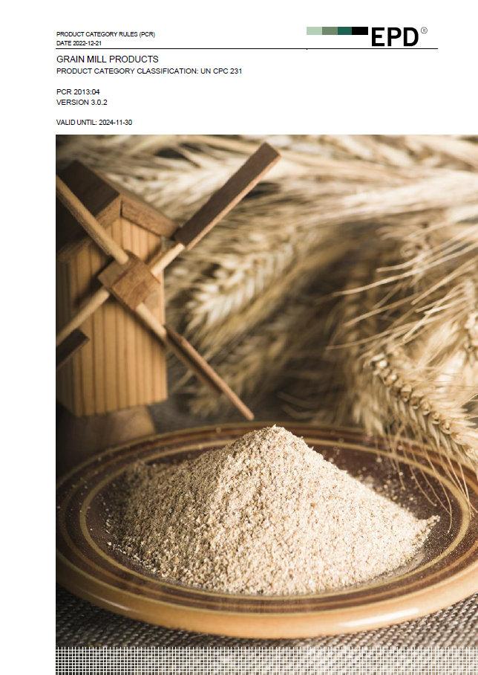
More than 100 valid PCRs available for free download in the EPD Portal (https://portal.environdec.com/)
Notes:
We have the world’s largest PCR library!

Slide 6
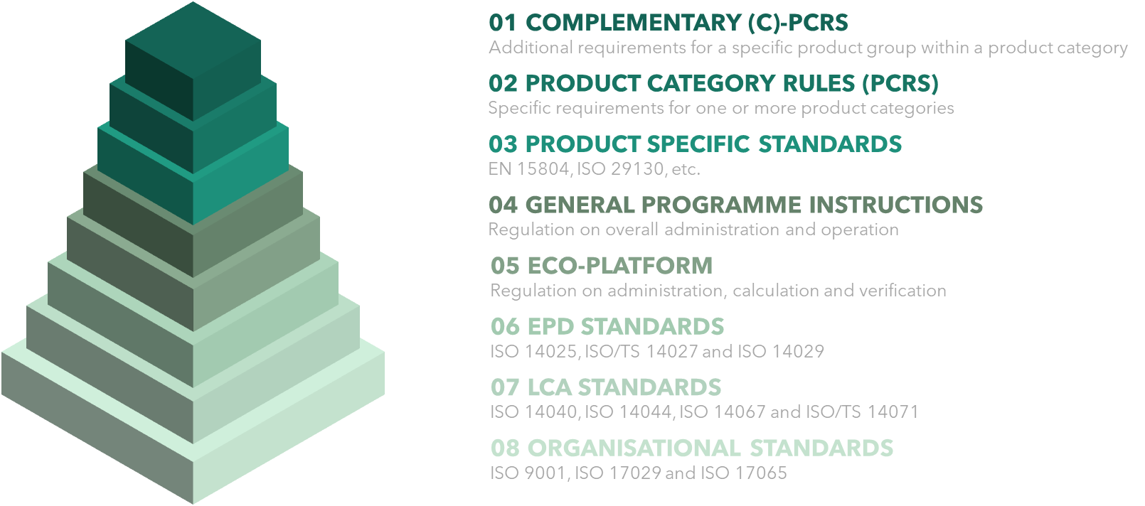
Draft GPI 5 will soon be on a two-month open consultation!
Notes:
On GPI 5: Keep your eyes open in your mailbox (for some of you) or at the website. Expected to be published first half of 2024. Some rules, e.g. on verification are implemented immediately or within 90 days, whereas LCA rules are implemented when PCRs are updated or new PCRs are developed

Slide 7
Agenda
What are product category rules (PCR)?
How is a PCR developed?
What methodological questions to consider in PCR development?

Slide 8
The PCR development process
Open, transparent and participatory process
Predictable and established process set by ISO 14027
Done by a working group – the PCR Committee – led by the PCR Moderator
  PCR Committee shall have LCA and product-category expertise
  PCR Moderator shall have project management skills
  PCR Committee typically involves manufacturers, industry associations, LCA consultants
Typically takes 10-12 months
No costs, except the time spent by the involved parties
Notes:
Why initiate a PCR dev?
To enable EPD publication
To be a frontrunner: which in itself is valuable from a marketing perspective, but also as it gives you influence of future rules

Slide 9
The development process consist of 5 steps
Initiation and announcement
PCR Committee develops the draft PCR and stakeholder list
Open consultation – for anyone to comment
Review and approval by the PCR Review Panel (the Technical Committee of the International EPD System)
Publication
… and 4 years later: updating process following the same five steps
Notes:
1: Important to inform the relevant stakeholders about the initation, especially manufactures and industry associations, and then be open to those wanting to join the PCR Committee
Global perspective important: when forming the PCR Committee, when development the stakeholder list, when setting the rules in the PCR (definitions, as Anna emphasised)
Broad scope is important! A PCR can then include rules and guidance for a sub-category of the scope. Important with broad scope for harmonization within the sector and for administrative reasons.
2: Based on a PCR Template provided by us at the Secretariat.
3:
4: Emphasise that this, and the open consultation, are the most important parts: ensure that the final document is accepted by the industry and seen as reliable and trustworthy outside the industry
5: After publication: valid for 4 years, normally, and then updated following the same procedure. This is important to ensure the PCRs are up-to-date. During the validity period: the PCR Moderator shall remain the contact person for input on the PCR, editorial clarifications done as minor updates, and to support if there are unclarities in its applicability for a certain product.

Slide 10
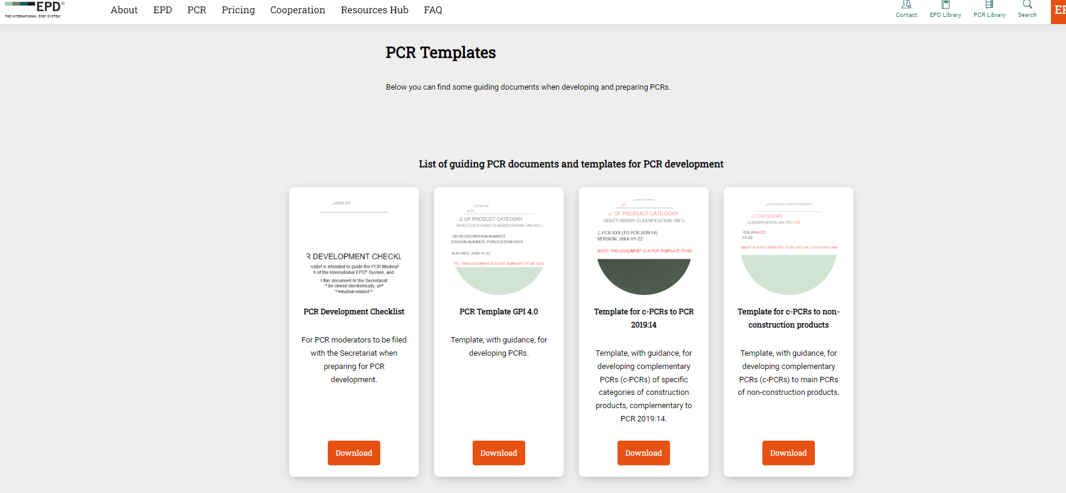
All necessary documents are available at our website

Slide 11
Agenda
What are product category rules (PCR)?
How is a PCR developed?
What methodological questions to consider in PCR development?

Slide 12
Important methodological questions for PCR development
Functional or declared unit?
If functional unit: how to define it? I.e., how to quantify the product performance provided during a certain time period (the reference service life, RSL)?
What shall be the system boundaries?
  This is about specifying the general description of system boundaries of the GPI
  What are the core processes for which specific data shall be required?
Any common multi-functional processes for this product category?
  There are general allocation rules in the GPI, but more specific rules can be set for certain processes
What indicators (environmental impact and resource use) shall be declared?
  All relevant environmental aspects of the product category should be covered
  There is a default set of indicators, but additional ones can be added
Any specific rules for the content declaration?
Any specific rules for the additional environmental, social or economic information?

Slide 13
Thank you for listening
EPD International AB
Proud Inventors of the PCR and EPD
Contact information
gustav.sandin@environdec.com
www.environdec.com

