Slide 1
EPD International System - Bootcamp
ISC 2026
October 9, 2026
EPD International AB

Slide 2
Agenda
1. Welcome & Context 9.00-9.30
2. How the International EPD System Works 9.30-10.00 AM
3.EPD Development Process Overview 10.00-10.40
Coffee break (20 min) 10.40-11.00
4. PCR Development & NIDO case (45 min) 11.00-11.45
5. The Journey for a New Client (Indian Manufacturer Focus) (45 min) 11.45-12.30
6. Wrap-up & Key Takeaways (30 min) 12.30-13.00

Slide 3
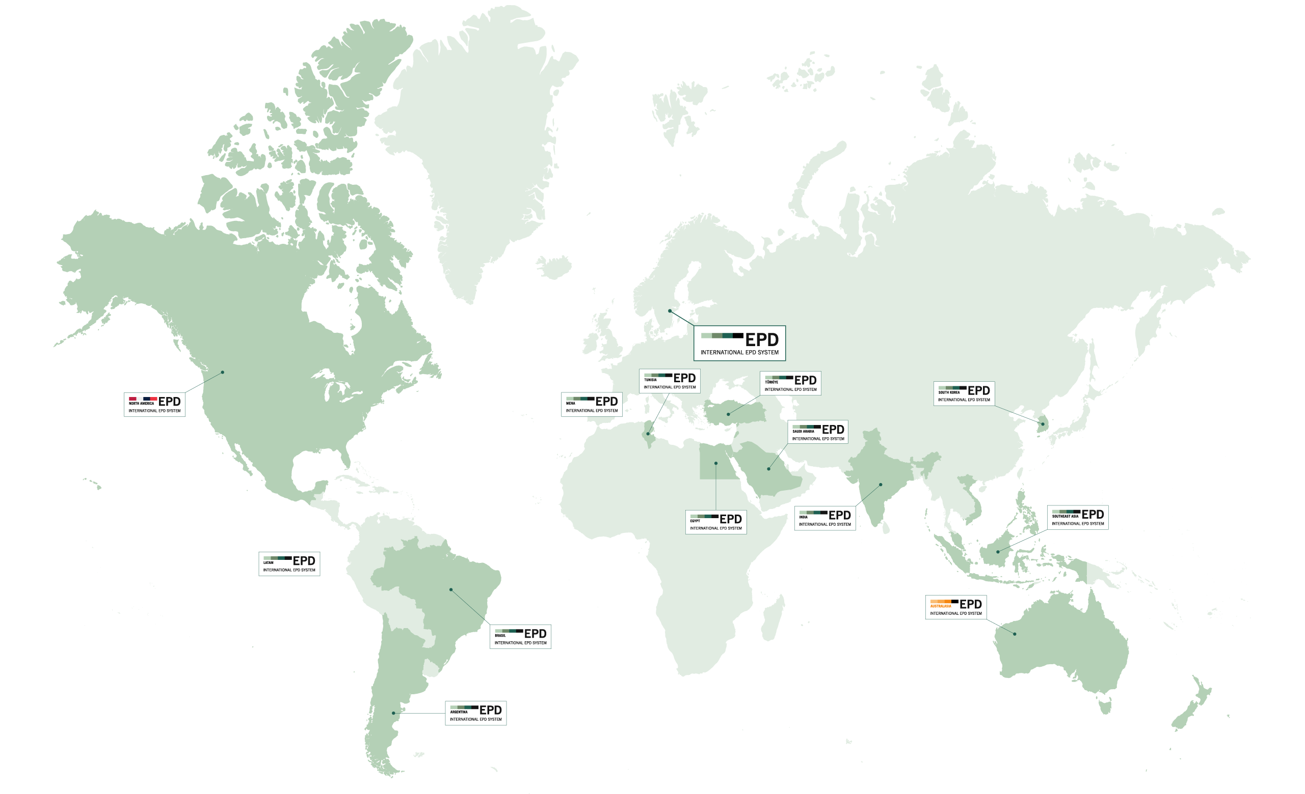

Welcome!
Notes:
Quick audience poll:
Manufacturer vs consultant?
Experience with LCA/EPD?
Depending on how many in the audience: an introductory round
Prith: Make a menti poll to test the demography
Where are you in the EPD process?
How aware are you about EPDs before coming into ISC?

Slide 4


Presenting
Manuel Mammen Parayil
Prithivesh Ashok
Business developer, Market & Sales
EPD International
LCA Expert, PCR & LCA Methodology
EPD International
Prithivesh.ashok@environdec.com

Slide 5
Why are we here today?

Slide 6
Five industries generate nearly half of registered manufacturing GVA
Latest exact industry shares are FY2023–24. MoSPI's FY2024–25 release confirms the same five leaders and a combined share above 45%.
SHARE OF REGISTERED MANUFACTURING GVA, FY2023–24
LATEST UPDATE: FY2024–25
Pharmaceuticals
7.24%
₹26.94 lakh crore
Registered manufacturing GVA
current prices
Food products
7.40%
+9.59%
Chemicals
8.81%
Year-on-year GVA growth
ASI 2024–25
Motor vehicles
9.11%
>45%
Basic metals
11.56%
Combined GVA share of the same
five leading industries
0
5
10
15
Analysis: the top-five share rose from 44.12% in FY2023–24 to above 45% in FY2024–25. Food led employment, while basic metals led GVA. Source: MoSPI ASI 2023–24 Vol I and ASI 2024–25 press note. Registered factories; current prices.
Notes:
Sources:
1. Ministry of Statistics and Programme Implementation, Annual Survey of Industries 2023-24, Volume I, Section 2, table of top industries by GVA share: https://new.mospi.gov.in/uploads/publications_reports/publications_reports1759229853481_27d8e959-0ae4-40fe-b9ff-d666b8aeb06d_ASI_Vol_I_2023-24C-2.pdf
2. Ministry of Statistics and Programme Implementation / Press Information Bureau, Annual Survey of Industries 2024-25 results, 30 September 2026: https://www.pib.gov.in/newsite/erelcontent.aspx?lang=2&reg=48&relid=295520
3. Official ASI 2024-25 press note PDF: https://static.pib.gov.in/WriteReadData/specificdocs/documents/2026/sep/doc_10046_20260930_15513601.pdf
Calculations and interpretation: FY2023-24 top-five combined share = 11.56 + 9.11 + 8.81 + 7.40 + 7.24 = 44.12%. The FY2024-25 release states that the same five industries contributed more than 45%, implying an increase of at least 0.88 percentage points, subject to rounding and the absence of exact FY2024-25 industry shares in the official press note. Food products accounted for 11.06% of employment and 7.40% of GVA in FY2023-24; basic metals accounted for 7.77% of employment and 11.56% of GVA. ASI covers the registered or organised factory sector and reports monetary aggregates at current prices. It does not cover the full informal manufacturing economy.

Slide 7
Why we are here today
EPDs are becoming increasingly significant at a global level
EPDs are becoming crucial for market access; actors along the value chain demand it
India – an emerging leader in sustainability policy
Being an emerging global leader in sustainability policy and regulatory development. India is rolling out ambitious green policy frameworks, many of which directly rely on LCA/EPD methodologies.
Regulations for example the CPR 2024 in EU will require LCA based indicators – where having EPDs today is a way to prepare for the upcoming regulatory demands
Green procurement – demanding sustainability data
Southeast Asia is rapidly strengthening its capacity in green infrastructure, low‑carbon materials, and sustainable construction practices. At the same time, export‑driven industries across the region are impacted by the evolving EU and global regulations, reinforcing the need for transparent and verified environmental performance data.
Notes:
Quick audience poll:
Manufacturer vs consultant?
Experience with LCA/EPD?
Depending on how many in the audience: an introductory round
Prith: Make a menti poll to test the demography
Where are you in the EPD process?
How aware are you about EPDs before coming into ISC?

Slide 8
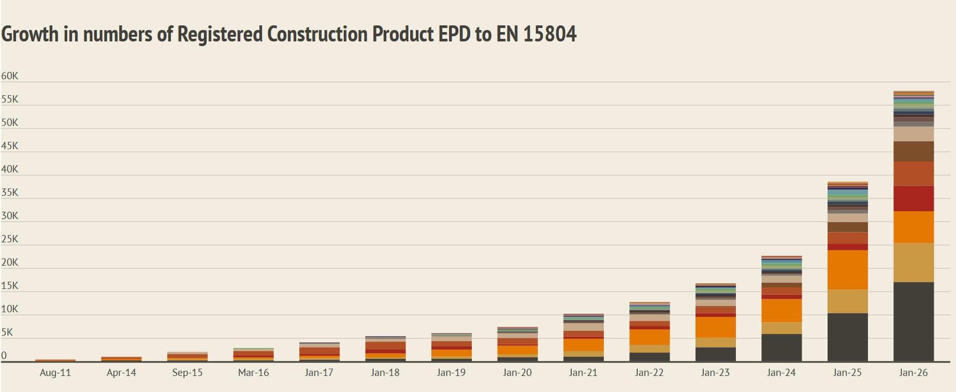
EPDs – an increasing demand
The EPD market is poised for remarkable growth, with a projected compound annual growth rate (CAGR) of 13.6% from 2026 to 2033.
EPDs published in IES have increased with over 30% since 2025 – and 2026 is still not over.
Regulations, procurement, green building schemes – several drivers contributing to this increase.
Construction product EPDs – source: Eco Platform

Slide 9
Today’s outcomes
Understand the system
Know how to get started
Build confidence to engage
Explore and identify your starting point.
Clarify the roles, rules and the journey
Leave with a practical path forward.

Slide 10
1. How the International EPD System works

Slide 11
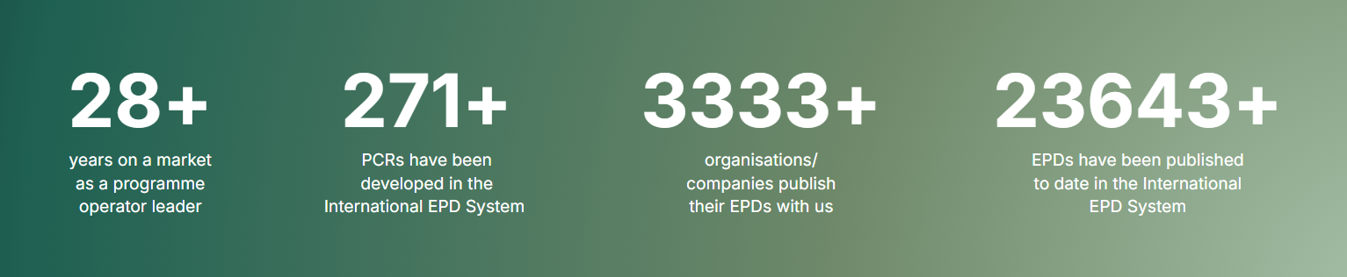
The International EPD System (IES)
EPD International AB operates the world’s first and longest‑established global EPD Programme, founded in 1997 by Swedish Environmental Protection Agency (SEPA).
We provide a globally recognised system for developing Environmental Product Declarations (EPDs), supported by a robust digital platform for registration, publication, and data access.
100% owned by IVL Swedish Environmental Research Institute with non‑profit status
More than 35 staff and a truly global presence
Our international licence network enables local implementation with global consistency
ISO 9001 certified programme

Slide 12
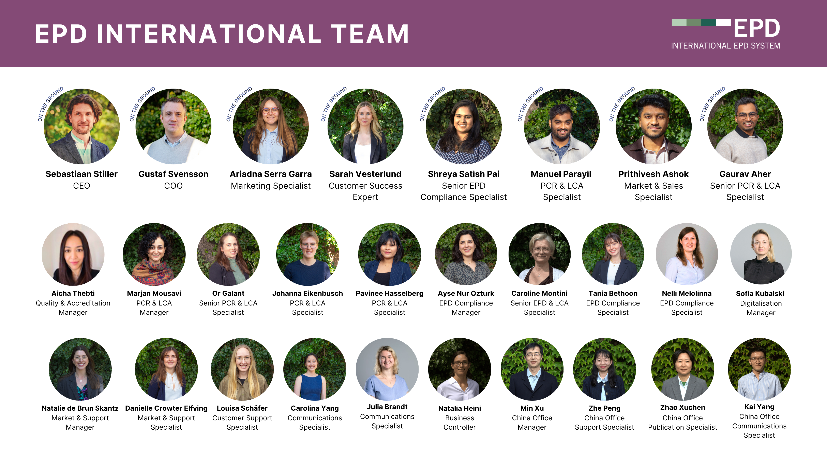
The Secretariate

Slide 13
Our stakeholder ecosystem
A connected network that drives the International EPD System
DELIVERY NETWORK
PCR & TECHNICAL COMMUNITY
MARKET & USERS
Develop, verify and scale
¨Methodology and merket outlook
Create demand and application
Licensees & co-location centres
Technical Committee
EPD owners & end-users
EPD
INTERNATIONAL
LCA consultants & external experts
PCR moderators & committees
Industry associations & academia
Programme operator
& Secretariat
Individual verifiers & certification bodies
PCR stakeholder consultation groups
Authorities and policymakers
Tool owners, tool verifiers & IT developers
International Advisory Board
EPD Aggregators: Database hosts
EPD, LCA Standardisation bodies
(ISO, EN,..)
One programme. Distinct roles.
GOVERNANCE → METHODS → DEVELOPMENT → VERIFICATION → PUBLICATION → USE
EPD INTERNATIONAL
STAKEHOLDER ECOSYSTEM

Slide 14
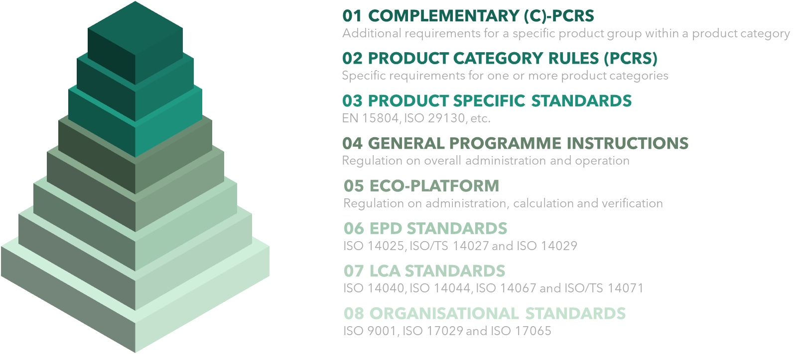
What standards are behind an EPD?

Slide 15
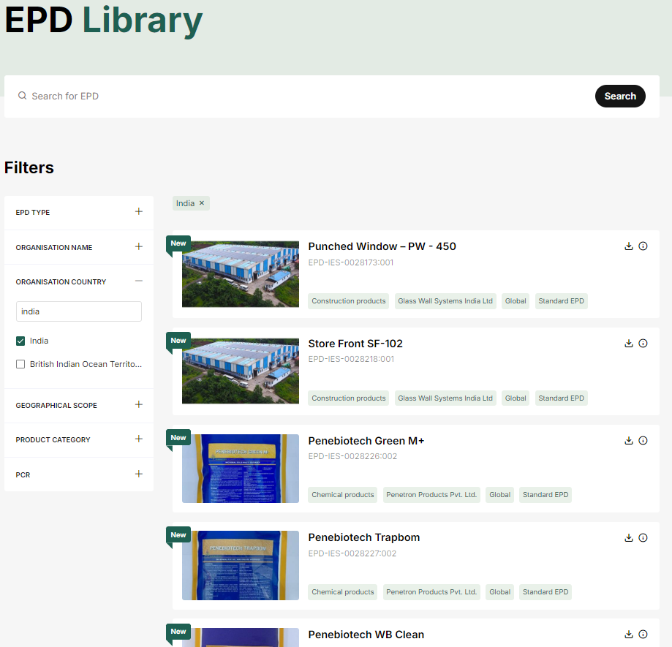
What is an EPD?
Type III Environmental Declaration (ISO14025):
Provides standardized, third-party verified life cycle assessment (LCA) data for products in various industries
  substantiate environmental claims on product level
Provides transparent, objective, and comparable environmental data
    Critical to systematic actions to reduce greenhouse gas (GHG) emissions as required in NetZero when reducing absolute emissions at the source, e.g. through energy efficiency, cleaner energy adoption, and low-carbon technologies
Important for public and private procurement
Blueprint for future regulation such as CPR2024/3110, a.o.
GPI Version 5.0.1, Section 1

Slide 16
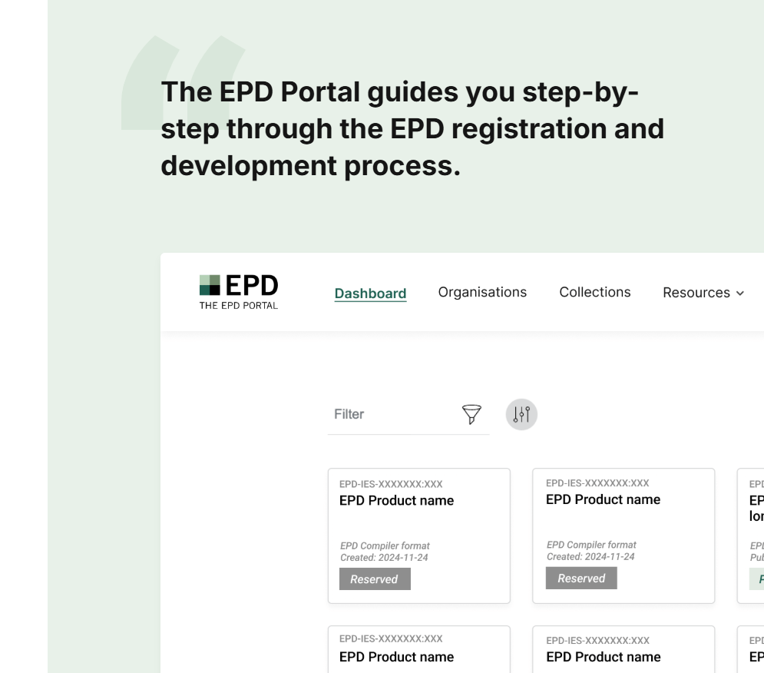
A Scalable, Open Digital EPD Ecosystem
At the International EPD System we offer:
Open and agnostic digital ecosystem - a transparent and non‑exclusive application process for LCA and EPD tool providers
The EPD Portal – a robust user interface for EPD registration, supporting both PDF‑based and fully digitised EPDs to meet diverse market needs
Scalable platform with EPD Tool integration – the EPD Portal is designed to handle large volumes and future growth efficiently
API‑enabled data exchange – secure upstream and downstream APIs enabling automated data sharing across digital value chains
Established ecosystem - active collaborations with 15+ software providers.

Slide 17

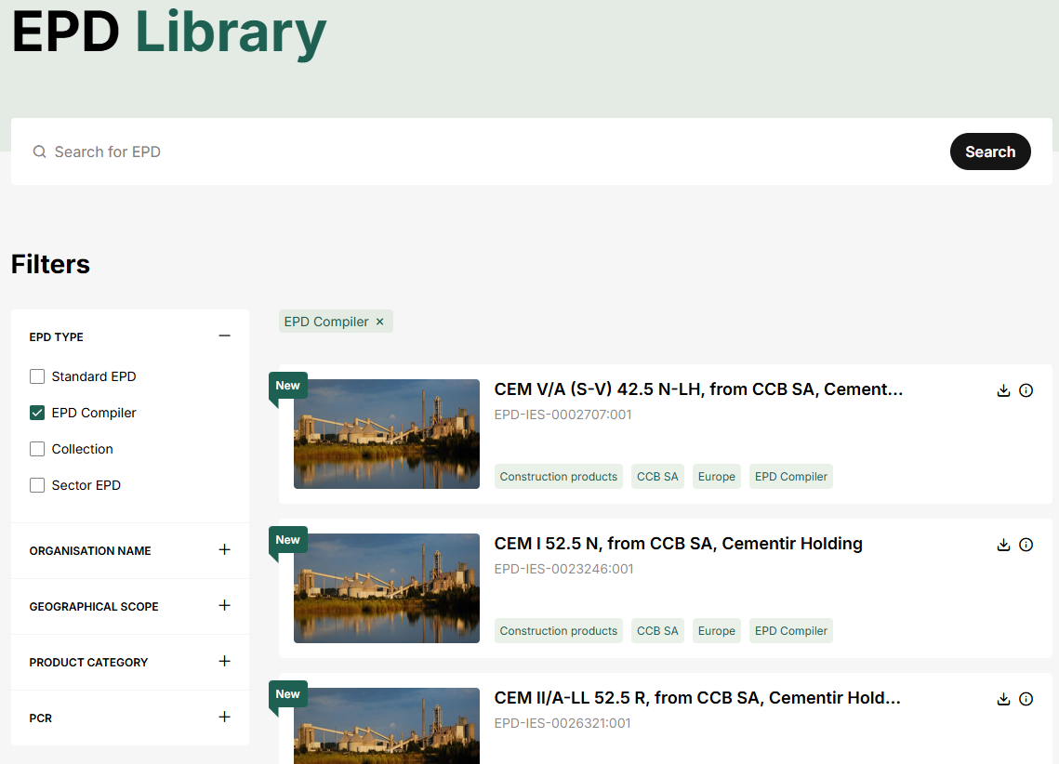
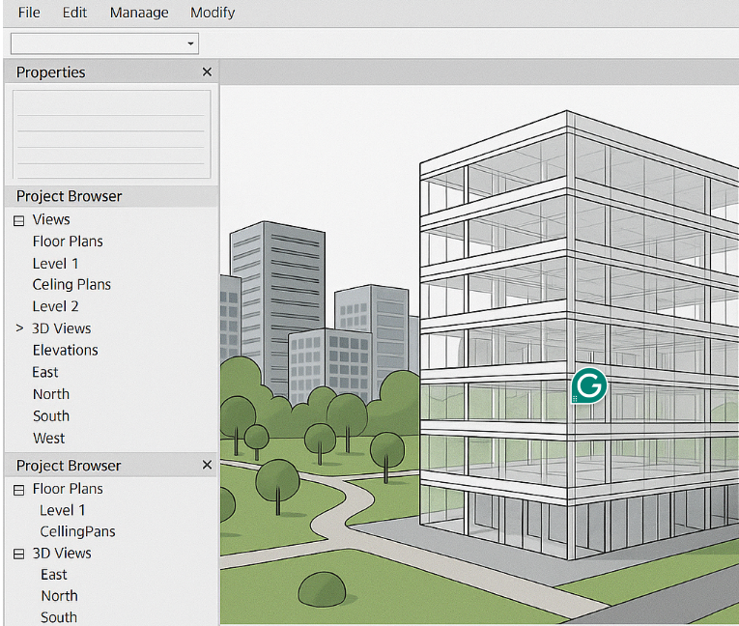

EPD Compiler – Enabling Fully Digital EPDs
  LCA/ EPD Tools
A secure and scalable infrastructure for high‑quality, machine‑readable EPD data.
EPD Compiler enables fully digitised EPDs, supporting the transition from document‑based declarations to structured, interoperable environmental data.
Why EPD Compiler matters:
Digital by design
Structured, machine‑readable EPD data prepared for automation and system‑to‑system exchange
Quality and consistency
Reduces manual handling, improves data integrity and ensures methodological consistency
Future‑proof integration
Designed to scale with market growth and increasing regulatory and digital demands.
EPD International Server
Upstream API
Upstream API
Downstream API
Downstream API
Upstream APIs
Secure integration with LCA & EPD tools
EPD Portal
EPD Portal
Central platform for registration, validation and controlled publication
  Access digital EPD data
Downstream APIs
Enables use of verified EPD data in e.g. BIM, procurement, reporting & digital value chains
BIM model
Procurement

Slide 18

Quality you can trust – in every EPD
Quality is not an add‑on. It is how our system is built.
  Consistent and credible data
  Clear methodological rules and a mature PCR system ensure EPDs that are reliable and comparable across products and markets.
  Robust third‑party verification
  A structured, transparent verification process with defined requirements for approved verifiers.
  High acceptance in practice
  Widely recognised EPDs that work in procurement, projects, certification schemes and regulation.
  Governance that lasts
  Controlled publication and long‑term maintenance ensure data remains valid and trustworthy over time
Choosing an EPD developed within a well-governed programme means to industry:
  Lower risk. Fewer disputes. Confidence that environmental data can be used – today and in the future.

Slide 19
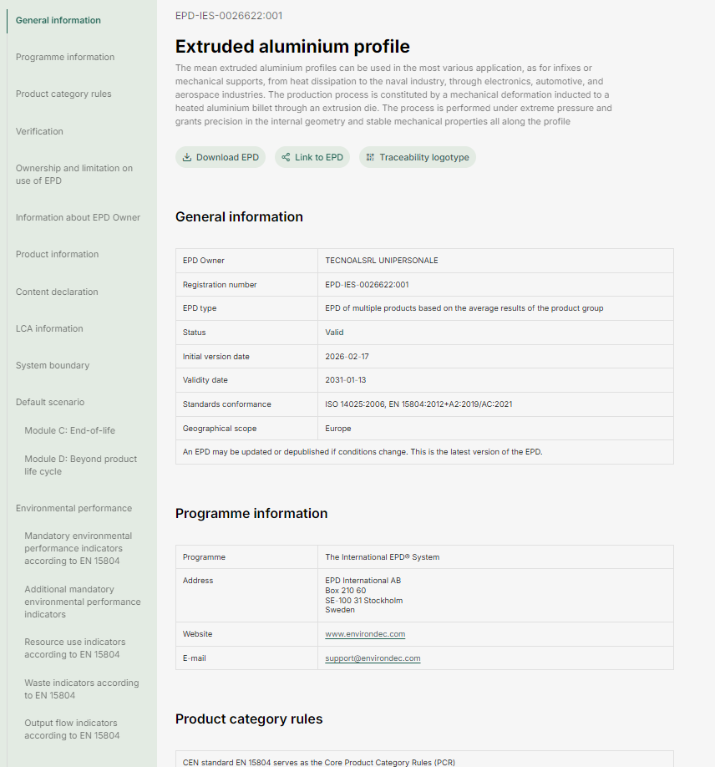
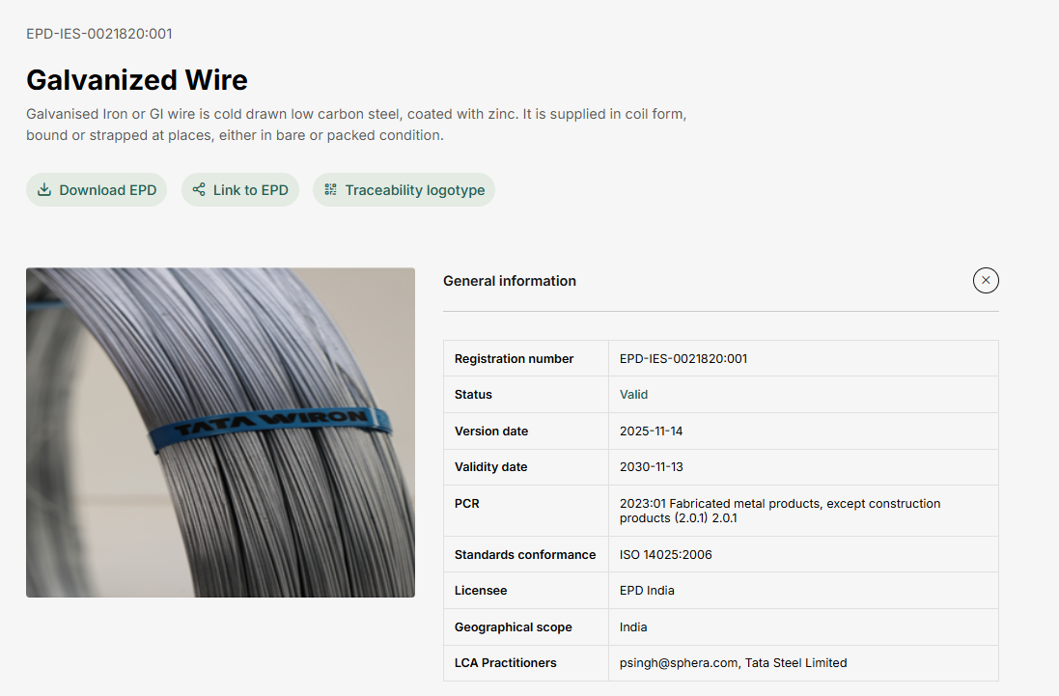
Why do we need EPDs?

Slide 20
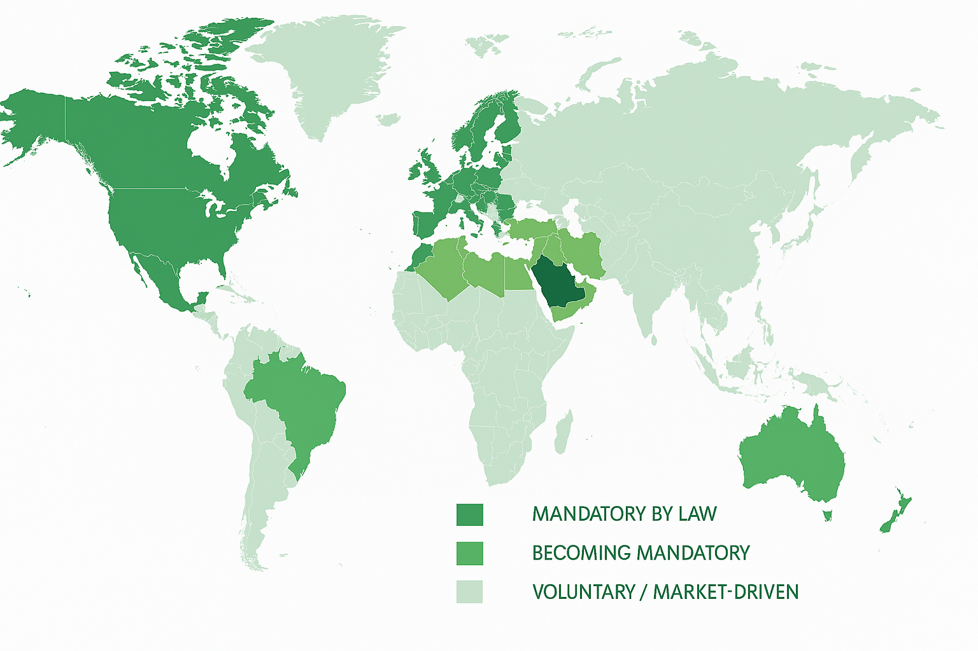
Facilitating global trade with EPDs
Enhancing Product Competitiveness
By demonstrating sustainability compliance, EPDs increase product credibility and competitiveness in international markets (eco-design).
Standardized, Harmonized Environmental Data
  The EPD provides a global framework to present consistent environmental data, helping businesses meet international standards efficiently.
Simplified Cross-Border Trade
  Transparent and verified EPDs facilitate easier compliance with regulations, reduce barriers in international trade and supports mutual recognition across borders.
Improved Market Access
  Sustainable products with EPDs gain better access to global markets through verified environmental credentials.
  EPDs help manufacturers gain market access, differentiate products, and comply with sustainability standards.
  Green building certifications and procurement policies increasingly require EPDs.
LCA A/O EPD

Slide 21
2. EPD Development Process Overview

Slide 22
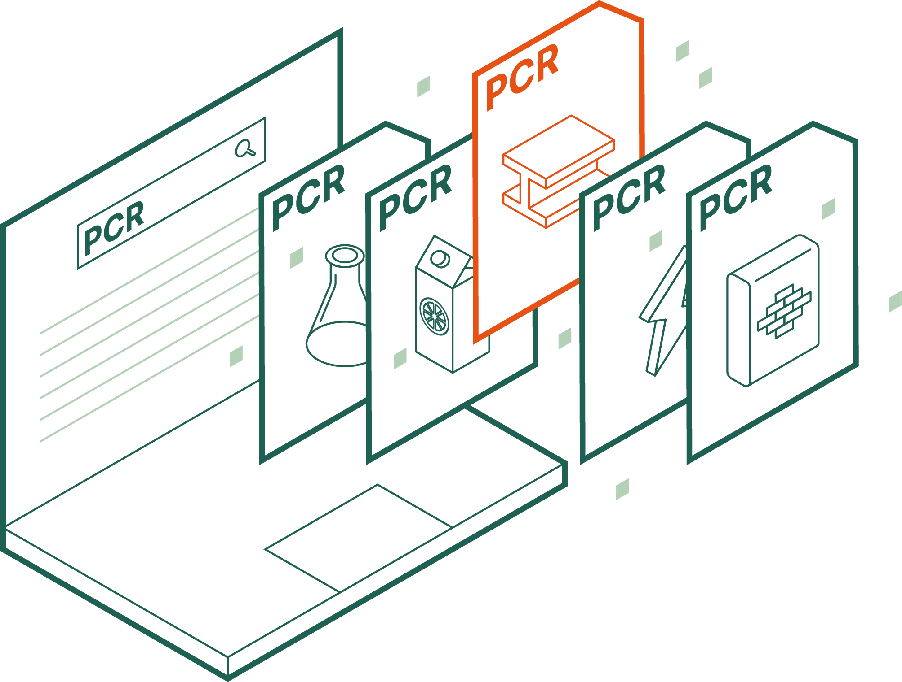
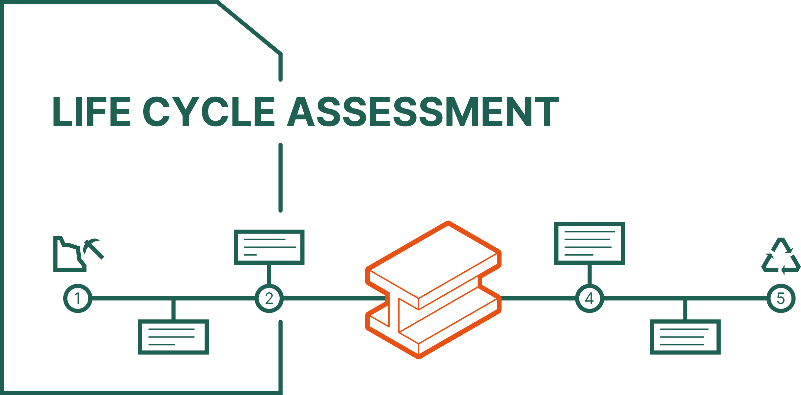
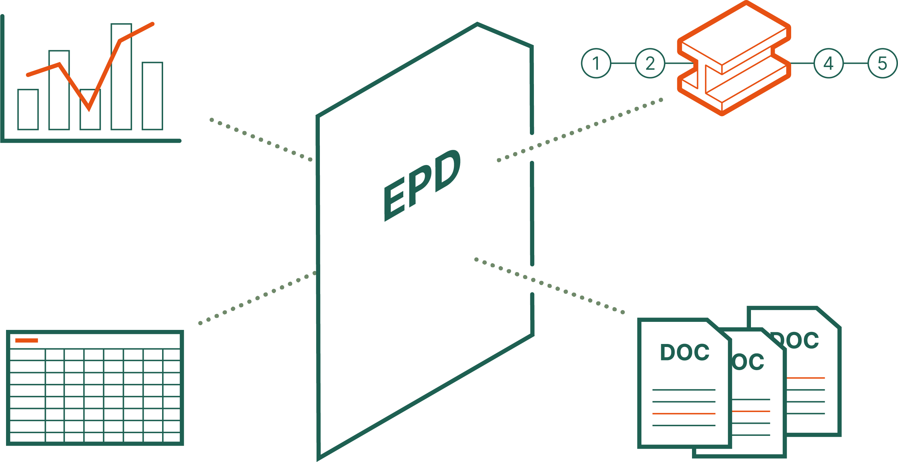
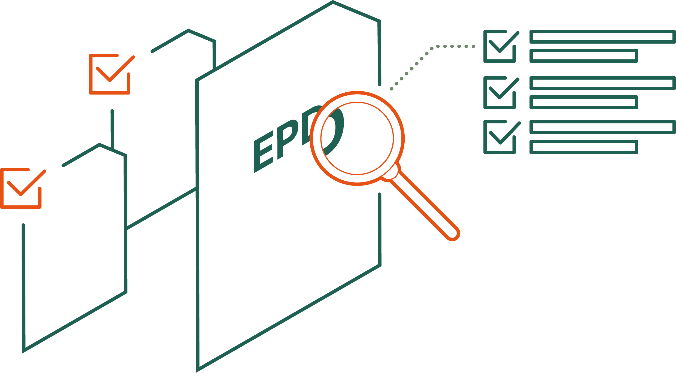
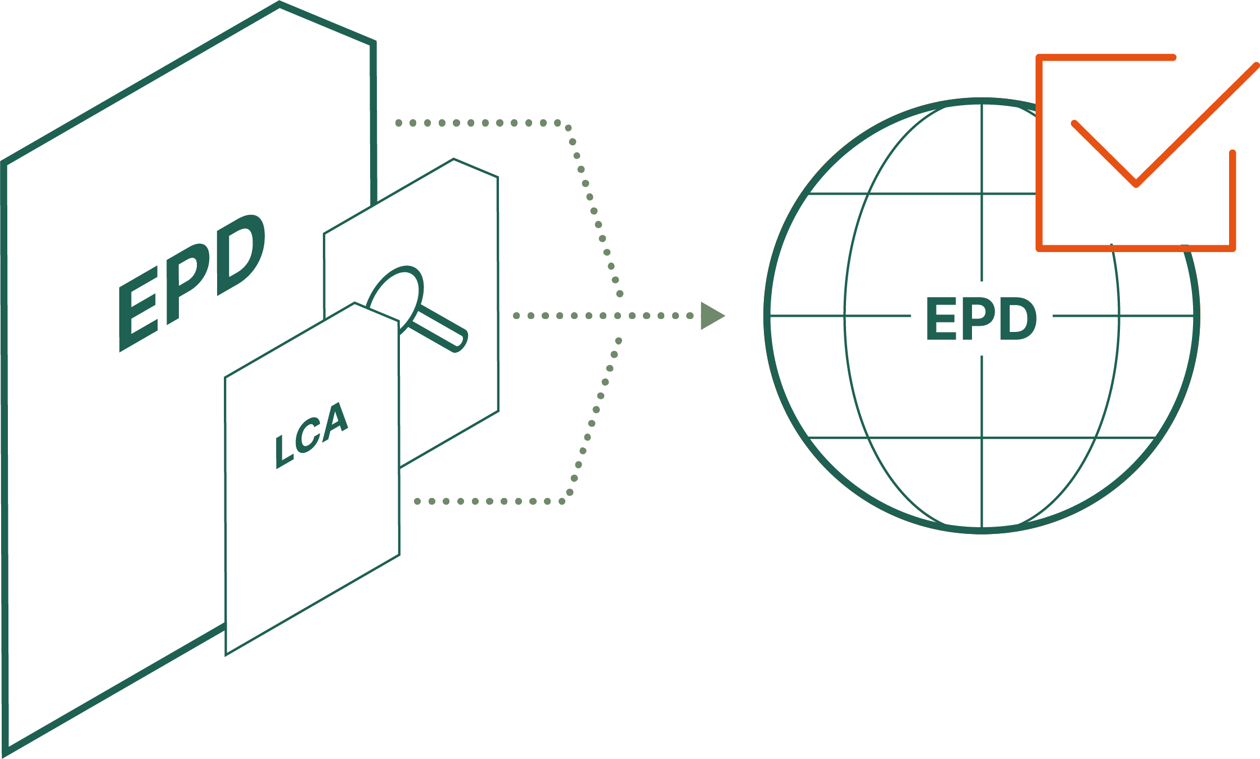

Process of EPD Development
SELECT YOUR PRODUCT CATEGORY RULES (PCR)
CONDUCT A LIFE CYCLE ASSESSMENT STUDY (LCA)
COMPILE THE INFORMATION
THIRD-PARTY VERIFICATION
REGISTRATION AND PUBLISHING

Slide 23
Select your Product Category Rules (PCRs)
All products affect the environment in different ways. Therefore, there are various ways to calculate the environmental impact, which is reflected in a PCR.
A PCR is a document that provides the instructions for how the life-cycle assessment should be conducted.
These are collected in the PCR library for the product category in question. If there is no PCR suitable for the product category, a new one can be developed.

Slide 24
Conduct a life cycle assessment study (LCA)
Through an LCA study, information is produced that describes the environmental impact of a product or service during its entire life cycle, from raw material to waste or recycled material. An LCA study can be produced either within the organisation or by an
External consultant. External consultants are listed on our website.
An LCA study usually takes between one and twelve months.

Slide 25
Compile the information
When the LCA study is complete, the results are summarised in an EPD format. Guidelines for this can be found on our website. An organisation can create this on its own or enlist the help of a consultant.

Slide 26
Third-party verification
The EPD and all associated documents undergo third-party verification by an individual verifier or accredited certification body. Verifiers must be approved by EPD International.
The review takes approximately two weeks, resulting in a report on how the EPD met the mandatory requirements.

Slide 27
Registration and publishing
In the final step, the request for publication of the EPD is sent through the EPD Portal.
The organisation registers the EPD and associated documents in the EPD portal for a final review. If there are no additions needed, the EPD is approved, published and made freely available on the website.

Slide 28
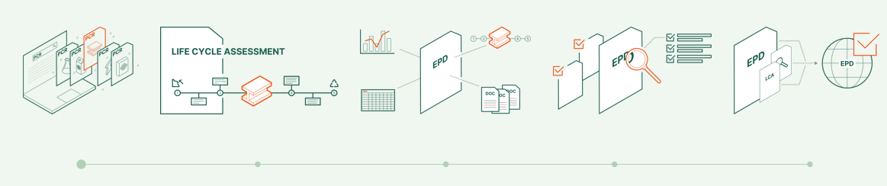
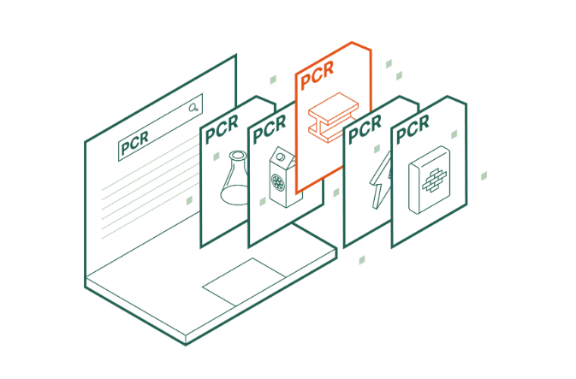
Step 1: Select PCR
Start by selecting the right PCR – this is the first step in developing an EPD.
PCRs define the rules for which products are covered and how environmental performance is calculated and reported.
Use a valid PCR from the International EPD System’s PCR Library; where applicable, a complementary PCR (c-PCR) must also be used.
Need support? The Secretariat can help identify the most appropriate PCR for your product.
If no suitable PCR exists, a new one can be developed; where several apply, choose the most product-specific option to support relevance and comparability.

Slide 29
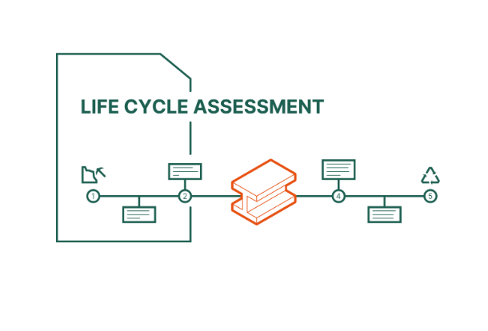
Step 2: Conduct LCA Study
The life cycle assessment must be conducted in accordance with a suitable PCR (and a c-PCR when relevant).
The environmental performance reported in an EPD is based on a Life Cycle Assessment (LCA), which evaluates a product’s environmental impacts throughout its entire life cycle.
The LCA can be carried out internally by your organisation or with the support of an experienced LCA consultant specialising in environmental declarations.

Slide 30
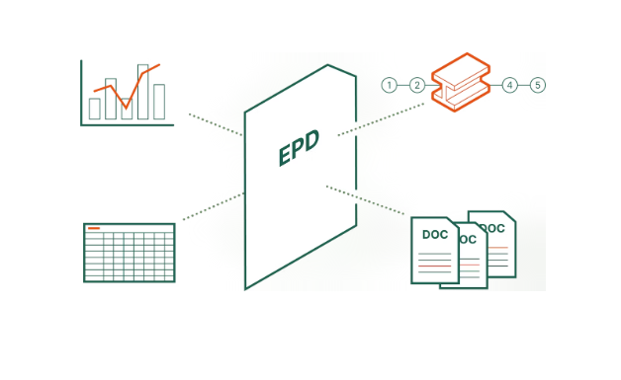
Step 3: Compile EPD data
Compile the LCA results into an EPD, together with all additional required product and environmental information.
Choose between two reporting formats: the Standard EPD Format or, for most construction products, the digital EPD Compiler.
Standard EPD Format: prepare the EPD as a PDF and register it with supporting metadata in the EPD Portal.
EPD Compiler: enter and manage EPD information directly in the EPD Portal for a more streamlined, fully digital process.
Ensure compliant and credible content: EPD information must be verifiable, accurate, relevant and not misleading, while following applicable ISO and EN requirements.

Slide 31
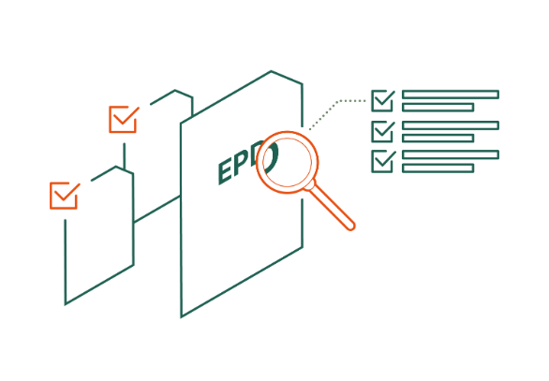
Step 4: Verify the EPD
Before publication, every EPD must undergo verification to ensure that the information presented is accurate, transparent, and compliant with programme requirements.
Verification must be conducted by:
  1) a third-party verifier, either an approved individual verifier or an accredited certification body
  2) through process certification
  3) through pre-verified tools.

Slide 32
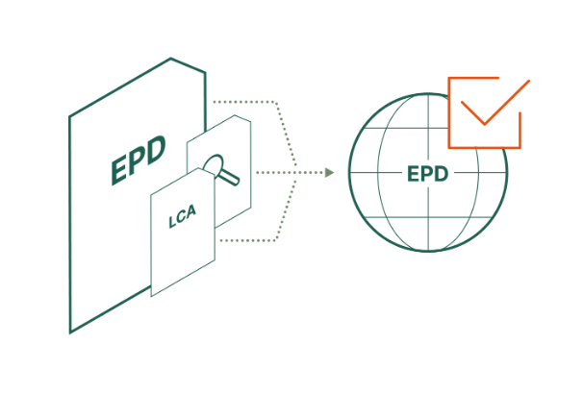
Step 5: Publish EPD
An EPD must be registered in the EPD Portal and published in EPD Library
EPDs are published in the EPD Library by the Secretariat after the EPD owner has provided all the necessary information and data, and signed the service agreement
The validity period of an EPD is 5 years, and a published EPD may be corrected and amended as needed

Slide 33
Breakout discussion:
- What role do you see most fit within the system?
- Where are you in the EPD process?
- What is your biggest bottleneck?

Slide 34

Coffee Break
10:40 – 11:00 AM

Slide 35
3. PCR Development

Slide 36
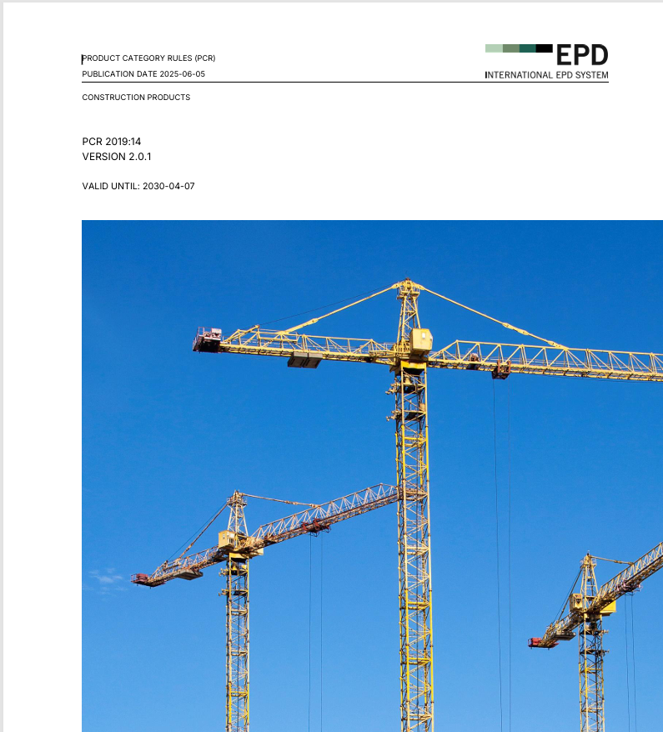
An over view of Product Category Rules (PCR)
What is a PCR and why it matters
PCR development process
How to choose a PCR for your EPD.

Slide 37
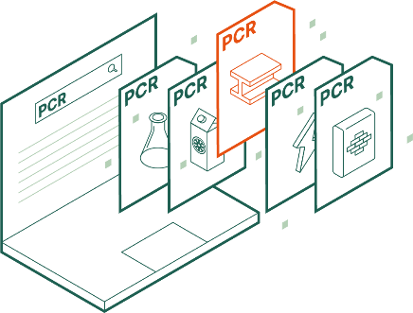
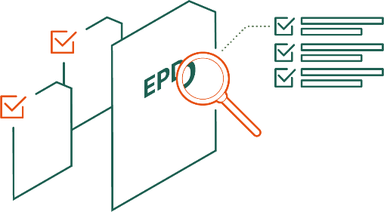
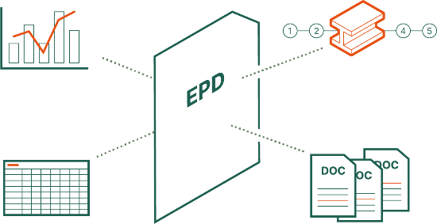
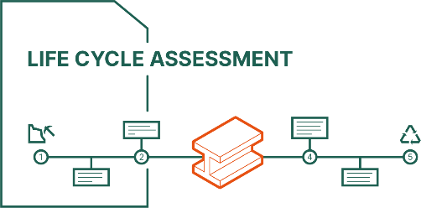
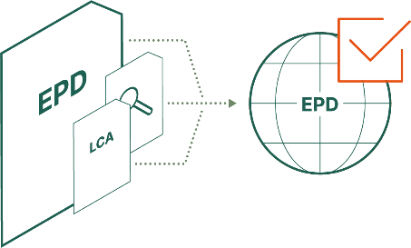
SELECT PCR
EPD VERIFICATION
1
4
COMPILE THE INFORMATION
3
CONDUCT LCA
EPD PUBLICATION
2
5
Notes:
The first step in developing any EPD is to select an applicable PCR. PCR stands for …

Slide 38
What is a PCR and why it matters
PCR – Product Category rules
Provides rules and guidelines for how an LCA is to be conducted for a particular product category and thereby publishing the EPD
PCRs try to ensure that consistent LCA results are calculated when following the rules
Provides rules that promote comparability

Slide 39
What is a PCR and why it matters
The GPI serve as the primary reference.
The development process must comply with ISO TS/14027.
They must be based on one or more LCA studies representing the full product life cycle conducted according to ISO 14044.
Comply with sector standards when relevant
  For instance, construction products PCR should comply with EN 15804.

Slide 40

Banana Bread Analogy
This Photo by Unknown Author is licensed under CC BY-SA-NC

Slide 41
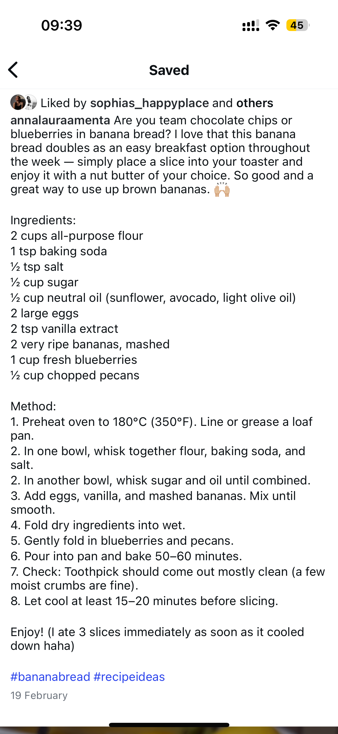
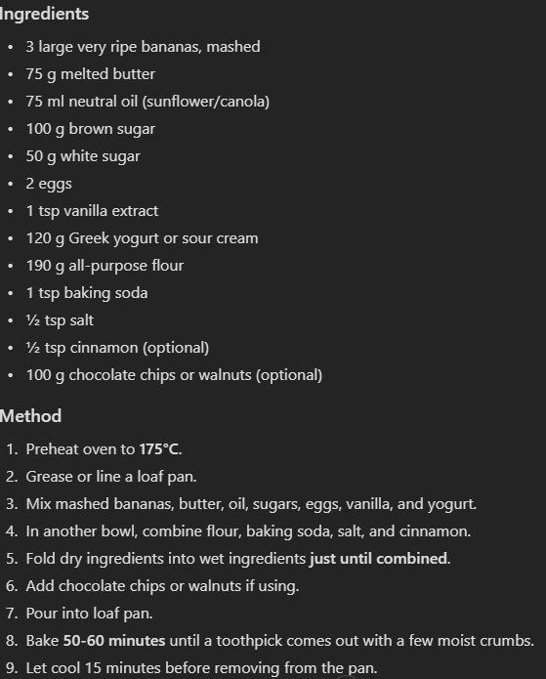

Slide 42
What is a PCR and why it matters
We need an agreed upon way of conducting LCAs
Different expertise and experiences
Different ways of handling modelling and allocation choices
PCR Team helps administer PCR developments and ensures rules are developed according to underlying standards and transparently.

Slide 43
PCR Development process
Initiation
Preparation
Open Consultation
Review and Publication

Slide 44
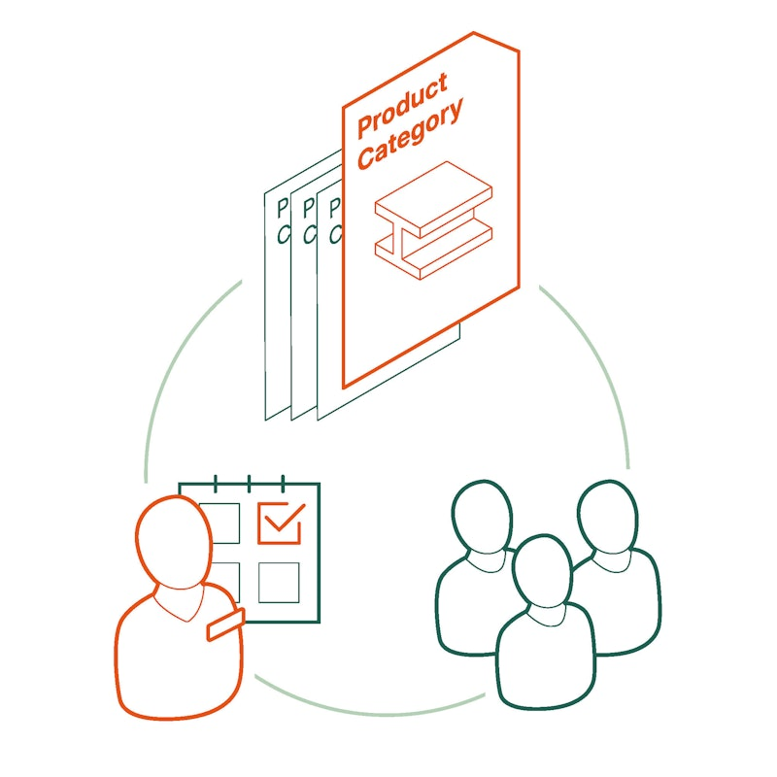
PCR Development process
Initiation
Discussion with the secretariat usually from trade associations, companies on desire to develop a PCR
Evaluate PCR checklist where information on PCR Moderator, Committee, market potential, etc. is listed and evaluated at the secretariat
We also look at scope of the products covered, any overlaps with existing PCRs and potential to expand
Once approved, the development is announced on the website, and the PCR committee moves to the next phase.

Slide 45
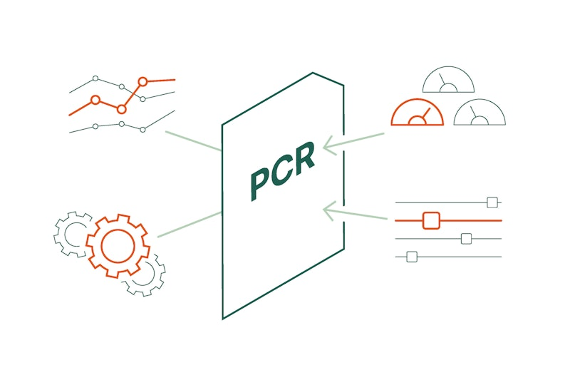
PCR Development process
Preparation
Committee prepares the draft according to the GPI and guidance provided in the template.
Focus is on providing sector specific rules for -
  System boundary
  Functional unit
  Allocation approach
  Data quality requirements
  Environmental performance indicators

Slide 46
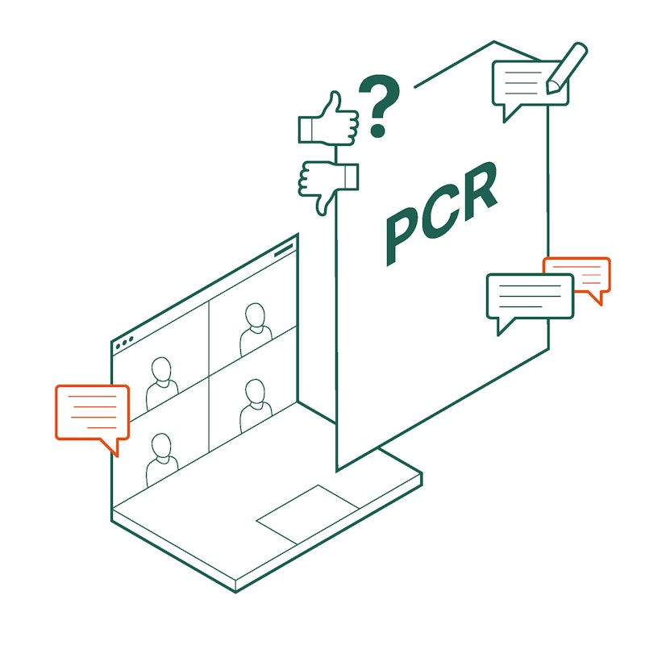
PCR Development process
Open Consultation
Once draft is prepared it moves to Open Consultation (OC)
Stakeholders are invited and comments collected by the PCR Moderator
Anyone can comment on the draft
Open for roughly 8 weeks.

Slide 47
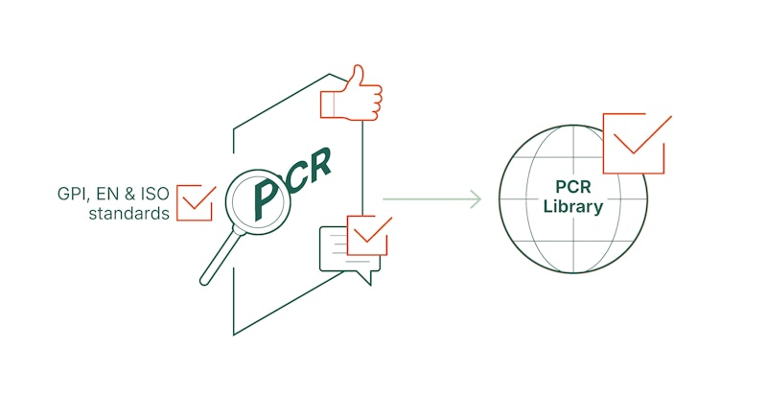
PCR Development process
Review and Publication
Once OC comments are addressed, draft moves to Technical review by the Technical Committee
TC has final say on if a PCR can be published, needs changes or should be declined
Once all comments are addressed the PCR is published on the library for use.

Slide 48
PCR Development process
No cost needs to be paid to IES to develop a PCR.
Time and resources to prepare a PCR are borne by the PCR committee.
On average a PCR can take 1-1.5 years to develop

Slide 49
How do I choose a PCR
Search the PCR Library - https://www.environdec.com/pcr-library
Try to classify the product under the UN CPC codes list
Find a PCR with matching UN CPC code listed in the scope.
  Building a new library to enable easier searching using CPC codes
Can it be used in the building or construction sector?
  EN 15804
Ask us at support@environdec.com
Discuss Potential to create a new PCR

Slide 50
Nido case; Karina Gómez García and Claudia Peña

Slide 51

Case study: NIDO Contech
When do emerging materials need new PCR rules?
- Karina Gomez & Claudia Peña

Slide 52
4. The journey of a new client – from Zero to Published EPD
Notes:
(45 mins)

Slide 53
Our stakeholder ecosystem
A connected network that drives the International EPD System
DELIVERY NETWORK
PCR & TECHNICAL COMMUNITY
MARKET & USERS
Develop, verify and scale
¨Methodology and merket outlook
Create demand and application
Licensees & co-location centres
Technical Committee
EPD owners & end-users
EPD
INTERNATIONAL
LCA consultants & external experts
PCR moderators & committees
Industry associations & academia
Programme operator
& Secretariat
Individual verifiers & certification bodies
PCR stakeholder consultation groups
Authorities and policymakers
Tool owners, tool verifiers & IT developers
International Advisory Board
EPD Aggregators: Database hosts
EPD, LCA Standardisation bodies
(ISO, EN,..)
One programme. Distinct roles.
GOVERNANCE → METHODS → DEVELOPMENT → VERIFICATION → PUBLICATION → USE
EPD INTERNATIONAL
STAKEHOLDER ECOSYSTEM

Slide 54
Explain different roles
EPD Owner – New & Existing
LCA Consultant
EPD Verifier
Licensee
Programme Operator

Slide 55
Roleplay

Slide 56
5. Wrap-up and key takeaways

Slide 57
Today’s outcomes
Understand the system
Know how to get started
Build confidence to engage
Explore and identify your starting point.
Clarify the roles, rules and the journey
Leave with a practical path forward.

Slide 58
Wrap-up and key takeaways
This workshop will give you an overview of everything you need to know when you want to develop an EPD
  Practical first steps
  How to choose PCR
  Insights from EPD owner
The value EPDs bring; EPDs are structured, standardized, and globally recognized environmental data
  Not just marketing, but verified environmental data
  An asset for the company, door opener to new markets
How PCRs work
  How to choose the right one
  When to develop a new one
How EPD International works and how we can support you on your EPD journey

