Slide 1
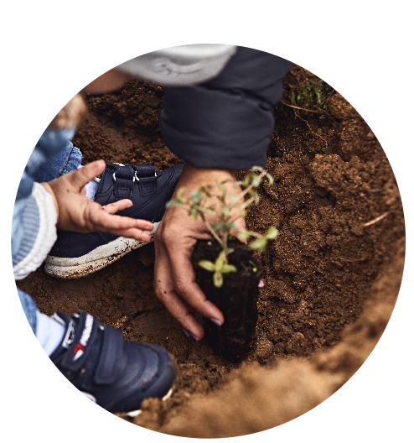
Life Terra, empowering schools for climate action
4th Scientix Conference
18-19 November 2022

Slide 2
Life Terra: 500 million trees
Life Terra is a European initiative with the mission to restore our connection with the Earth and to enable people to take impactful climate action now.
We work with a consortium of 15 partners from 8 EU countries that bring together expertise, knowledge and network in Implementation, Technology, Communication, and Education.
Life Terra is approved and supported by the European Commission through the LIFE programme.
Notes:
NO N. 2
remove SM thing

Slide 3
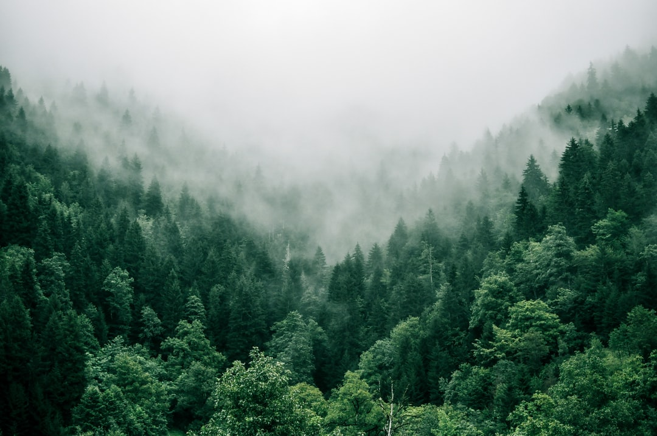
Life Terra Education
“An opportunity for teachers across Europe and around the world”
Notes:
TM for 8-14 pupils - the edupack that you will be exploring during this MOOC
BUT, we have MORE educational activities that we will inform/share with you once this MOOC is concluded

Slide 4
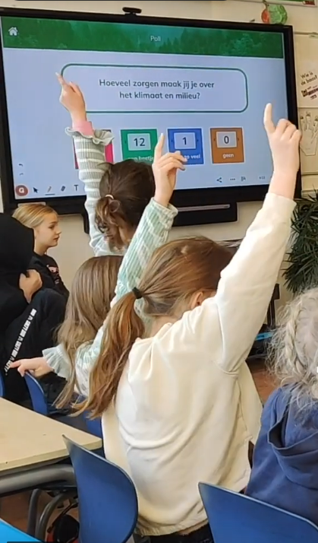
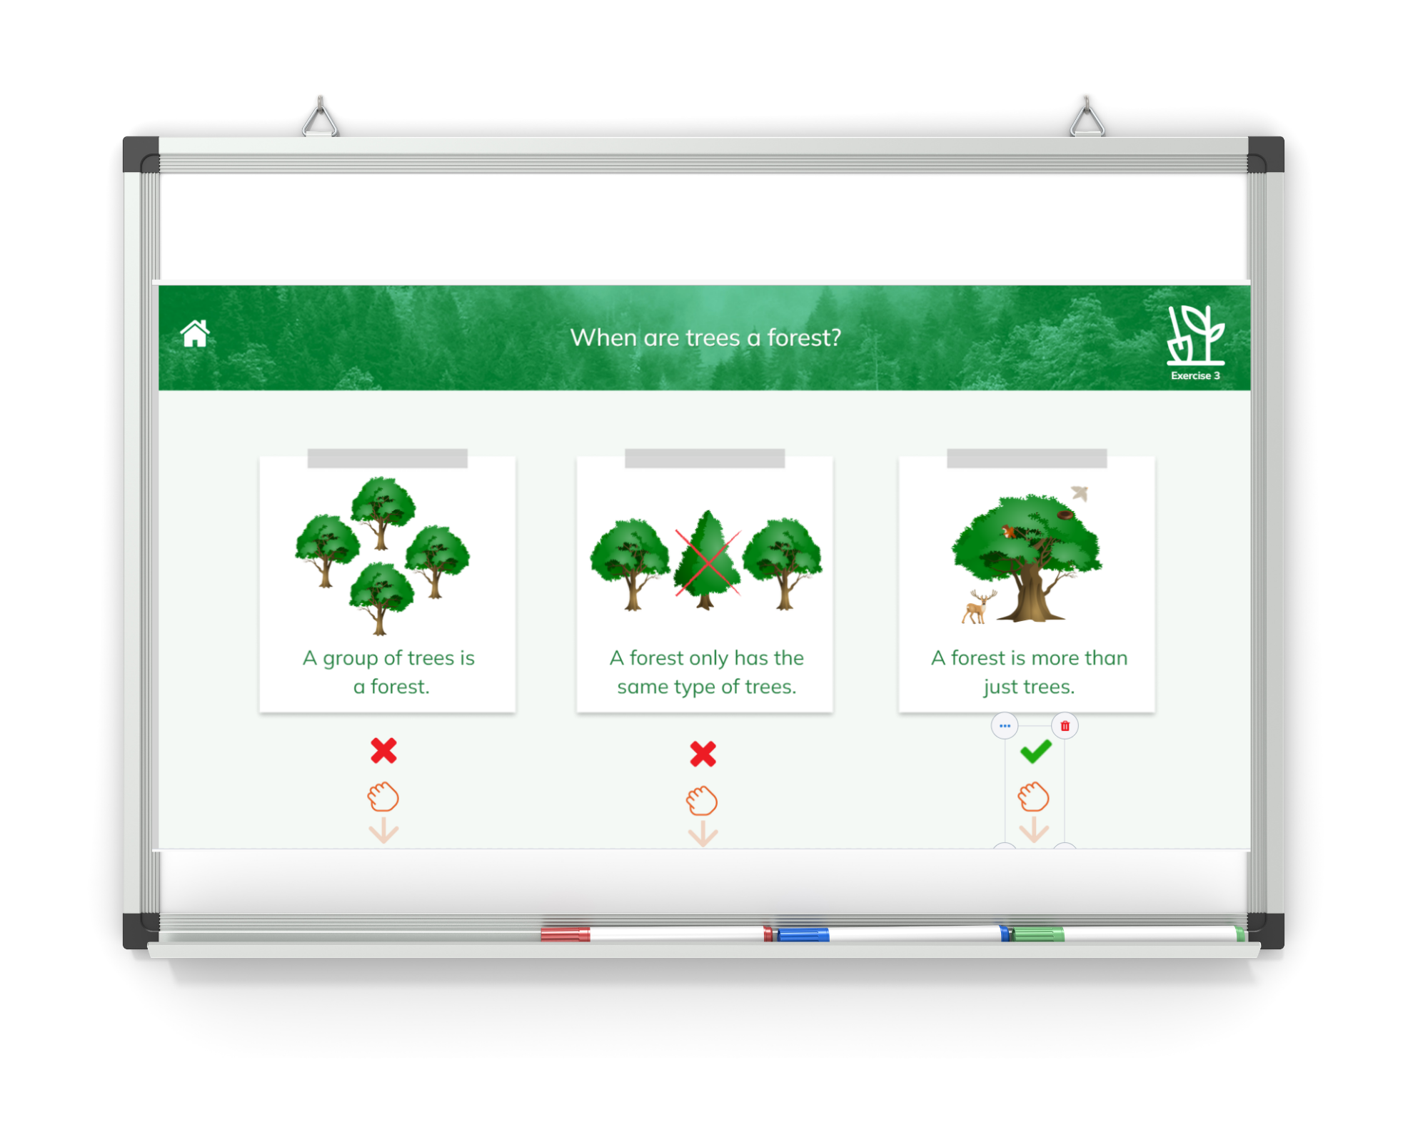
What we offer
Terra Mission Education Pack
Pupils aged 8-14
8 sustainability themes
Available in 7 languages
STEM-based interactive lessons with videos, games, exercices, ideas for outdoor activities & teacher manual
TM MOOC: Teaching Sustainability for Action
Create your own Learning Scenarios using Terra Mission in your class
Guide for School Plantings
Learn how to organise a tree planting activity with your pupils
https://www.lifeterra.eu/en/education
Notes:
NO N. 2
remove SM thing

Slide 5
Thanks for your attention!
Contact us at:
education@lifeterra.eu

