Slide 1
23/10/2023
Future 17 project
Marketing & PR Strategy

Slide 3
Life Terra’s mission: 500 million new trees for Europe
Life Terra is a foundation with a mission to restore our connection with the Earth and to enable people to take impactful climate action now. We facilitate tree planting, educate future generations, and develop tree monitoring technology.

Slide 4
Strong pact
Life Terra is one of Europe’s largest climate action initiatives. It brings together 17 experienced organisations from 8 countries and is led by the newly established Life Terra foundation.

Slide 5
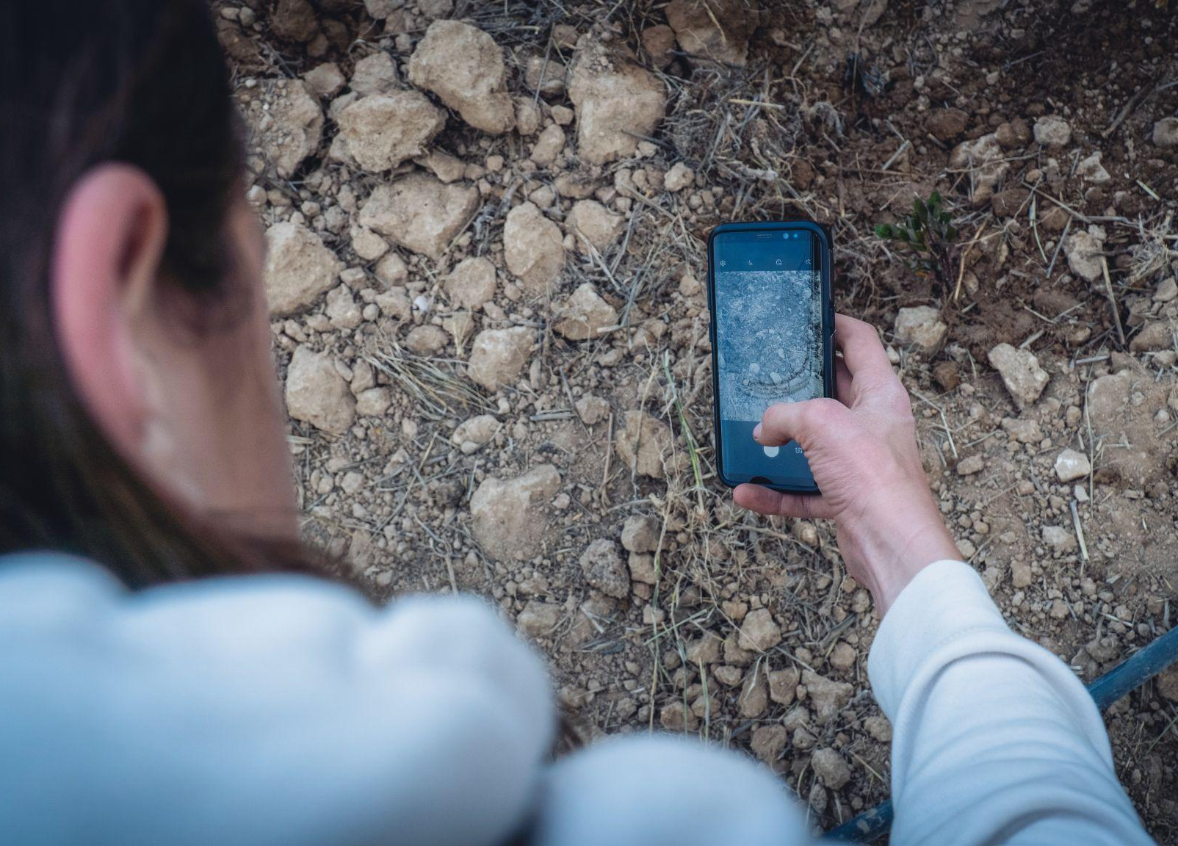
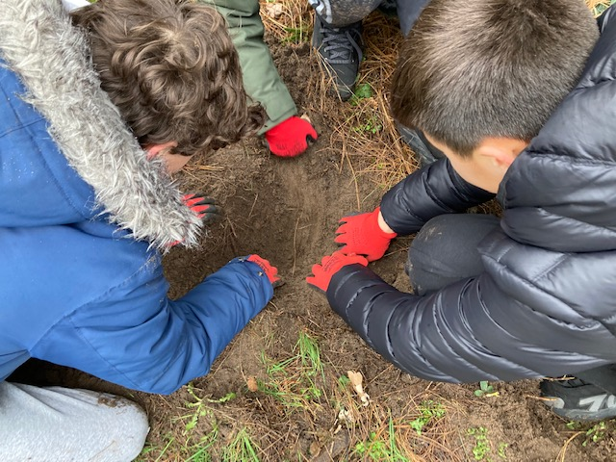
What makes us unique
Plant the right tree in the right place, share knowledge and expertise
Monitor each tree planted, with our unique tracking system
Educate future generations, about sustainability and climate change
Build communities, because planting trees impacts society at large

Slide 6
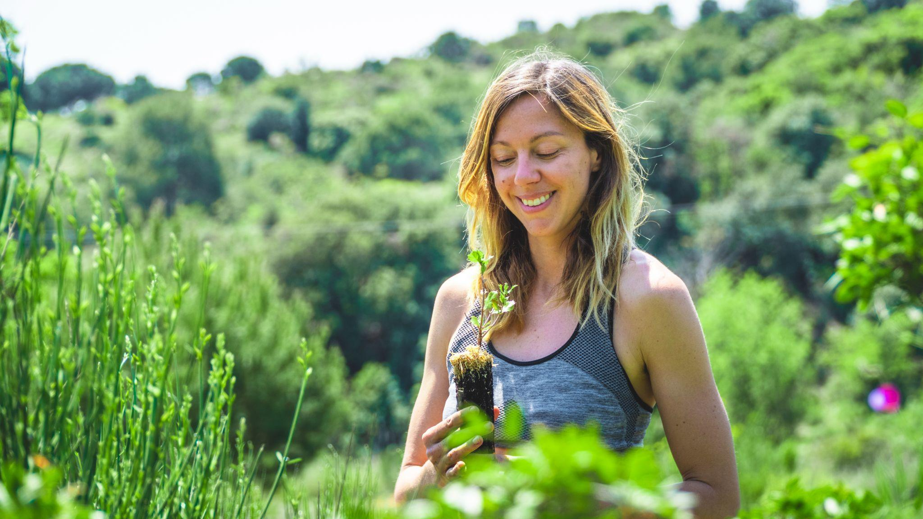
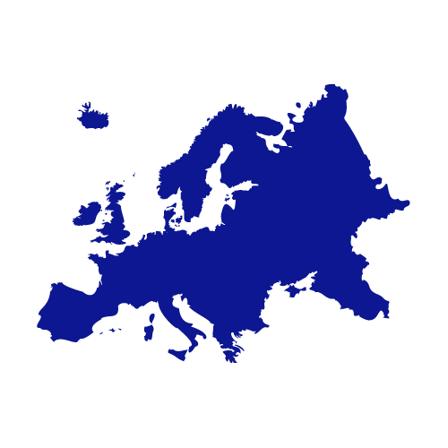
Our impact
4,107,120
Trees planted
Active in 19 countries
+10,390,504
people reached via SM*
+1,127
Number of events
15,169
Classrooms participating
68,489
Citizens involved

Slide 7
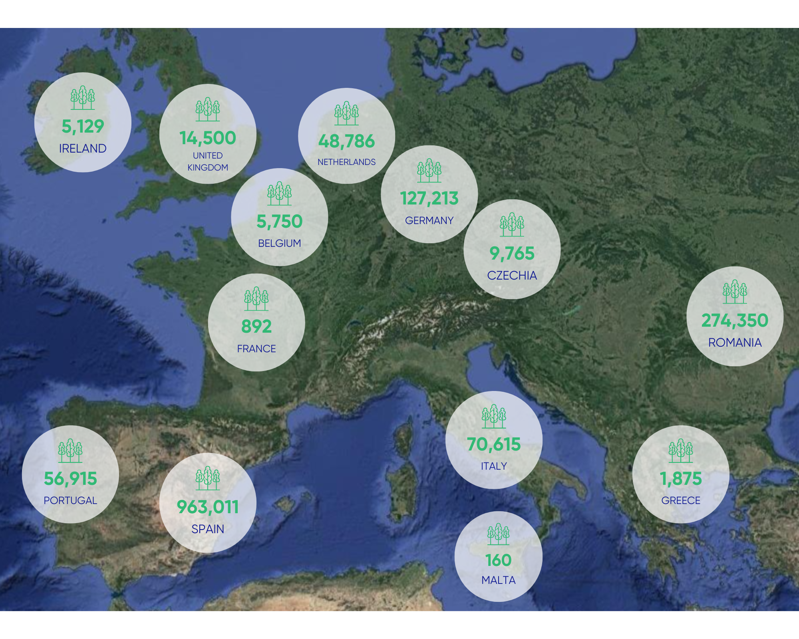
Our impact in Europe
in 2022

Slide 8
Future plans
Create true impact in society → be the climate action movement in Europe
Improve reach with more “Story telling” incl. personal stories, special events
Support Sales team in “selling” our trees in the platform
Grow again with 5-6 countries to create “full” European presence → need of a PR network
Challenge: attract big donors

Slide 9
Expectations
Marketing campaign on how to monetise our planted trees through the “Adopt a tree” option on the Life Terra platform.
Target group: individuals (B2C).
Marketing assets (Create content for social media, email templates, videos for tiktok, etc)
Market Expansion: creation of a pitch deck presenting the Life Terra project to attract government organisations and individual/businesses donors.
Target group: B2B and B2G
PR strategy including a database on relevant journalists, influencers, and media outlets interested in sustainability, climate change, and environmental initiatives.
Mapping of relevant media in key countries for Life Terra

Slide 10
23/10/2023

