Slide 1
Organized People Never Have to Look for Things
Professor Ellen Genovesi

Slide 2
BIO 113 – Biological Science Concepts
Formats Fall 2020
Online
Remote
Hybrid

Slide 3
BIO 106 – Human Anatomy
Formats Fall 2020
Online
Hybrid

Slide 4
Organizing your content in blackboard

Slide 5
Course Info Tab

Slide 6
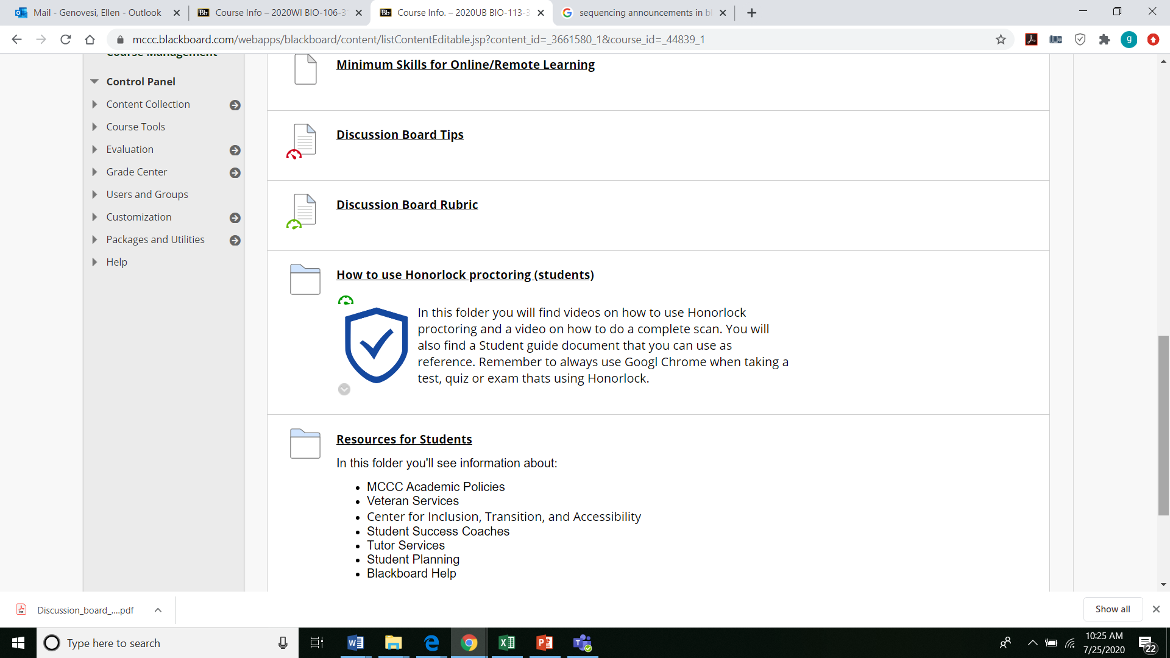
Course Info Tab

Slide 7
Course Info Tab

Slide 8
Course Schedule (Syllabus) - Road Map

Slide 9
Course Key Points

Slide 10
Course Key Points

Slide 11
Announcements
Landing page for important information
Reinforce course key points
End date unnecessary announcements
Sequence order by date
Preview in student mode

Slide 12
This one a keeper …

Slide 13
Reinforce a course key point

Slide 14
End date

Slide 15
Student Preview Mode

Slide 16
Course content
Consistent Structure
Clearly define due dates
Distinguish what items are graded vs non-graded

Slide 17
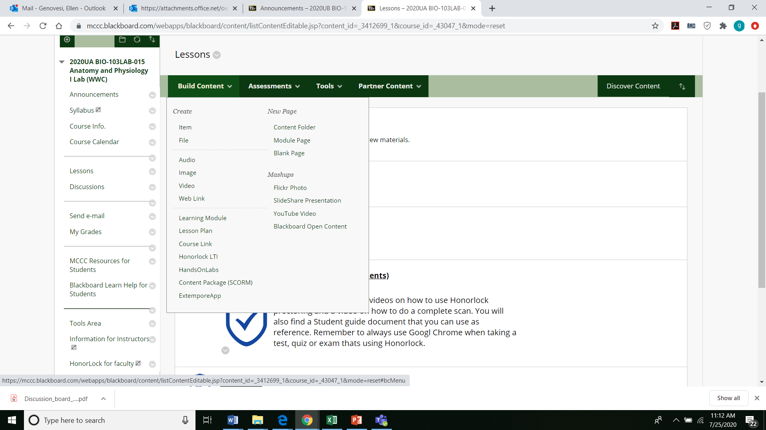
Build Content

Slide 18
Methods of Sharing Content (just a few)
Course link
Short cut tool to content in other areas
Item
Title, text, file
File
Title, file, no additional text
Content folder
Folder name, text
Ability to insert items into a folder
Learning Module
Content folder + table of contents + sequential viewing order.
Web link
Mashup
You tube video

Slide 19
Course link

Slide 20
Introduce Yourself
https://youtu.be/6jjD7s-BrEM

Slide 21
Content Folders

Slide 22
Copy format

Slide 24
Establish due dates & Learning Objectives

Slide 25
Reading Assignment / presentation/ web link

Slide 26
Mashup-you tube video / Quiz *Clearly indicate graded assignments

Slide 27
Assignments / Module folder

Slide 28
Learning Module

Slide 29
Video

Slide 30
Assignment

Slide 31
Assignment

Slide 32
Post Lab Quiz

Slide 34
Bio 113 Remote / hybrid (separate lab folder)

Slide 35
Lab Folder

Slide 37
Alternate format – BIO 103 Lab Remote SummerUA

Slide 39
