Slide 1
Creating a Virtual Classroom
Using Asynchronous and Synchronous Learning Tools Lisa Shave M.S., MLS(ASCP)^{CM}SBB^{CM} Mercer County Community College MLT Program Coordinator and Professor
Notes:
Online learning environments are more prevalent in teacher education than ever before. Today’s technology has evolved so that a student can access instruction from a desktop computer via web conferencing tools that simulate the traditional classroom experience. Online courses may be separated into two categories, asynchronous and synchronous, depending on the nature of the online tool.

Slide 2
Takeaways from this session
1) The importance of supplementing asynchronous learning with online synchronous sessions through real-time interactions to foster an engaging environment that creates a social presence for students.
2) Some tools and online learning platforms that faculty within our institution must embrace for high-quality academic pedagogy and content delivery.
3) The MLT Program’s approach to implementing, evaluating, analyzing, and mastering synchronous communication technologies for the purpose of incorporating synchronous learning into the asynchronous learning environment.
Notes:
Today, my session is going hoping to stay focused on the following. 1. We will talk about the emergence of online teaching, the personalized learning experience, the importance of creating a social presence and I wil.l define asynchronous and synchronous learning. 2. I will refresh everyone's’ memories on the tools and platforms that are available to us that can assist with transitioning traditional face-to-face instruction onto an online learning environment. 3. I will explain how the MLT instruction shifted this past summer as a result of the COVID pandemic and what approach we took.
I’m hoping that this session empowers you to become more familiar with the tools that are available to use to assist us with delivering high-quality content that aids in student success.

Slide 3
Distance Learning Timeline
1953
The University of Houston offered the first televised college level credit classes on the first public TV station in the U.S.
1990s
Online learning, or virtual classes offered over the internet, is contrasted with traditional courses taken in a brick-and-mortar school building. It is the newest development in distance education that began in the mid-1990s with the spread of the internet and the World Wide Web
1990-2000s
Learning Management Systems (LMSs) emerge
2018
The update reports that over 3500 US institutions in higher education are using some type of learning management systems for facilitating blended and online courses. ANGEL, Blackboard Learn, Canvas, Desire2Learn, Moodle, and Pearson and Sakai are most commonly used LMSs by both faculty and students in higher education institutions. (Sulan, 2018)
Today
Personalized distance learning that is engaging, meaningful and allows for social presence.
https://thebestschools.org/magazine/online-education-history/
Notes:
I think sometimes its important for us to take a step back and realize that the online education that we see today as evolved over many decades. Today, it ties together several historical threads — computers, distance learning, and telecommunications, just to name a few. This means tracing the history of online education goes back much further than just the dawn of the Internet. This slide pictures a shortend timeline of the history of online education. I encourage you to visit to resource to read more in depth. I merely wanted to highlight and introduce the fact that distance learning has been practiced for many years and that we can learn a lot from the past to develop a more student-centric learning environment as we move forward.
1900-1959- After a decade of robust post-war production and innovation, the United States is well-positioned to take a lead in technology development. In this era, radio technology reaches into every home, and television and video recording are invented
1950s – the television was utilized and by 1958, Bell Labs had created the modem which would link at the time multiple computers together. It was that initial first step towards “wired” communication.
1960-1980- The Internet took its first wobbly steps, allowing for a period of rapid and remarkable breakthrough If we fast forward a little bit to 1990-2000s – this was the tech boom era. Companies began utilizing the internet to pioneer brand new platforms- LMS
As of 2018, you can see how many institutions of higher education advanced to using the LMS
Today, despite what global issues we are facing, we are still moving forward. However, we are not taking a more data-drive approach to ensure that are practices are truly tailored towards the students.

Slide 4
Personalized learning and social presence
Personalized learning
“Personalization refers to instruction that is paced to learning needs, tailored to learning preferences, and tailored to the specific interests of different learners. In an environment that is fully personalized, the learning objectives and content as well as the method and pace may all vary (so personalization encompasses differentiation and individualization).” (Innovate to Educate, 2010)
Social Presence
“The ability of participants to identify with the community (e.g. course. or study), communicate purposefully in a trusting environment, and develop interpersonal. relationships by way of projecting their individual personalities” (Garrison, 2009)
Notes:
It’s more of a holistic way of teaching online. I believe that is what we are now all most concerned with. We understand that we have the technological capacity to serve students from a distance, but how do we ensure that we are upholding these two principles.
Why is it important? Online learners who have stronger sense of community and perceive greater cognitive learning should feel less isolated and have greater satisfaction with their academic programs, possibly resulting in fewer dropouts.
Is it possible to create an environment that can be self-paced and flexible enough for students while also empowering them and allowing them to form a connection with others in that same classroom? I’m here to tell you that the evidence supports it and so do my current group of MLT students (even the ones who didn’t originally sign-up for it).

Slide 5
Distance Education Modality
Fully online: Active instruction, testing, assignments, and discussion takes place online
Blended or Hybrid: Between 25-50% of instructions, assignments, and discussion takes place online
Students study course material outside class and utilize classroom time to reinforce learning, ask questions, and interact with their instructor
Face-to-Face Web Enabled: Students “meet” virtually with their instructors (and other class members) via video chat or teleconferencing
Emergency remote teaching: shifting of face-to-face, blended, or other courses to a fully online format in the event students or faculty are unable to come to campus.
National Center for Education Statistics Institute of Education Sciences and https://educationdata.org/online-education-statistics/
Notes:
Professors (sometimes with the help of instructional designers) have the responsibility to develop the curriculum and present it (or design it) in a way that will allow for students to learn.
I know at this point, we’ve become very used to hearing these terms. A lot of us had to make that decision this past summer as to which format we wanted to use. I know quite frankly we were unsure as to whether or not we had made the correct decision. Sometimes, you may not be so comfortable or you may be treading on uncharted waters with online education, but as the content-expert, you are able to see both sides of the spectrum which provides us with power to transition to an online or distant environment.

Slide 6
Distance Education Synchronicity
Asynchronous
Fully online
Flexible scheduling (self-paced)
Elapsed time between exchanges
Synchronous
In-person or remote
Designated meeting times
Live discussion
Notes:
Here is where I am going to spend a majority of my talk. I wanted to discuss the importance of these two terms and how both can be used to develop a social presence for our students. Both can be used to the advantage of us and our students.
On this slide you’ll see how I defined the two. On the next, for those of you who prefer illustrations, there is a chart that distinguishes the two.

Slide 7
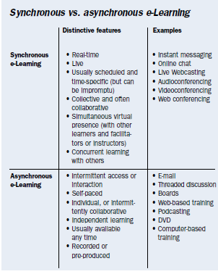
Notes:
In this image, some examples are also presented for each type of e-Learning format. E-learning, here defined as learning and teaching online through network technologies.

Slide 8
What does the Research Say?
Notes:
I’m going to be completely honest and let you know that I performed this research AFTER I already had transitioned the MLT courses over to the online environment. The following research does reaffirm that the path I decided to go has proven to be successful. I am sharing with you today to provide you with some insight to see if this may be the road you’d like to go as well.

Slide 9
In the US
https://educationdata.org/online-education-statistics/
Over 6 million Americans are pursuing an online education
The number of online students has risen every year for the past few years—and the most recent figures indicate that more than a quarter of all college students are taking an online class.
Notes:
Some may still debate that online learning is not as beneficial or conducive to students’ learning as face-to-face traditional classrooms. I am not hear to argue that. I believe it has already been proven as an equal if not superior alternative.
I want to focus on the question that many of us were faced with when we were forced to move face-to-face over to a 100% online environment. Asynchronous or sychnrous?

Slide 10
What are the benefits/limitations of asynchronous versus synchronous learning environments?

Slide 11
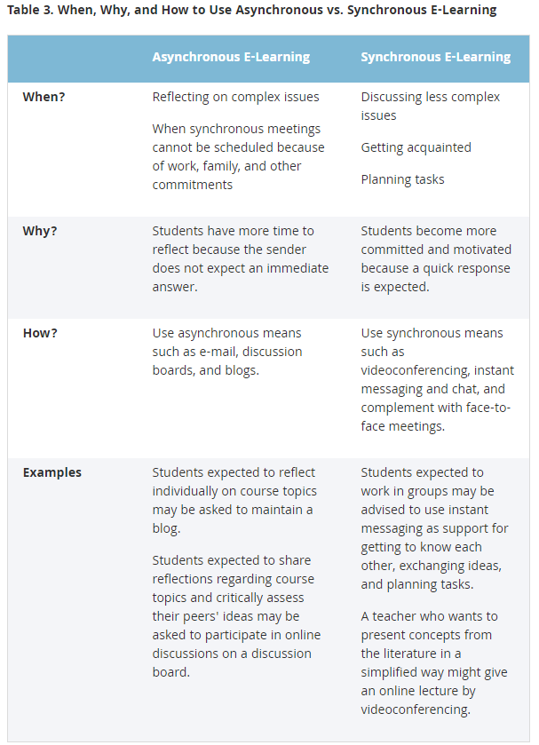
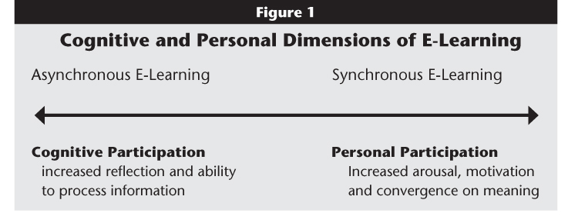
2008 Stefan Hrastinski
“The research discussed here demonstrates that asynchronous and synchronous e-learning complement each other. An implication for instructors is to provide several types of asynchronous and synchronous communication so that appropriate means are available for different learning activities. ”
Notes:
Professor in Sweden
For e-learning initiatives to succeed, organizations, educational institutions and instructors must understand the benefits and limitations of different e-learning techniques and methods. Research can support practitioners by studying the impact of different factors on e-learning's effectiveness.
In a study in 2008, by Stefan Hrastinski, he investigated the asynchronous and synchronous e-learning methods and discovered that each supports different purposes. He began with a view of learning as participation in the social world,⁵ which implies that learning is a dialogue (form of communication) internally and externally. Benefits and Limitations to both. If we take a look at the cognitive
Benefit- Asynchronous - Asynchronous e-learning makes it possible for learners to log on to an e-learning environment at any time and download documents or send messages to teachers or peers. Students may spend more time refining their contributions, which are generally considered more thoughtful compared to synchronous communication Limitation- If e-learners seldom meet face-to-face and teachers mainly rely on asynchronous e-learning, students might feel isolated and not part of learning communities, which is essential for collaboration and learning
Benefit- Synchronous- Synchronous sessions help e-learners feel like participants rather than isolates. Enables monitoring the receiver's reaction to a message, making the student more motivated to performing better in real-time. Limitations- Synchronous- Responses were more so quantity rather than quality—that is, students were trying to speak/write something quickly because "someone else will say what I was going to say”.
Personal participation describes a more arousing type of participation appropriate for less complex information exchanges, including the planning of tasks and social support. Cognitive participation describes a more reflective type of participation appropriate for discussions of complex issues. I suggest that, other things being equal, synchronous e-learning better supports personal participation and asynchronous e-learning better supports cognitive participation. Please note: the difference between asynchronous and synchronous e-learning is often a matter of degree and by what mode that communication is taking place.

Slide 12
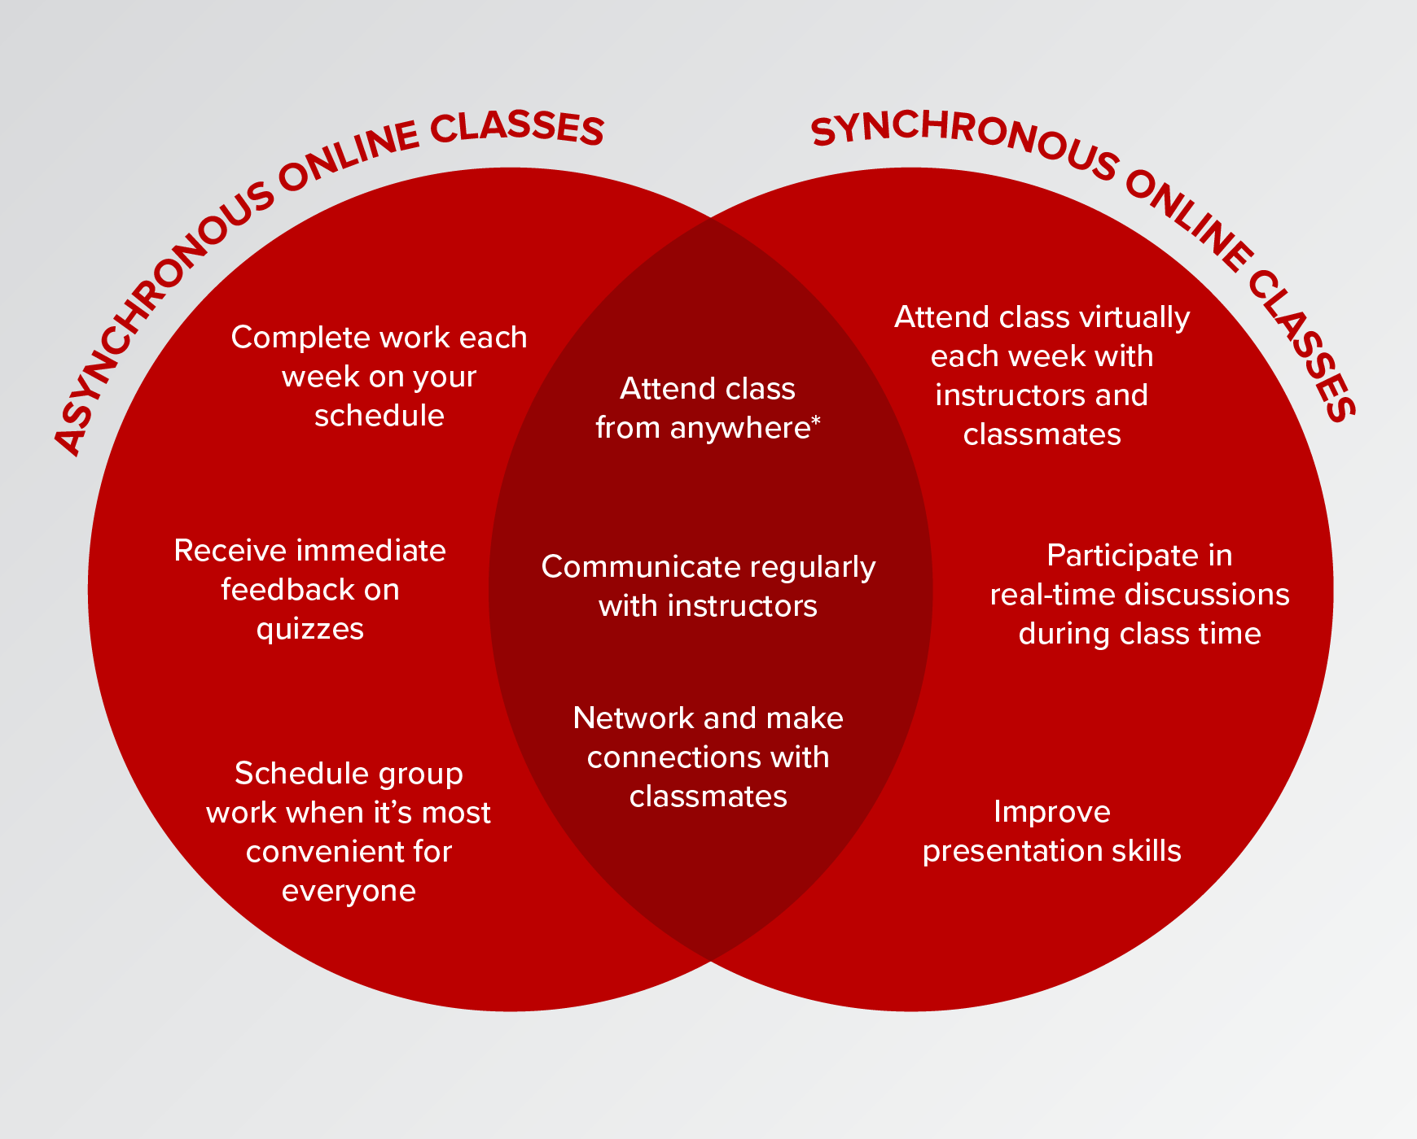
Combining the two modalities
Notes:
It is possible.

Slide 13
Are students more successful with an asynchronous or a synchronous environment?

Slide 14
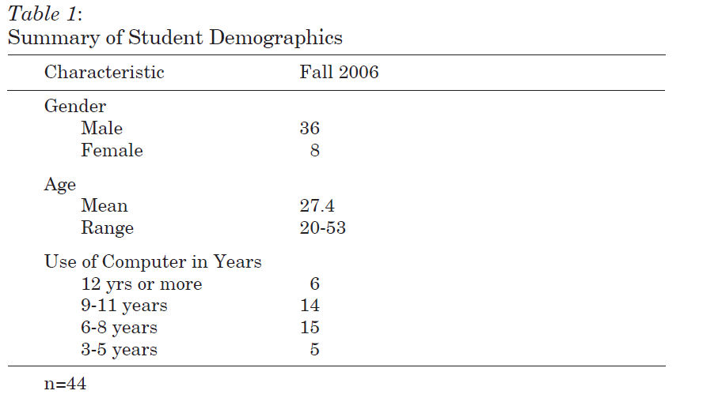
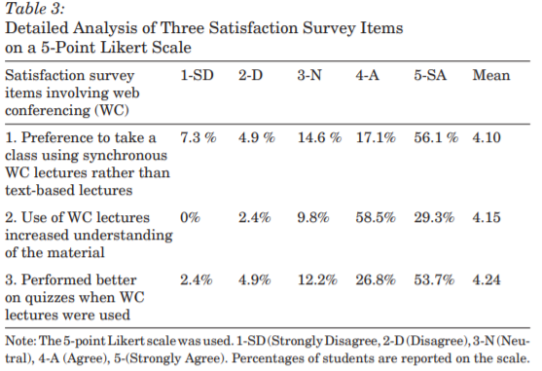
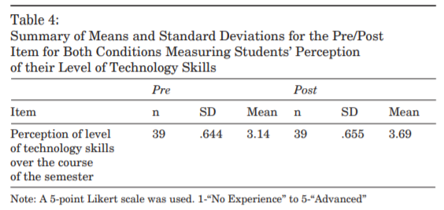
A Comparison of Asynchronous Online Text-Based Lectures and Synchronous Interactive Web Conferencing Lectures (Skylar, 2009)
Goal: This study aimed to compare asynchronous online environments and synchronous web conferencing environments and their effect on the achievement and satisfaction of students.
Investigated whether asynchronous and synchronous online instruction results in differences in student performance, student satisfaction, or student perception of their technology skills.
Findings
Student Performance
Students’ performance was slightly improved when provided with synchronous web conferencing lecture vs. only asynchronous text-based lectures. However, both types of lectures were effective in delivering online instruction.
Satisfaction
73.2% (30) of the students would prefer to take an online course which uses synchronous web conferencing
87.8% (36) of the students felt that participating in synchronous web conferencing lectures increased their understanding of the course material, in addition to using the text-based lecture materials
80.5% (33) of the students felt that they performed better on weekly quizzes when synchronous web conferencing lectures were used to present the material rather than using asynchronous text-based materials only to prepare for quizzes
Technology skill level
An improvement in students’ perception of these specific technology skills over the course of the semester
Notes:
California Professor
In 2009, Despite the growth in the use of synchronous tools to facilitate online instruction, little was known about how people use synchronous web conferencing technology, particularly how it impacted Student performance, student satisfaction (something that we are most concerned with) and then student technology skill level (which I know we have seen some students have challenges with).
1. Are there differences in performance between students accessing content presented in a synchronous interactive web conferencing lecture format compared to students that access content in an asynchronous text-based lecture format?
2. Would students prefer to take an online course that uses synchronous interactive web conferencing lectures or asynchronous text-based lectures?
3. Do students perceive an increased level of technology skills when taking an online course?
Forty-four preservice general education and special education students enrolled in two sections of a special education course on inclusion participated in this study. All students received both conditions: synchronous interactive web conferencing lectures and asynchronous text-based lectures. Of the 44 students in this study, 36 (82%) were female and eight (18%) were male. All students had used computers for three years or more: six students 12 years or more, 14 students 9-11 years, 15 students 6-8 years, and seven students 3-5 years. All students except one had indicated that they had access to a computer outside of school and five students indicated that they did not like completing assignments that require them to access the computer/Internet. The average age of all the students was 27.4. The youngest student was 20 and the oldest student was 53
Same Instructor. One group- The course presentation of content was asynchronous and used the course management system WebCT. A typical class week included the students downloading text-based lecture notes (e.g., PowerPoint, html, Word), reading a chapter in the textbook to correspond with the lecture notes, and taking a 10-item quiz at the end of the week.
Second group- had access to the same thing but with weekly meetings.

Slide 15
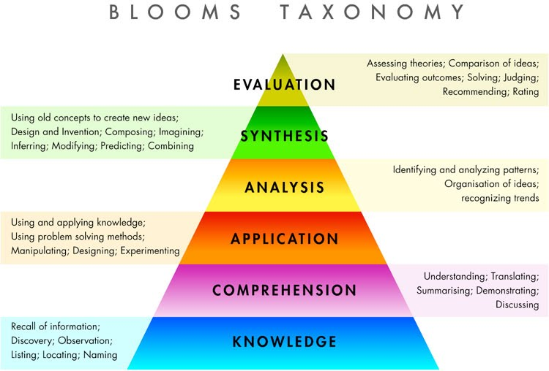
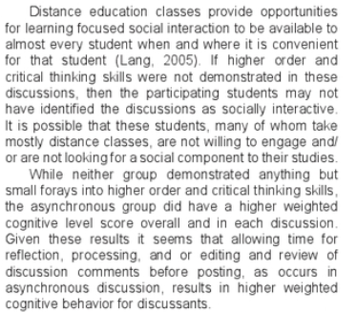
A Comparison of Higher Order Thinking Skills Demonstrated in Synchronous and Asynchronous Online College Discussion Posts (Bierton, 2016)
Goal: Explore what higher order thinking skills develop naturally via student social constructivism. This exploratory study measured instances of higher order thinking skills in synchronous and asynchronous online discussion.
Used the Taxonomy of Cognitive Behavior
Findings
Overall synchronous discussion was found to be at the knowledge level and overall asynchronous discussion was at the comprehension level.
A statistically significant difference in the overall cognitive level of comments between the two groups was found.
Notes:
Are they more successful with higher order thinking?
I know that sometimes we are hesitant about whether discussion is more beneficial in the live environment or behind the screen. This was published research which demonstrated that
Limitation = NOT identifying the discussions as socially interactive. Not willing to engage and/or not looking for a social component to their studies.
Overall, the asynchronous group did have higher weighted cognitive behaviors.

Slide 16
What if we blend the two?
Do students feel more motivated or engaged?
Notes:
I’ve already mentioned that this was the format that I took with my students. What does the research say?

Slide 17
A dynamic analysis of the interplay between asynchronous and synchronous communication in online learning: The impact of motivation (Reinties, 2014)
Goal:
Synchronous communication does not afford as much time for reflection as asynchronous communication. Therefore, a combination of synchronous and asynchronous communication in e‐learning would seem desirable to optimally support learner engagement and the quality of student learning
Investigated how learners balance the use of synchronous and asynchronous communication during the runtime of an online course, and how these decisions are related to learners’ degree of self-determination/engagement/motivation.
Findings
Positive relations between engagement in synchronous and asynchronous communication were found, with the strongest influence from using asynchronous to synchronous communication.
Participating in a web-videoconference, which enlarges the interpersonal dynamics, may have provided opportunities for students to mutually influence each other’s motivation to engage in learning.
There level of engagement did drop over time amongst both groups of students. Incorporate more stimulating or collaborative projects to enhance the cohesion and drive motivation.
Notes:
Little was known about how to combine synchronous and asynchronous communication over time, in a way that effectively enhanced student learning.
By this point in time, research had demonstrated that the actual use of both synchronous and asynchronous communication tools and the resulting interactions in an online learning situation are related to individual differences between learners, and specifically strong relations have been found with motivation or self-determination.
This study addresses that relationship in an online course (N = 110), taking into account student motivation from the beginning of a program through the end and looking at two different types of learners. Autonomy-oriented learners (i.e. learners with an intrinsic drive who can effectively steer their own learning) engaged significantly more in both task-related and non-task related discourse than control-oriented learners (i.e. learners with an external drive, who are less efficient in steering their learning process).
They coded their discussion board postings as task-related and non-task related and compared the two. The coding scheme employs non-task-related and task-related discourse as the main categories. Within the category non-task-related, messages are further divided into the categories 1) planning; 2) technical; 3) social; and 4) nonsense. Messages coded as task-related are further divided into the categories 5) facts; 6) personal experience; 7) theoretical ideas; 8) explication; and 9) evaluation
In line with their assumptions, they found some support for the expected association between autonomous motivation and engagement in asynchronous and synchronous communication, be it restricted primarily to the first course period. Also, positive relations between engagement in synchronous and asynchronous communication were found, with the strongest influence from using asynchronous to synchronous communication.
Important with the communication= Let the choice of communication media to be dependent of the way in which it can support the educational processes.

Slide 18
What if we blend the two?
Will more students be able to “attend” class? Will this contribute to their overall success?

Slide 19
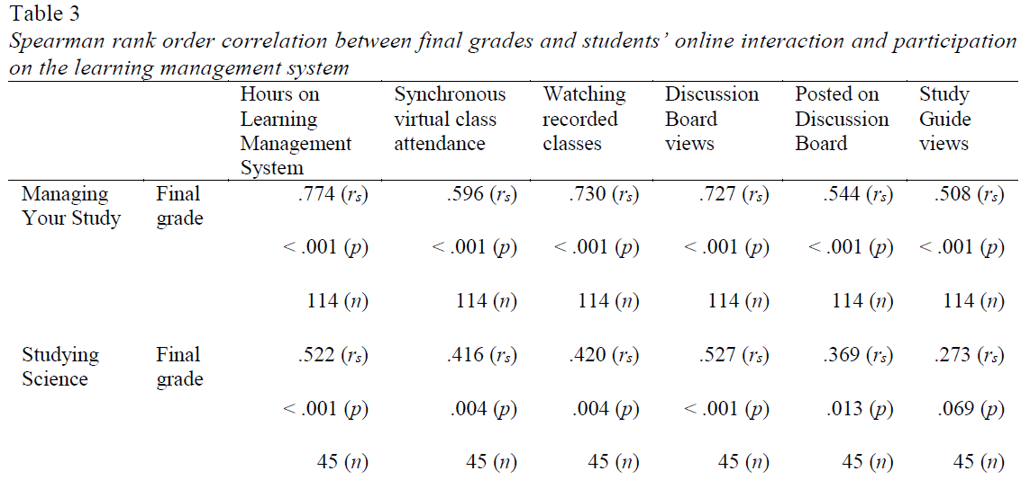
Investigating synchronous and asynchronous class attendance as predictors of academic success in online education (Nieuwoudt 2020)
Goal:
investigated the relationship between students’ academic success and online interaction and participation
compared their class attendance (synchronous virtual classes and/or watching the recorded virtual classes) with final grades
Findings
Attendance is important for academic success.
it is important for students to attend class, but it does not necessarily make a difference whether students attend synchronous virtual classes or watch the recordings of the virtual classes.
Academic success may be increased by providing various options for students to participate and interact online, and to attend classes synchronously or asynchronously.
The flexibility of online education can enable students to be successful in their studies.
The inclusion of varied activities is therefore recommended to increase academic success in online education.
Notes:
In order to facilitate learning and improve academic success in online education, it is important to understand the different ways students access and participate in the online learning system.
Self-directed learning enables the online student to decide how and when to interact and participate. While online education does increase access to higher education, the attrition rates are higher for online students compared to on-campus students (National Centre for Student Equity in Higher Education, 2017; Stone, 2017). To decrease attrition rates and increase academic success in online education, it is important to understand the various ways students interact and participate in the online environment.
The research looked at over 140 students who were enrolled in two different course subjects (Managing Your Study and Studying Science in Austraila)
The subject Managing Your Study promotes independent learning by building an understanding of the culture of learning at university and creating a toolkit of learning strategies and skills.
The subject Studying Science introduces students to science, and key concepts in biology, physics, and chemistry.
Managing Your Study and Studying Science subjects, weekly classes were held in Blackboard Collaborate ™ (via the Blackboard Learn LMS), a virtual classroom where students and the teacher interacted online during live synchronous sessions. There was one synchronous virtual class per week for each subject. Presentation slides were uploaded and the students and the teacher communicated orally and exchanged messages through typing in the chat box, using emoticons, and writing on the shared whiteboard. Classes consisted of explanations of content, activities to test understanding (e.g., drag and drop activities, labelling activities, answering questions in the chat box, writing key words on the shared whiteboard). Attendance of the synchronous virtual classes were not mandatory. The virtual classes were recorded and made available to students to watch at a convenient time if they were unable to attend the live synchronous virtual class. The presentation slides and additional learning resources were available for students in the LMS. Managing Your Study students had access to the Study Guide in a portable document format (PDF).
Only difference was the study guide access Managing Your Study students had access to the Study Guide in a portable document format (PDF) wheras Studying Science students had access to the interactive online Study Guide, consisting of reading content, video clips, and interactive activities that are compatible with mobile devices. Students had to logon to the LMS to access the interactive Study Guide. The Study Guide supplements the weekly classes. Weekly activities related to the class content were posted on the discussion forum. Students were encouraged to participate on the discussion forum, but it was not mandatory nor graded. Students were also encouraged to ask questions related to the assessments on the discussion forum.
The retrieved data for each subject consisted of:
number of hours on the LMS 2. the number of times the synchronous virtual classes were attended 3. the number of times the recorded classes were watched, the number of views of the discussion board 4. the number of posts made on the discussion board, and the number of times the Study Guide was viewed. 5. Final grades (in percentage format) were acquired from the LMS as an indicator for academic success.
found significant correlations between final grades and student activity on the LMS, except between final grade in the Studying Science subject and Study Guide views, as presented in Table 3.
While it does not seem to make a difference whether students attend synchronous virtual classes or watch the recorded virtual classes, it is important for students to attend classes.
This study also goes into a discussion about ensuring that there is sufficient high-quality interactions of the students. Worth mentioning

Slide 20
Highlights of the Research Articles
(2009) Students’ performance was slightly improved when provided with synchronous web conferencing lecture vs. only asynchronous text-based lectures.
(2016)-Overall synchronous discussion was found to be at the knowledge level (lower level) and overall asynchronous discussion was at the comprehension level (higher level).
(2013)- Positive relations between engagement and motivation were found amongst students who were enrolled in a asynchronous/synchronous learning environment.
(2020)-Both the attendance of synchronous virtual classes and the watching of recorded virtual classes (asynchronously) significantly predicted final grades.

Slide 21
How to combine asynchronous and synchronous learning?

Slide 22
They are complementary

Slide 23
What we have through Mercer
Learning Management System- Blackboard
Attendance
Create and store our Course Outline, CLO, Weekly objectives
Add content-specific material (PPTs, PDFs, OneDrive links, Website Links, Publisher material, OER, Videos, etc.)
Videoconferencing- Blackboard Collaborate
Assignments (Discussion Boards, Wikis, Quizzes, Exams) as well as the ability to link course questions back to our learning objectives.
Gradebook calculations visible to faculty and students
Microsoft 365
Office Suite (PPT, Excel, Etc.), Outlook (email), OneDrive (files), Skype, OneNote, Microsoft Teams, Microsoft Stream, Forms, etc.
Videoconferencing
Microsoft Teams, Zoom, Skype.
Proctored Testing
Library Services – databases, OER, etc.

Slide 24
Other tools that we can utilize
Presentations (Interactive):
iSpring
Prezi
AdobeSpark
https://h5p.org/ *** new 3/2020 - will integrate with most LMS (quizzing, games, etc)
Kaltura CaptureSpace*
Edpuzzle
Screencasting:
Screencast-o-matic
SnagIt
Screencastify
Audio/Podcasts:
Audacity
GarageBand
Adobe Audition*
Blogs:
Wordpress
Wix
Video:
Flipgrid
iMovie
Concept Mapping/Flash Cards:
Coggle
Draw IO
Cram.com
Survey/Assessment Tools:
IF-AT cards
PollEverywhere
Socrative
Kahoot
PearDeck
FlipQuiz
Quizizz
Notes:
Ones that I’m interested in include h5P and Kaltura that allow you to incorporate formative assessments in the middle of presentations (self-created or YouTube videos) Stimulating activities might include podcasts or blogs.
Concept mapping has proven to be a valuable tool and you can still incorporate it into an online/e-learning environment. I’ve had my students make flashcards using cram.com
I am going to begin using IF-AT cards when I resume face-to-face this fall. However, you could always mail it out to students and to it in a synchronous web conference.
Kahoot is something I have used a LOT. It’s more of an interactive gaming experience.
I’d be more than happy to go in depth about how I’ve used these.

Slide 25
More Tools
Whiteboard/Chalkboard:
ExplainEverything
ShowMe
Educreations
Simulation Repository:
PhET Interactive Simulations: University of Colorado Boulder
MERLOT: California State University Center for Distributed Learning
CAREO: Campus Alberta Repository of Educational Objects
Wisc-Online: Wisconsin Technical College System
Labster*
HHMI Biointeractive
University of Arizona Biology Project (go to activities)
Open Repository/CourseWare:
Creative Commons
Open CourseWare Consortium
Science Learning Hub
Online Databases:
WorldMapper http://www.worldmapper.org/
WolframAlpha https://www.wolframalpha.com
Video annotation:
YouTube
VoiceThread
VideoAnt
BubblePly
Viddler
Word Clouds:
TagCrowd
Wordle
ToCloud
Tagul
Tagxedo
Worditout
WordSift

Slide 26
Social Media/Phone Apps
Twitter
Facebook
Instagram
LinkedIn
Almost all of our apps can be put on the phone screen (Microsoft Teams (messaging), Blackboard, Outlook, etc.
Notes:
I think it is worth mentioning that you can get creative with your classroom activities while utilizing social media platforms and expanding students’ knowledge through engaging experiences through the use of these.

Slide 27
What have I used to instruct the MLT Program students?
How have I incorporated an asynchronous and synchronous environment?

Slide 28
Asynchronous Lecture
Narrated PowerPoint Lectures
Interactive assignments
Students assigned weekly to create questions.
Discussion Boards (initial due by Wed/discuss by Monday)
Supplemental Resources
YouTube Videos (embedded in Blackboard)
Self-Made Videos utilizing Zoom/MT
Online platforms (free and paid subscriptions)
CDC online learning modules, Instrument mfr training videos, MediaLab courses
Assessments
Blackboard weekly quizzes (clear instructions, time-limits, had one student that needed an accommodation (extended time)
Utilized Honorlock for major assessments only (Midterm/Final)

Slide 29
Asynchronous Laboratory
Narrated Standard Operating Procedures
Utilized video conferencing platform to record the recitation period that normally takes place before each class.
Reviewed the principle, procedure, limitations and interoperations of the test
Video demonstration
YouTube and self-made
Simulation Platforms
Simtic Tutor- Venipuncture
MediaLab- Urinalysis dipsticks, Microscopic Analysis of Urine, Microscopic Analysis of Peripheral Blood Smears to analyze red blood cells, white blood cells and platelets.
Other possibilities
Mail kits home to the students
Homework was STILL ASSIGNED – required more in-depth reading.
Also preparing the students for when in-person sessions resumed

Slide 30
Synchronous Components
Video Conferencing
Note: All students were required to have their video ON. Students were muted, but could unmute themselves to ask questions. The chat feature was also utilized.
First initial meeting (Welcome to the Course!)
Introduce Professor
Icebreaker for students to have them introduce themselves
Introduce Blackboard Shells
Review the course outline/syllabus
Answer student questions
Weekly meetings (2 designated times) (excluding Virtual Office Hours)
Kahoot! games were played to reinforce theory and assess knowledge/memory recall
Concepts were reviewed through instructor-mediated discussion as well as through questions posed by students.
Could also have had students develop questions to ask one another.
Could have also created breakout sessions to have each group focus on specific area and then reconvene the group to discuss collaboratively.

Slide 31
Other Synchronous Components cont’d
Wikis
Presentations/Flipped-learning
Can be created by the students and uploaded to Blackboard for others to view.
Evaluation-easily accessible for professor and peer-review of the presentations
Microsoft Teams
Group text message features
My students and I celebrated National Medical Laboratory Professionals Week through messaging, thgames, a meme-challenge, and felt very connected.
Private text message features (with/without voice calling/video conferencing)
Great if not more superior alternative to Blackboard LMS
I had to use one week that Blackboard was down and I could see the added benefit through the ease of operation which stimulated creativity.
Numerous ways to file share, link platforms and engage students

Slide 32
Monitoring Student Engagement
Microsoft Teams
Feed activity
Assignment activity
Blackboard
Last time accessed
Assignment Activity
Submission, Time report
Collaborate Attendance report
Zoom
Sign-up feature
Attendance feature
Save transcript feature

Slide 33
Monitoring Student Engagement (Microsoft Forms)
All 28 students answered Survey Questions (1 =Strongly disagree, 2=Disagree, 3= Somewhat agree, 4=Agree, 5=Strongly agree).
Please rate the following statements:
I do NOT feel that the hybrid format inhibited my ability to learn the content and theory. On-campus→Hybrid = 3.33 AVERAGE = 4.08 Hybrid = 4.82
2. The weekly Zoom Meetings were helpful in reviewing the weekly material and solidifying content. On-campus→Hybrid = 4.17 AVERAGE = 3.91 Hybrid = 3.64

Slide 34
Key Things To Include in your eLearning
Learners need to be able to ask questions and share information and ideas.
Planning tasks ahead of time is essential.
Incorporate independent and collaborative projects/assignments.
Social support is mandatory.
Notes:
Previous research points to the critical role that community can play in building and sustaining productive learning and that teaching presence, defined as the core roles of the online instructor and is among the most promising mechanisms for developing online learning community. Utilizing both modalities of e-learning can help you succeed in creating an environment that engages students.

Slide 35
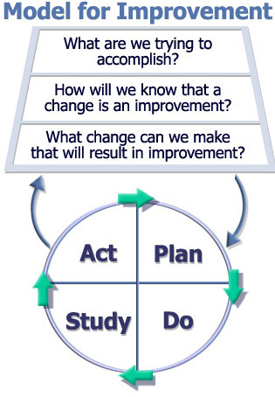
Remember:
Choose What’s Right for You!
You are the content expert.
I advise you to do your Research!
(Not like me though!)
PDCA
Plan, Implement, Evaluate, and Revise.
Listen to your students’ feedback!

Slide 36
Resources
Brierton, S., Wilson, E., Kistler, M., Flowers, J., & Jones, D. (2016). A comparison of higher order thinking skills demonstrated in synchronous and asynchronous online college discussion posts. NACTA Journal, 60(1), 14-21. Retrieved from https://mccc.idm.oclc.org/login?url=https://search-proquest-com.mccc.idm.oclc.org/docview/1774548652?accountid=40611
Hrastinski, Stefan (2008). A Study of Asynchronous and Synchronous e-learning discovered that each supports different purposes, Educause Quarterly, 4/2008, pp. 51-52.
Giesbers, B., Rienties, B., Tempelaar, D., & Gijselaers, W. (2014). A dynamic analysis of the interplay between asynchronous and synchronous communication in online learning: The impact of motivation. Journal of Computer Assisted Learning, 30(1), 30-50. doi: http://dx.doi.org.mccc.idm.oclc.org/10.1111/jcal.12020
Nieuwoudt, J. E. (2020). Investigating synchronous and asynchronous class attendance as predictors of academic success in online education. Australasian Journal of Educational Technology, 15–25. doi:10.14742/ajet.5137
Skylar, A. A. (2009). A comparison of asynchronous online text-based lectures and synchronous interactive web conferencing lectures. Issues in Teacher Education, 18(2), 69-84. Retrieved from https://mccc.idm.oclc.org/login?url=https://search-proquest-com.mccc.idm.oclc.org/docview/233320705?accountid=40611

