Slide 1
KAHOOT!

Slide 2
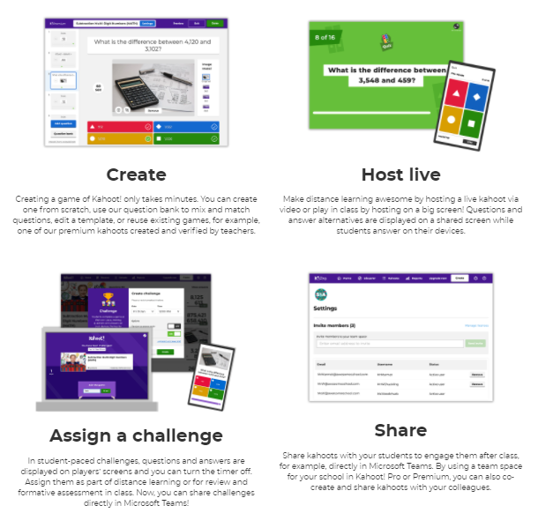
How it works:

Slide 3
How to Play
https://kahoot.com/schools/ways-to-play/
CREATE or DISCOVER
Game Mode – LIVE , VIRTUALLY, or CHALLENGES (competeitive/self-paced) (Review)
Create different question types
Quiz
True/False
Add images to questions/answers
(Pro or Premium Accounts only)
Create polls to collect quick feedback (no points awarded for these)
Add slides to give more context
Puzzles so that students must answer in the correct order
Have students type-in answers

Slide 4
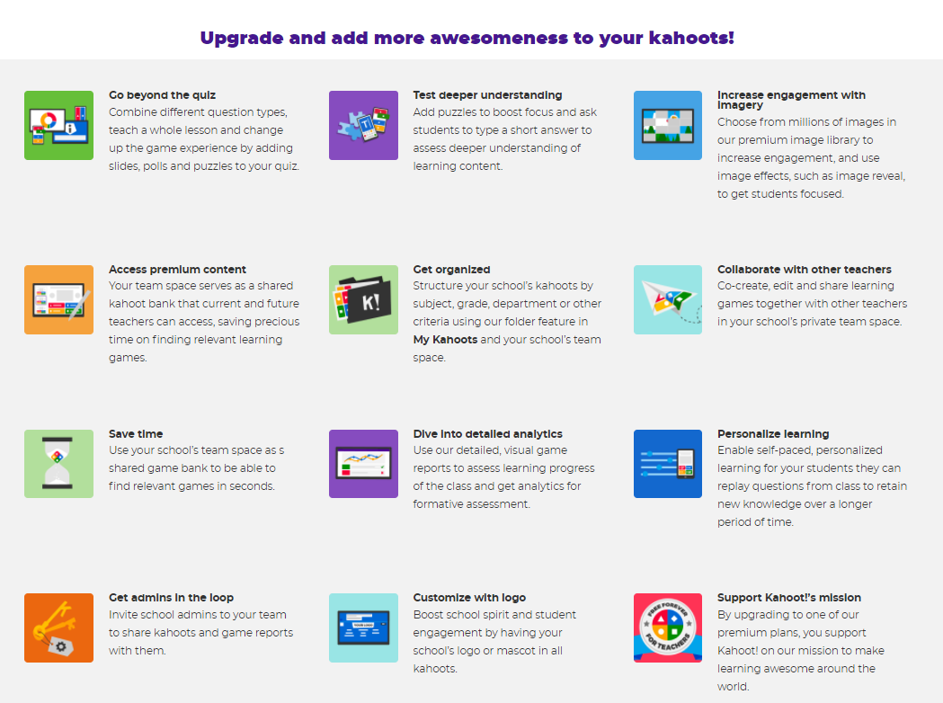

Slide 5
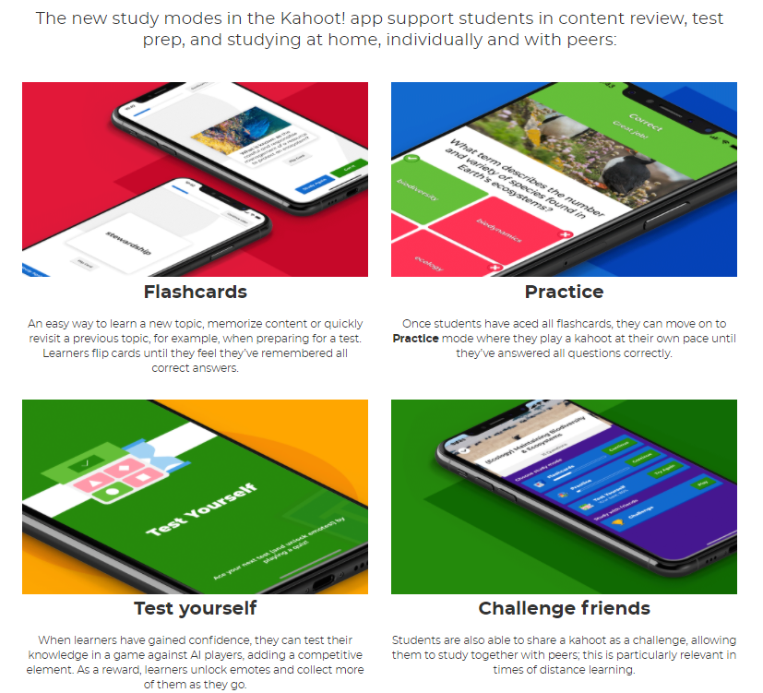
There’s an APP!

Slide 6
BASIC DEMONSTRATION

Slide 7
Set Expectations/Incentivize
Course Outline Instructions to Access Kahoot!
Separate Area of your Blackboard Shell to include:
Recordings of live challenges/review sessions
Links to self-paced challenges
Continuously use to provide praise or reach out to students who’ve been identified as struggling
Include as a grade within your course.
Remain Relevant with your Kahoots!
Connect them back to the Learning Objectives (lesson, weekly, course)
Have fun! ☺

Slide 8
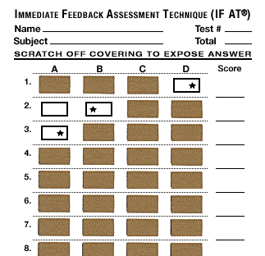
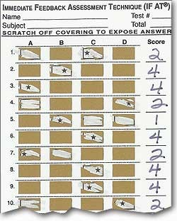
IF-AT

Slide 9
TBL or Team-Based Learning
Is an active learning and small-group instructional strategy
Provides students with the ability to apply conceptual knowledge through a sequence of activities
Individual Work
Teamwork
Immediate Feedback
May be used with either large or small classes
Will require groups of 5-7 students

Slide 10
Immediate Feedback Assessment Technique
http://www.epsteineducation.com/
Immediate Feedback Assessment Technique (IF-AT) forms are used in higher education to engage students with assessment.
How it works?
Students consider a question, choose a response, and scratch off answers like a lottery ticket until the correct answer is revealed. IF-AT forms (named after the idiom, “If at first you don’t succeed, try try again”) ensure that students have fun and leave class knowing the correct answer choice, a form of immediate feedback known to support learning. IF-AT forms have also been shown to reduce test anxiety (DiBattista et. al, 2006).
IF-AT forms have been used in team-based learning activities, as well as individual assessments.

Slide 12
What if we do not see students F2F?
Using Paper Forms
IRAT
You can mail the IF-AT cards to students and…
Pre-Number/Professor-initialed all IF-AT cards
require them to record themselves scratching off their IF-AT card
require them to upload an image of the IF-AT card
Breakout sessions (using Blackboard Collaborate or Zoom, etc.)
Preassigned groups whereby one student will scratch for everyone and then submit in a similar fashion.
Using Digital (electronic scratch offs)
Variety of companies
Drawbacks:
None really tailored to educational assessment.
No known free software at this time.
Using Blackboard Applications
Create Groups
Assessment Options
IRAT
individual quiz
TRAT
Option 1
Assign a group to a quiz
One person answers questions while in a Breakout Room
Option 2
Upload the questions to a Wiki and have students each contribute rather than one person selecting the answer choices.

Slide 13
Virtual Flash Cards

Slide 14
CRAM
https://www.cram.com/flashcards/create
Students can CREATE, MEMORIZE, and/or TEST themselves/others
What I did with the MLT students
I created a Blackboard assignment and listed the terms to define for students.
I required them to upload their finished product for an assignment grade. EXAMPLE
What else could be done?
Students may PRINT
Students may SHARE/EXPORT
Students can share with one another or can utilize their flashcards during study sessions.
Professors can create their own set and share with students during as a group exercise or learning activity.

