Slide 1
MSC CRUISES
TRENDS REPORT MARKET TOOLKIT
November 2019

Slide 2
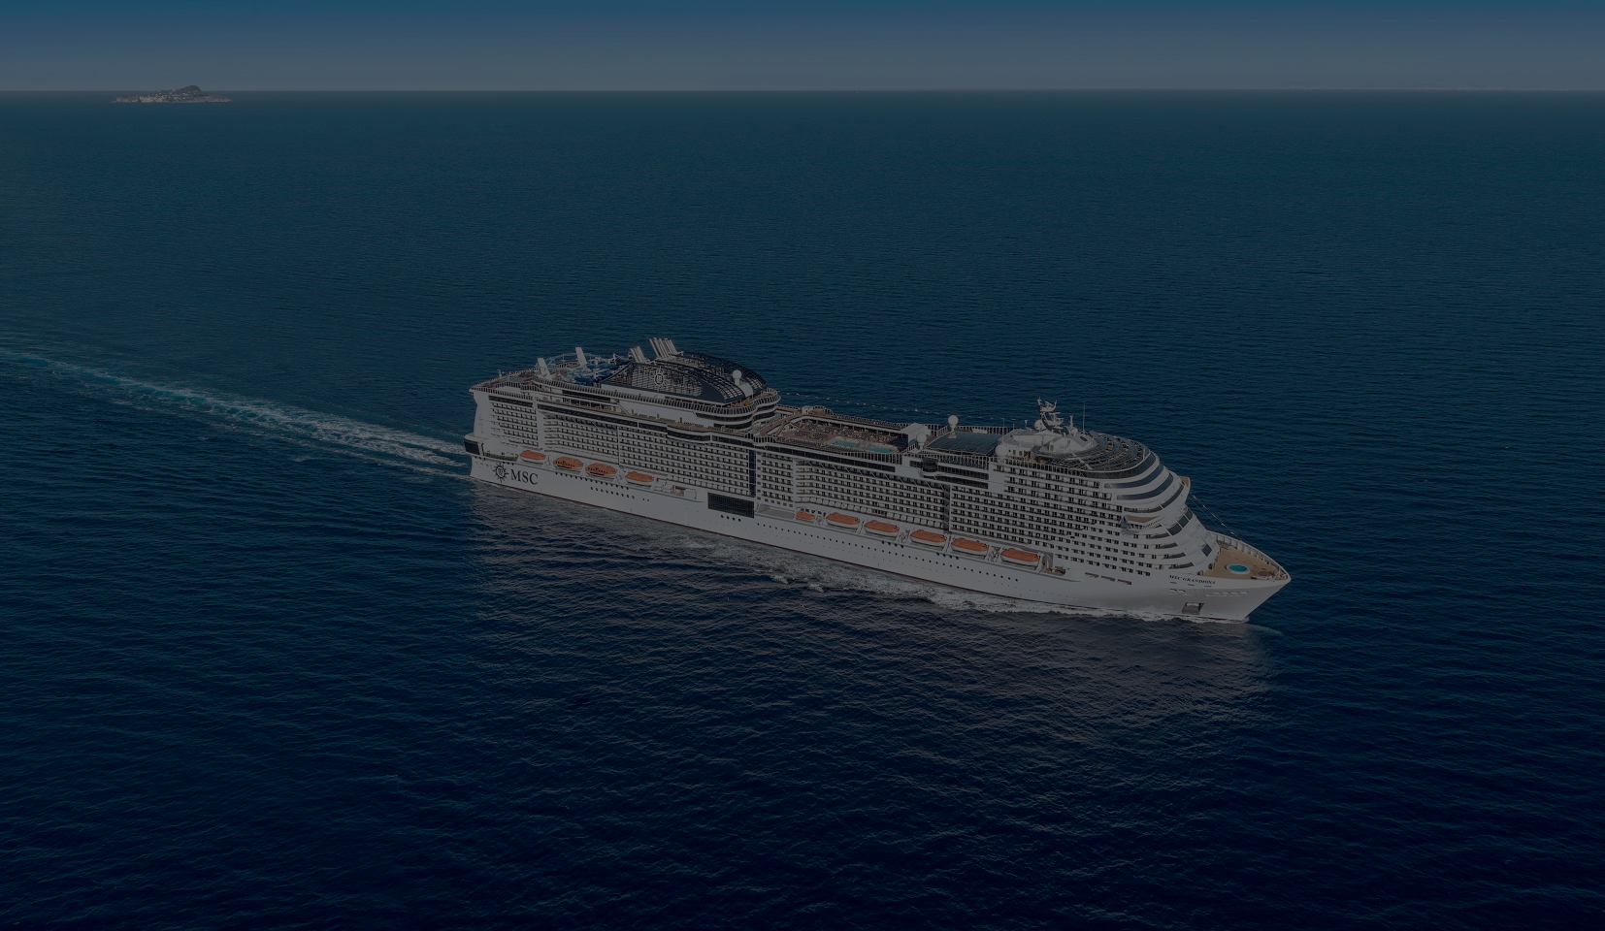
The Future of the Guest Experience
The Future of the Guest Experience is a forward-looking report ,which investigates how the world will have changed by 2030, and the impact of this on future guests, resulting in a number of proof-points that can help travel companies such as us ensure that we satisfy these future guests.
The objective of the report is to position us as a thought-leader and innovator within the travel industry.
It has been created in partnership with trend forecasting experts, The Future Laboratory, one of the world’s leading futures consultancies.
MSC Cruises Executives including Mr Vago and Mr Onorato were interviewed for their insights into the subjects discussed, and then used their comprehensive knowledge to predict the trends of 2030.

Slide 3
How can I use the report?
MEDIA
- The report should be launched to media as a news story sharing the full report and supporting assets
On-going media relations outreach, sharing trends and insights when appropriate
EVENTS
Slides are provided for you to leverage the findings at events. These can be used for media events or trade events
A briefing can be provided to your Country Manager or Sales Team
TRAVEL AGENTS
The report can be sent to Travel Agents if desired and relevant
SOCIAL MEDIA
- Please connect with Chiara Cutolo as to how you can leverage the report through social media

Slide 4
What are the supporting assets?
The Full Report
A designed full report will be provided in PDF format.
Imagery from the Report
Supporting images from the report will be provided.
One Pager
A one page overview of the trends in PDF format.
Press Release
An announcement news release outlining some of the key trends and relevant proof points.
Powerpoint Slides
Designed PPT slides will be provided for inclusion in presentations or for use with media briefings.
Key Messages
Key messages/talking points are provided later in this document.

Slide 5
timings
Launch date: xxx
Issue release and report to media
Hold media briefings / in-person meets to present the report
Sustain throughout 2020: continue to use the report and its findings in media materials, interviews, during face-to-face and during events throughout the year

Slide 6

What is the main take-out from the report?
THE FUTURE GUEST EXPERIENCE WILL BE ULTRA-HIGH DEFINITION
The report predicts that the public's constant search for new and more personal experiences combined with technological advancements, will lead to each of these areas being elevated to an ultra-high definition (UHD) experience by 2030.

Slide 7
KEY MESSAGES
Created in partnership with Future Laboratory, MSC Cruises has commissioned The Future of the Guest Experience. A forward-looking report which examines how guest expectations of a holiday experience will change over the next decade. The report showcases how MSC Cruises is already applying many of these insights into the design and development of its current ships and guest experience.
MSC Cruises’ investment plan is built around innovation to ensure that the Company is able to deliver the ultimate guest experience today and in the future.
A privately-owned company with an entrepreneurial spirit, MSC Cruises has the unique ability to invest in the design and construction of some of the most innovate ships in the industry.
Big data will help transform, personalise and tailor the guest experience of the future.
MSC Grandiosa and MSC bellissima offer the world’s first virtual personal cruise assistant
ZOE speaks seven different languages and is voice activated Artificial Intelegence
Technology such as ZOE will pave the way for Smart Cabins of the future that respond to a guest’s emotions and personal preferences
Despite a hyper-connected world, guests will look for increasing human connections from their holiday experiences.
The anthro-tainment trend will see human-centric entertainment that puts the audience at the heart of the show.
Excentricks, the new Cirque du Soleil at Sea show is based around audience participation and their interaction with the artists – designed to engage with people of ages from all nationalities, regardless of language,
Purpose-driven travel will drive a significant focus on sustainability, social impact and civic engagement.
MSC Cruises is the first cruise line to go carbon neutral across our marine operations and the emphasis that we place on our commitment to the environment is driven not only by our personal passion to protect the oceans but also the need to provide our guests with a sustainable way to travel.
Ocean Cay MSC Marine Reserve in The Bahamas is an example of one of these destinations. Formerly a sand excavation site, MSC Cruises has worked to transform this industrial site into an eco-friendly destination for guests. The island has been developed to create a positive long-term impact both in terms of the environment and the local communities of The Bahamas.

Slide 8
SPOKESPEOPLE FOR MEDIA INTERVIEWS
Below are proposed spokespeople that could be used for media interviews. Top Tier media interviews can be facilitated by phone and the rest via email.
Country Manager
Your country manager should be briefed on the report and its findings to be an advocate for its messages.
Luca Pronzati
Chief Business Innovation Officer
For any elements relating to the future of technology’s involvement of the guest experience
Trevor Young
Vice President, New Builds
For any elements relating to the ship designs of the future
Future Laboratory
For any elements relating to the report itself (TBC)
Can provide background briefings in advance of interviews
Jacques Van Staden
Vice President, Food & Beverage
For any elements relating to the future of the dining experience
Gary Glading
Head of Entertainment
For elements relating to the future entertainment
8

Slide 9
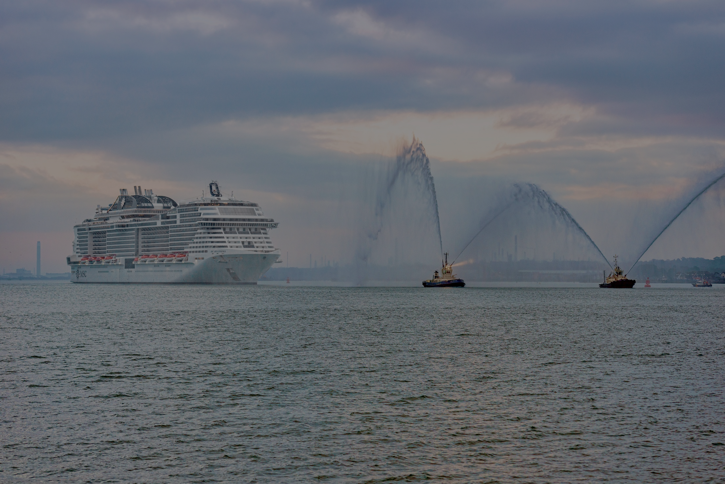
What success looks like
  Coverage in top tier consumer, travel and trade publications as well as newspapers
  Key message inclusion, inc link-backs to how MSC Cruises is leading in many of these areas
  Quotes from MSC Cruises spokespeople and the report in the articles
  Website link to MSC Cruises to find out more

