Slide 1
When we talk about the Holocaust, we often talk about the loss of life.
But this is not the only horror victims had to face – those who did survive often had to face the further trauma of losing their home.

Slide 2
What is ‘home’?
The place where one lives permanently, especially as a member of a family or household. Oxford English Dictionary
Home can be the physical place in which you live, but it can also mean the people you live with.
Home can mean different things to different people, but it is hugely important to all of us, whichever shape it takes.
Words we associate with home:
• Safety • Security
• Peace • Love
• Privacy • Dignity
Think about what ‘home’ means to you.
Can you write a list of other words you associate with ‘home’?

Slide 3
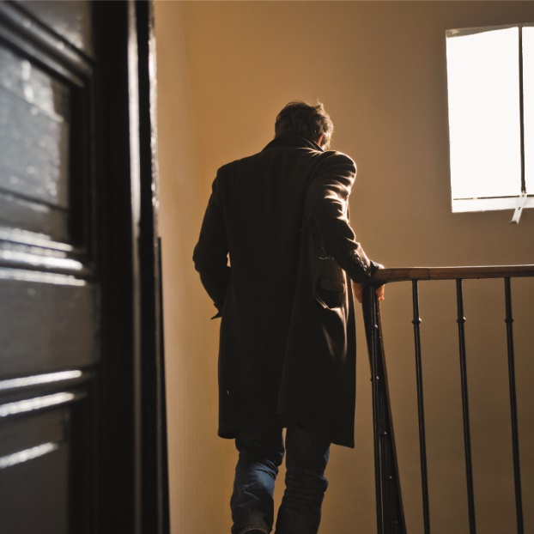
What do people lose when they lose their homes?
Whatever form ‘home’ takes for a person, the loss of it is traumatic and can also be extremely dehumanising.
Loss of ‘home’ means loss of the place where you feel safe and secure. It can also mean the loss of dignity and privacy.
It is impossible for people to understand how hard it is to just leave your home, your parents, and know that you will most likely never see your parents again. Leave everything that was everything to you, just behind, just close the door behind you. Hetty d’Ancona Deleeuwe - hid from Nazi persecution in the Netherlands
Think about how you would feel if someone took your home away from you. What would you lose?

Slide 4
Why would people choose to leave their homes?
My parents decided we had to leave Vienna and that our only chance was to go to France…and very hurriedly we decided to leave everything behind and just pack a couple of suitcases.
Eva Rapaport Edmands – hid from Nazi persecution in France
At the start of Nazi rule in Germany, Jews and other increasingly persecuted groups chose to leave their homes.
Some went to neighbouring countries, others went much further.
Imagine having to leave everything you know, to go to a completely foreign country. What do you think made people choose to leave their homes, before anybody forced them to?
And what challenges do you think they faced in setting up a new home in a foreign country?

Slide 5
Why did the Nazis force Jews out of their homes?
The Nuremberg Laws stripped Jews of their German citizenship in 1935 and, just before the outbreak of WW2, Jews in Nazi Germany were also told that their homes could legally be taken from them.
As the Nazis’ power spread across Europe, Jews across the continent were forced out of their homes and into ghettos.
Think about what ‘home’ means to people.
Why do you think the Nazis did this?

Slide 6
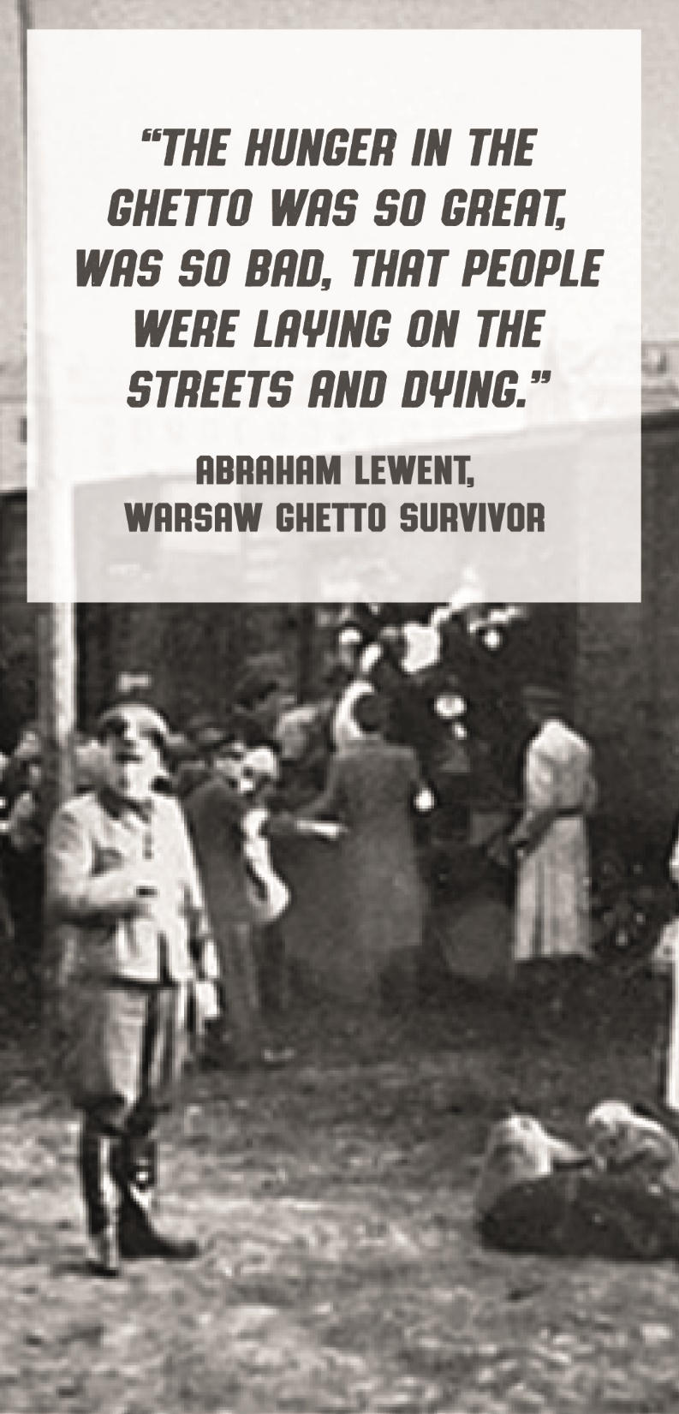
What was life like in the ghettos?
The ghettos were overcrowded, dirty and unsanitary but Jews had to move into them, or they could be killed.
The Warsaw Ghetto was the largest in Nazi-occupied Europe. 400,000 people were crammed into an area of just 1.3 square miles.
That’s 30% of the city’s population forced to live in just 2.4% of the city’s total area.
On average that meant more than 7 people shared each room in the ghetto.
The inhabitants of the ghetto were put on starvation rations of just 10% of those allocated to German citizens.
The lack of sanitation and medical supplies meant that there were regular epidemics of infectious diseases.
76,000 people died of ‘natural causes’ in the Warsaw Ghetto before July 1942.

Slide 7
What was life like in hiding?
They are listening for us…the dog sniffs and sniffs and even sticks its head into our tent…we live through hours of terror.
Otto Wolf, Czech Jewish teenage diarist killed in the Holocaust
To escape persecution during the Holocaust, some Jews went into hiding.
Some were taken into other peoples’ homes where they were hidden. And some stayed in their hiding places for several years.
But could these places be considered home?
Did they provide any of what’s needed to constitute a home?

Slide 8
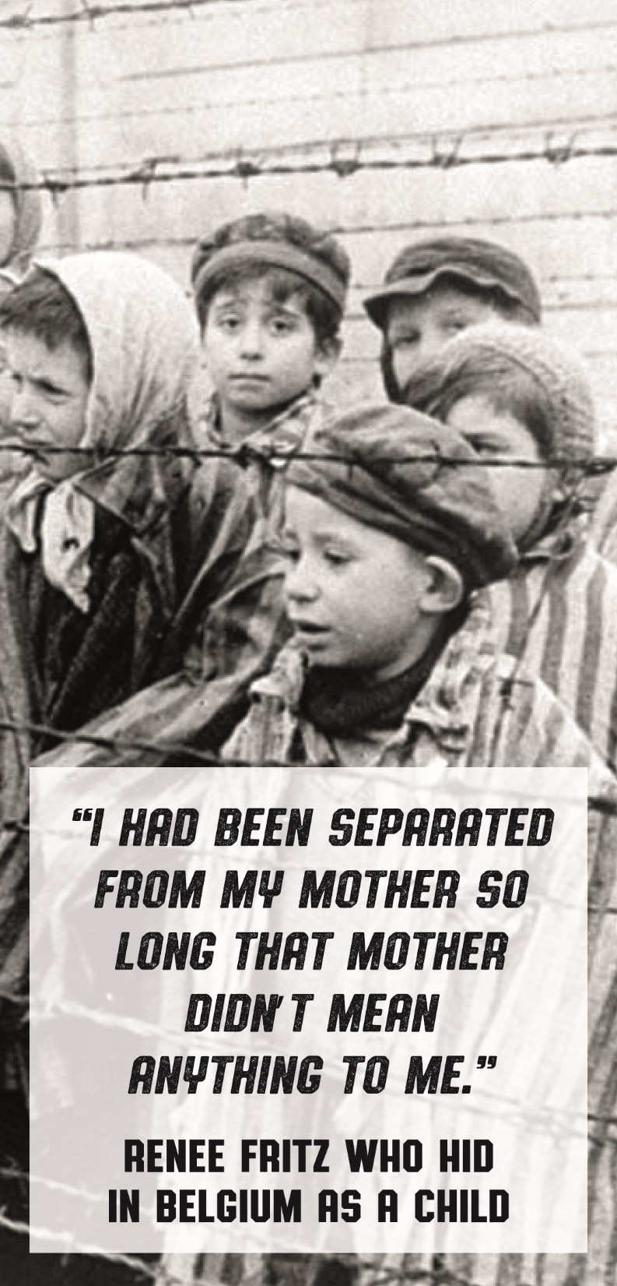
Making a home after the Holocaust
The Second World War ended in 1945, leaving an estimated 11-20 million people displaced across Europe.
The general plan was to repatriate people as quickly as possible – i.e. to get them home.
However, many people who tried to return to their former homes found they’d been looted, sold, given away, or even destroyed.
Even if it was possible to return to their house, many found that their families, the thing that makes a house a home, would not return.
For some children, they’d been away from their families so long that they were unsure of their identity and were unwillingly removed from their foster families.
And some were unable to be repatriated for various reasons, such as borders having changed.
So, many who survived the horrors of the Holocaust then experienced the further trauma of having lost their ‘home’.

Slide 9
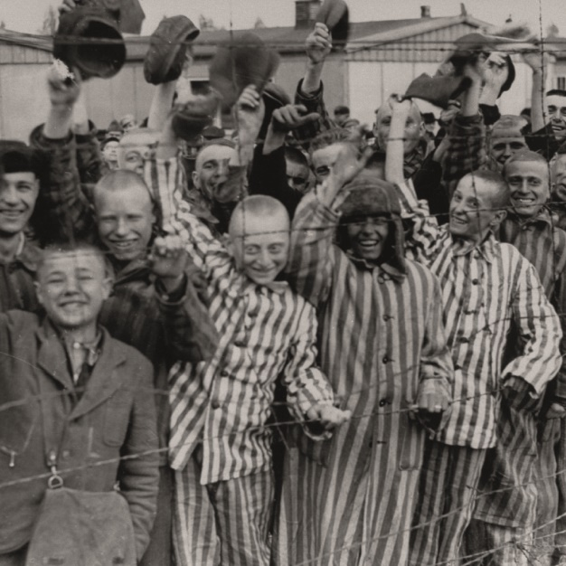
What happened to those who were displaced after WW2?
Camps were set up all over Europe to temporarily house the people displaced by WW2 and the Holocaust.
Many of the displaced people had serious health issues, both physical and mental as a result of their experiences.
The idea that we are really survivors couldn’t sink in yet... For years you lived like a hunted animal. It gets into your psyche.
Leah Hammerstein Silverstein, Jewish Polish Holocaust survivor
For many, their primary objective was to locate loved ones from whom they’d been separated. This meant that many moved regularly from camp to camp. And, eventually, certain ethnic and religious groups tended to congregate in specific camps.

Slide 10
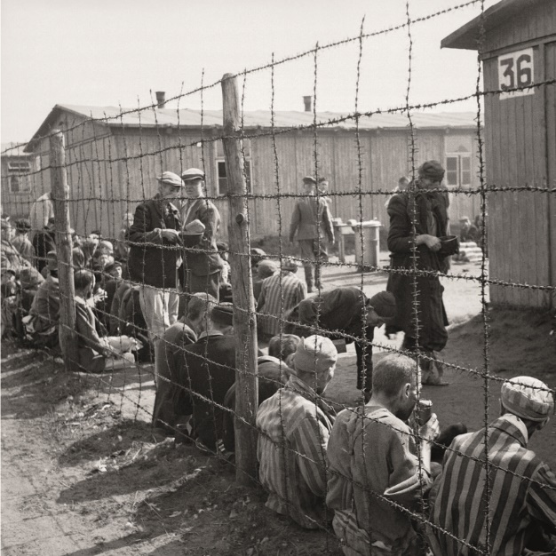
Making a new home
Despite the harsh conditions (strict rations and curfews), some inhabitants did begin to make the camps into some semblance of home, setting up places of worship, newspapers, schools and even universities.
Some were eventually allowed to settle in other European countries, Australia, the US, Canada and some countries in South America.
And around 1,150,000 Jews relocated to the new nation state of Israel between 1948 and 1970.
After the Holocaust I was 14. I had no one. For years. I moved to Israel and met my husband…[now] I have an amazing family. We always had Friday night meals together. I’d say “Everyone at this table is mine. They’re all mine.” Shela Altaraz, Holocaust survivor

Slide 11
Can you think of any other examples where people have been torn from home since the end of WW2?
Can you think of any situations currently around the world where people are being torn from their homes?
halsbury.com/school-travel-resources

