Slide 1
[School Name]
*you can replace this image with the image on your quote*
[Trip Destination], [date]

Slide 2
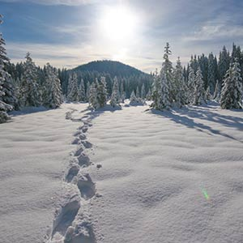
What are we here to talk about?
Where, when and why are we going?
How much and who can go?
What does the resort offer?
Where are we staying?
Who’s our tour operator?
What happens now?
Anything else we should know?
Any questions?

Slide 3
Where, when and why are we going?
Where?
[Destination]
When?
[Dates, departure and return times?]
Why?
[Aim of the tour]

Slide 4
How much and who can go?
How much?
Who can go?
£…
This includes:
Return transportation by air/coach
… nights’ full-board/half-board/room only accommodation
Travel insurance
Ski lift pass
Ski lessons
Après-ski activities
Group passport?
Itinerary planning service
Ski equipment (skis, poles, helmet)
E.g. ‘This trip is open to all Year 10 students.’

Slide 5
What does the resort offer?
Resort Name
More information on the resort
Use the info on your quote and destination guide.

Slide 6
What does the resort offer?
e.g. Prato Nevoso
Take a school ski trip to Prato Nevoso/Artesina to find out why it’s so popular with our school groups. One of the quieter resorts that we offer, Prato Nevoso/Artesina offers a warm, welcoming atmosphere and friendly ski school.
As a smaller, friendlier area it feels really safe and quiet – somewhere you’ll really feel comfortable taking a group of students to. And, despite its smaller size, the various villages in the area offer a great choice of après-ski activities to keep students entertained in the evenings.
Prato Nevoso/Artesina’s friendly ski school, extensive ski area and ability to offer doorstep skiing all make the resort ideal for school ski groups.

Slide 7
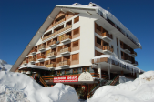
Where are we staying?
Provide details on your accommodation
Use the text and images from your quote and destination guide or create your own description

Slide 8
Where are we staying?
e.g. Hotel Marguareis
The 3* Hotel Marguareis provides comfortable and secure accommodation directly on the main piste.
It is modern with many areas refurbished in the last couple of years.
Bedrooms are very comfortable and the dining room is done in a traditional Italian style. There is also a gym and steam room available to use at the end of a hard day!
There is a bar overlooking the slopes and a pleasant sunny terrace, as well as plenty of spacious communal areas, one of which can be converted to host a disco or mini-cinema room and has table tennis and table football.

Slide 9
Where are we staying?
e.g. Hotel Marguareis
Location
The convenient location of this hotel really can not be beaten. The nursery slopes and lifts are within metres of the front door with the ski school and ski hire located right next to the hotel.
This allows for door to door skiing, easy access at lunchtime to return for a hot lunch and the ski room is easily accessed at the end of the day which means that skis almost never need to be carried. Additional apres ski activities are nearby in Prato Nevoso (15 minutes away by coach)

Slide 10
Who’s our tour operator?
Over 30 years of experience
Halsbury Ski is the specialist school ski division of Halsbury Travel. Halsbury Travel has been arranging school trips abroad for more than 30 years. The company was founded in 1986 by former teacher Keith Sharkey.
Keith’s passionate belief in the educational value of school trips is what drove the creation of Halsbury Travel. He wanted to make the process easier for teachers, so that more young people would have the opportunity to experience learning outside the classroom.
Financially protected
You’re financially protected by Halsbury’s ABTA bond and all the company’s flight packages are ATOL protected too.

Slide 11
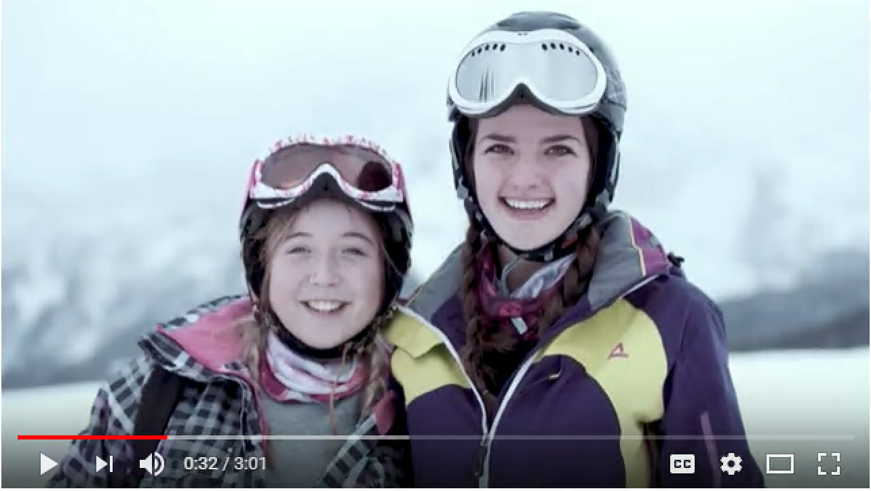
Who’s our tour operator?

Slide 12
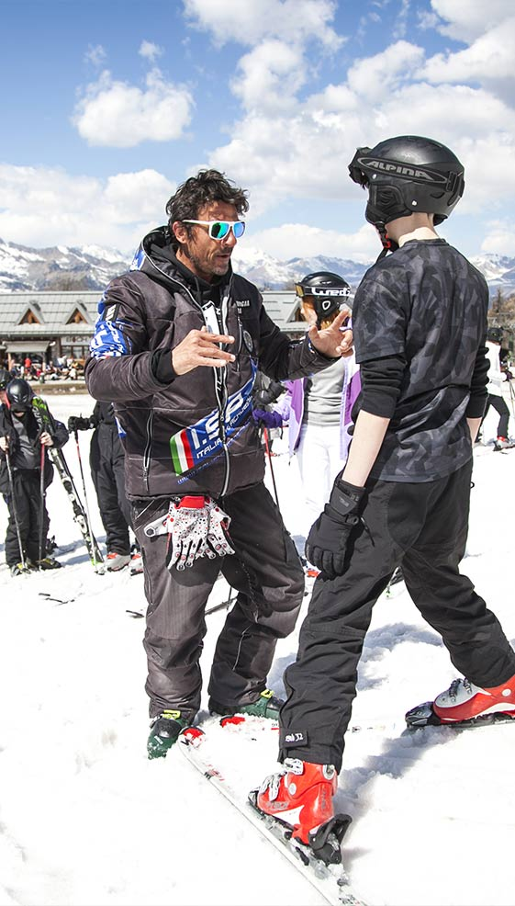
Who’s our tour operator?
Committed to prioritising health and safety
Halsbury is also an Assured Member of the School Travel Forum, which demonstrates its commitment to prioritising the health and safety of its groups.
And it’s been awarded the Learning Outside the Classroom Quality Badge, which demonstrates its commitment to offering activities that are safe and beneficial to learning.

Slide 13
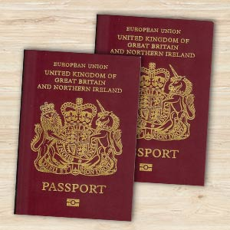
Anything else we should know?
Relevant info on passport validity, visas etc.
Info on EHIC – free via the NHS website
Inform them that they will need to make you aware of any medical conditions/special dietary requirements that their child has as soon as possible
How much spending money should my child bring and in what currency?
Info on ski hire – what measurements you’ll need

Slide 14
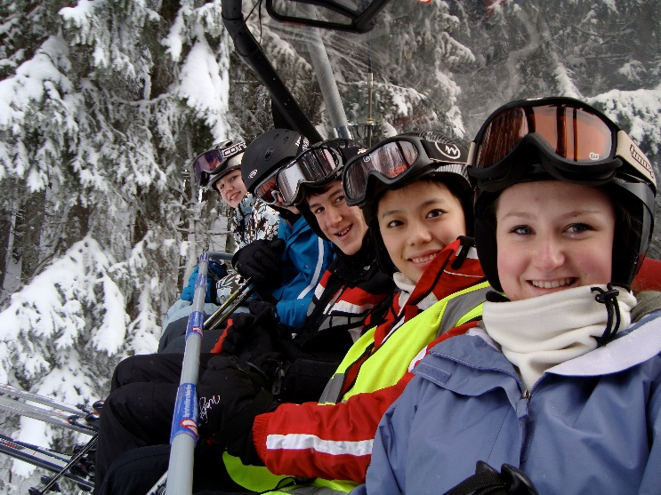
Anything else we should know?
What ski clothing/equipment will I need to provide my child with?
Thermal Top
Thermal Underwear
Tube Socks
Fleece
Salopettes
Ski Jacket
Waterproof Gloves
Scarf or buff
Woolly Hat
Goggles

Slide 15
Anything else we should know?

Slide 16
Anything else we should know?
If you’re looking to save some money and help the environment, check out whoski.com.
Peer-to-peer marketplace specialising in preloved ski clothing.
Donate 25% of their commission to teenage mental health charity stem4
Resell the clothes on whoski.com when your children grow out of them

Slide 17
What happens now?
To secure your child’s place on the trip, please return the signed permission slip with the initial deposit payment of £… by ….
The balance of £… must be paid by …
Please make sure that your child’s passport and visa (if applicable) meet all requirements. If in any doubt at all, please contact us as soon as possible.

Slide 18
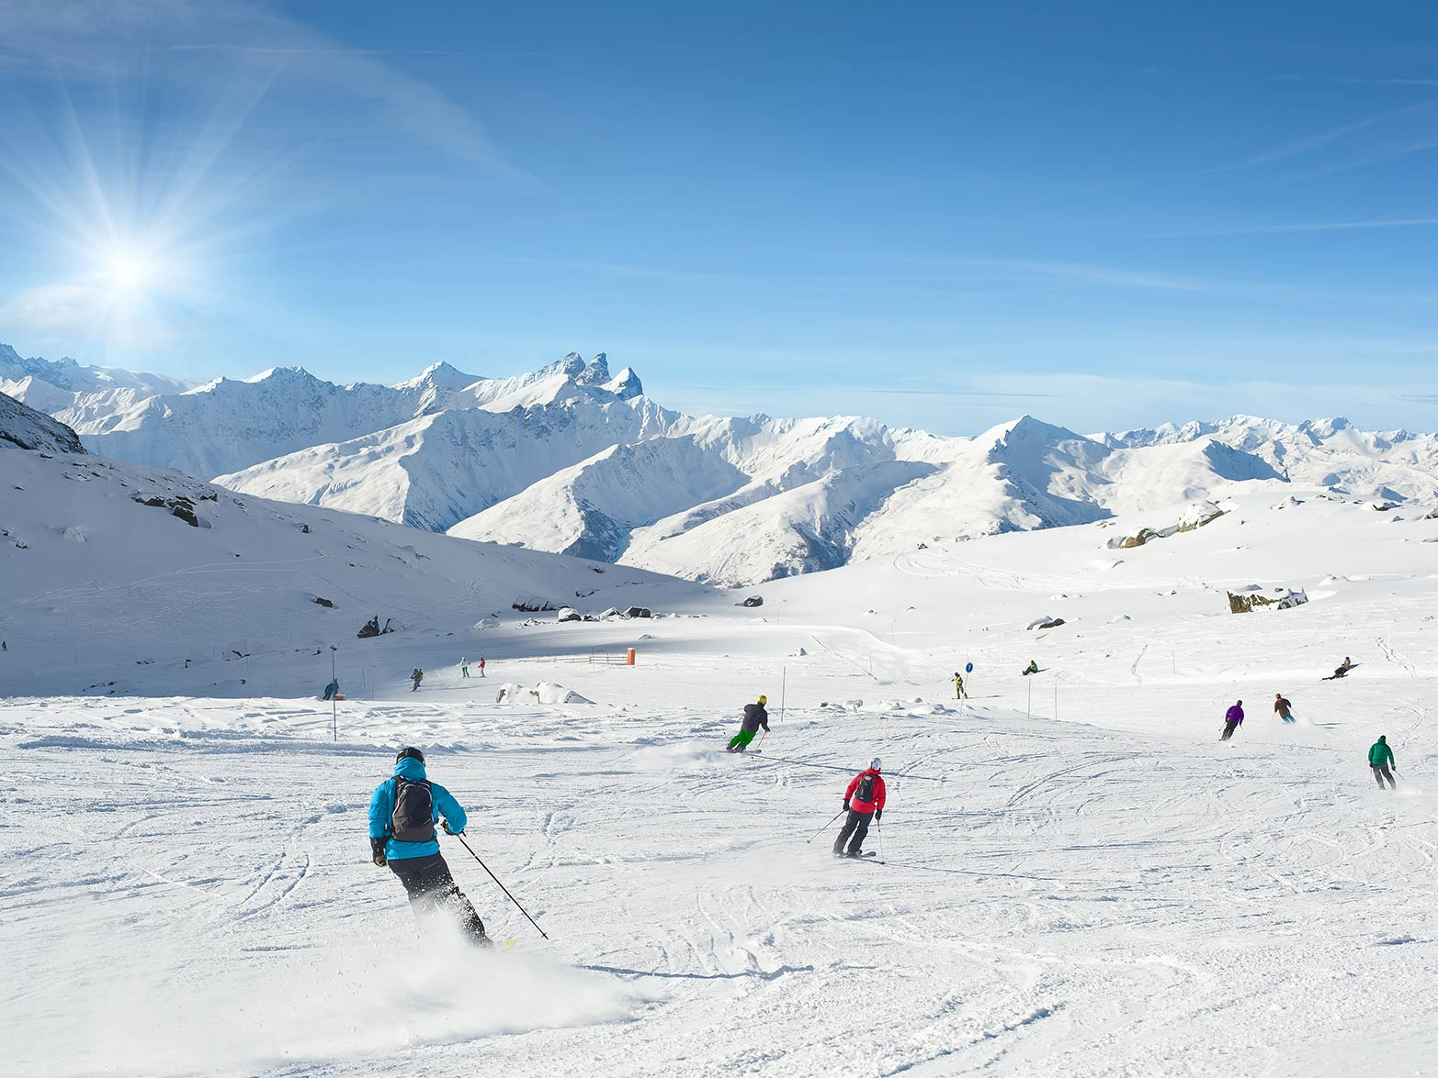
Any Questions?
*Invite parents to ask questions. If you’re not sure of the answer, please feel free to contact us. Of course, we can also attend parents’ evenings to support you, please let us know in advance if you require this.*

