Slide 1
[School Name]
*you can replace this image with the image on your quote*
*you can replace this image with the image on your quote*
[Trip Destination], [date]

Slide 2
What are we here to talk about?
Where, when and why are we going?
How much and who can go?
What are we going to see and where are we going to perform?
Where are we staying?
Who’s our tour operator?
What happens now?
Anything else we should know?
Any questions?

Slide 3
Where, when and why are we going?
Where?
[Destination]
When?
[Dates, departure and return times?]
Why?
[Aim of the tour]

Slide 4
How much and who can go?
How much?
Who can go?
£…
This includes:
Return transportation by air/coach
… nights’ full-board/half-board/room only accommodation
Travel insurance
Visits and entrance fees?
Group passport?
Itinerary planning service
E.g. ‘This trip is open to all members of the school choir.’

Slide 5
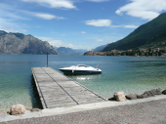
What are we going to see and do?
1 slide per venue/visit
Use the text and images from your quote destination guide or create your own description

Slide 6
What are we going to see and do?
e.g. Boat Trip – Lake Garda
What better way to see Lake Garda than from the lake itself.
Taking a boat cruise from Riva del Garda to Limone or Malcesine is not only a lovely way to spend an hour or so, but can be used instead of using the coach which you pick up later in the day.

Slide 7
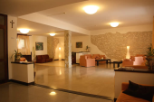
Where are we staying?
Provide details on your accommodation
Use the text and images from your quote and destination guide or create your own description

Slide 8
Where are we staying?
e.g. Hotel San Zeno
Hotel San Zeno is located towards the west of Monte Baldo in a quiet and charming location overlooking Lake Garda.
Students will generally be acccommodated in multibedded rooms, with staff members in twins (or singles if necessary due to male/female split). All rooms come with private bathroom facilities.

Slide 9
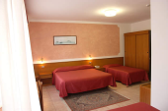
Where are we staying?
e.g. Hotel San Zeno
Location
Well located for visiting Parco Natura Viva

Slide 10
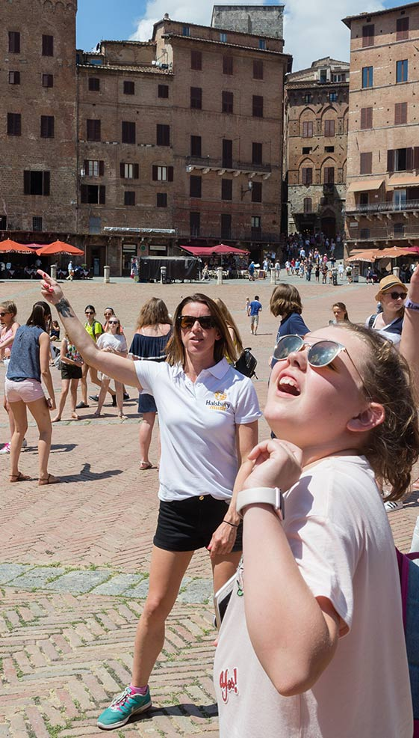
Who’s our tour operator?
Over 35 years of experience
Halsbury Music is the specialist music tour division of Halsbury Travel.
Halsbury Travel has been arranging school trips abroad for more than 35 years. The company was founded in 1986 by a former teacher. He created Halsbury Travel to make the process easier for teachers, so that more young people would have the opportunity to experience learning outside the classroom. And Halsbury still have many former teachers in their staff, helping them to fully understand the needs of school groups.

Slide 11
Financially protected
Halsbury Travel are a Member of ABTA, membership number V2645. They are obliged to maintain a high standard of service to you by ABTA’s Code of Conduct. They can also offer you ABTA’s scheme for the resolution of disputes which is approved by the Chartered Trading Standards Institute. If they can’t resolve your complaint, go to www.abta.com to use ABTA’s simple procedure. Further information on the Code and ABTA’s assistance in resolving disputes can be found on www.abta.com

Slide 12
Financially protected
The Association of Bonded Travel Organisers Trust Limited (ABTOT) provides financial protection under The Package Travel and Linked Travel Arrangements Regulations 2018 for Halsbury Travel (5493), and in the event of their insolvency, protection is provided for:
Non-flight packages
ABTOT cover provides for a refund in the event you have not yet travelled or repatriation if transportation was included in your package. Please note that bookings made outside the UK are only protected by ABTOT when purchased directly with Halsbury Travel.
In the unlikely event that you require assistance whilst abroad due to our financial failure, please call our 24/7 helpline on 01702 811397 and advise you are a customer of an ABTOT protected travel company.
You can access The Package Travel and Linked Travel Arrangements Regulations 2018 here: https://www.legislation.gov.uk/uksi/2018/634/contents/made
You can find out more about ABTOT here: https://www.abtot.com/

Slide 13
Financially protected
ATOL
ATOL stands for Air Travel Organiser’s Licence and is a financial protection scheme that specifically covers air package holidays sold by tour operators and other travel businesses. If a company that holds an ATOL fails, the scheme ensures that minimal disruption is caused to passengers already abroad and those who haven’t travelled yet receive a full refund.

Slide 14
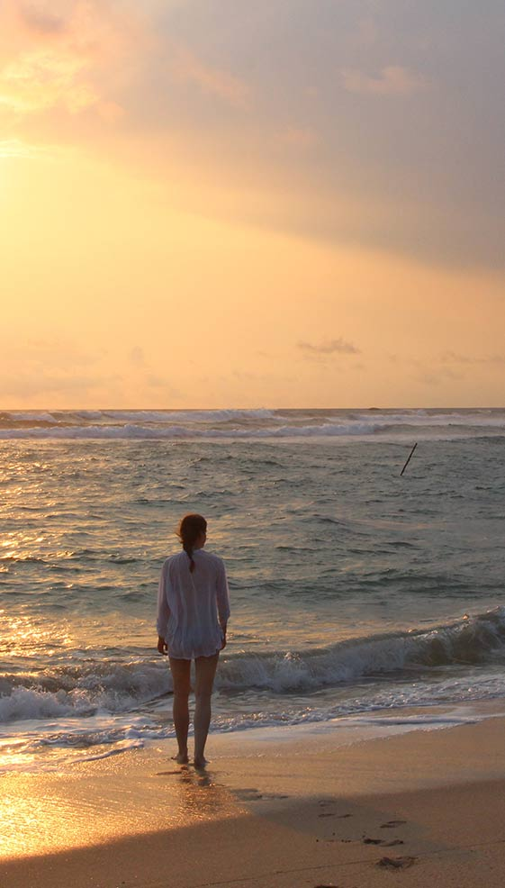
Who’s our tour operator?
Committed to prioritising health and safety
Halsbury is also an Assured Member of the School Travel Forum, which demonstrates the company’s commitment to prioritising the health and safety of its groups.
And Halsbury has been awarded the Learning Outside the Classroom Quality Badge, which demonstrates the company’s commitment to offering activities that are safe and beneficial to learning.

Slide 15
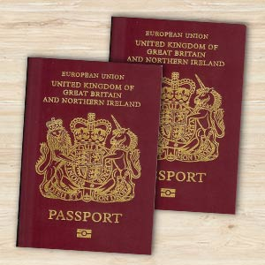
Anything else we should know?
Relevant info on passport validity, visas etc.
Info on EHIC – free via the NHS website
Inform them that they will need to make you aware of any medical conditions/special dietary requirements that their child has as soon as possible
How much spending money should my child bring and in what currency?

Slide 16
Anything else we should know?
What clothing/equipment will I need to provide my child with?
A small backpack
Basic toiletries, i.e. shampoo and soap, toothbrush and toothpaste
Towel (if not provided by accommodation)
Sensible shoes
Raincoat (depending on destination)
Sun lotion (depending on destination)
Spare t-shirt, jumper, socks, underwear, coat
Camera (please note that this will be the student’s responsibility, please read the insurance documents carefully)

Slide 17
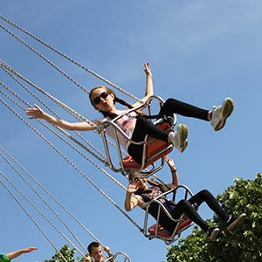
What happens now?
To secure your child’s place on the trip, please return the signed permission slip with the initial deposit payment of £… by ….
The balance of £… must be paid by …
Please make sure that your child’s passport and visa (if applicable) meet all requirements. If in any doubt at all, please contact us as soon as possible.

Slide 18
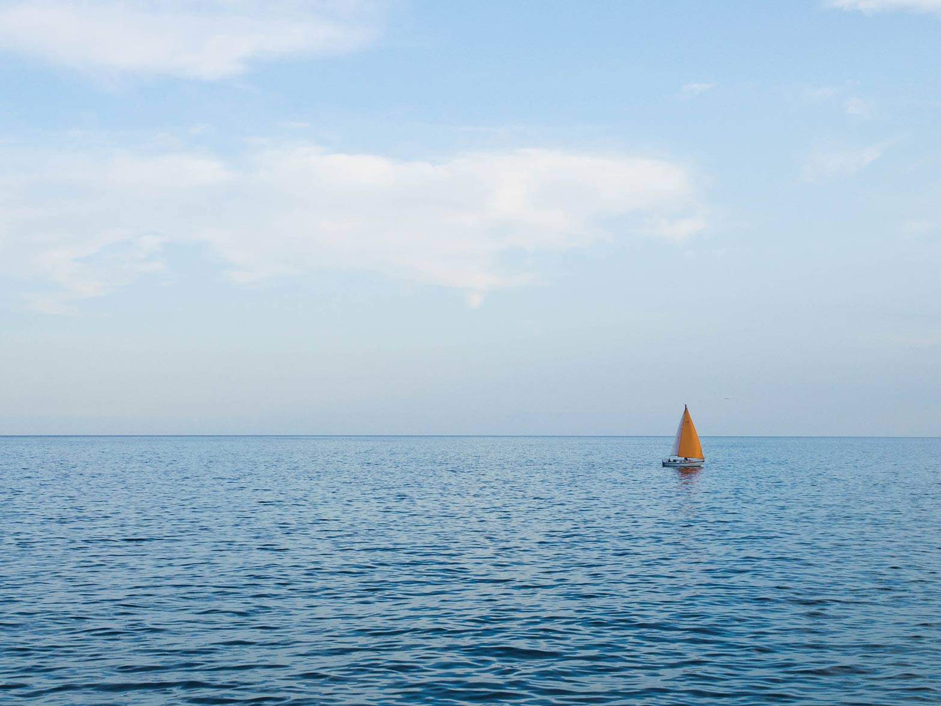
Any Questions?
*Invite parents to ask questions. If you’re not sure of the answer, please feel free to contact us. Of course, we can also attend parents’ evenings to support you, please let us know in advance if you require this.*

