Slide 2
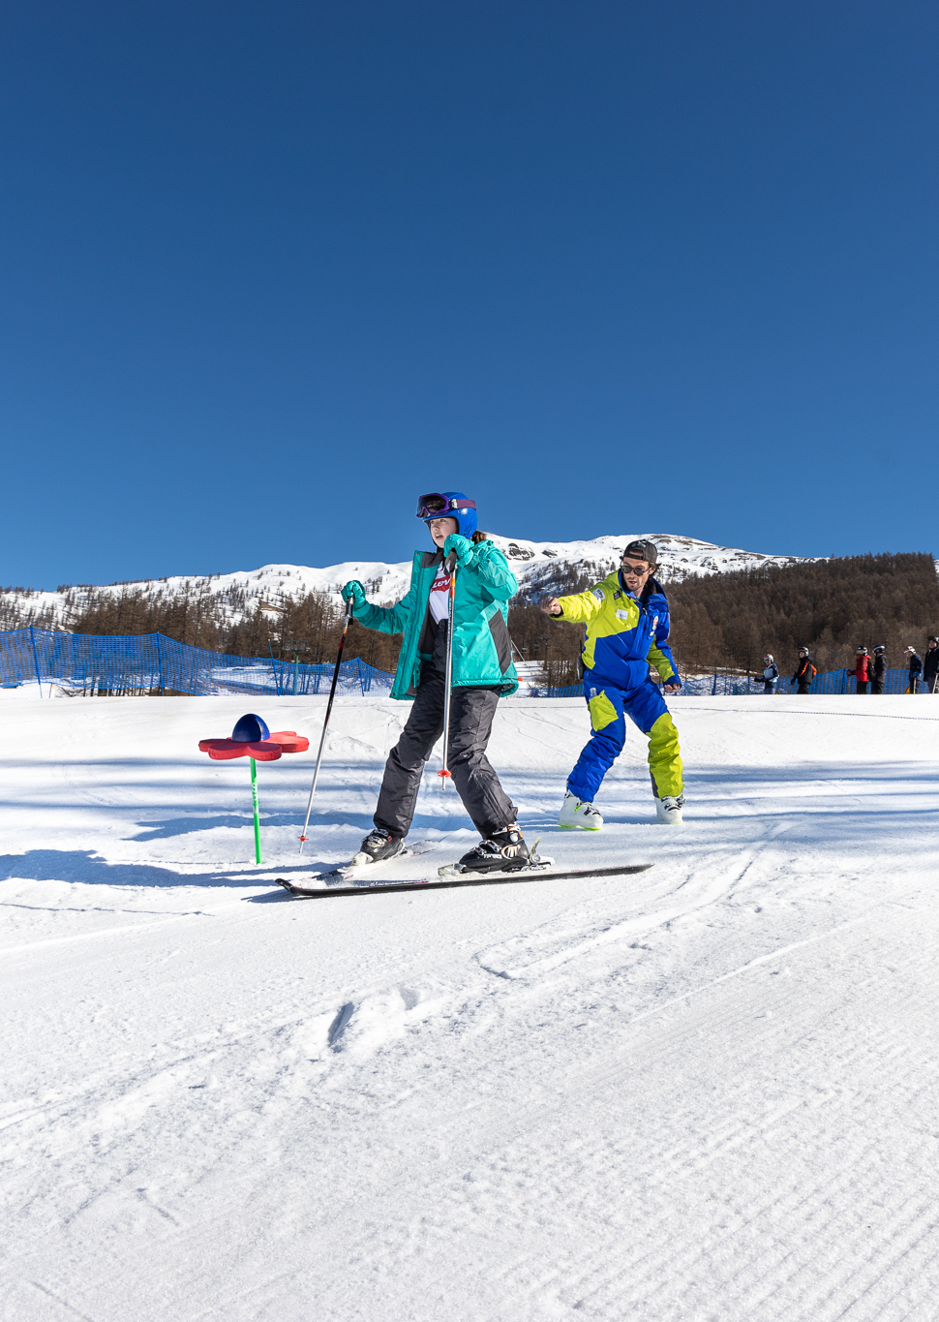
WHAT ARE WE HERE TO TALK ABOUT?
Where, when and why are we going?
What does the resort offer?
Where are we staying?
How much and who can go?
Who’s our tour operator?
Anything else we should know?
What happens now?
Any questions?

Slide 3
WHERE, WHEN AND WHY ARE WE GOING?
Where?
When?
Why?
[Destination]
[Dates, departure and return times]
[Aim of the tour]

Slide 4
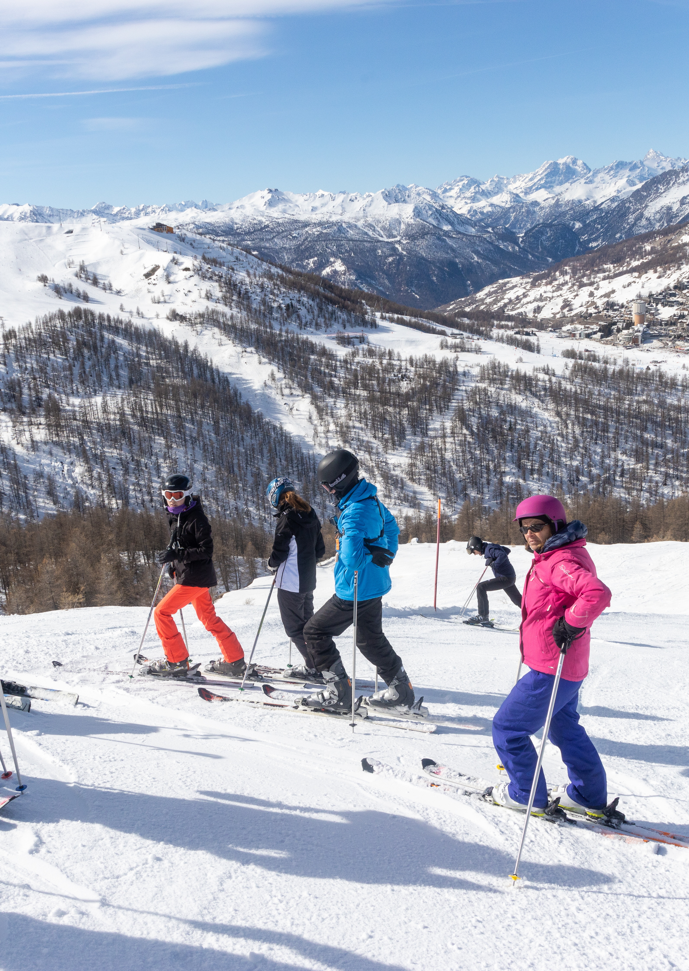
WHAT DOES THE RESORT OFFER?
Resort Name
[Insert resort name here]
Resort Stats
[Use resort stats from your quote – also available on halsbury.com/ski]

Slide 5
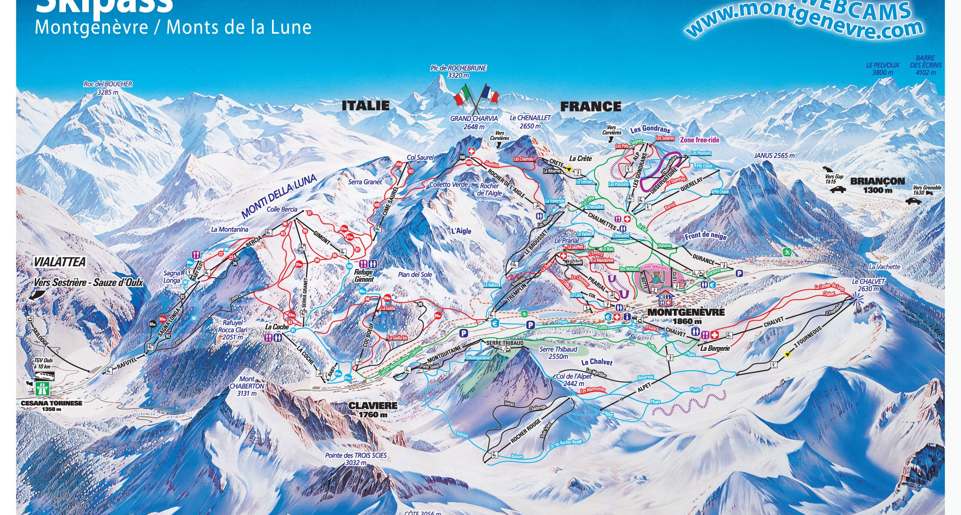
PISTE MAP

Slide 6
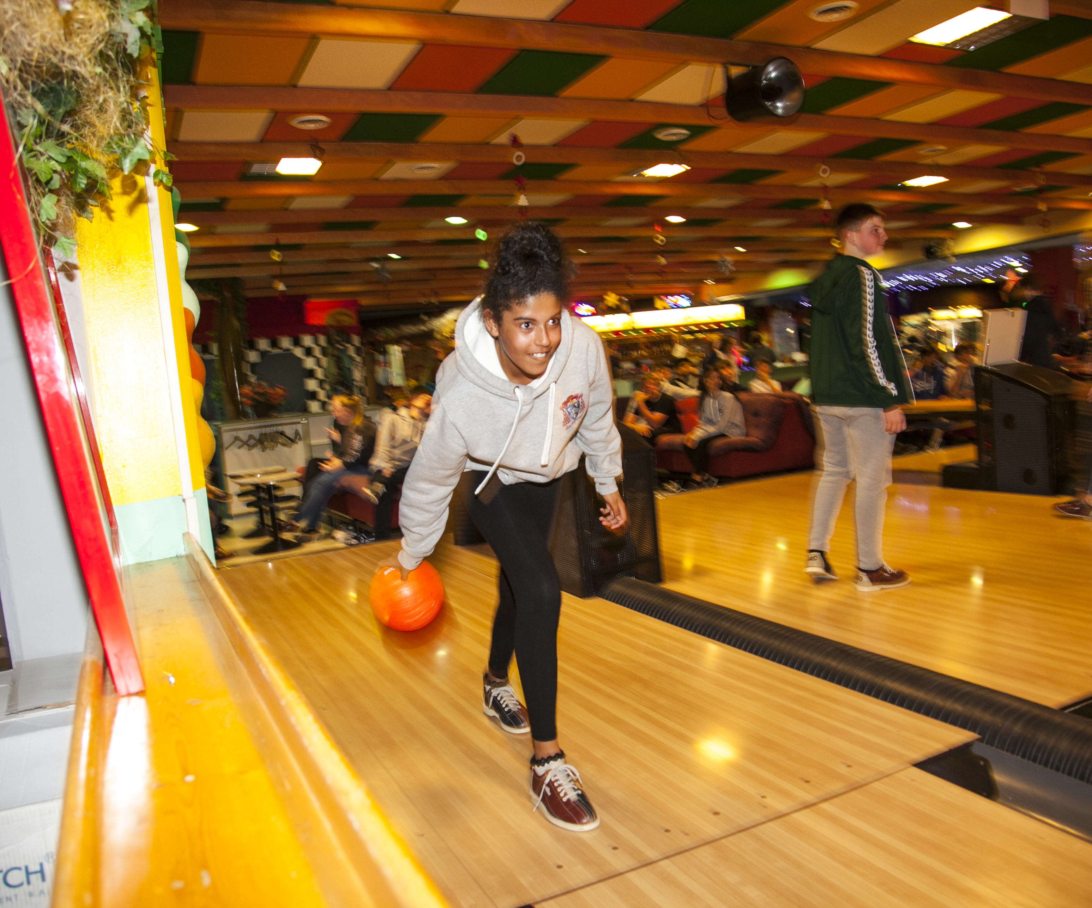
APRÉS SKI
Activity 1
[short description]

Slide 7
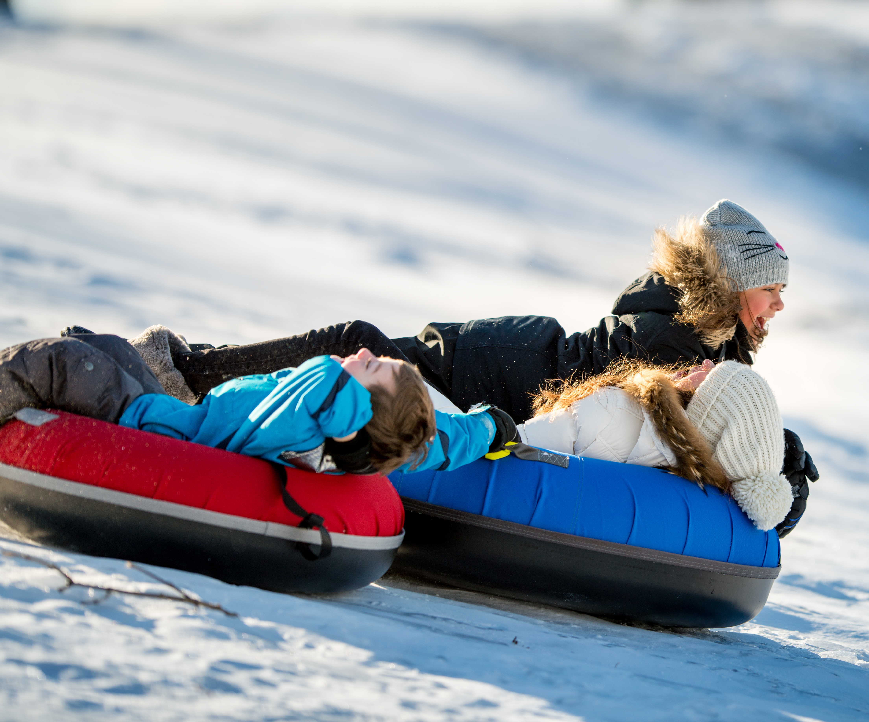
APRÉS SKI
Activity 2
[short description]

Slide 8
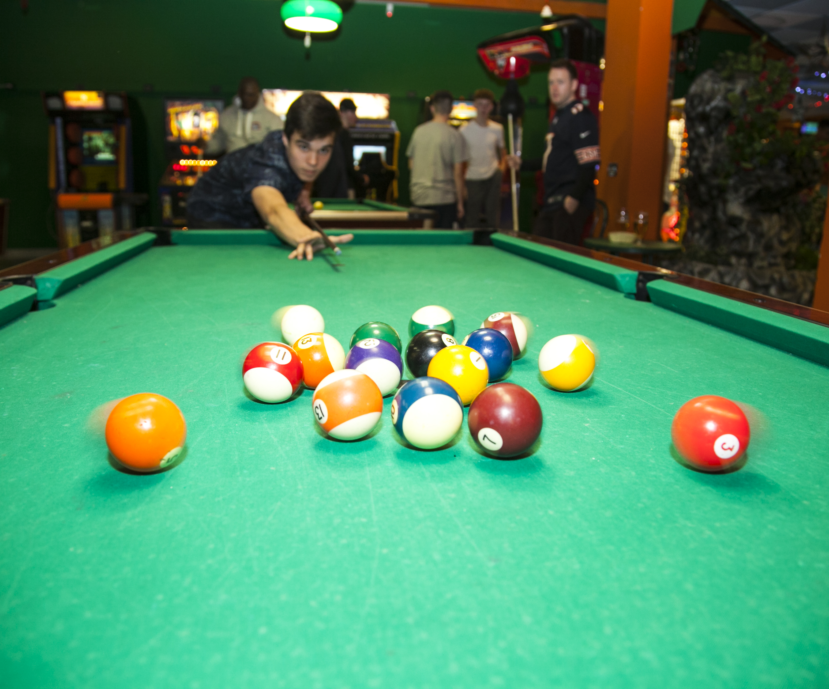
APRÉS SKI
Activity 3
[short description]

Slide 9
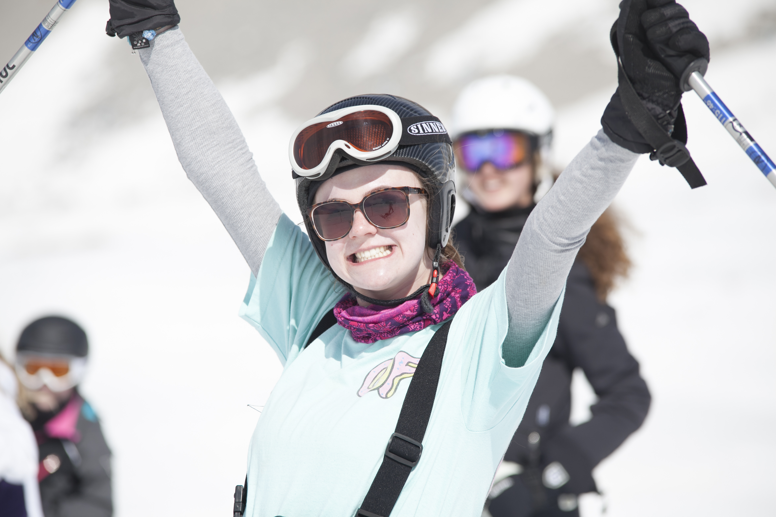






WHERE ARE WE STAYING?
[Insert hotel name here]
This large 3* hotel is located ...
Rooms
[Use the text and images from your quote or create your own description]
Meals
[Use the text and images from your quote or create your own description]
USP [i.e. how far to the slopes/lifts?]
USP [i.e. great facilities like an indoor swimming pool, hot lunches etc.]

Slide 10
WHERE ARE WE STAYING?
[Insert Hotel Name] Facilities
[Facility 1]
[Short description of faciltily e.g. indoor swimming pool and wellness area… ]
[Facility 2]
[Short description of facility e.g. games room with table football and cinema area…]

Slide 11
HOW MUCH AND WHO CAN GO?
How much?
What’s included?
Who can go?
££ per person
Return transport by air/coach
… nights’ full-board/half-board/room only accommodation
Travel insurance
Ski hire?
Après-ski activities?
Itinerary planning service
E.g. ‘This trip is open to all Year 10 students.’

Slide 12
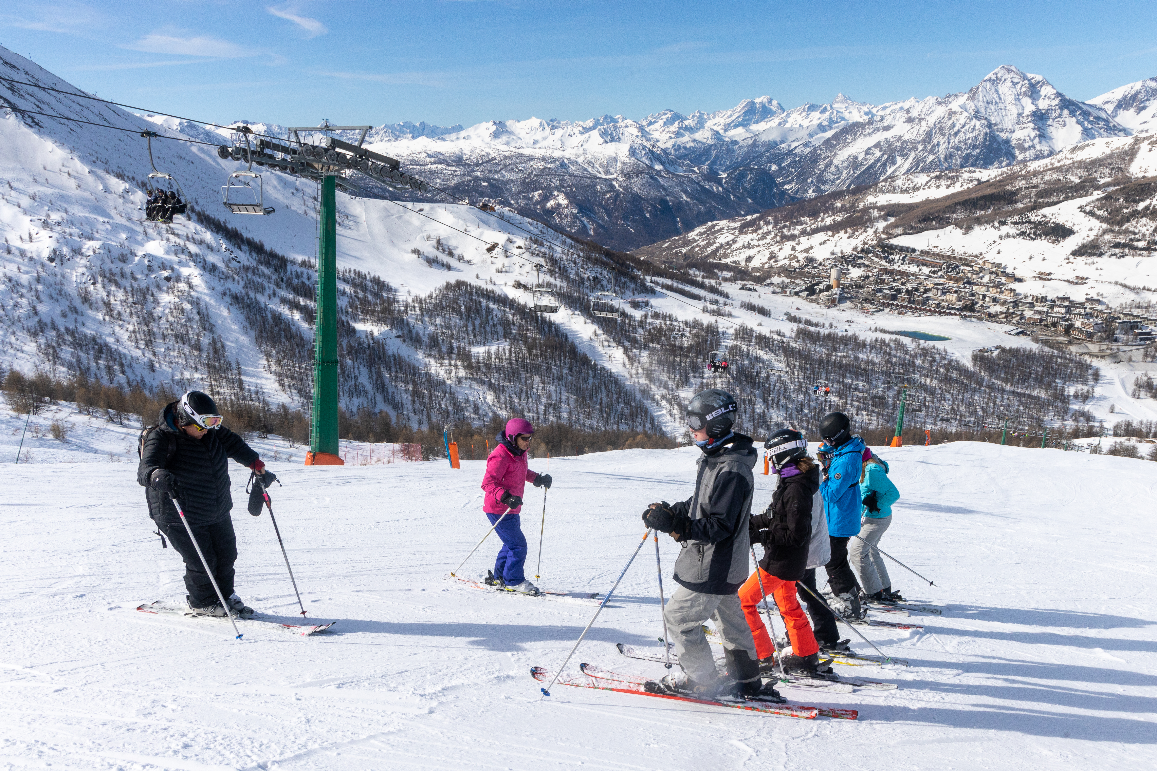
WHO’S OUR TOUR OPERATOR?
Halsbury Travel:
School & group tours specialist since 1986
Over 900 tours per year, carrying over 40,000 passengers
Fully accredited - ABTA, ABTOT, ATOL, STF & LOtC Quality Badge
Effective Safety Management System
Financial protection
Comprehensive travel and medical insurance (if applicable)
24-hour emergency telephone number while we’re abroad

Slide 13

ACCREDITATIONS
School Travel Forum
Halsbury is an Assured Member of the STF, which demonstrates its commitment to prioritising the health and safety of its groups.
Council for Learning Outside the Classroom (CLOtC)
Halsbury has been awarded the Learning Outside the Classroom Quality Badge, which demonstrates its commitment to offering activities that are safe and beneficial to learning.
Association of British Travel Agents (ABTA)
Halsbury’s also a Member of ABTA, which means they’re obliged to maintain a high standard of service to us by ABTA’s Code of Conduct.
Air Travel Organiser’s Licence
ATOL is a financial protection scheme that specifically covers air package holidays. If a company that holds an ATOL (like Halsbury) fails, the scheme ensures minimal disruption is caused to passengers already abroad and those who haven’t travelled yet receive a full refund.
Association of Bonded Travel Organisers Trust (ABTOT)
ABTOT provides financial protection under The Package Travel and Linked Travel Arrangements Regulations 2018 for Halsbury Travel (5493). In the event of their insolvency, protection is provided for non-flight packages.
ABTOT cover provides for a refund if we’ve not yet travelled or repatriation if transportation was included in our package.

Slide 14







HALSBURY REPRESENTATIVE
Local language speaker
Resort knowledge
Emergency liaison
Problem solver
Evening events coordinator
Friendly and approachable
OUR REP MADE OUR TRIP. HE WAS ABSOLUTELY AMAZING!”
King Edward VI Academy, February 2024

Slide 15
ANYTHING ELSE WE SHOULD KNOW?
Relevant info on passport validity, visas etc.
Info on GHIC – free via the NHS website
Inform them that they will need to make you aware of any medical conditions/special dietary requirements that their child has as soon as possible
How much spending money should my child bring and in what currency?
Info on ski hire – what measurements you’ll need

Slide 16
What ski clothing/equipment will I need to provide my child with?
Ski jacket
Thermals/base layers
Tube socks
Fleece
Salopettes
Waterproof gloves
Scarf or buff
Woolly hat
Goggles
Suncream
Snow boots or walking shoes
ANYTHING ELSE WE SHOULD KNOW?

Slide 17
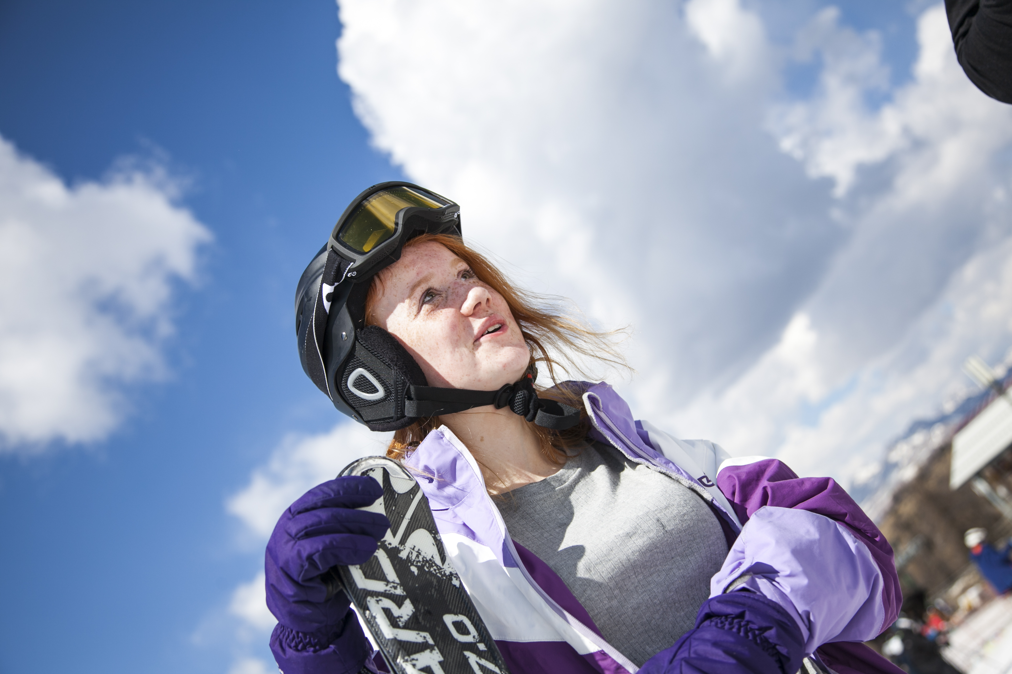
WHAT HAPPENS NOW?
To secure your child’s place on the trip, please return the signed permission slip with the initial deposit payment of £… by ….
The balance of £… must be paid by …
Please make sure that your child’s passport and visa (if applicable) meet all requirements.

Slide 18

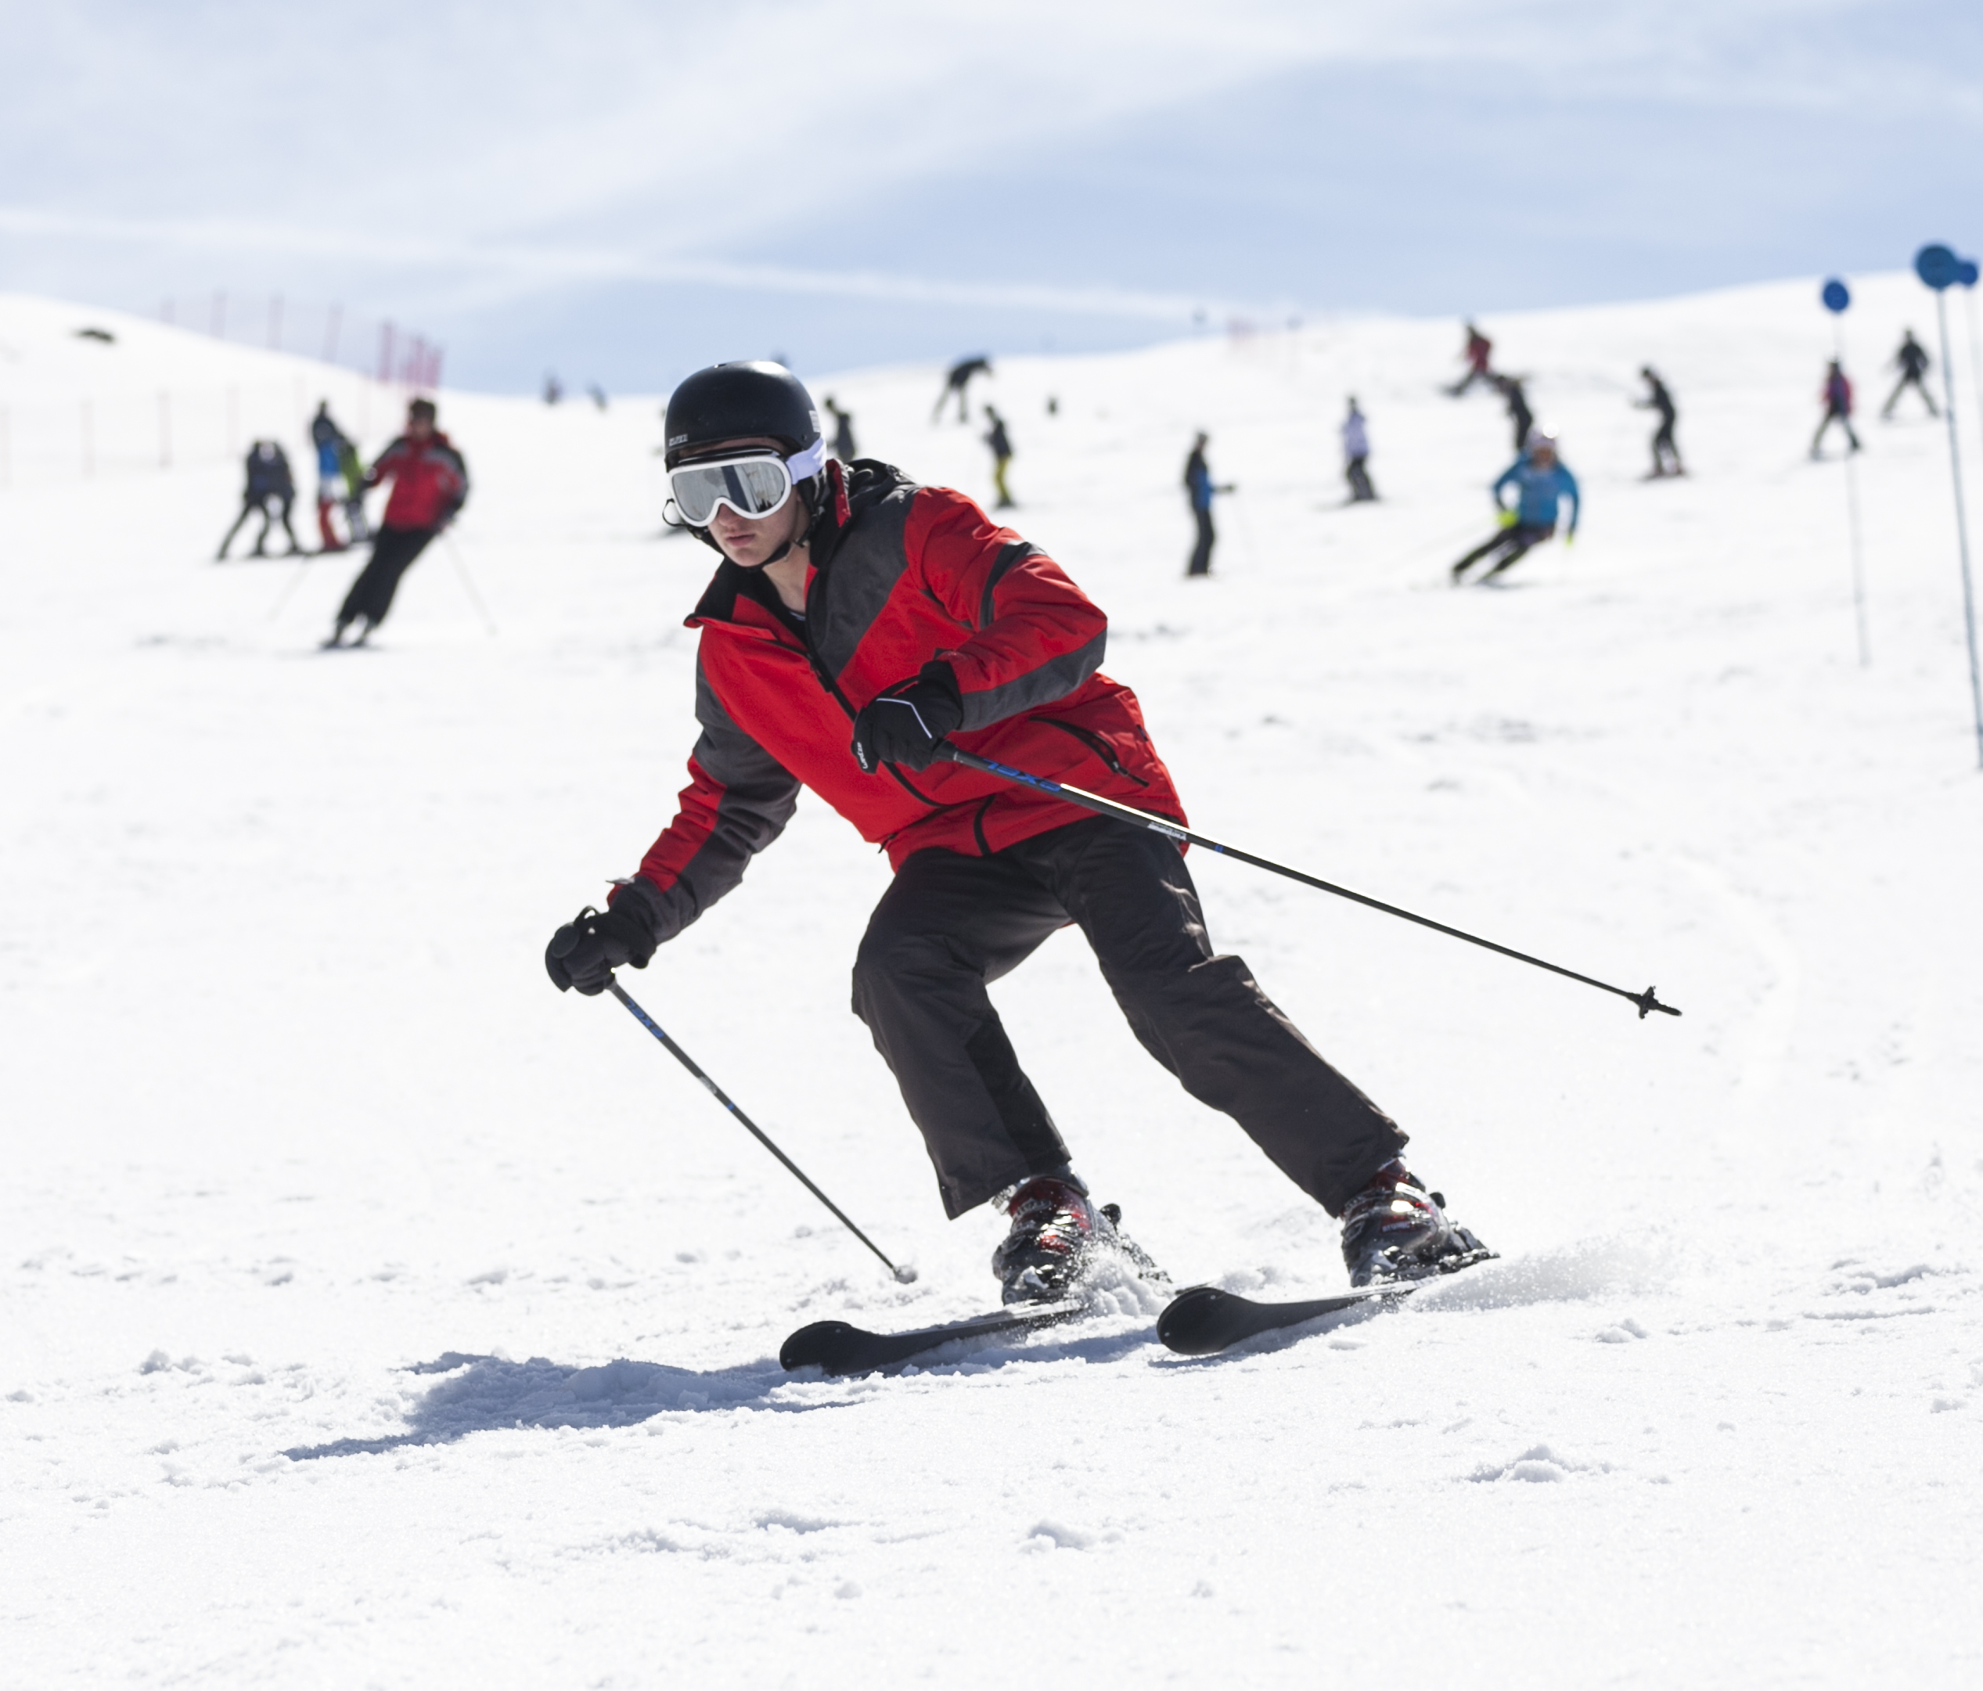
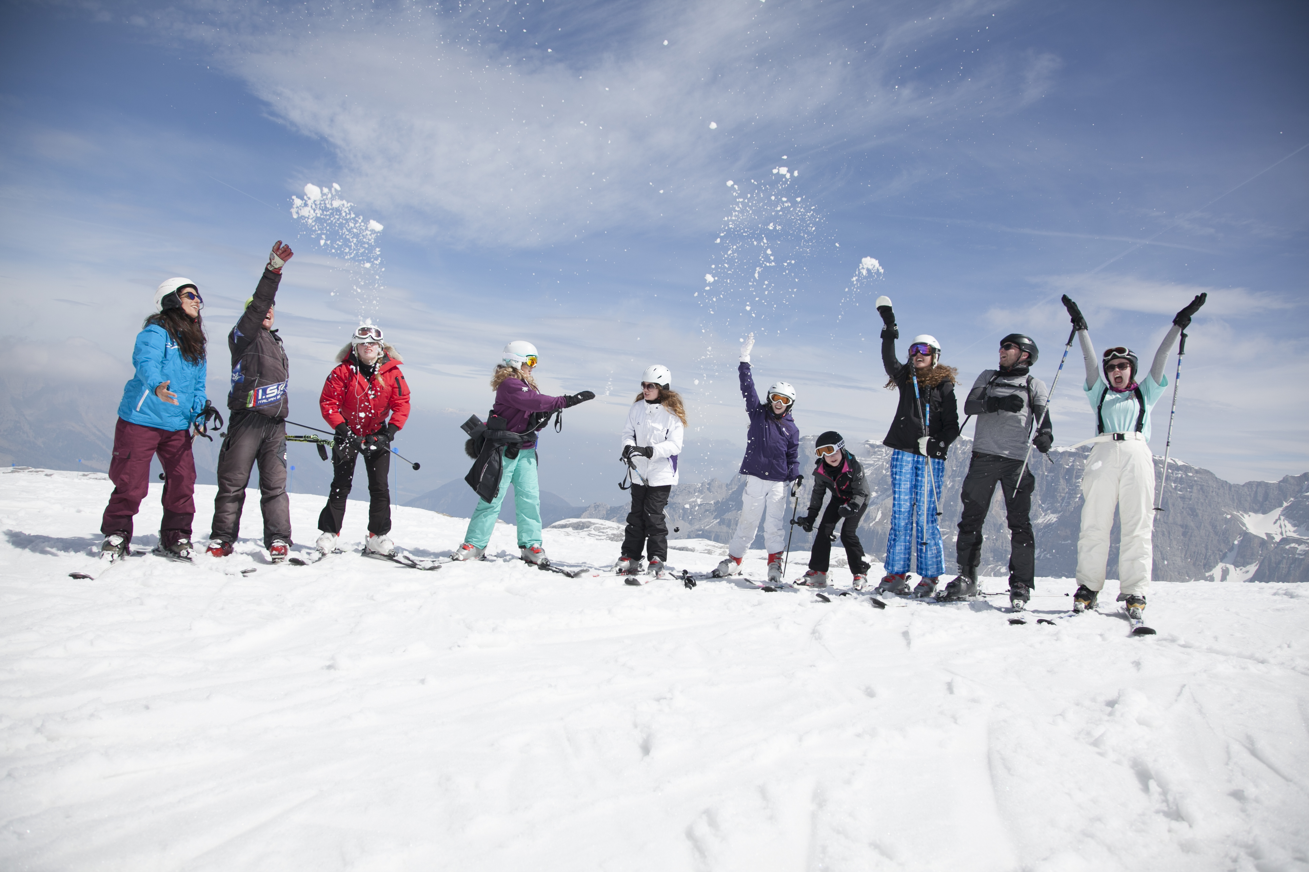
ANY QUESTIONS?

