Slide 1
Insert image here:
Right-click, select ‘Format background’ and choose ‘Picture or texture fill’ from the list on the right.
Under ‘Picture Source’ choose ‘Insert’ to place a picture from your desktop or select ‘Clipboard’ to paste an image in.
To remove the image, select ‘Remove background’ at the bottom of the right-side menu.

Slide 2
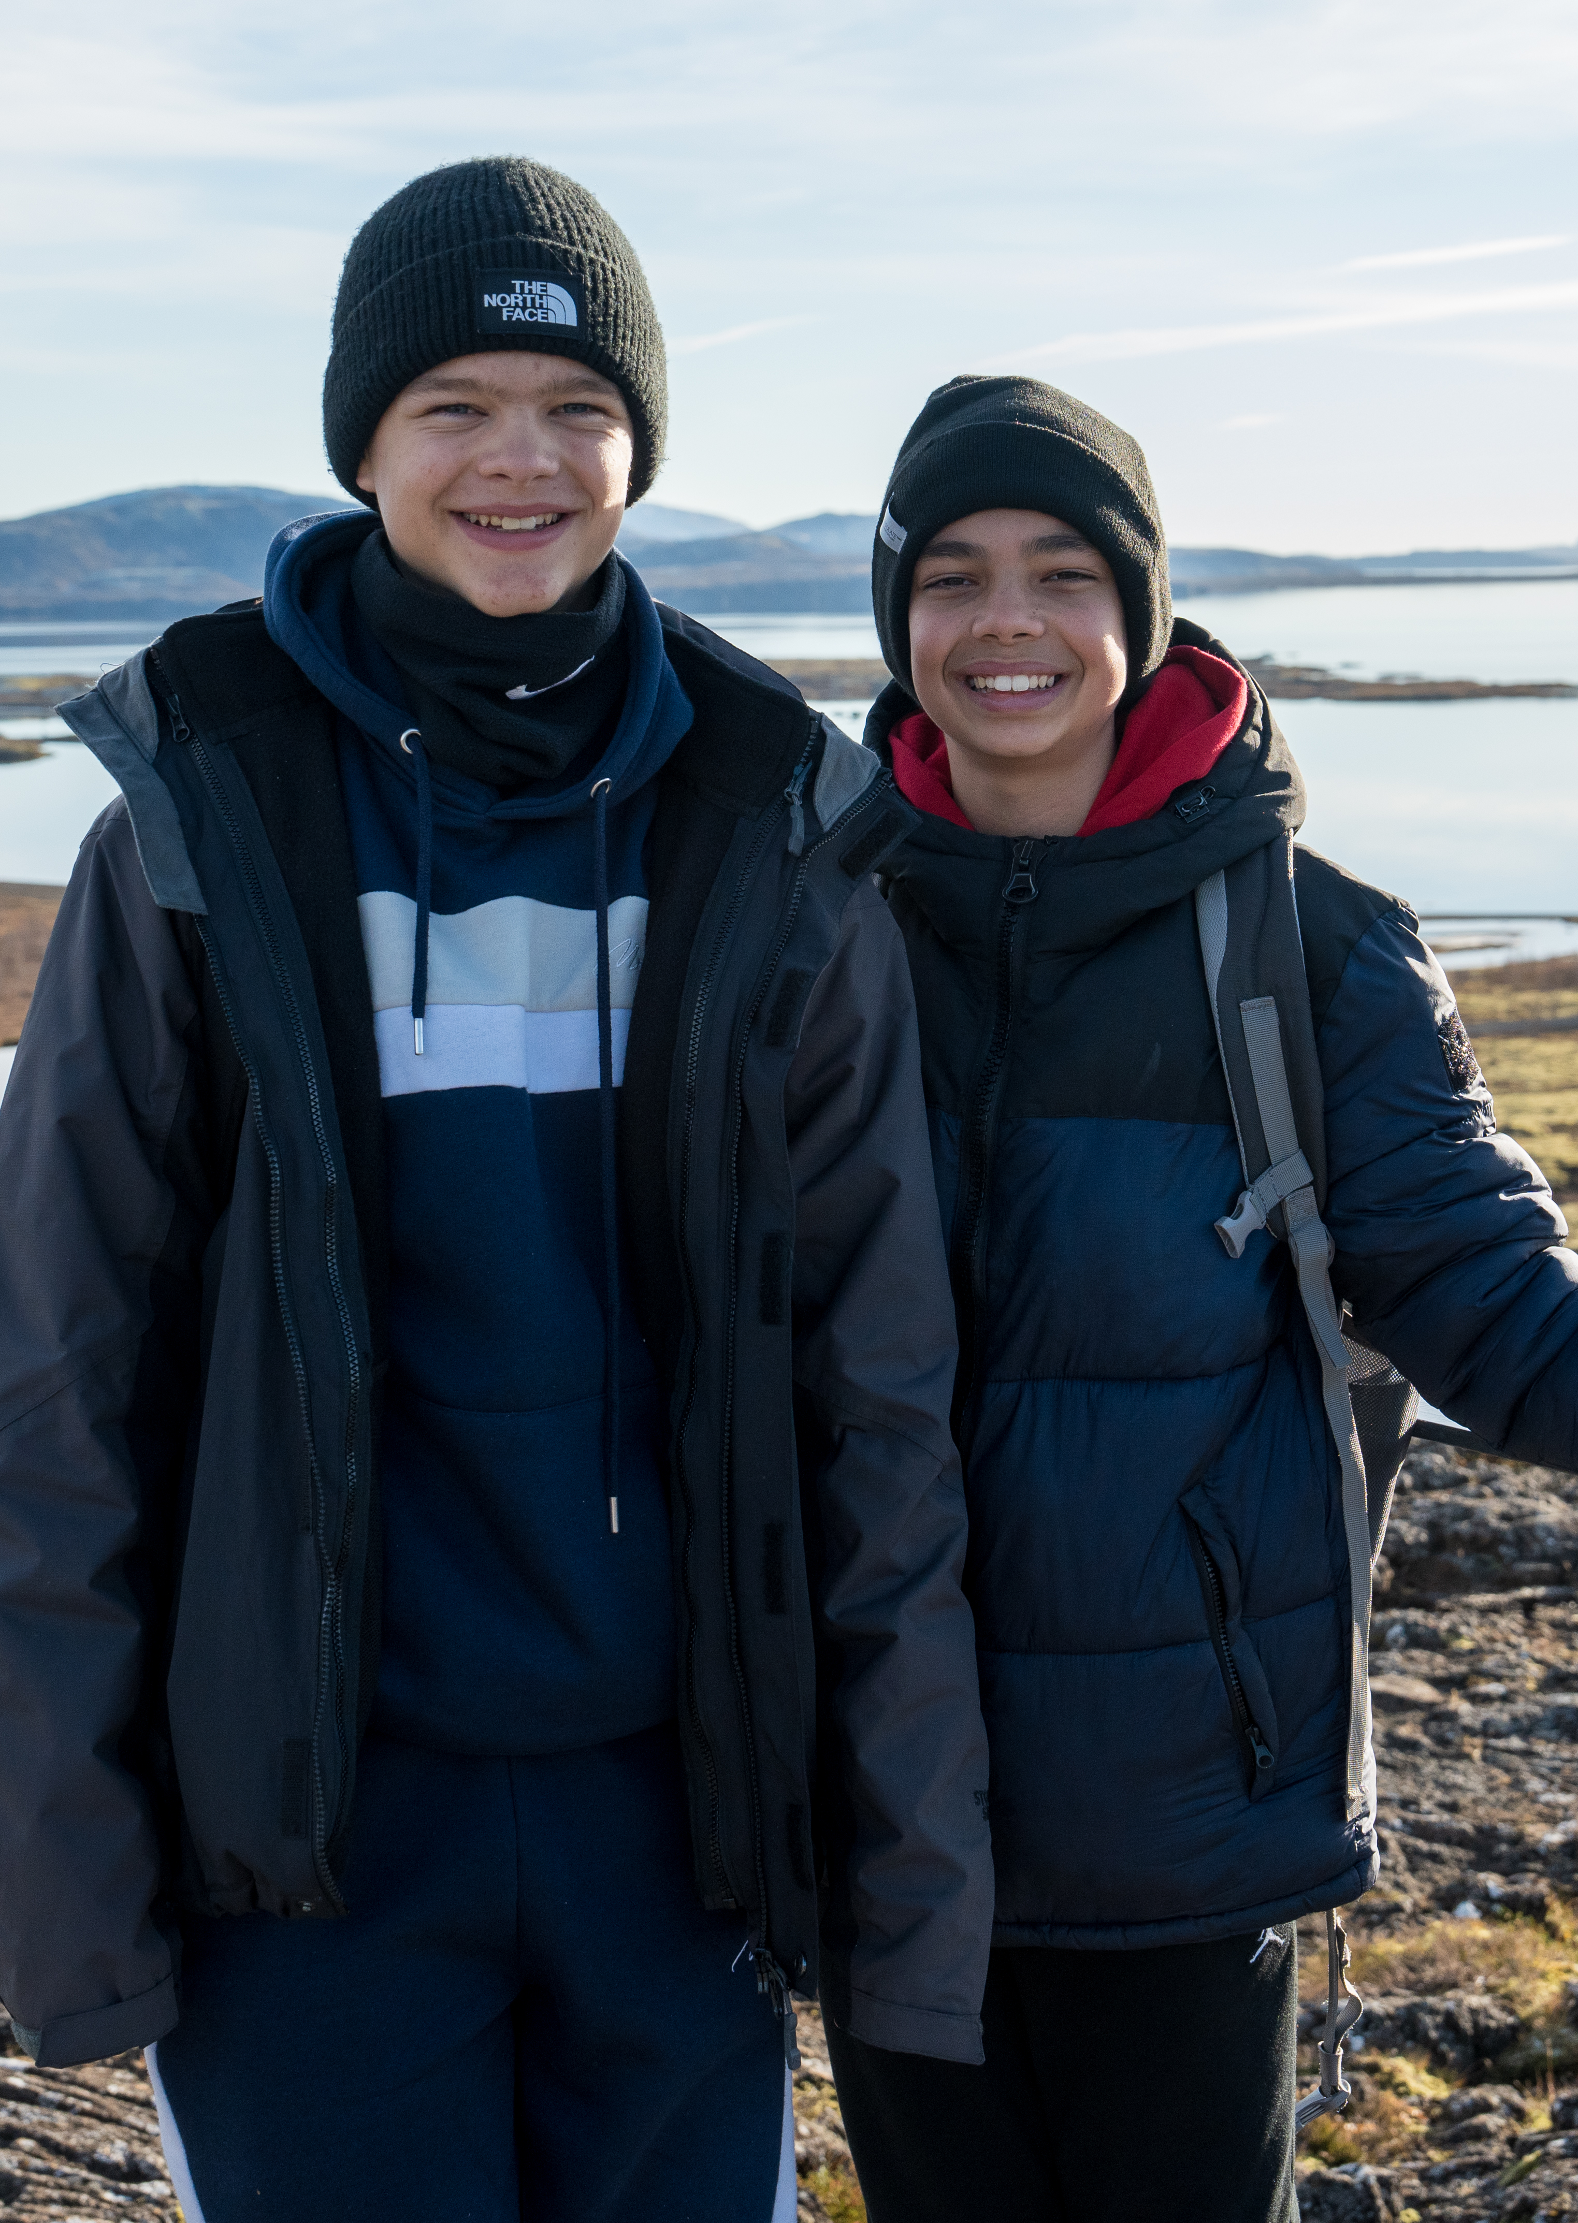
WHAT ARE WE HERE TO TALK ABOUT?
      How much and who can go?
      What does the resort offer?
      Where are we staying?
      How are school trips beneficial?
      Who’s our tour operator?
      Any questions?

Slide 3
WHERE, WHEN AND WHY ARE WE GOING?
Where?
When?
Why?
[Destination]
[Dates, departure and return times]
[Aim of the tour]

Slide 4
HOW MUCH AND WHO CAN GO?
How much?
What is included?
Who can go?
££ Per person
Return transportation by air/coach
… nights’ full-board/half-board/room only accommodation
Travel insurance
Visits and entrance fees?
Group passport?
Itinerary planning service
E.g. ‘This trip is open to all Year 10 history students.’

Slide 5
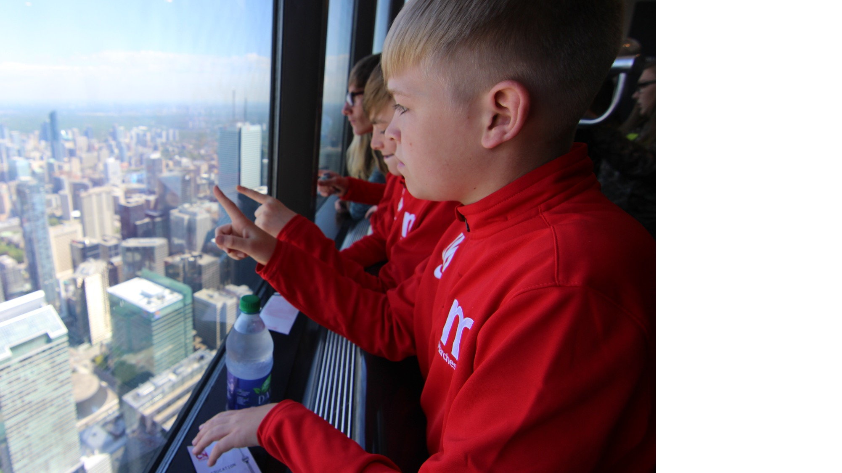
WHAT ARE WE GOING TO SEE AND DO?
    1 slide per visit/attraction
      Use the text and images from your quote destination guide or create your own description
Insert image here:
Right-click, select ‘Format background’ and choose ‘Picture or texture fill’ from the list on the right.
Under ‘Picture Source’ choose ‘Insert’ to place a picture from your desktop or select ‘Clipboard’ to paste an image in.
To remove the image, select ‘Remove background’ at the bottom of the right-side menu.

Slide 6
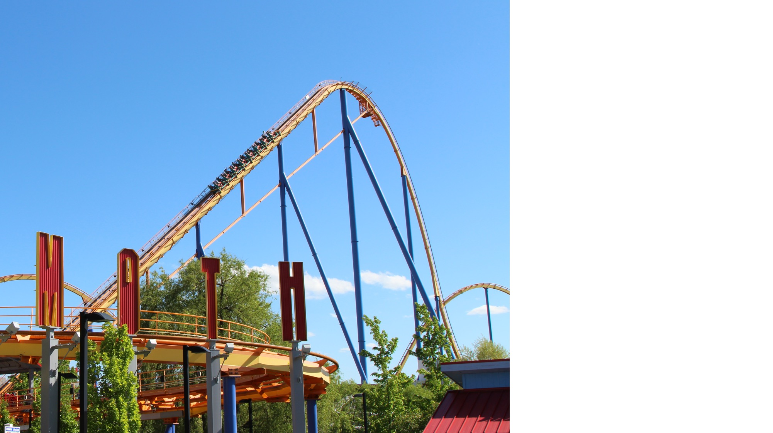
WHAT ARE WE GOING TO SEE AND DO?
    1 slide per visit/attraction
      Use the text and images from your quote destination guide or create your own description
Insert image here:
Right-click, select ‘Format background’ and choose ‘Picture or texture fill’ from the list on the right.
Under ‘Picture Source’ choose ‘Insert’ to place a picture from your desktop or select ‘Clipboard’ to paste an image in.
To remove the image, select ‘Remove background’ at the bottom of the right-side menu.

Slide 7
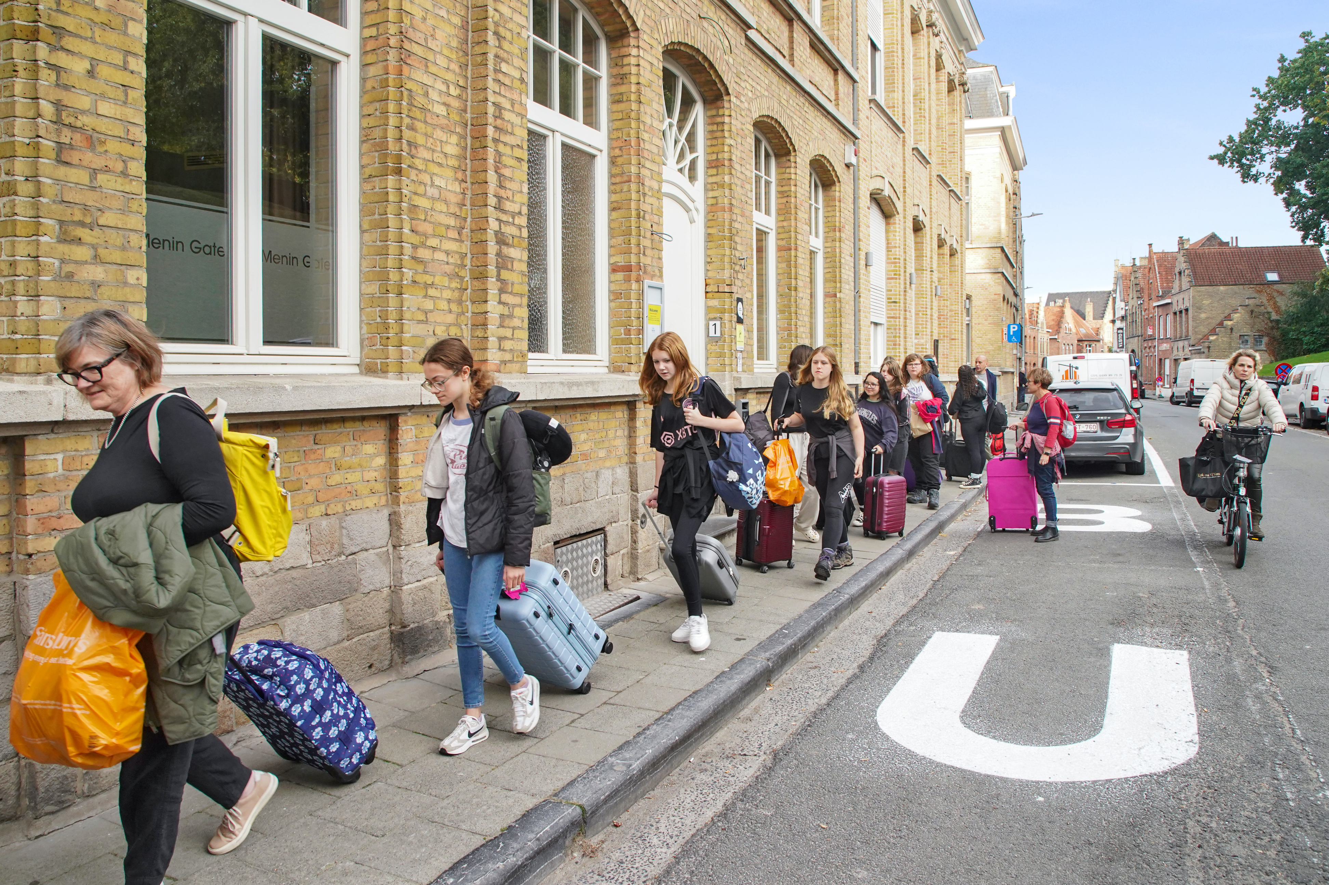





WHERE ARE WE STAYING?
  This large 3* hotel is located ...
    Rooms
      Explandae magnatq uidusa aspitas dolorem es ime eum entis dolla sum nametus sit perum eat.
    Meals
      Renditionse necatem cumquam, aut hil ipsam, quia eaquia consenit venis dolo is nes doluptaes sam inum erit duciatiume pores esci sus dem qui.
      USP Explandae magnatq uidusa eum entis dolla sum nametus.
      USP Explandae magnatq uidusa eum entis dolla sum nametus.

Slide 8
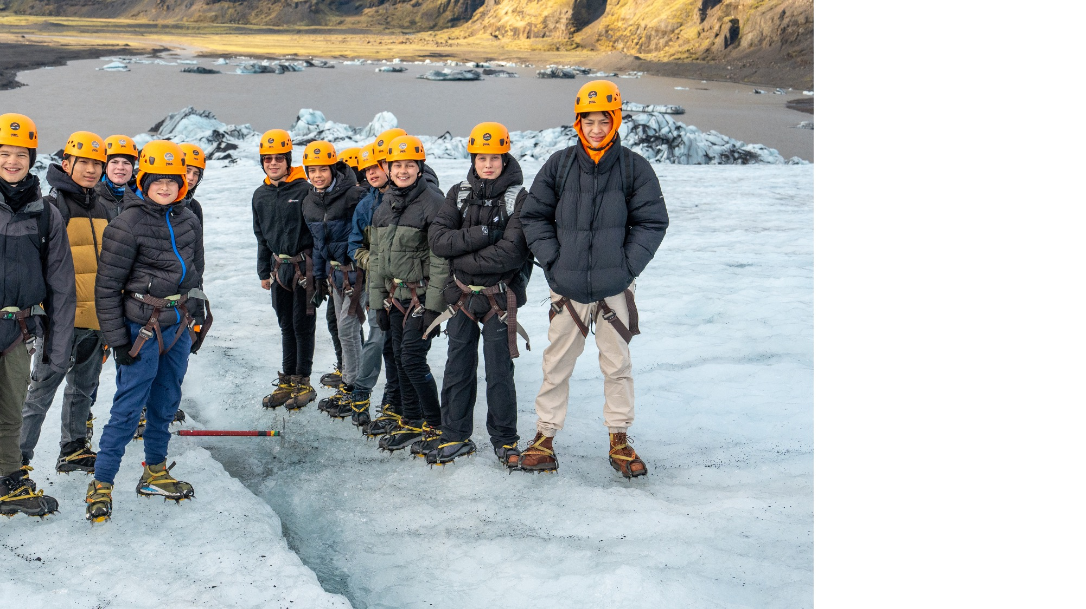

When planned and implemented well, learning outside the classroom contributed significantly to raising standards and improving pupils’ personal, social and emotional development.”
Ofsted, LOtC: how far should you go? 2008
WHAT ARE THE BENEFITS OF SCHOOL TRIPS?

Slide 9
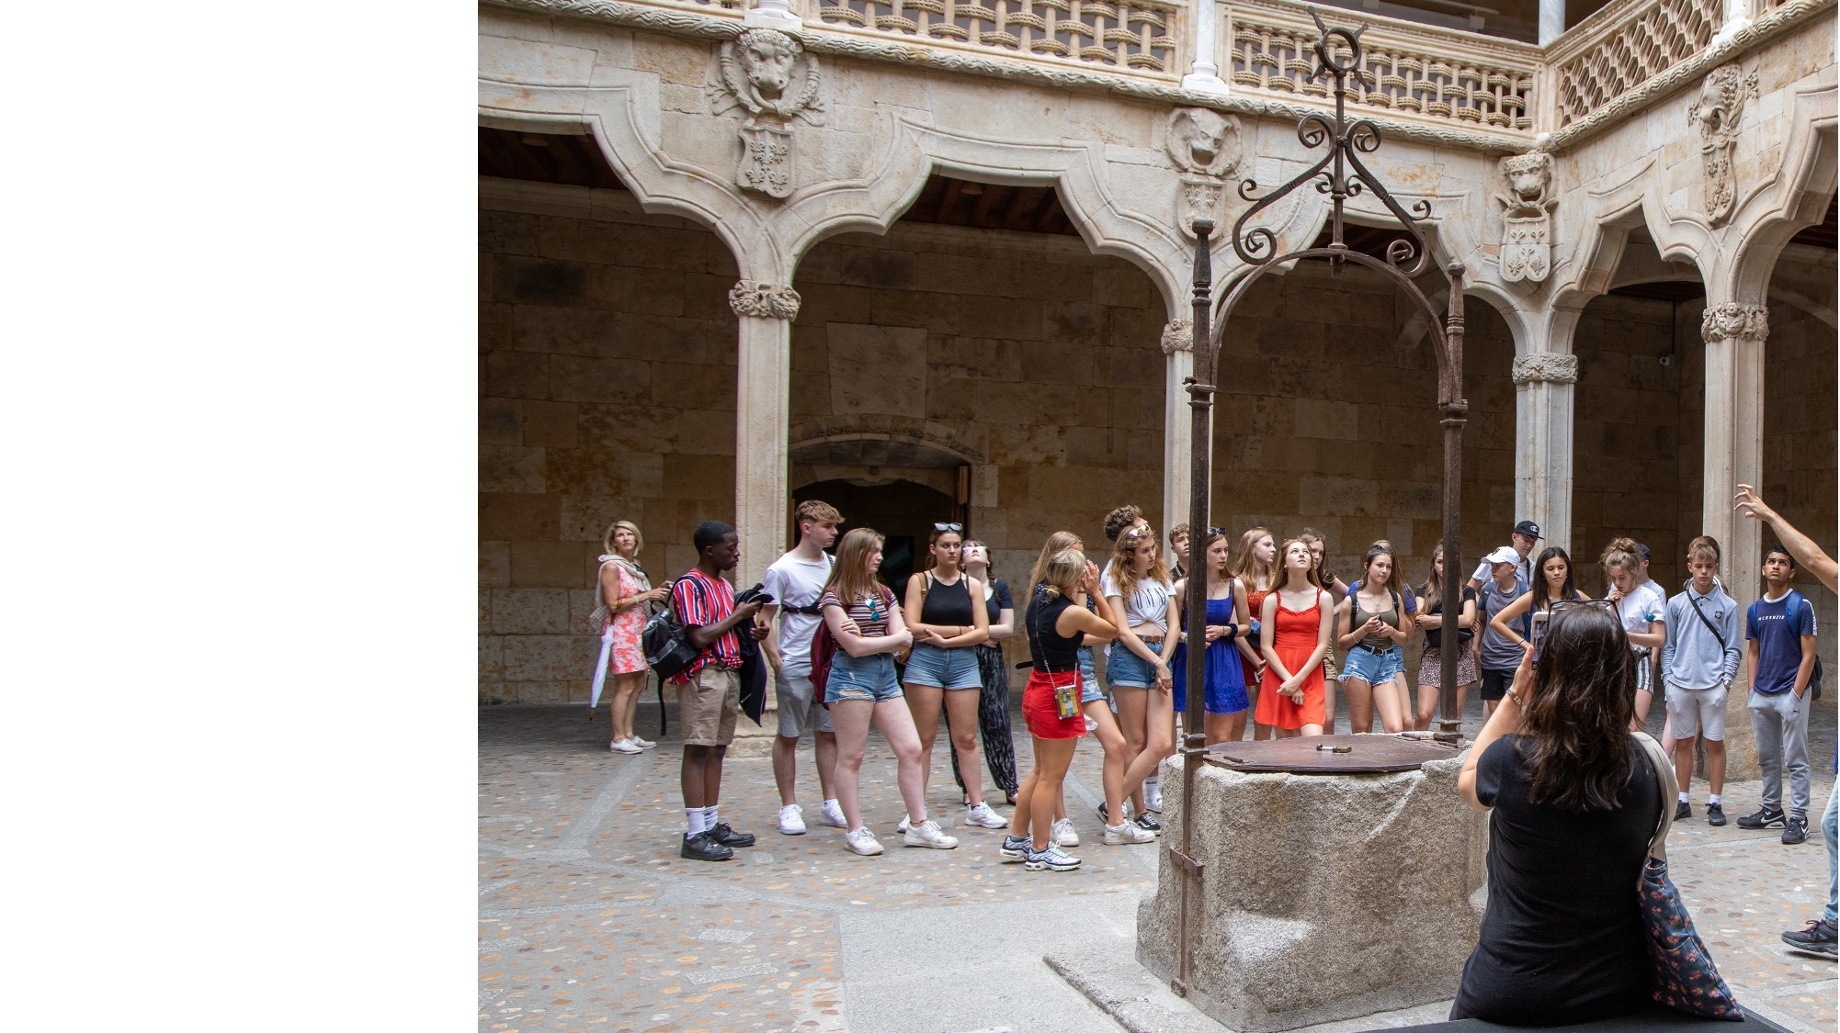
REINFORCEMENT
By seeing for themselves what they’ve been learning about in class, students will gain a better, deeper understanding of the topic.

Slide 10
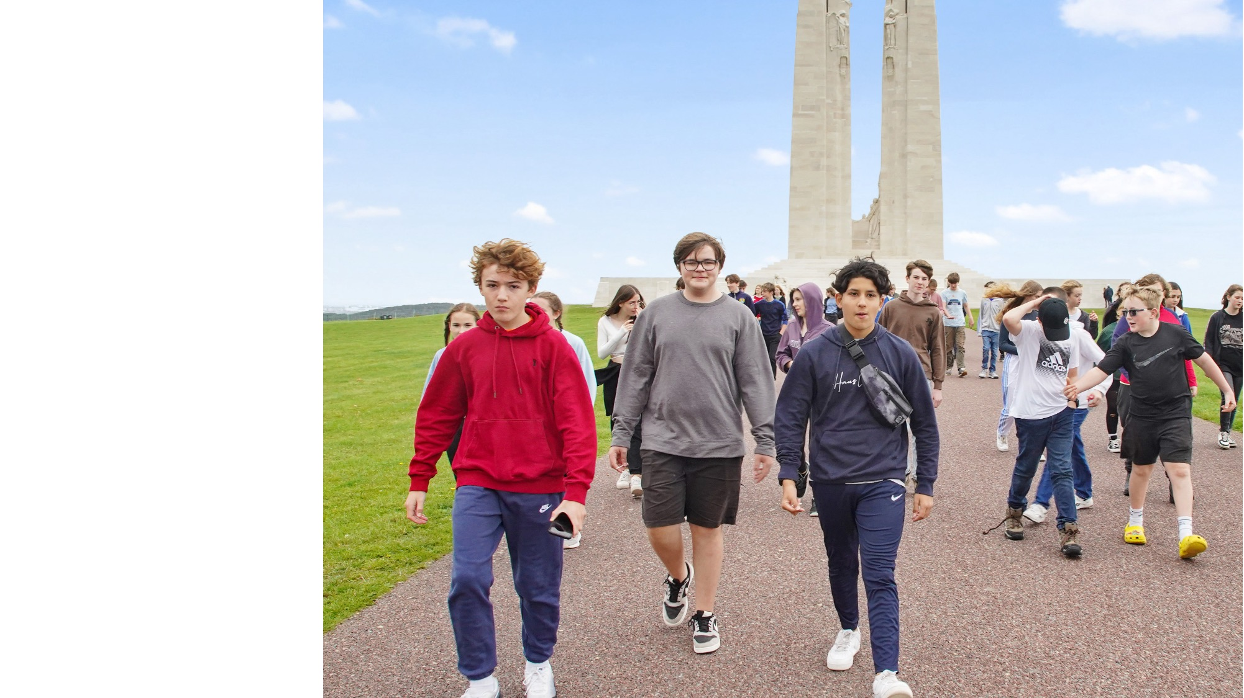
REINFORCEMENT
Wide-ranging out-of-classroom activities, including school trips, are cited as examples of outstanding teaching. Students are able to appreciate their studies from a different, and usually more active, perspective. Trips to Berlin and the battlefields of Belgium are named as examples.”
Ofsted, History for all, 2011

Slide 11
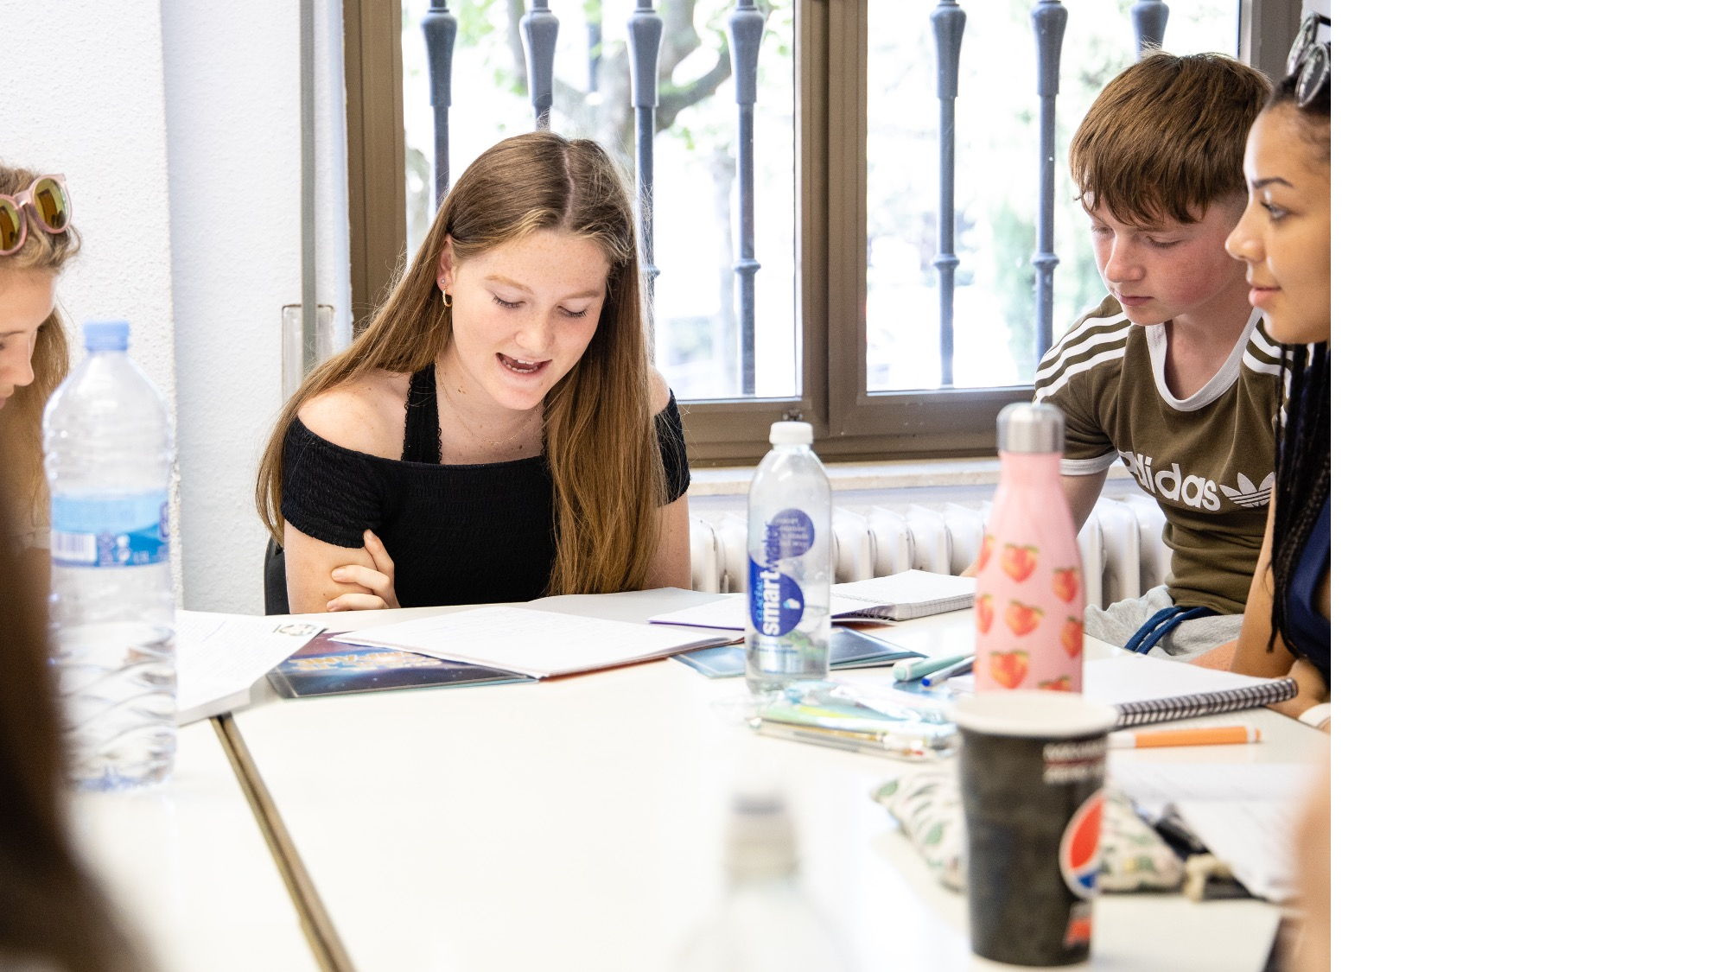
HIGHER ACHIEVEMENT IN EXAMS
A school trip gives students practical memories to draw on during exams.

Slide 12
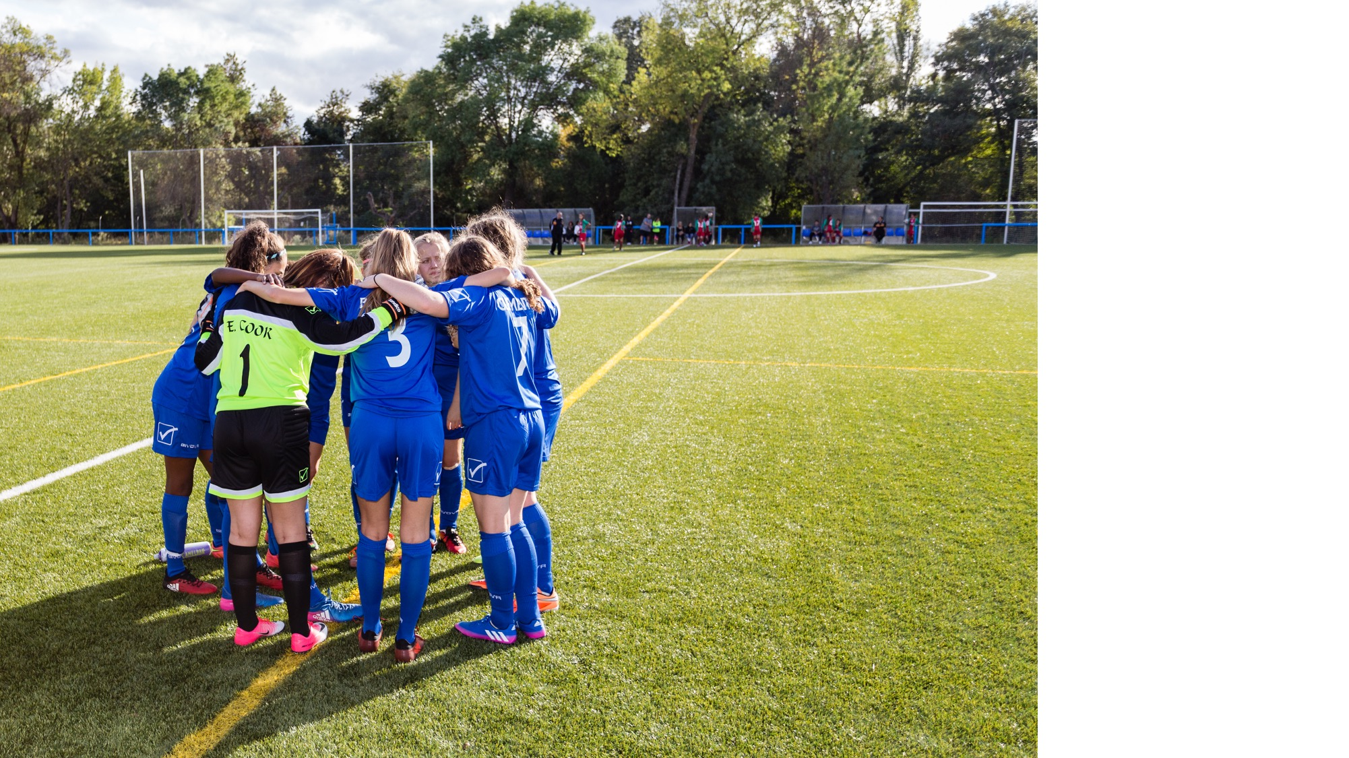
By escaping the everyday confines of the classroom and sharing new experiences, students can build trust and respect with each other and with their teacher.
IMPROVED RELATIONSHIPS

Slide 13
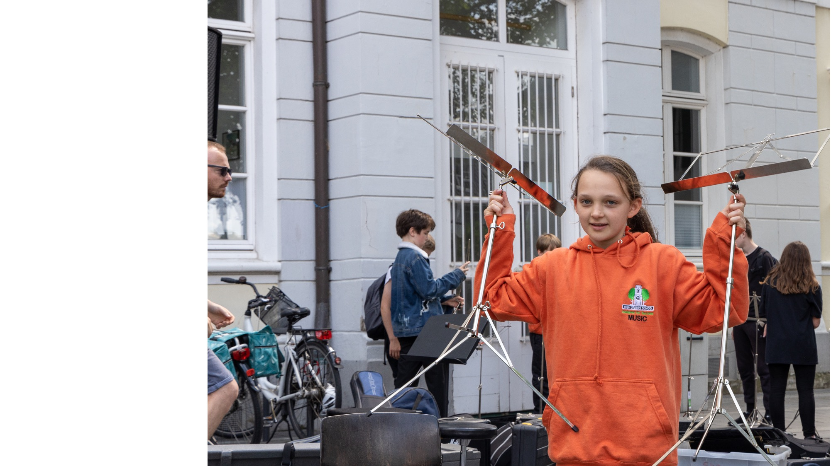
HIGHER ENGAGEMENT
The opportunities that school trips offer to embrace different learning styles means that those that prefer more visual or tactile methods will engage more in the learning.

Slide 14
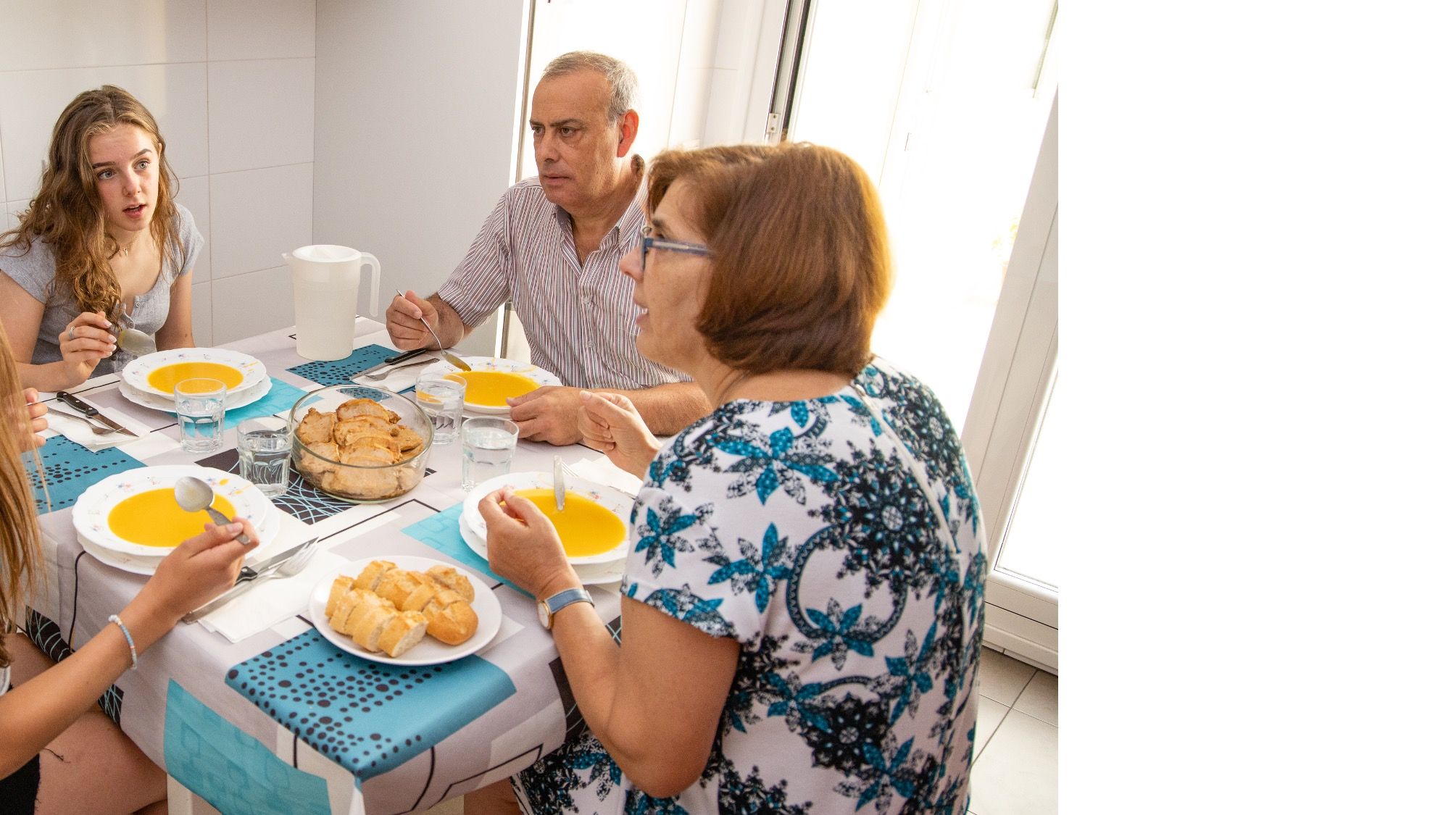
IMPROVED CONFIDENCE
By experiencing another country and culture, enjoying new foods and seeing different landscapes on a school trip, students can become more confident and open to new things.

Slide 15
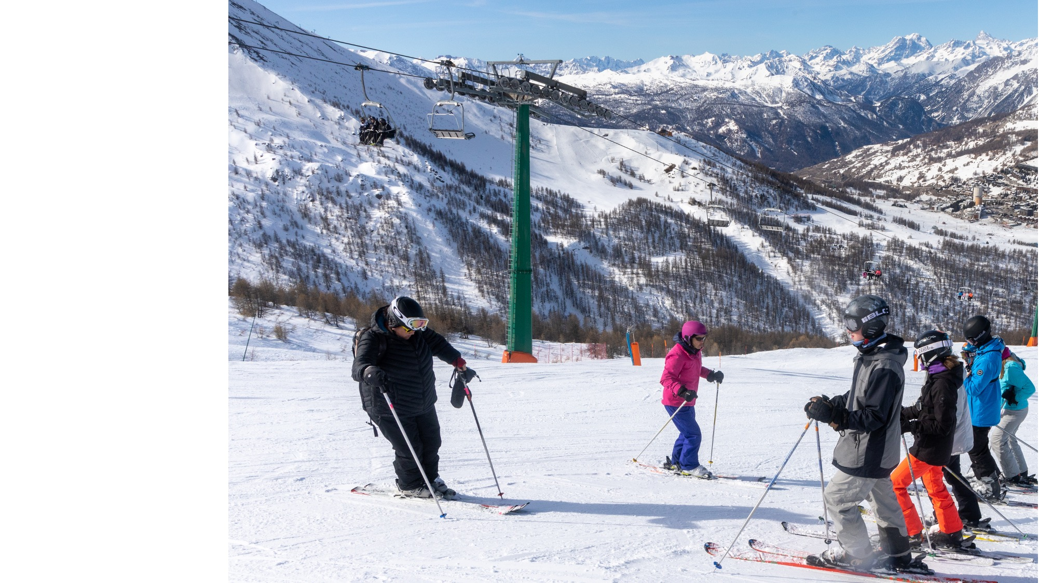
ABOUT HALSBURY TRAVEL
Established Since 1986
School & Group Tours Specialist
Over 900 tours per year, carrying over 40,000 passengers
Effective Safety Management System
Financial Protection incl. scheduled airline insurance
Fully accredited with ABTA, ABTOT, ATOL & STF
Comprehensive Travel and Medical Insurance (if applicable)
24-Hour Emergency Telephone Number whilst on Tour

Slide 16
ACCREDITATIONS
    STF
      Halsbury is also an Assured Member
      of the School Travel Forum, which demonstrates its commitment to prioritising the health and safety
      of its groups.
    Council for Learning Outside
    the Classroom
      We have been awarded the Learning Outside the Classroom Quality Badge, which demonstrates our commitment to offering activities that are safe and beneficial to learning.
    ABTA
      We are a Member of ABTA, which
      means we are obliged to maintain a
      high standard of service to you by
      ABTA’s Code of Conduct.
    ATOL
      ATOL stands for Air Travel Organiser’s Licence and is a financial protection scheme that specifically covers air package holidays. If a company that holds an ATOL fails, the scheme ensures that minimal disruption is caused to passengers already abroad and those who haven’t travelled yet receive a
      full refund.
    ABTOT
      The Association of Bonded Travel Organisers Trust Limited (ABTOT) provides financial protection under The Package Travel and Linked Travel Arrangements Regulations 2018 for Halsbury Travel (5493), and in the event of their insolvency, protection is provided for Non-flight packages.
      ABTOT cover provides for a refund in the event you have not yet travelled or repatriation if transportation was included in your package. Please note that bookings made outside the UK are only protected by ABTOT when purchased directly with Halsbury Travel.

Slide 17

ANY QUESTIONS?

