Slide 1
Achieve Precise Brain
Targeting for Neurosurgery
RebrAIn services aim to enhance patient outcomes in Parkinson’s Disease and Essential Tremor treatments by combining peer innovation with Best-in-Class supervised AI.

Slide 2
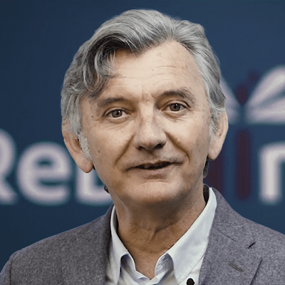
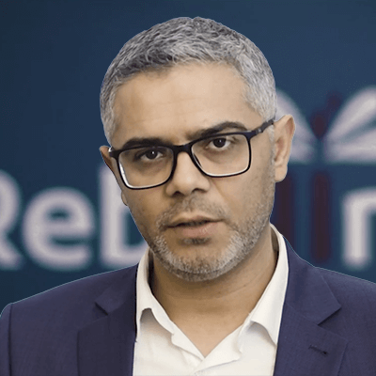
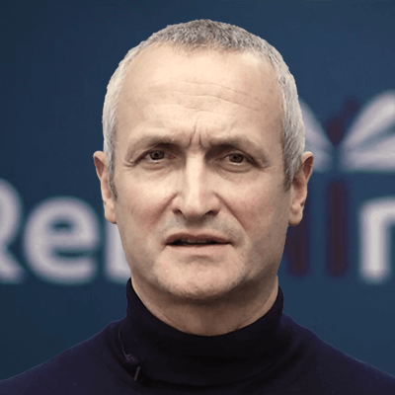
RebrAIn at a glance
RebrAIn is a spin-off of the University Hospital of Bordeaux and the INRIA, created by Professor Emmanuel Cuny, Neurosurgeon, and Professor Nejib Zemzemi, Researcher at Inria in Applied Mathematics, after 10 years of academic research and 2 thesis.
RebrAIn’s Service, a best-in-class AI-driven solution to streamline complex, patient-specific neurosurgery with faster, simpler and safer treatment using augmented neuromodulation planning.
Emmanuel Cuny
Professor of Neurosurgery Bordeaux University Hospital Board member Vygon,
Co-founder, CMO & Board President
Nejib Zemzemi
Researcher at Inria; 100 Publications in mathematical inverse problems,
Co-Founder, CSO & /CTO
Revolutionising the traditional approach by combining advanced algorithms and best-in-class medical data,
Improve patient outcomes with precision-guided therapies,
Democratise access to cutting-edge neurological care for more patients, more diseases, in more medical centers, by more doctors,
Leveraging SaaS technology to bring clinical excellence
Neuromodulation market change paradigm from 1% to 10% patient treated
David Caumartin
Public Company CEO, Global P& L., VP France Biotech, EIT Health Advisor, FUS Sr. Partner
CEO
SaaS (HDS, GDPR, HIPAA compliant)
CE marking & FDA 510(k) clearance
ISO 13485
WW Patent coverage
+600th+ Targeting performed
60 centres in test WW
Publishing the phase 2 trial DBS on ET
Clinical trials in Phase 3 on DBS PD recruitment completed & on radiosurgery on ET (pending IRB)
€3,7M Seed investment with Karista and NACO
Seelcted by EIC Bootcamp Neuro Group
€1,7M of nondilutive financing led by BPI expanding runway & Capabilities

Slide 3
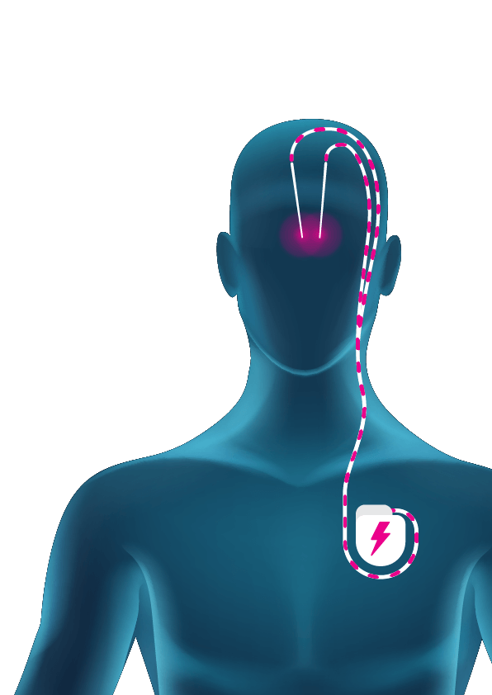
Deep brain stimulation (DBS)
Electrode (DBS lead) a thin, insulated wire that is implanted in the brain
10% of patients with Parkinson's Disease (PD) and Essential Tremor (ET) do not respond to pharmacological treatments, necessitating alternative methods.
Developed in France in the late 1980s by Prs. Benabid and Pollak, DBS is an invasive neurosurgical technique designed specifically for these movement disorders.
Often described as the brain's pacemaker, DBS involves the delivery of electrical pulses to specific motor control areas.
This procedure requires milimetric targeting and implanting of electrodes while the patient is awake, presenting a significant challenge for both neurosurgeons and patients.
Electrical pulse
Treated motor control brain region
Neurostimulator
Implanted pacemaker
that gives the electrical
pulse,
Implanted insulated wire placed under the skin

Slide 4
+6M patients to treat Neurodegenerative diseases are booming. Although very effective techniques are available, cost and complexity make them inaccessible to the greatest number.

Slide 5
Shortcomings that prevent access
Less than 3% of eligible patients undergo DBS treatment due to the complexity of accurately and safely targeting specific brain areas.
______________________________________
DBS treatments are highly personalized, challenging standardization and increasing complexity and risk due to the use of multiple modalities and tools.
______________________________________
DBS procedures are expensive and lengthy, often traumatic for patients, with inconsistent results due to imperfect brain mapping.
10M
patients
_____________
1M
eligible for surgery
_____________
30.000
patients treated
PARKINSON DISEASE
50M
patients
_____________
5M
patients treated
_____________
30.000
patients treated
ESSENTIAL TREMOR
< 3 %
of the eligible patients
< 0.1 %
of the eligible patients

Slide 6
The real challenge
Neurosurgery is a personalized treatment that requires a perfect mapping of the patient's brain to target specific brain areas accurately and safely.
Intraoperative awakening of the patient required for micro-recording (MER) & clinical evaluation
Traumatic, invasive, expensive, long, Irreversible (for lesioning)
The challenge for 80% of the centers
Complex, inhomogeneous, not reproducible, long

Slide 7
Current Solution. RebrAIn’ MR pre-operational automatic targeting solution inside of Operating Room : OptimMR Saas model.

Slide 8
Achieving precise targeting for neurosurgery
RebrAIn is a spin-off of the University Hospital of Bordeaux and the INRIA, created by Professor Emmanuel Cuny, Neurosurgeon, and Professor Nejib Zemzemi, Researcher at Inria in Applied Mathematics, after 10 years of academic research and 2 thesis.
They bring you RebrAIn’s Service, a best-in-class AI-driven solution to streamline complex, patient-specific neurosurgery with faster, simpler and safer treatment using augmented neuromodulation planning.
Regulatory
CE marked, FDA 510(k)cleared
Adoption
In use in 55 sites worldwide
Indications
Parkinson's disease(STN), Essential tremor(VIM)
Volume
500+ targeting operations performed

Slide 9
Rethink the brain pre-surgery planning
We have developed a targeting service that uses an AI algorithm & collaborative registry of consolidated clinical data to simplify and standardize neurosurgical procedures.
Our solution seamlessly integrates AI-guided targeting into any workflow to streamlines and standardize neurosurgical procedures.
1
Anonymized MRI
patient metadata
2
RebrAIn facility
Operator using SaMD*
Process patient data
Landmarks detection
Targeting process
Neurosurgeon
RebrAIn’s
secure cloud
GDRP & HDS certified
ready-to-use
Marked
MRI
3
Marked
MRI
* RebrAIn service leverages CE Marked and FDA 510(k) cleared Software as a Medical Device (SaMD)
With RebrAIn, every neurosurgeon has easy access to milimetric MRI-guided targeting of the STN or VIM, actively increasing the number of treated patients.

Slide 10
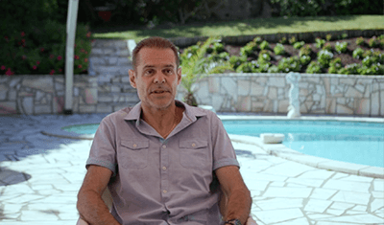
Less invasive, with better outcomes
Surgery under AG
Less traumatic procedure
Fast workflow
Reduced surgery and recovery time
Precise surgery
Improved targeting and outcomes
Safe and efficient
Minimized risk
and complications
RebrAIn’ Service simplifies surgery planning and significantly shortens operation time and minimizes health risks and complications.
Testimony of a Parkinsonian patient operated on with the help of RebrAIn’s technology
Testimony of an Essential Tremor Patient operated on with the help of RebrAIn’s technology
Surgery under AG
Less traumatic procedure
Fast workflow
Reduced surgery and recovery time
Precise surgery
Improved targeting and outcomes
Safe and efficient
Minimized risk
and complications

Slide 11
Providing a shorter, safer and streamlined workflow
From MRI upload to surgery planning, RebrAIn’ Service streamlines the pre-surgical planning process, reduces operation time, and minimizes patient risk.
DBS Workflow WITHOUT RebrAln
Selection patient
Local Anesthesia Frame insertion
Operating Room
Targeting with Neurologist - Patient under consious sedation
Micro Electric Recording
Patient under General Anesthesia
Electrode & Generator implantation
Post operative control
Post operative clinical evaluation
Patient Cycle - 6 to 8h with asleep / awake patient in 1 -3 steps
DBS workflow WITH RebrAIn OptiMRI
Selection patient
General Anesthesia Frame insertion
Operating Room
Electrode & Generator implantation
Post operative control
Post operative clinical evaluation
Surgery skin to skin - 2h50 +/- 1h00 (min: 1h30 Max 4h50 min) under AG
The mean distance between the target and the leads : 0,9 mm
Peace of mind
Targeting simplification
Standardization of DBS
Time reduction
Decreased surgical duration
Time freed up for other tasks
Affordable Growth
Reduced operational costs
Increased patient intake

Slide 12
Value proposition and benefits of OptimMRI
NEUROSURGEONS
Targeting simplification
Standardization of techniques
Fastest workflow
More patients treated
Fastest learning curve for fellows
New optimized workflow for younger neurosurgeons
PATIENTS
Surgery under general anaesthesia
Less traumatic procedure by eventually avoid MER
Fastest workflow (2-3h)
Safe and efficient
Reversible Therapy
HOSPITALS
More affordable solution (cost-savings of 20%/30%)
Centers of excellence & attract new patients
More surgeries performed
Workflow traceability
Stress free planning for seasoned and young
Cost-effective
Affordable solution promoting healthcare cost-savings
Precision & Speed
AI driven, rapid and accurate neurosurgery planning
Integration & Access
User-friendly platform, No additional SW install. required. GDPR cloud-based service.
Driving Innovation
Advanced AI algorithms to provide detailed targeting

Slide 13
RebrAIn NextGen Solution. RebrAIn Targeting outside of Operating Room using an MR interventional solution: Focused ultrasound & Radiosurgery (Gamma Knife / Cyber Knife,…)

Slide 14
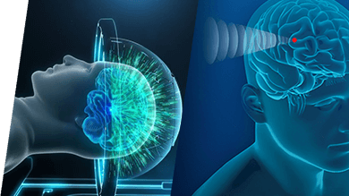
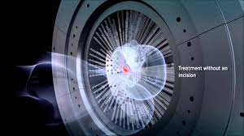
Our next solution: Focused Ultrasound (HIFU) & Radiosurgery (GK, CK, …)
HIFU & Radiosurgery are hightech, incisioness techniques that uses ultrasound waves & radioactivity to accurately target and treat tissue deep within the body.
It is particularly revolutionary in treating severe neurological diseases, such as Parkinson's disease, essential tremor, and other neurological conditions, as it eliminates the need for open brain surgery.
Lesioning for neurological diseases involves detailed imaging to identify targets and crafting a precise treatment plan without harming healthy tissue. The patient receives local anesthesia for HIFU device first validates the target with low power before lesioning with high power. Radiosurgery patient are treated with no sedation.
Those incisionless methods penetrates the skull, destroying only diseased tissue with millimetric accuracy, with many patients reporting symptom relief.

Slide 15
Market & goals. Expand access to 10% of patients worldwide to transform the neuromodulation niche market from under $2B to a solid $20B+.

Slide 16
Ambitions and HealthCare economics
2032
$ 3.2B
2032
$ 20B
2032
$ 1.4B
2022
c. 60,000
(incl. 3% HIFU)
ADDRESSABLE
MARKET
2032
c. 900,000
(incl. 85% HIFU)
P.D. E.T. treatments
(WW+Reop)
2022
4 to 7d 2-3 operations
2022
$ 1.5B
$ 100M
2032
2h in one shot
$ 115M
Hospitalization
(PATIENT TIME)
DBS
(ASP 27K / TT)
Lesioning
(ASP 25K / TT)
Targeting
(ASP 2K / TT)
Glossary: PD: Parkinson’s disease, ET: Essential Tremor, DBS: deep brain stimulation, Lesioning: HIFU & Radiosurgery, ASP: Average sale price, TT: treatment,…

Slide 17
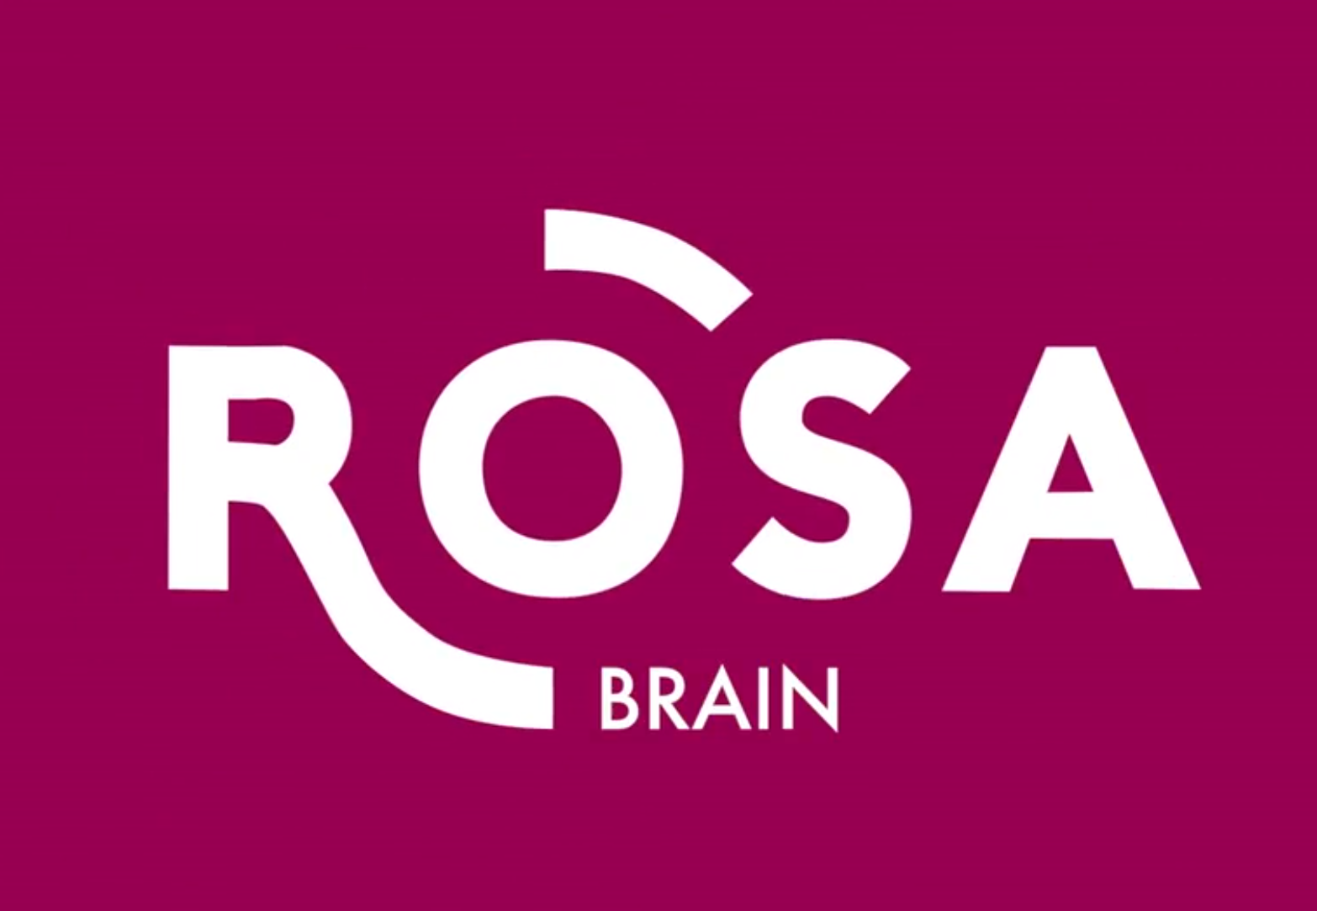
A seasoned and motivated team
Emmanuel Cuny
Professor of Neurosurgery Bordeaux University Hospital Board member Vygon,
Co-founder, CMO & Board President
A team of 10 employees with multidisciplinary and complementary expertise in Clinical practice, Data Science, Software development, Market access, Business and Quality & Regulatory Affairs
Nejib Zemzemi
Researcher at Inria; 100 Publications in mathematical inverse problems,
Co-Founder, CSO & /CTO
David Caumartin
Global P& L., Public Company CEO, VP France Biotech,EIT Health Advisor, FUS Senior Partner
CEO

Slide 18
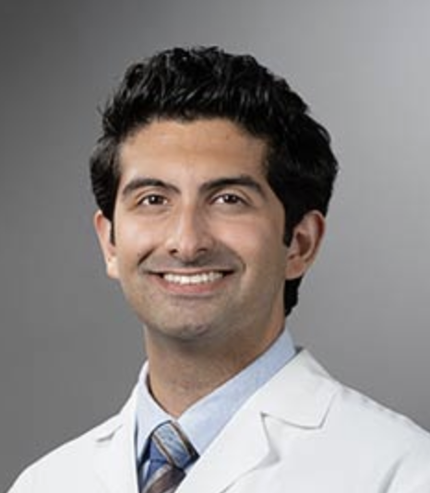
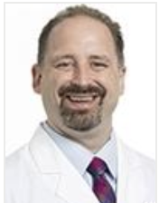
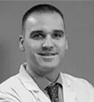
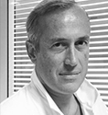
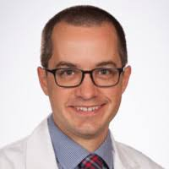
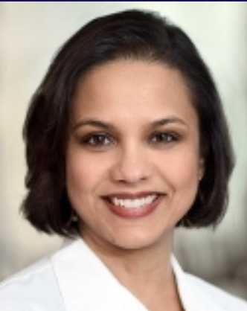
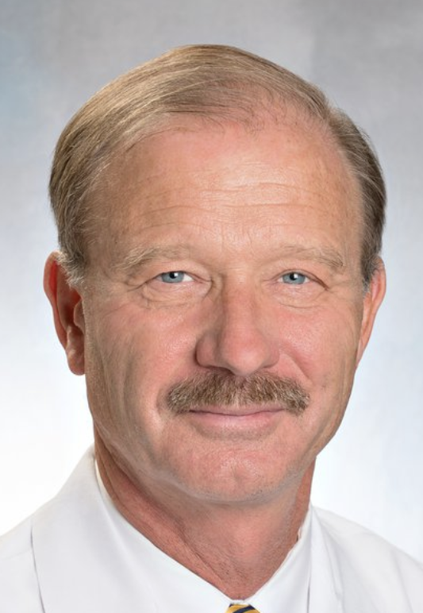
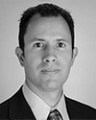
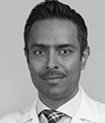
Top-level scientific and strategic boards
Strategic Board
Emmanuel Cuny Co-founder, CMO & Board President
Nejib Zemzemi Co-Founder, CSO & CTO
David Caumartin CEO
Vincent Pretet M CAPITAL
Catherine Boule KARISTA
Observer
Amine Benamoussa KARISTA
Tom Beauvironnet KARISTA
Dr. Shayan Moosa UVA Charlottesville | Dr Charles Munyon Charlotte Novant Health | Dr. Lain Hermes González Clínica Universidad de Navarra SPAIN | Pr Jean Regis APHM, Marseille / FRANCE | Pr John D. Rolston Brigham and Women's Hospital Boston
Dr Joohi Jimenez-Shahed Mont Sinai New York | Pr Rees Cosgrove Brigham and Women’s Hospital Boston | Pr Michael J Kinsman University of Kansas Hospital, Kansas City | Pr Ausaf A. Bari UCLA Brain Research Institute, Los Angeles

Slide 19
RebrAIn: a leader in stereotactic brain mapping
RebrAIn addresses high unmet growing
markets in neurological diseases
RebrAIn streamlines complex and costly neurosurgical procedures
making them accessible to more patients worldwide
RebrAIn has gathered a seasoned and committed team with all the expertise needed for success
RebrAIn has a solid IP strategy
with patents and know-how.
RebrAIn has successfully raised €4M
and has multiple investors on board

Slide 20
Medical Appendix Evidence of Excellence

Slide 21
Efficiency and Safety
ESSFN ‘23 WSSFN ‘24 communication pending publication
22 patients underwent surgery under general anaesthesia between June 2019 and Mai 2023 (OptiVIM study. 9M/13F, mean age 63 years old, located in FR Lyon and Marseille). | Preop. | Postop. | %
The Fahn-Tolosa-Marin scale (Mean ± SD) | 51 ± 13 | 20 ± 9.5 | 61% CI 95% [53% ; 69%] Giordano et al. JNNP 2020 meta analysis 60% ± 9,7 Lu et al. Neural Plast 2020 meta analysis 61.3% CI [56% ; 66%]
The mPDQ39 (Mean ± SD) | 43 ± 17 | 22 ± 16 | 49%
The SARA (Mean ± SD) | 5 ± 3 | 4 ± 3 | 15%
The mean distance between the target and the leads (Mean in mm ± SD) : 0.9mm ± 0.7 Min 0mm Max 2.6mm Duration of the surgery: surgery skin to skin mean 2h50 ± 1h00 (Min: 1h30min Max: 4h50min)
RebrAIn service simplifies surgery planning, significantly shortens operation time, and minimizes health risks and complications.
RebrAIn service simplifies surgery planning, significantly shortens operation time, and minimizes health risks and complications.

