Slide 1
Topline Growth & Operational Efficiency
The ICONIQ Growth Board Reporting Template
2023

Slide 2
About the
Research
2023 Report
The New Era of Efficient Growth
Every year, the ICONIQ Growth Analytics team analyzes the financial and operating metrics from the ICONIQ Growth portfolio and a selection of public companies to understand the data behind scaling B2B SaaS companies.
Along with a full refresh of the analysis, this year we are excited to share 3 companion reports focused on vertical SaaS businesses, product-led growth companies, and scaling early-stage companies, in addition to a board reporting template with benchmarks from our ICONIQ Growth Enterprise Five and Resiliency Rubric scorecards.
If you’re not on our mailing list and are interested in receiving these studies directly, please let us know here.
Companion Reports
Vertical SaaS
Product-Led Growth
Early-Stage SaaS
Tools & Reference Materials
Board Reporting Template
The SaaS Glossary
Interactive Dashboard
Portfolio Only
Scorecard Overviews
The Enterprise Five
The Resiliency Rubric

Slide 3
How to Use this Template
Every year, we analyze the quarterly performance of ICONIQ Growth’s portfolio and top-performing public companies to understand the data behind scaling B2B SaaS companies. We are excited to now have over a decade’s worth of SaaS data for companies from $1M ARR to IPO and beyond. Explore the key insights in our 2023 research here.
Feel free to leverage these companion slides for your next internal planning session, board meeting, all hands, pitch deck, or any other forum to understand how your company stacks up against other SaaS businesses.
The benchmarks shown are based on quarterly financial and operating benchmarks for leading private and public SaaS companies aggregated over the past 10 years. For more granularity on where you stand, please use the slide that matches your ARR scale in the following pages and make it your own by adding your logo and metrics.
For definitions of each metric, please reference our SaaS glossary.
The ICONIQ SaaS Glossary
See our SaaS Glossary for a complete guide to the metrics included in this template, including formulas and key considerations. Other topics include:
Cost classification
Revenue recognition
Cohort analysis
Unit economics
ARR funnel template
Efficiency metrics

Slide 4
The ICONIQ Growth SaaS Glossary
See our SaaS Glossary for a complete guide to the key metrics included in this report, plus:
THE ICONIQ GROWTH
Enterprise Five
Cost classification
Revenue recognition
Cohort analysis
Unit economics
Median & Top Quartile Performance by ARR Range¹
ICONIQ Growth standards across five key metrics we believe are highly representative of a B2B SaaS company’s overall growth and efficiency:
Median Top Quartile
 | <$25M | $25-$50M | $50-$100M | $100-$200M | $200M to IPO | Post-IPO⁴
YoY ARR Growth (EOP ARR – prior year EOP ARR) /prior year EOP ARR | 125% 240% | 90% 130% | 70% 100% | 50% 70% | 40% 60% | 45% 70%
Net $ Retention (BOP ARR + expansion ARR - gross churn ARR) / BOP ARR | 105% 125% | 110% 120% | 110% 125% | 110% 120% | 110% 115% | 120% 130%
Rule of 40 YoY ARR growth + FCF margin² | Less Relevant | Less Relevant | 25% 55% | 15% 45% | 30% 50% | 45% 70%
Net Magic Number Current Q net new ARR / prior Q S&M OpEx³ | 0.8x 1.7x | 0.8x 1.2x | 0.9x 1.4x | 0.8x 1.2x | 0.6x 1.1x | 0.8x 1.6x
ARR per FTE EOP ARR / EOP FTEs | $95K $135K | $140K $190K | $175K $215K | $200K $235K | $220K $255K | $270K $345K
1
2
3
4
5
Given the current environment, we expect that median benchmarks shown here will be more realistic for companies to target in 2023, but have included top quartile as reference for “best in class” performance regardless of time period
1 Quarterly operating and financial data from the companies included
2 Alternative Rule of 40 calculations include YoY Revenue Growth and EBITDA Margin
3 Quarter of S&M OpEx utilized in magic number calculations should depend your company’s sales cycle
4 Within 2 fiscal years after IPO

Slide 5
What is the Resiliency Rubric?
Read about why we believe it’s so important for SaaS companies to start tracking these 5 metrics in the current market.
THE ICONIQ GROWTH
Resiliency Rubric
Legend
Median Top Quartile
Median & Top Quartile Performance by ARR Range¹
In addition to the Enterprise Five, we recommend SaaS companies keep in mind these additional metrics that will drive resilience in times of volatility
 | <$25M | $25-$50M | $50-$100M | $100-$200M | $200M to IPO | Post-IPO⁵
Quick Ratio Gross New ARR / Gross Churned ARR | 8x 19x | 5x 16x | 6x 11x | 5x 10x | 4x 6x | Low N-Size
Topline Attainment Actuals as % of annual plan, net new cumulative bookings | Companies should aim to achieve 100% quarterly net new attainment of their topline plan, regardless of scale. Top performers have managed to stay in the 80-100% range regardless of scale in the current environment.
Burn Multiple FCF / Net New ARR¹ | 2.0x 1.1x | 1.6x 0.7x | 0.9x 0.5x | 1.1x 0.6x | 0.9x 0.4x | 0.3x 0.2x
CAC Payback CAC / (New MRR x Gross Margin)² | 22 10 | 28 15 | 20 13 | 19 14 | 34 19 | 12 8
Productivity Ratio ARR per FTE / OpEx per FTE³ | 0.5x 0.7x | 0.7x 0.8x | 0.9x 1.1x | 1.0x 1.3x | 1.2x 1.4x | 1.2x 1.5x
1
2
3
4
5
Given the current environment, we expect that median benchmarks shown here will be more realistic for companies to target in 2023, but have included top quartile as reference for “best in class” performance regardless of time period
1 Quarterly operating and financial data from the companies included
2 Non-profitable companies only
3 CAC Payback shown in months. Overall gross margin reflects customer support
4 The productivity ratio = ARR / OpEx. We believe it is topical to present the ratio in this format as companies continue to look at metrics on a per FTE basis post-RIF
5 Within 2 fiscal years after IPO

Slide 6
ICONIQ Growth Chartmaker

Slide 7
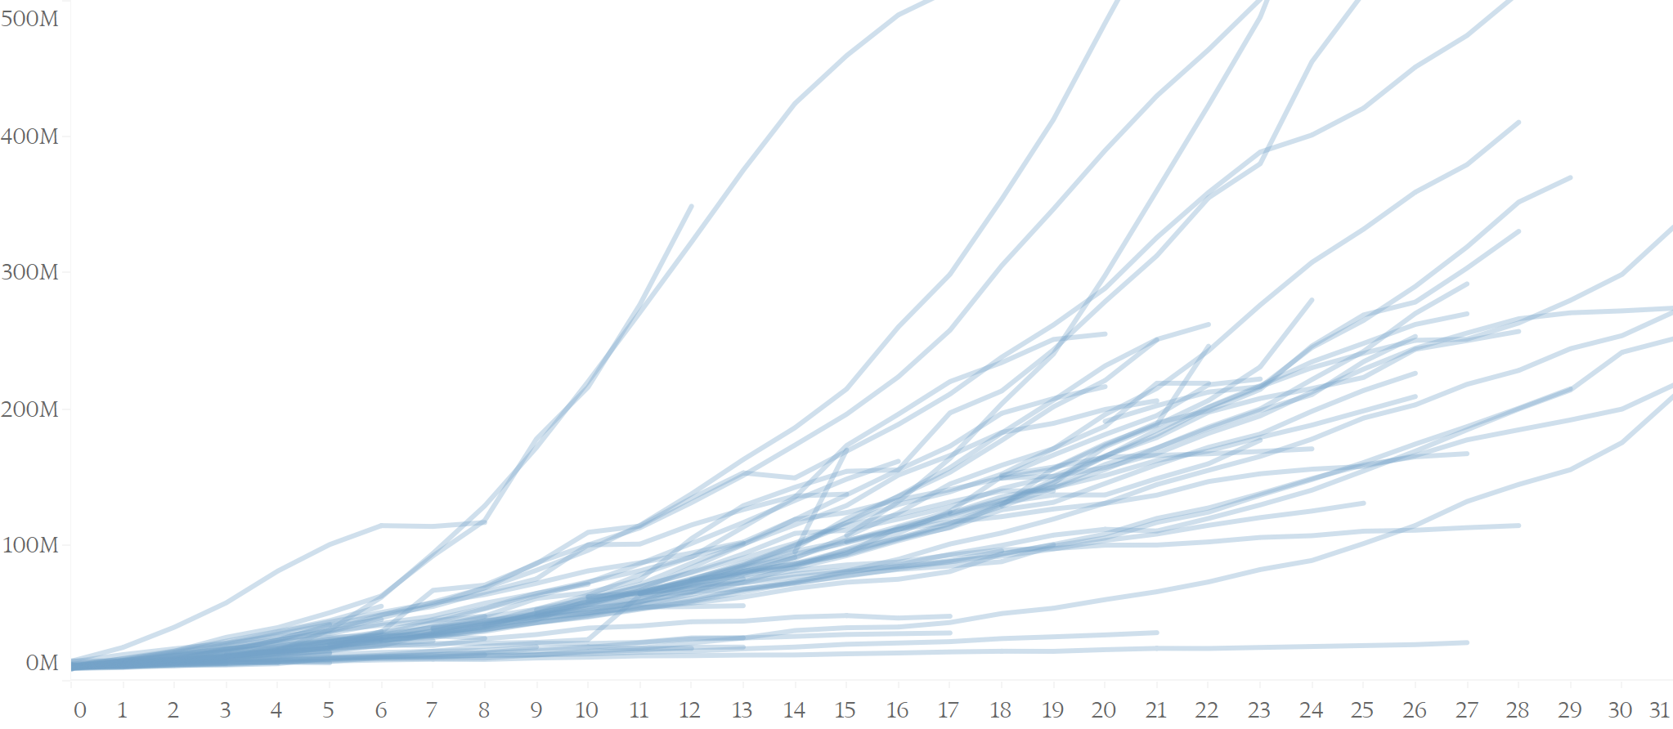
The ICONIQ Growth Scorecard
Benchmark your ARR growth against the trajectory of other SaaS companies as they scaled past $10M ARR up to $500M ARR. To update this chart, click “Edit Data” under the chart tab and input your ending ARR each quarter.
Scaling since $10M ARR
Scaling since $10M ARR
Quarterly ARR for SaaS Companies
ARR
Add Logo
Quarters since $10M
Source: Quarterly operating and financial data from ICONIQ Growth portfolio companies from 2013 – 2023 1H, N-Size = 48

Slide 8
The ICONIQ Growth Scorecard
Benchmark your ARR growth against top quartile SaaS. To update this chart, click “Edit Data” under the chart tab, input your most recent YoY growth, and update the “as of” details below.
YoY ARR Growth
YoY Growth
Top Quartile SaaS Benchmarks
Add Logo
As of: Q1 2023
ARR: $75M
By ARR Range
Source: Quarterly operating and financial data from ICONIQ Growth portfolio companies from 2013 – 2023 1H, N-Size = 83

Slide 9
The ICONIQ Growth Scorecard
Benchmark your operating spend against SaaS benchmarks. To update this chart, click “Edit Data” under the chart tab, input your spend as a % of revenue, and update the “as of” details below.
Spend as a % of Revenue
OpEx as a % of Revenue
Average SaaS Benchmarks
Add Logo
G&A
As of: Q1 2023
ARR: $75M
R&D
S&M
By ARR Range
Source: Quarterly operating and financial data from ICONIQ Growth portfolio companies from 2013 – 2023 1H, N-Size = 83

Slide 10
The ICONIQ Growth Scorecard
Benchmark your headcount against SaaS peers. To update this chart, click “Edit Data” under the chart tab, input your headcount by function, and update the “as of” details below.
Headcount
Headcount by Function
Average SaaS Benchmarks
Add Logo
G&A
As of: Q1 2023
ARR: $75M
R&D
S&M
By ARR Range
Source: Quarterly operating and financial data from ICONIQ Growth portfolio companies from 2013 – 2023 1H, N-Size = 83

Slide 11
The ICONIQ Growth Scorecard
Benchmark your burn multiple against other SaaS companies. To update this chart, click “Edit Data” under the chart tab, input your burn multiple, and update the “as of” details below.
Burn Multiple
Burn Multiple
Median SaaS Benchmarks
Add Logo
As of: Q1 2023
ARR: $75M
By ARR Range
Source: Quarterly operating and financial data from ICONIQ Growth portfolio companies from 2013 – 2023 1H, N-Size = 83

Slide 12
ICONIQ Growth Enterprise SaaS Scorecard

Slide 13
<$10M ARR
The ICONIQ Growth Scorecard
Best-in-Class Benchmarks for <$10M ARR SaaS Companies
 | Median | Top Quartile | [Insert Logo]
ICONIQ Growth Enterprise 5
YoY ARR Growth | 200% | 450%
Net $ Retention | 105% | 125%
Rule of 40 | Less Relevant | Less Relevant
Net Magic Number | 1.2x | 2.2x
ARR per FTE | $70K | $98K
ICONIQ Growth Efficiency Scorecard
Gross Margin | 70% | 85%
FCF Margin | Less Relevant | Less Relevant
OpEx per FTE | $200K | $150K
S&M as % of Revenue | 100% | 50%
R&D as % of Revenue | 110% | 50%
G&A as % of Revenue | 75% | 40%
ICONIQ Growth Resiliency Rubric
Quick Ratio | 8x | 22x
Topline Attainment | 80% | 100%
Burn Multiple | 2.2x | 1.1x
CAC Payback | 15 months | 8 months
Productivity Ratio | 0.3x | 0.6x
Source: Quarterly operating and financial data from ICONIQ Growth portfolio companies from 2013 – 2023 1H, N-Size = 147

Slide 14
$10-$25M ARR
The ICONIQ Growth Scorecard
Best-in-Class Benchmarks for $10-$25M ARR SaaS Companies
 | Median | Top Quartile | [Insert Logo]
ICONIQ Growth Enterprise 5
YoY ARR Growth | 100% | 165%
Net $ Retention | 105% | 120%
Rule of 40 | Less Relevant | Less Relevant
Net Magic Number | 0.7x | 1.3x
ARR per FTE | $125K | $150K
ICONIQ Growth Efficiency Scorecard
Gross Margin | 70% | 85%
FCF Margin | Less Relevant | Less Relevant
OpEx per FTE | $240K | $175K
S&M as % of Revenue | 70% | 50%
R&D as % of Revenue | 60% | 40%
G&A as % of Revenue | 35% | 30%
ICONIQ Growth Resiliency Rubric
Quick Ratio | 4x | 10x
Topline Attainment | 80% | 100%
Burn Multiple | 1.7x | 0.9x
CAC Payback | 25 months | 12 months
Productivity Ratio | 0.6x | 0.7x
Source: Quarterly operating and financial data from ICONIQ Growth portfolio companies from 2013 – 2023 1H, N-Size = 229

Slide 15
$25-$50M ARR
The ICONIQ Growth Scorecard
Best-in-Class Benchmarks for $25-$50M ARR SaaS Companies
 | Median | Top Quartile | [Insert Logo]
ICONIQ Growth Enterprise 5
YoY ARR Growth | 90% | 130%
Net $ Retention | 110% | 120%
Rule of 40 | Less Relevant | Less Relevant
Net Magic Number | 0.8x | 1.2x
ARR per FTE | $140K | $190K
ICONIQ Growth Efficiency Scorecard
Gross Margin | 70% | 80%
FCF Margin | -60% | -25%
OpEx per FTE | $210K | $170K
S&M as % of Revenue | 70% | 45%
R&D as % of Revenue | 50% | 30%
G&A as % of Revenue | 30% | 20%
ICONIQ Growth Resiliency Rubric
Quick Ratio | 5x | 16x
Topline Attainment | 80% | 100%
Burn Multiple | 1.6x | 0.7x
CAC Payback | 28 months | 15 months
Productivity Ratio | 0.7x | 0.8x
Source: Quarterly operating and financial data from ICONIQ Growth portfolio companies from 2013 – 2023 1H, N-Size = 155

Slide 16
$50-$100M ARR
The ICONIQ Growth Scorecard
Best-in-Class Benchmarks for $50-$100M ARR SaaS Companies
 | Median | Top Quartile | [Insert Logo]
ICONIQ Growth Enterprise 5
YoY ARR Growth | 70% | 100%
Net $ Retention | 110% | 125%
Rule of 40 | 25% | 55%
Net Magic Number | 0.9x | 1.4x
ARR per FTE | $175K | $215K
ICONIQ Growth Efficiency Scorecard
Gross Margin | 75% | 80%
FCF Margin | -40% | -10%
OpEx per FTE | $205K | $165K
S&M as % of Revenue | 55% | 40%
R&D as % of Revenue | 30% | 20%
G&A as % of Revenue | 25% | 20%
ICONIQ Growth Resiliency Rubric
Quick Ratio | 6x | 11x
Topline Attainment | 80% | 100%
Burn Multiple | 0.9x | 0.5x
CAC Payback | 20 months | 13 months
Productivity Ratio | 0.9x | 1.1x
Source: Quarterly operating and financial data from ICONIQ Growth portfolio companies from 2013 – 2023 1H, N-Size = 170

Slide 17
$100-$150M ARR
The ICONIQ Growth Scorecard
Best-in-Class Benchmarks for $100-$150M ARR SaaS Companies
 | Median | Top Quartile | [Insert Logo]
ICONIQ Growth Enterprise 5
YoY ARR Growth | 50% | 75%
Net $ Retention | 110% | 120%
Rule of 40 | 15% | 40%
Net Magic Number | 0.9x | 1.4x
ARR per FTE | $190K | $240K
ICONIQ Growth Efficiency Scorecard
Gross Margin | 75% | 80%
FCF Margin | -30% | -5%
OpEx per FTE | $190K | $160K
S&M as % of Revenue | 55% | 40%
R&D as % of Revenue | 30% | 20%
G&A as % of Revenue | 20% | 20%
ICONIQ Growth Resiliency Rubric
Quick Ratio | 4x | 9x
Topline Attainment | 80% | 100%
Burn Multiple | 1.0x | 0.4x
CAC Payback | 20 months | 12 months
Productivity Ratio | 1.0x | 1.3x
Source: Quarterly operating and financial data from ICONIQ Growth portfolio companies from 2013 – 2023 1H, N-Size = 145

Slide 18
$150-$200M ARR
The ICONIQ Growth Scorecard
Best-in-Class Benchmarks for $150-$200M ARR SaaS Companies
 | Median | Top Quartile | [Insert Logo]
ICONIQ Growth Enterprise 5
YoY ARR Growth | 45% | 60%
Net $ Retention | 110% | 120%
Rule of 40 | 35% | 60%
Net Magic Number | 0.8x | 1.0x
ARR per FTE | $210K | $250K
ICONIQ Growth Efficiency Scorecard
Gross Margin | 80% | 85%
FCF Margin | -15% | 10%
OpEx per FTE | $200K | $160K
S&M as % of Revenue | 50% | 40%
R&D as % of Revenue | 25% | 20%
G&A as % of Revenue | 20% | 20%
ICONIQ Growth Resiliency Rubric
Quick Ratio | 3x | 4x
Topline Attainment | 80% | 100%
Burn Multiple | 1.0x | 0.5x
CAC Payback | 20 months | 12 months
Productivity Ratio | 1.0x | 1.3x
Source: Quarterly operating and financial data from ICONIQ Growth portfolio companies from 2013 – 2023 1H, N-Size = 101

Slide 19
$200M+ ARR
The ICONIQ Growth Scorecard
Best-in-Class Benchmarks for $200M+ ARR SaaS Companies
 | Median | Top Quartile | [Insert Logo]
ICONIQ Growth Enterprise 5
YoY ARR Growth | 45% | 60%
Net $ Retention | 110% | 120%
Rule of 40 | 35% | 65%
Net Magic Number | 0.7x | 1.2x
ARR per FTE | $230K | $275K
ICONIQ Growth Efficiency Scorecard
Gross Margin | 80% | 85%
FCF Margin | -5% | 10%
OpEx per FTE | $200K | $165K
S&M as % of Revenue | 50% | 40%
R&D as % of Revenue | 25% | 20%
G&A as % of Revenue | 15% | 10%
ICONIQ Growth Resiliency Rubric
Quick Ratio | 3x | 4x
Topline Attainment | 80% | 100%
Burn Multiple | 1.0x | 0.3x
CAC Payback | 25 months | 17 months
Productivity Ratio | 1.2x | 1.4x
Source: Quarterly operating and financial data from ICONIQ Growth portfolio companies from 2013 – 2023 1H, N-Size = 215

Slide 20
ICONIQ Growth Vertical SaaS Scorecard

Slide 21
<$50M ARR
Vertical SaaS
The ICONIQ Growth Scorecard
Best-in-Class Benchmarks for <$50M ARR Vertical SaaS Companies
 | Median | Top Quartile | [Insert Logo]
ICONIQ Growth Enterprise 5
YoY ARR Growth | 115% | 175%
Net $ Retention | 105% | 125%
Rule of 40 | Less Relevant | Less Relevant
Net Magic Number | 1.1x | 1.8x
ARR per FTE | $100K | $140K
ICONIQ Growth Efficiency Scorecard
Gross Margin | 75% | 85%
FCF Margin | Less Relevant | Less Relevant
OpEx per FTE | $185K | $130K
S&M as % of Revenue | 75% | 45%
R&D as % of Revenue | 70% | 45%
G&A as % of Revenue | 60% | 30%
ICONIQ Growth Resiliency Rubric
Quick Ratio | 8x | 18x
Topline Attainment | 80% | 100%
Burn Multiple | 2.0x | 0.8x
CAC Payback | 18 months | 10 months
Productivity Ratio | 0.6x | 0.8x
Source: Quarterly operating and financial data from ICONIQ Growth portfolio companies from 2013 – 2023 1H, N-Size = 43

Slide 22
$50-100M ARR
Vertical SaaS
The ICONIQ Growth Scorecard
Best-in-Class Benchmarks for $50-100M ARR Vertical SaaS Companies
 | Median | Top Quartile | [Insert Logo]
ICONIQ Growth Enterprise 5
YoY ARR Growth | 80% | 115%
Net $ Retention | 115% | 150%
Rule of 40 | 40% | 115%
Net Magic Number | 1.4x | 1.9x
ARR per FTE | $185K | $215K
ICONIQ Growth Efficiency Scorecard
Gross Margin | 70% | 75%
FCF Margin | -40% | -10%
OpEx per FTE | $190K | $110K
S&M as % of Revenue | 45% | 20%
R&D as % of Revenue | 40% | 25%
G&A as % of Revenue | 25% | 20%
ICONIQ Growth Resiliency Rubric
Quick Ratio | 4x | 4x
Topline Attainment | 80% | 100%
Burn Multiple | 0.4x | 0.8x
CAC Payback | 13 months | 10 months
Productivity Ratio | 0.9x | 1.5x
Source: Quarterly operating and financial data from ICONIQ Growth portfolio companies from 2013 – 2023 1H, N-Size = 27

Slide 23
$100M+ ARR
Vertical SaaS
The ICONIQ Growth Scorecard
Best-in-Class Benchmarks for $100M+ ARR Vertical SaaS Companies
 | Median | Top Quartile | [Insert Logo]
ICONIQ Growth Enterprise 5
YoY ARR Growth | 35% | 60%
Net $ Retention | 110% | 115%
Rule of 40 | 25% | 35%
Net Magic Number | 0.8x | 1.3x
ARR per FTE | $205K | $230K
ICONIQ Growth Efficiency Scorecard
Gross Margin | 75% | 85%
FCF Margin | -20% | 0%
OpEx per FTE | $175K | $150K
S&M as % of Revenue | 45% | 35%
R&D as % of Revenue | 30% | 25%
G&A as % of Revenue | 20% | 15%
ICONIQ Growth Resiliency Rubric
Quick Ratio | 4x | 5x
Topline Attainment | 80% | 100%
Burn Multiple | 0.4x | 0.9x
CAC Payback | 17 months | 15 months
Productivity Ratio | 1.2x | 1.3x
Source: Quarterly operating and financial data from ICONIQ Growth portfolio companies from 2013 – 2023 1H, N-Size = 22

Slide 24
ICONIQ Growth Product-Led Growth Scorecard

Slide 25
<$25M ARR
Product-Led Growth
The ICONIQ Growth Scorecard
Best-in-Class Benchmarks for <$25M ARR PLG SaaS Companies
 | Median | Top Quartile | [Insert Logo]
ICONIQ Growth Enterprise 5
YoY ARR Growth | 270% | 480%
Net $ Retention | 105% | 120%
Rule of 40 | Less Relevant | Less Relevant
Net Magic Number | 2.3x | 3.5x
ARR per FTE | $75K | $95K
ICONIQ Growth Efficiency Scorecard
Gross Margin | 70% | 85%
FCF Margin | Less Relevant | Less Relevant
OpEx per FTE | $195K | $155K
S&M as % of Revenue | 80% | 60%
R&D as % of Revenue | 110% | 40%
G&A as % of Revenue | 50% | 20%
ICONIQ Growth Resiliency Rubric
Quick Ratio | 2x | 3x
Topline Attainment | 80% | 100%
Burn Multiple | 1.2x | 0.7x
CAC Payback | 11 months | 9 months
Productivity Ratio | 0.4x | 0.5x
Source: Quarterly operating and financial data from ICONIQ Growth portfolio companies from 2013 – 2023 1H, N-Size = 43

Slide 26
$25-100M ARR
Product-Led Growth
The ICONIQ Growth Scorecard
Best-in-Class Benchmarks for $25-100M ARR PLG Companies
 | Median | Top Quartile | [Insert Logo]
ICONIQ Growth Enterprise 5
YoY ARR Growth | 95% | 140%
Net $ Retention | 110% | 130%
Rule of 40 | -10% | 100%
Net Magic Number | 1.0x | 2.2x
ARR per FTE | $150K | $200K
ICONIQ Growth Efficiency Scorecard
Gross Margin | 80% | 85%
FCF Margin | -65% | -20%
OpEx per FTE | $225K | $180K
S&M as % of Revenue | 75% | 45%
R&D as % of Revenue | 60% | 30%
G&A as % of Revenue | 25% | 20%
ICONIQ Growth Resiliency Rubric
Quick Ratio | 2x | 3x
Topline Attainment | 80% | 100%
Burn Multiple | 1.4x | 0.7x
CAC Payback | 23 months | 18 months
Productivity Ratio | 0.6x | 0.9x
Source: Quarterly operating and financial data from ICONIQ Growth portfolio companies from 2013 – 2023 1H, N-Size = 27

Slide 27
$100M+ ARR
Product-Led Growth
The ICONIQ Growth Scorecard
Best-in-Class Benchmarks for $100M+ ARR PLG Companies
 | Median | Top Quartile | [Insert Logo]
ICONIQ Growth Enterprise 5
YoY ARR Growth | 60% | 85%
Net $ Retention | 110% | 130%
Rule of 40 | 60% | 90%
Net Magic Number | 0.9x | 1.8x
ARR per FTE | $260K | $340K
ICONIQ Growth Efficiency Scorecard
Gross Margin | 80% | 90%
FCF Margin | 10% | 25%
OpEx per FTE | $215K | $190K
S&M as % of Revenue | 40% | 25%
R&D as % of Revenue | 25% | 20%
G&A as % of Revenue | 15% | 10%
ICONIQ Growth Resiliency Rubric
Quick Ratio | 2x | 2x
Topline Attainment | 80% | 100%
Burn Multiple | 0.8x | 0.3x
CAC Payback | 14 months | 8 months
Productivity Ratio | 1.3x | 1.7x
Source: Quarterly operating and financial data from ICONIQ Growth portfolio companies from 2013 – 2023 1H, N-Size = 27

Slide 28
ABOUT
Entrepreneurs Backing Entrepreneurs

Slide 29
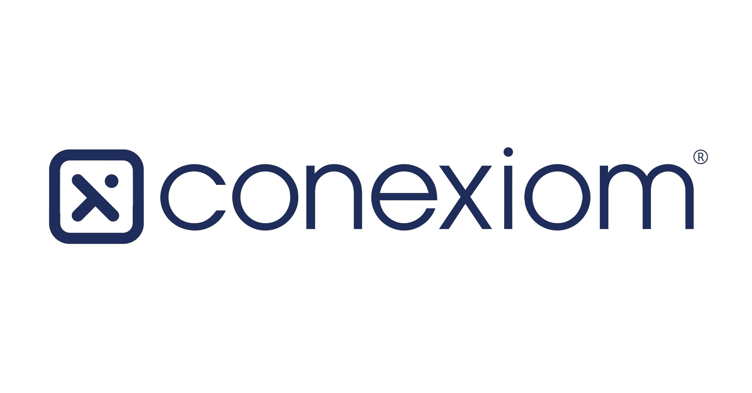
ICONIQ Growth
A global portfolio of category-defining businesses
These companies represent the full list of companies that ICONIQ Growth has invested in since inception through ICONIQ Strategic Partners funds as of the date these materials were published (except those subject to confidentiality obligations). Trademarks are the property of their respective owners. None of the companies illustrated have endorsed or recommended the services of ICONIQ.

Slide 30
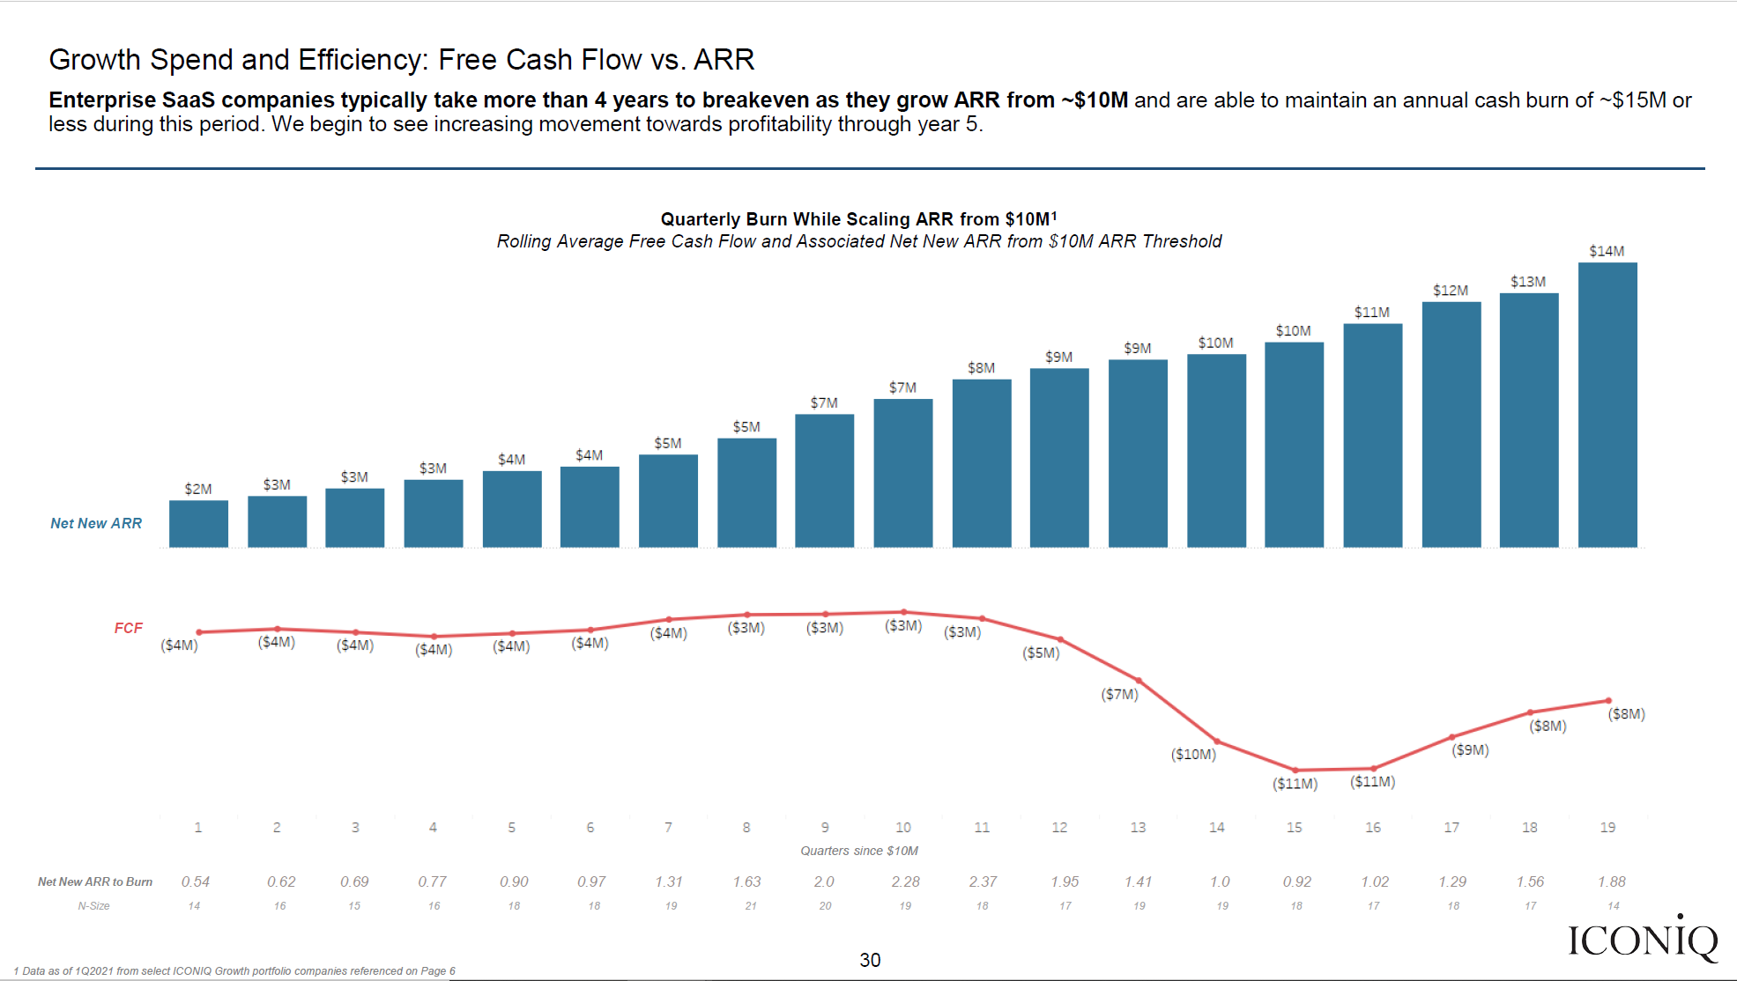
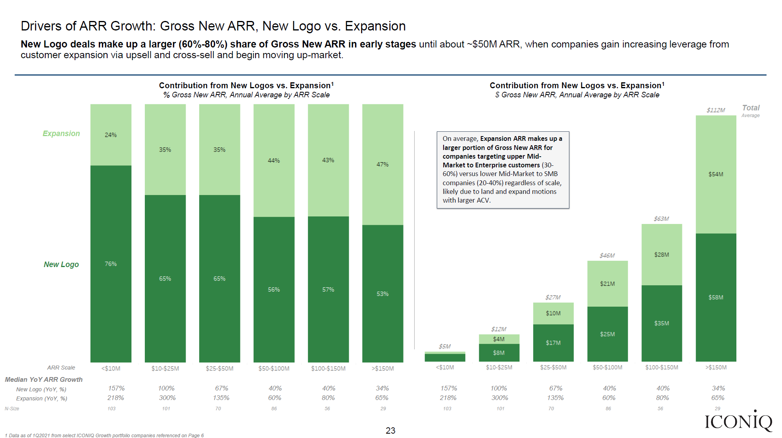
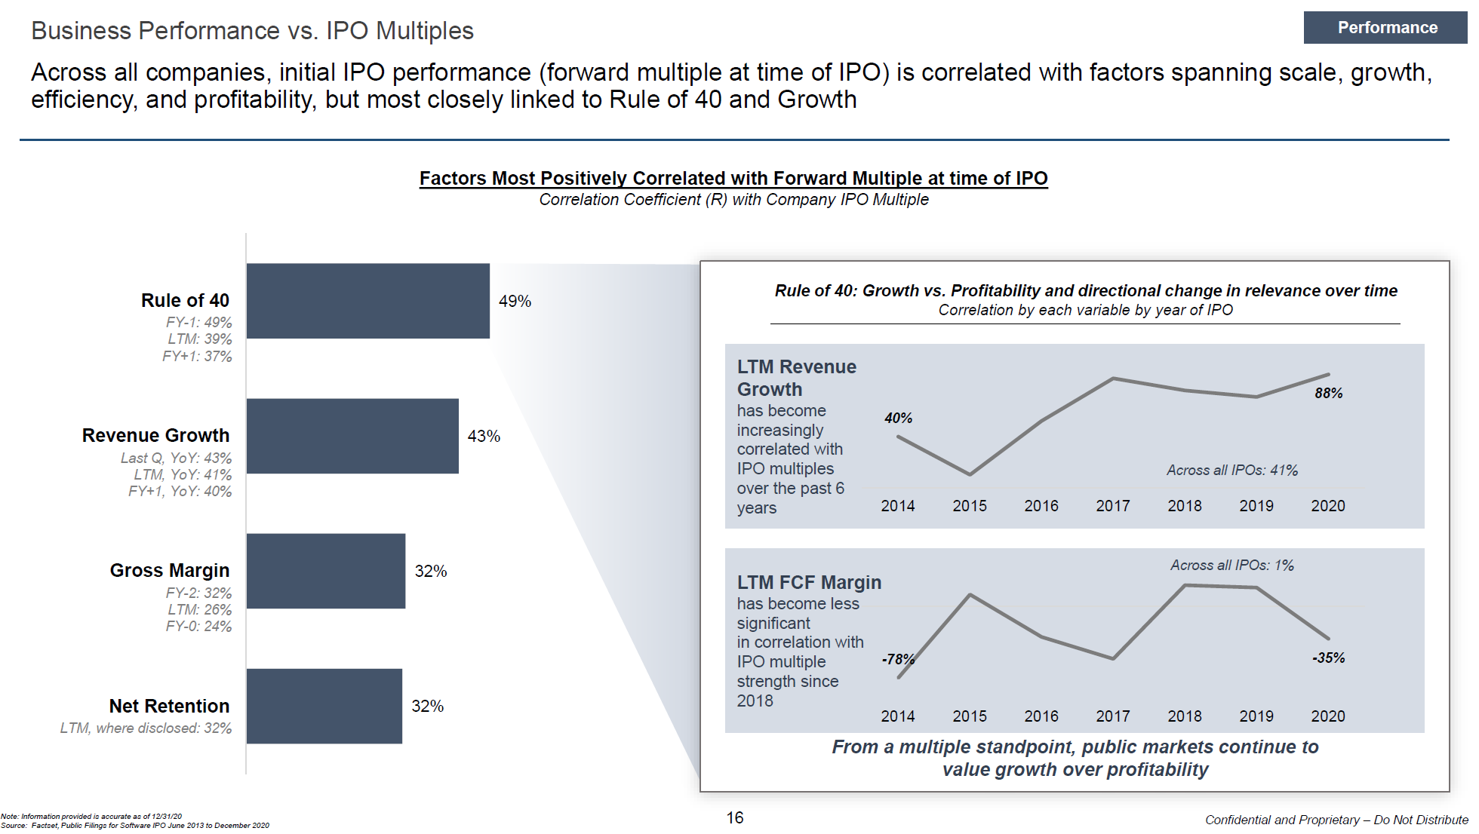
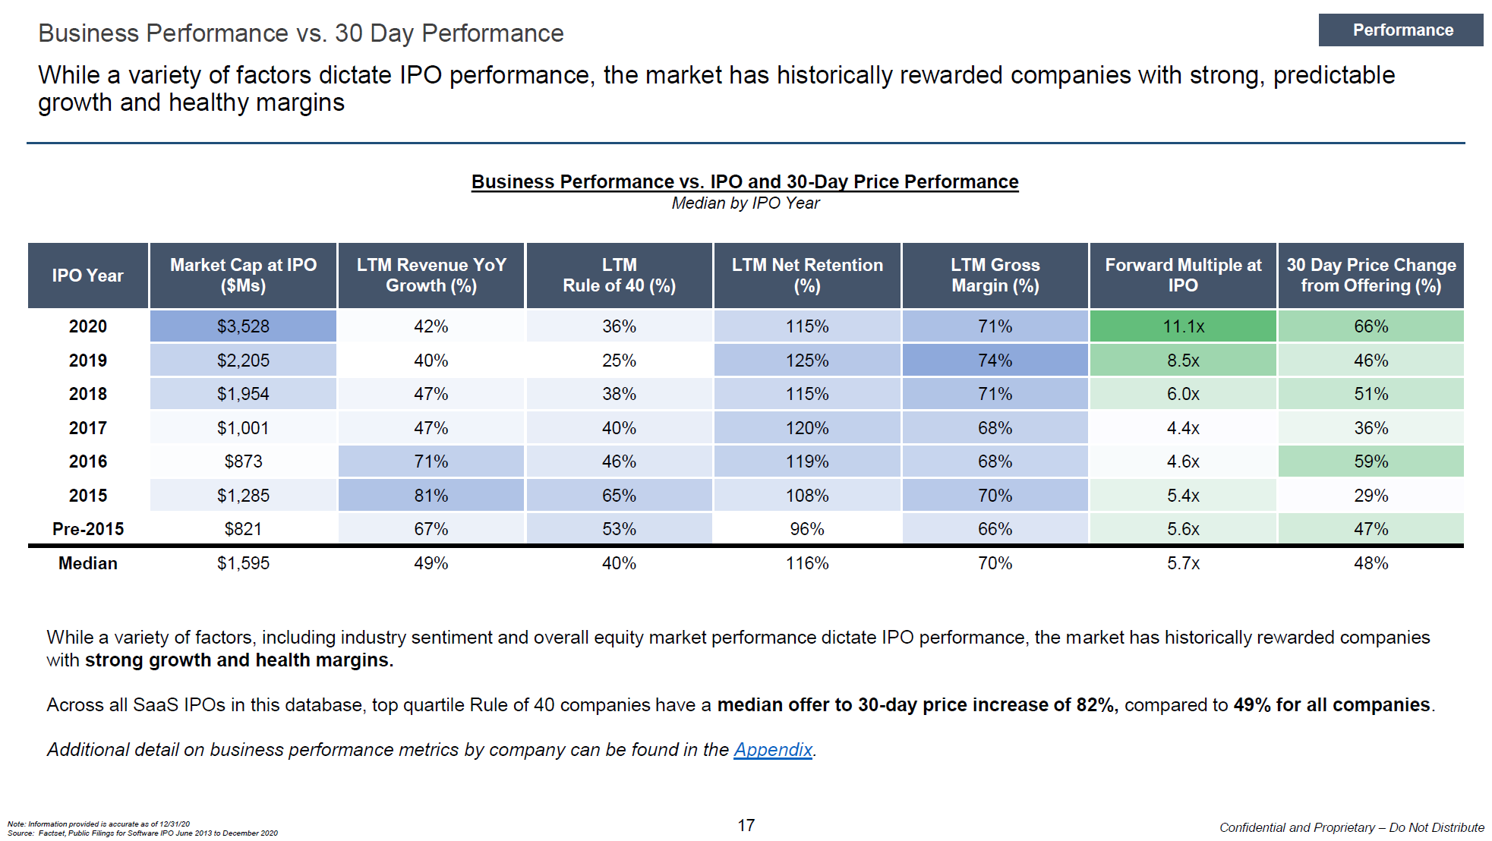
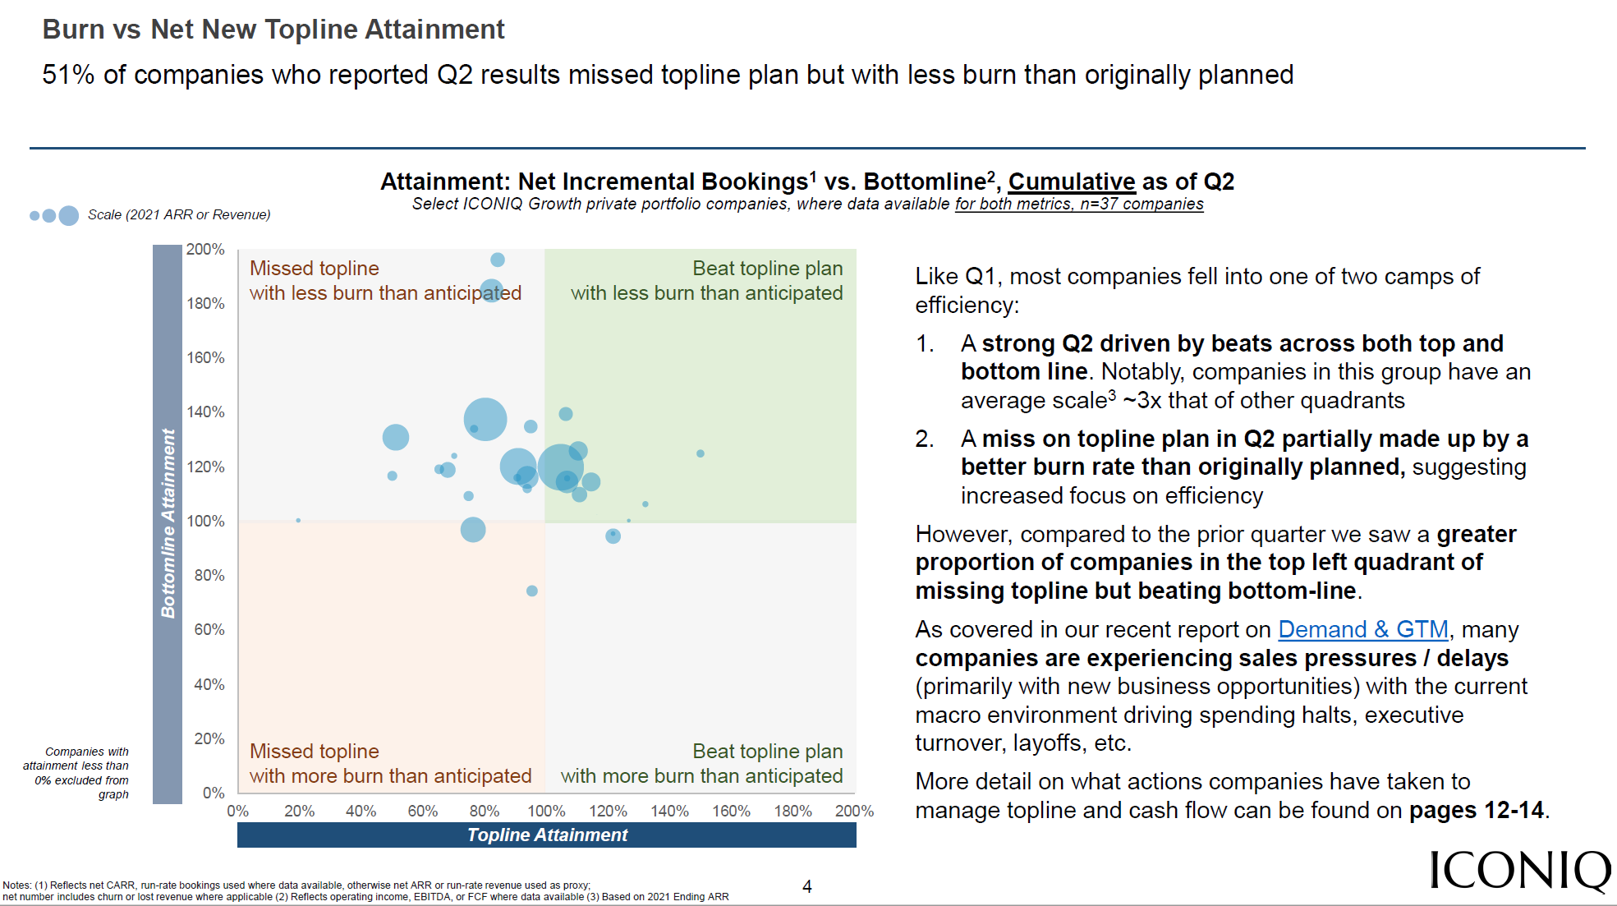
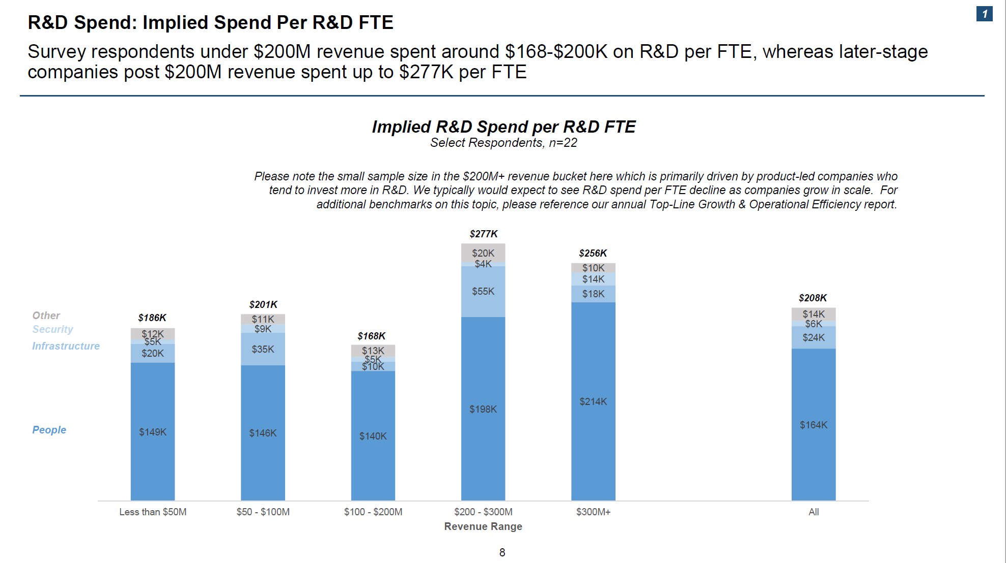
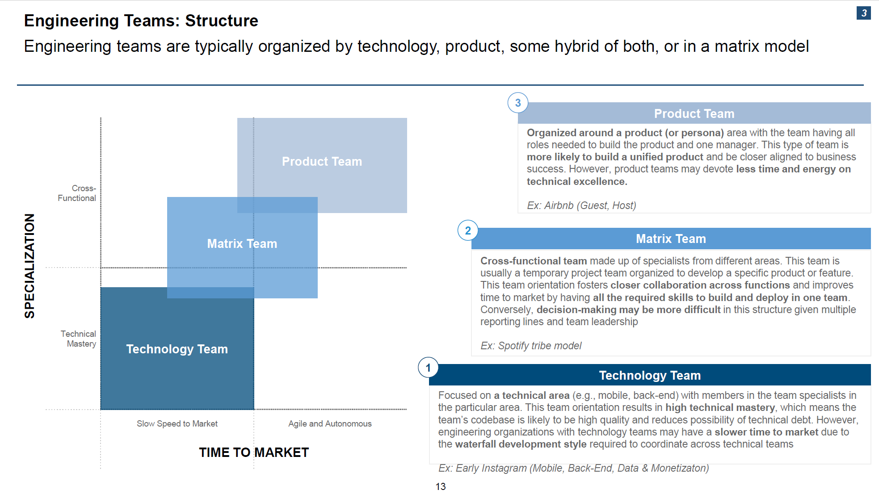
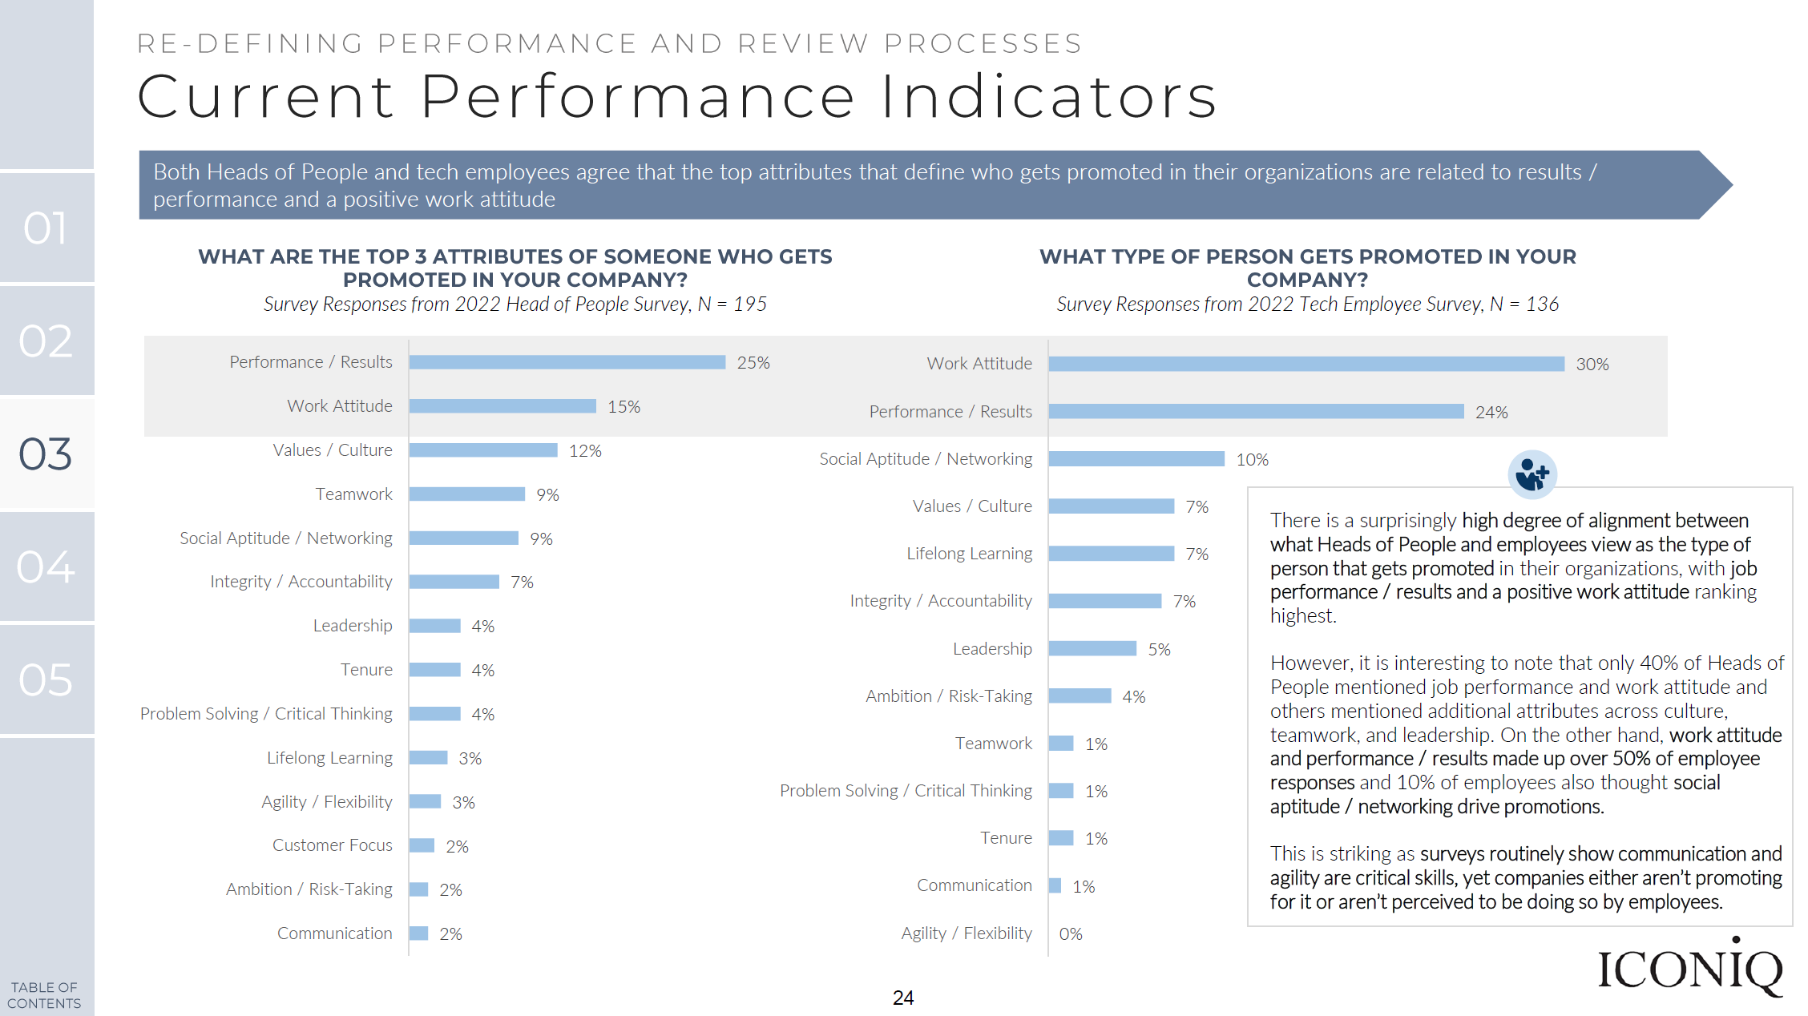
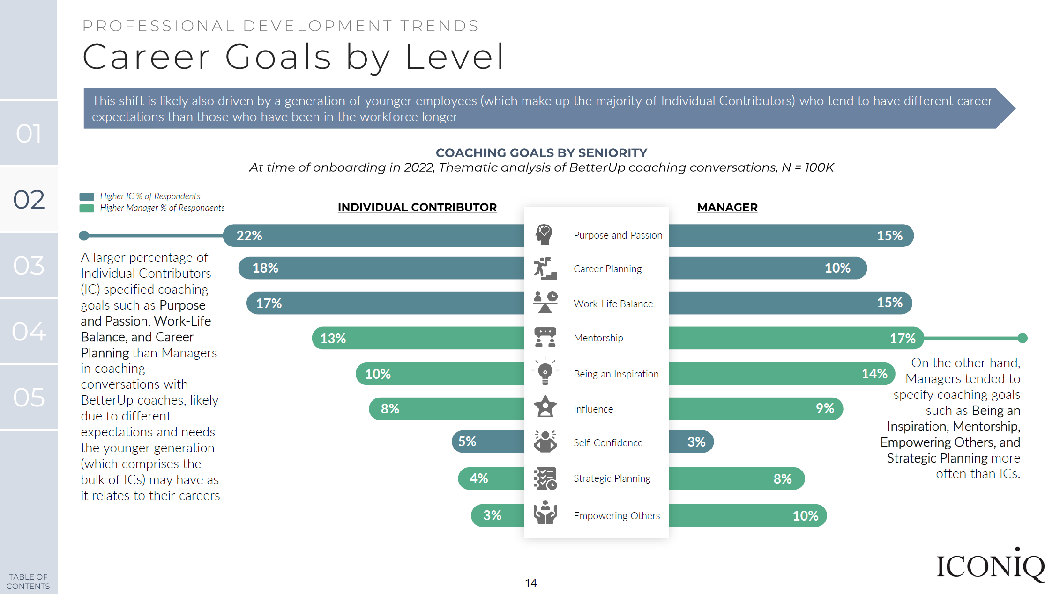
Other research from
ICONIQ Growth
The ICONIQ Growth analytics mission is to empower our portfolio and network with proprietary insights that inform business operations and strategy.
Our annual report on the data behind scaling a B2B SaaS business: we answer key questions on how these companies scale quickly and efficiently and explore what we believe to be early indicators of long-term success
Data source: quarterly financial and operating data from the ICONIQ Growth B2B SaaS portfolio
SaaS Topline Growth & Operational Efficiency
IPO Preparedness & Performance
Our annual software, consumer, and healthcare IT IPO reports answer key questions across several major topics related to successfully planning for an executing an IPO
Data source: Public filings for IPOs from 2013 to now
Real-time insights into performance and attainment across top- and bottom-line forecasts, how key performance metrics have been impacted by the current market environment, and how companies are adjusting plan and strategy in response
Data source: quarterly attainment and budget data from and proprietary surveys of the ICONIQ Growth portfolio
Navigating a Turbulent Environment
Our annual report in collaboration with the ICONIQ Growth Technical Advisory Board on the data behind high-functioning engineering organizations
Data source: proprietary survey of ICONIQ Growth portfolio and broader network
Engineering Efficiency
This report details the top tools powering modern-day software organizations across product development, data and security, go-to-market, and internal operations (in collaboration with G2)
Data source: proprietary survey of ICONIQ Growth portfolio engineering leaders and proprietary G2 review data
The Essential Tech Stack
Select research shown. We invite you to explore additional resources on our ICONIQ Growth Insights page.
These studies include proprietary information. Please reach out to iconiqgrowthanalytics@iconiqcapital.com to request access.

Slide 31
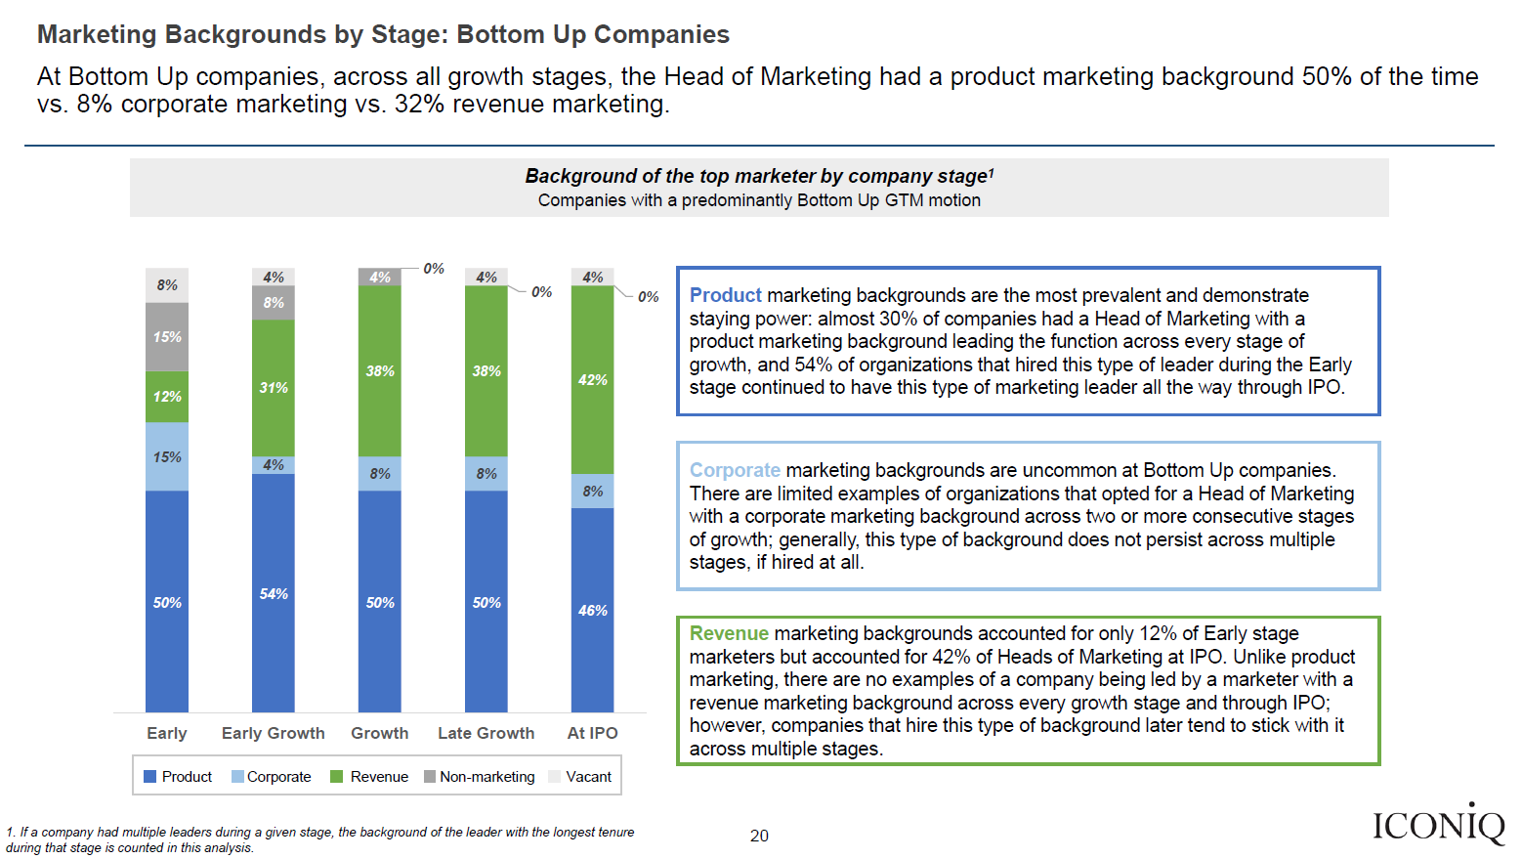
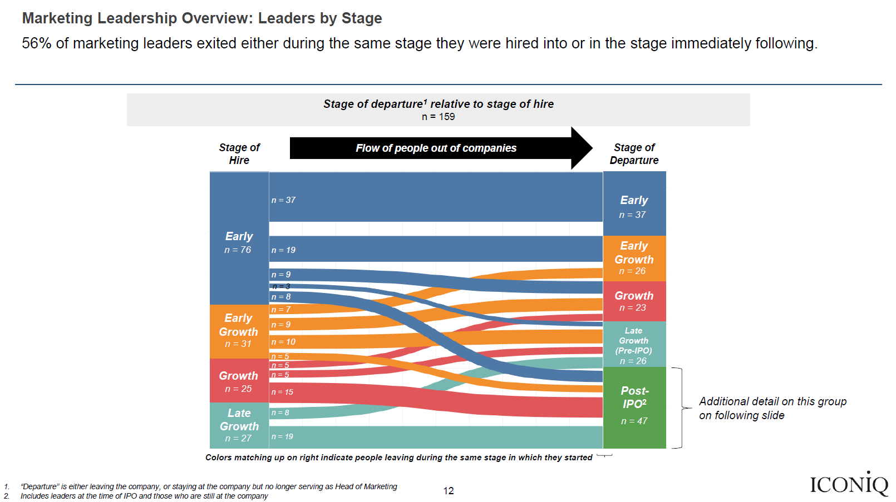
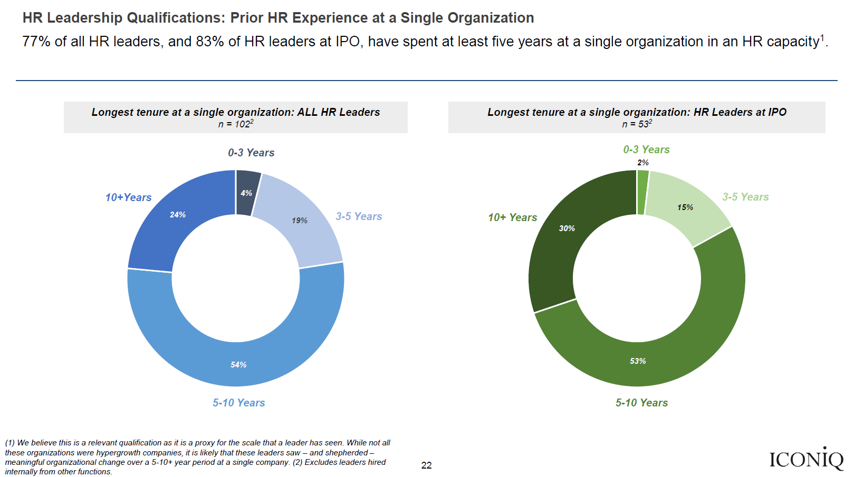
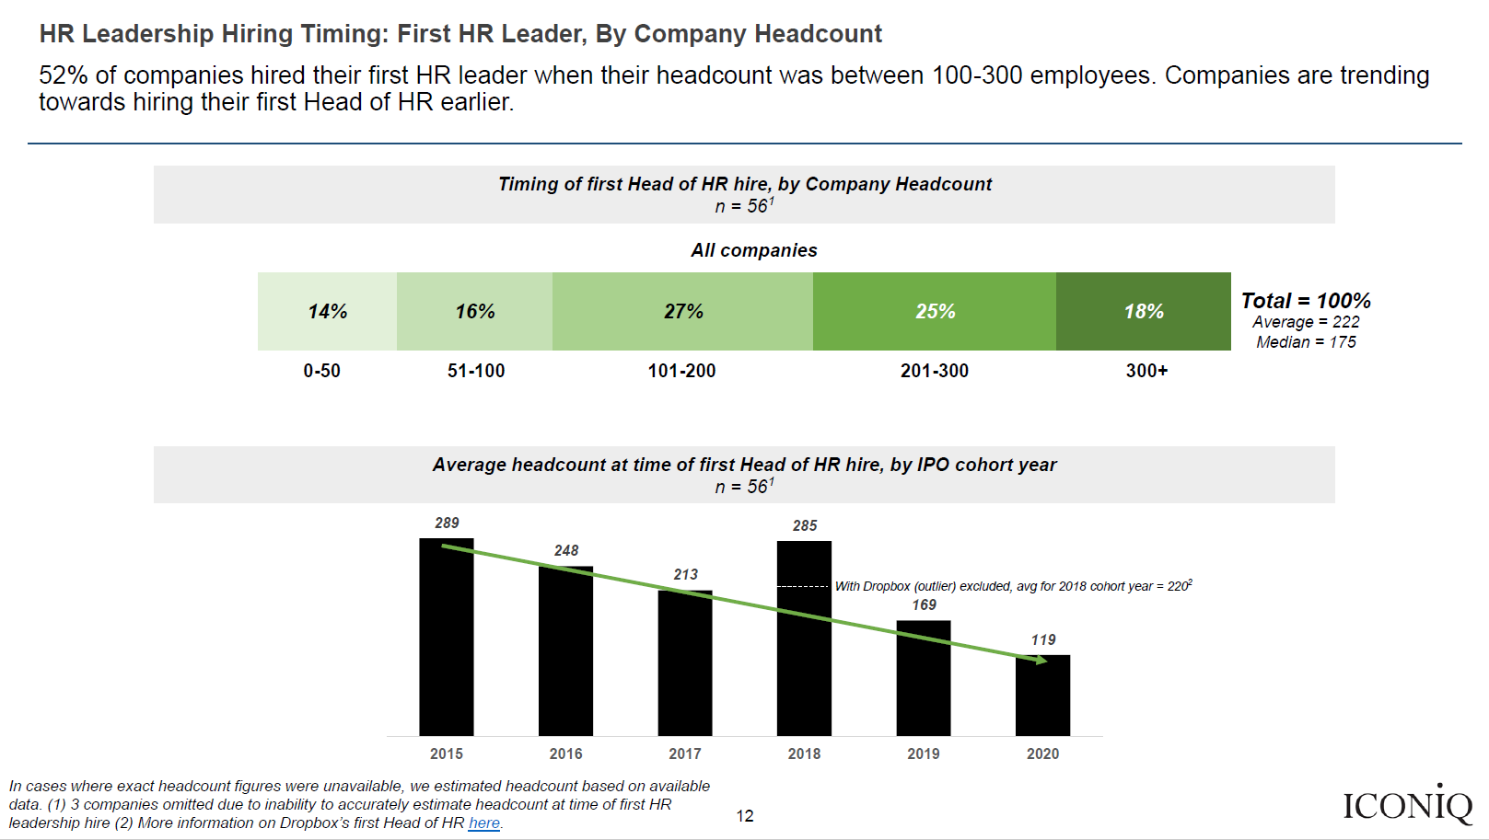
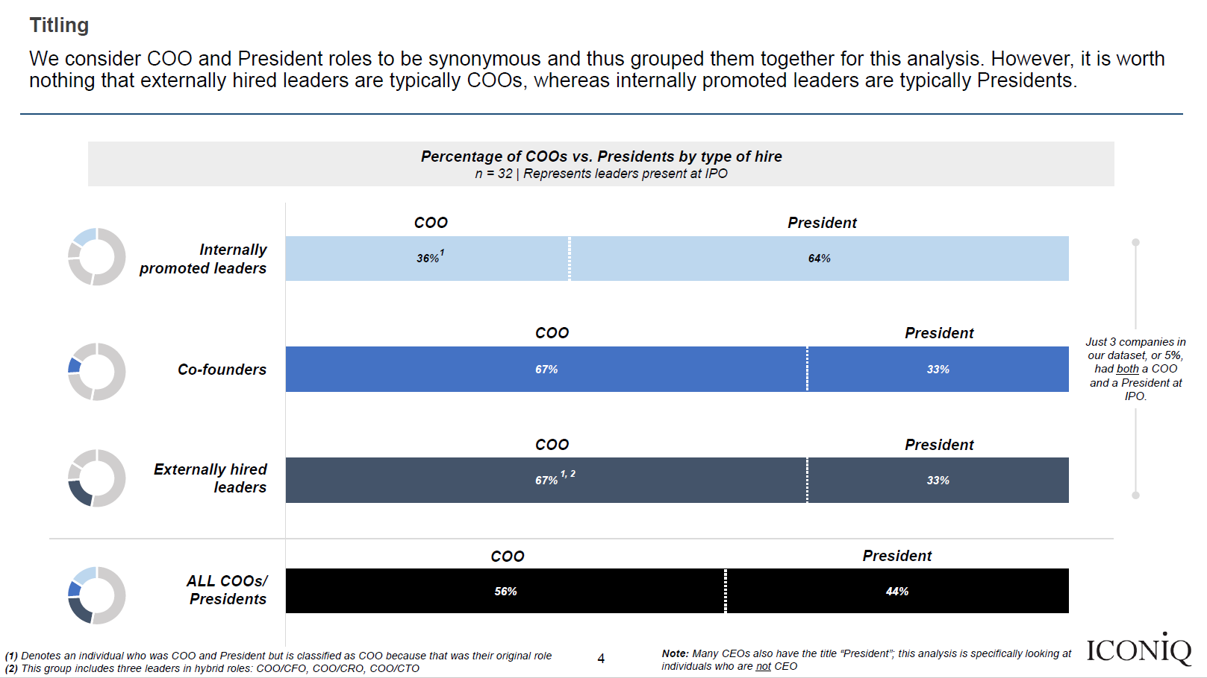
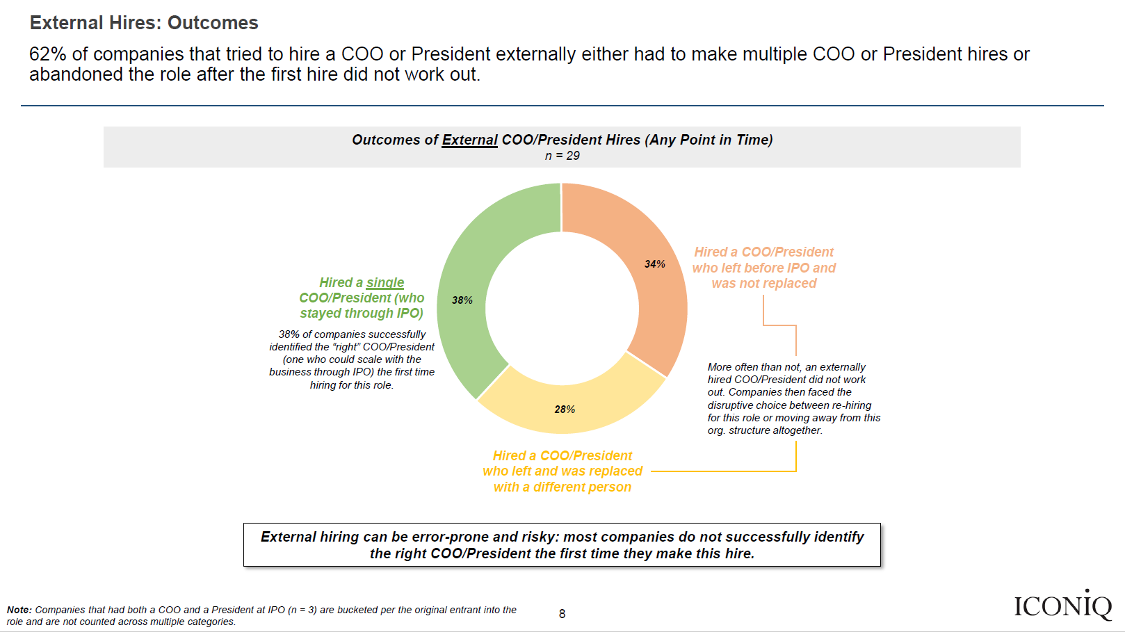
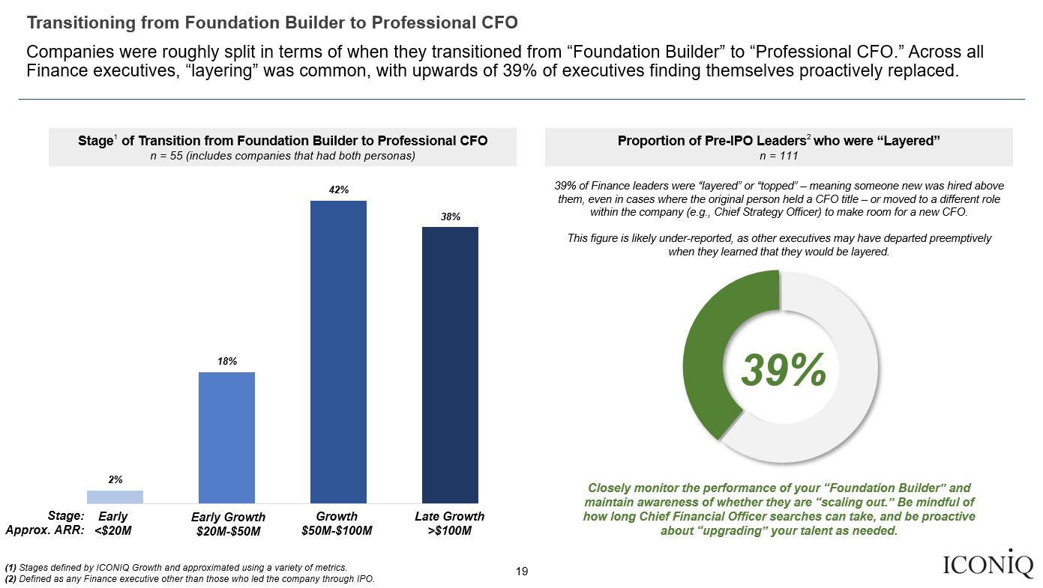
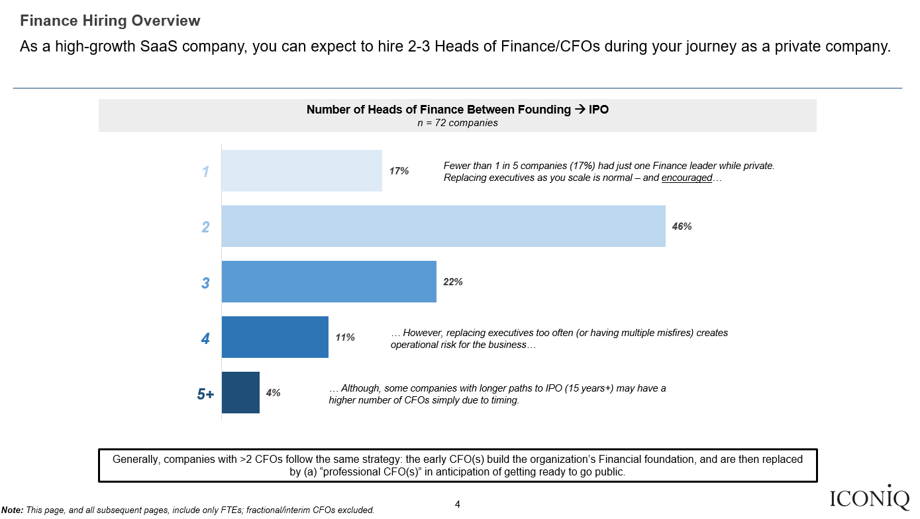
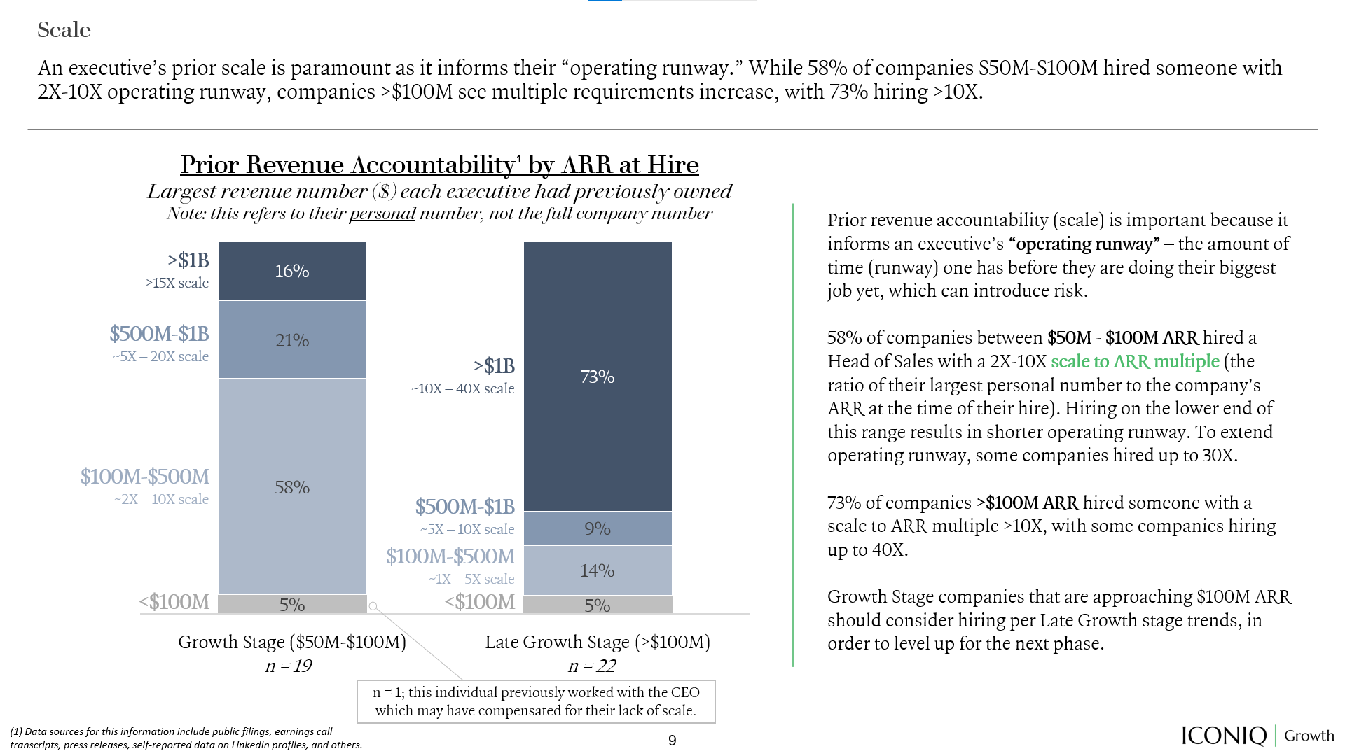
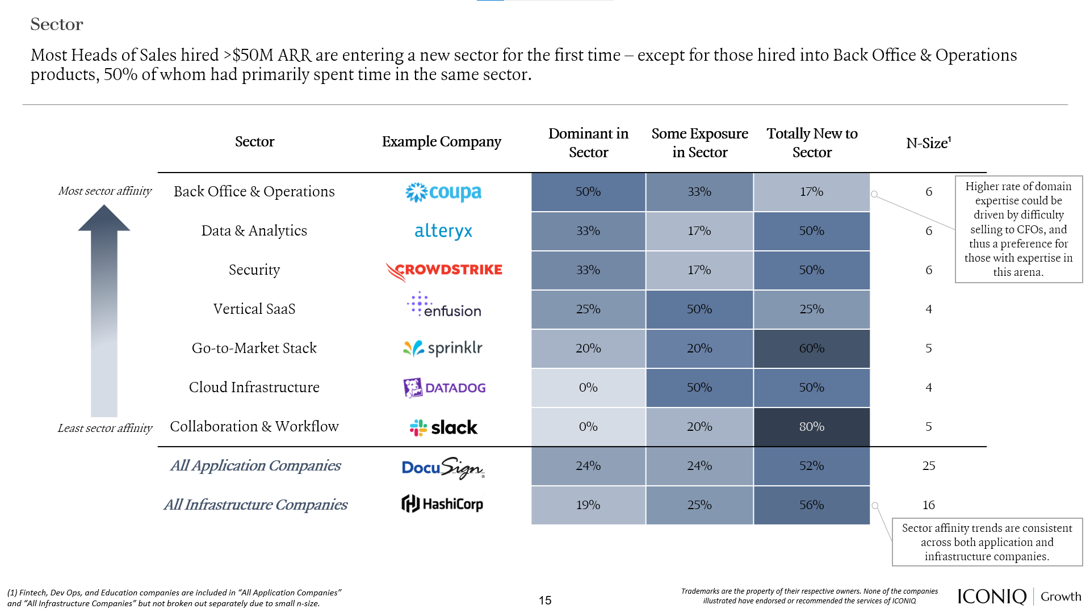
Other research from
ICONIQ Growth
Leadership Analytics
Executive hiring is the final frontier within the modern organization that is yet to see a proliferation of data. Despite having data to guide nearly every other business decision, CEOs and Founders have heretofore been forced to rely on anecdotal evidence. ICONIQ Growth Leadership Analytics helps de-risk hiring decisions by empowering CEOs and Founders with executive hiring data: we study every leadership hire between founding and IPO at high-caliber SaaS companies to create a series of first-of-their-kind playbooks that help guide decision-making across the entire company lifecycle.
Chief Marketing Officer Study
(Two-Part Series)
Quantitative analysis of the most prevalent – and most successful – operational backgrounds and qualifications for Heads of Marketing at private SaaS companies, segmented by Growth Stage
Data source: Proprietary dataset of >200 marketing leaders at 63 SaaS companies
Quantitative analysis of the most prevalent – and most successful – operational backgrounds and qualifications for Heads of People at private SaaS companies, segmented by Growth Stage
Data source: Proprietary datasets of >100 People leaders at 59 companies; 2021 Cloud 100 People leaders
Chief People Officer Study
President & Chief Operating Officer Study
Examination of the advantages and challenges of having a COO and/or President role
Data source: Proprietary dataset of every past and current COO/President at 61 SaaS companies
Quantitative analysis of the most prevalent – and most successful – operational backgrounds and qualifications for Heads of Finance at private SaaS companies, segmented by Growth Stage
Data source: Proprietary dataset of >170 finance leaders at 72 companies
Chief Financial Officer Study
Chief Revenue Officer Study (Two-Part Series)
Quantitative analysis of the most prevalent – and most successful – operational backgrounds and qualifications for Heads of Sales/CROs at private SaaS companies, segmented by Growth Stage
Data source: Proprietary dataset of >180 sales leaders at 72 companies
Please reach out to leadershipadvisory@iconiqcapital.com with any questions.

Slide 32
DISCLOSURE
UNLESS OTHERWISE INDICATED, THE VIEWS EXPRESSED IN THIS PRESENTATION ARE THOSE OF ICONIQ GROWTH ("ICONIQ" OR THE "FIRM"), ARE THE RESULT OF PROPRIETARY RESEARCH, MAY BE SUBJECTIVE, AND MAY NOT BE RELIED UPON IN MAKING AN INVESTMENT DECISION. INFORMATION USED IN THIS PRESENTATION WAS OBTAINED FROM NUMEROUS SOURCES. CERTAIN OF THESE COMPANIES ARE PORTFOLIO COMPANIES OF ICONIQ GROWTH. ICONIQ GROWTH DOES NOT MAKE ANY REPRESENTATIONS OR WARRANTIES AS TO THE ACCURACY OF THE INFORMATION OBTAINED FROM THESE SOURCES.
THIS PRESENTATION IS FOR EDUCATIONAL PURPOSES ONLY AND DOES NOT CONSTITUTE INVESTMENT ADVICE OR AN OFFER TO SELL OR A SOLICITATION OF AN OFFER TO BUY ANY SECURITIES WHICH WILL ONLY BE MADE PURSUANT TO DEFINITIVE OFFERING DOCUMENTS AND SUBSCRIPTION AGREEMENTS, INCLUDING, WITHOUT LIMITATION, ANY INVESTMENT FUND OR INVESTMENT PRODUCT REFERENCED HEREIN.
ANY REPRODUCTION OR DISTRIBUTION OF THIS PRESENTATION IN WHOLE OR IN PART, OR THE DISCLOSURE OF ANY OF ITS CONTENTS, WITHOUT THEPRIOR CONSENT OF ICONIQ, IS PROHIBITED.
THIS PRESENTATION MAY CONTAIN FORWARD-LOOKING STATEMENTS BASED ON CURRENT PLANS, ESTIMATES AND PROJECTIONS. THE RECIPIENT OF THIS PRESENTATION ("YOU") ARE CAUTIONED THAT A NUMBER OF IMPORTANT FACTORS COULD CAUSE ACTUAL RESULTS OR OUTCOMES TO DIFFER MATERIALLY FROM THOSE EXPRESSED IN, OR IMPLIED BY, THE FORWARD-LOOKING STATEMENTS. THE NUMBERS, FIGURES AND CASE STUDIES INCLUDED IN THIS PRESENTATION HAVE BEEN INCLUDED FOR PURPOSES OF ILLUSTRATION ONLY, AND NO ASSURANCE CAN BE GIVEN THAT THE ACTUAL RESULTS OF ICONIQ OR ANY OF ITS PARTNERS AND AFFILIATES WILL CORRESPOND WITH THE RESULTS CONTEMPLATED IN THE PRESENTATION. NO INFORMATION IS CONTAINED HEREIN WITH RESPECT TO CONFLICTS OF INTEREST, WHICH MAY BE SIGNIFICANT. THE PORTFOLIO COMPANIES AND OTHER PARTIES MENTIONED HEREIN MAY REFLECT A SELECTIVE LIST OF THE PRIOR INVESTMENTS MADE BY ICONIQ.
CERTAIN OF THE ECONOMIC AND MARKET INFORMATION CONTAINED HEREIN MAY HAVE BEEN OBTAINED FROM PUBLISHED SOURCES AND/OR PREPAREDBYOTHER PARTIES. WHILE SUCH SOURCES ARE BELIEVED TO BE RELIABLE, NONE OF ICONIQ OR ANY OF ITS AFFILIATES AND PARTNERS, EMPLOYEES AND REPRESENTATIVES ASSUME ANY RESPONSIBILITY FOR THE ACCURACY OF SUCH INFORMATION.
ALL OF THE INFORMATION IN THE PRESENTATION IS PRESENTED AS OF THE DATE MADE AVAILABLE TO YOU (EXCEPT AS OTHERWISE SPECIFIED),AND IS SUBJECT TO CHANGE WITHOUT NOTICE, AND MAY NOT BE CURRENT OR MAY HAVE CHANGED (POSSIBLY MATERIALLY) BETWEEN THE DATE MADE AVAILABLE TO YOU AND THE DATE ACTUALLYRECEIVED OR REVIEWED BY YOU. ICONIQ ASSUMES NO OBLIGATION TO UPDATE OR OTHERWISE REVISE ANY INFORMATION, PROJECTIONS, FORECASTS OR ESTIMATES CONTAINED IN THE PRESENTATION, INCLUDING ANY REVISIONS TO REFLECT CHANGES IN ECONOMIC OR MARKET CONDITIONS OR OTHER CIRCUMSTANCES ARISING AFTER THE DATE THE ITEMS WERE MADE AVAILABLE TO YOU OR TO REFLECT THE OCCURRENCE OF UNANTICIPATED EVENTS.
FOR AVOIDANCE OF DOUBT, ICONIQ IS NOT ACTING AS AN ADVISER OR FIDUCIARY IN ANY RESPECT IN CONNECTION WITH PROVIDING THIS PRESENTATION AND NO RELATIONSHIP SHALL ARISE BETWEEN YOU AND ICONIQ AS A RESULT OF THIS PRESENTATION BEING MADE AVAILABLE TO YOU.
ICONIQ IS A DIVERSIFIED FINANCIAL SERVICES FIRM AND HAS DIRECT CLIENT RELATIONSHIPS WITH PERSONS THAT MAY BECOME LIMITED PARTNERS OF ICONIQ FUNDS. NOTWITHSTANDING THAT A PERSON MAY BE REFERRED TO HEREIN AS A "CLIENT" OF THE FIRM, NO LIMITED PARTNER OF ANY FUND WILL, IN ITS CAPACITY AS SUCH, BE A CLIENT OF ICONIQ. THERE CAN BE NO ASSURANCE THAT THE INVESTMENTS MADE BY ANY ICONIQ FUND WILL BE PROFITABLE OR WILL EQUAL THE PERFORMANCE OF PRIOR INVESTMENTS MADE BY PERSONS DESCRIBED IN THIS PRESENTATION.
THESE MATERIALS ARE PROVIDED FOR GENERAL INFORMATION AND DISCUSSION PURPOSES ONLY AND MAY NOT BE RELIED UPON.
THIS MATERIAL MAY BE DISTRIBUTED TO, OR DIRECTED AT, ONLY THE FOLLOWING PERSONS: (I) PERSONS WHO HAVE PROFESSIONAL EXPERIENCE IN MATTERS RELATING TO INVESTMENTS FALLING WITHIN ARTICLE 19(5) OF THE FINANCIAL SERVICES AND MARKETS ACT 2000 (FINANCIAL PROMOTION) ORDER 2005 (THE “FP ORDER”), (II) HIGH-NET-WORTH ENTITIES FALLING WITHIN ARTICLE 49(2) OF THE FP ORDER, AND (III) ANY OTHER PERSONS TO WHOM IT MAY OTHERWISE LAWFULLY BE COMMUNICATED (ALL SUCH PERSONS TOGETHER BEING REFERRED TO AS “FPO RELEVANT PERSONS”). PERSONS WHO ARE NOT FPO RELEVANT PERSONS MUST NOT ACT ON OR RELY ON THIS MATERIAL OR ANY OF ITS CONTENTS. ANY INVESTMENT OR INVESTMENT ACTIVITY TO WHICH THIS MATERIAL RELATES IS AVAILABLE ONLY TO FPO RELEVANT PERSONS AND WILL BE ENGAGED IN ONLY WITH FPO RELEVANT PERSONS. RECIPIENTS MUST NOT DISTRIBUTE, PUBLISH, REPRODUCE, OR DISCLOSE THIS MATERIAL, IN WHOLE OR IN PART, TO ANY OTHER PERSON.
COPYRIGHT © 2023 ICONIQ CAPITAL, LLC. ALL RIGHTS RESERVED.

Slide 33
San Francisco | Palo Alto | New York | London
Join our community

