Slide 1
Cbs executive Sustainable Leadership & transformation
Beyond awareness
how boards can integrate sustainability into their decision-making
27 November 2024

Slide 2
KEY QUESTIONS
Which structures should boards create (e.g. a committee) to ensure high-quality oversight of sustainability?
Which mix of competencies does a board need to successfully address the sustainability agenda?
What can boards do to move the discussion of sustainability beyond regulatory compliance?

Slide 3
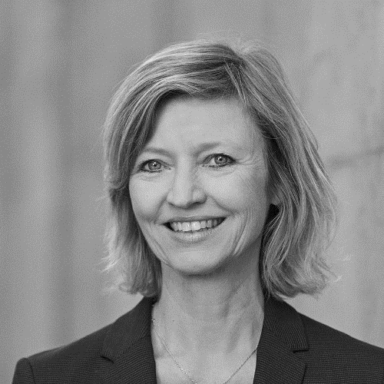
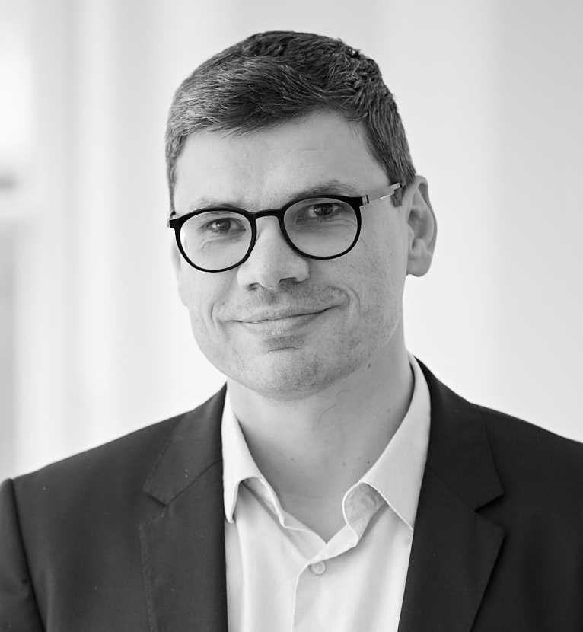
OUR EXPERTS
Jeanette is experienced board member, author and advisor.
Currently Board member in COWI, JP Politikens Hus, Andel Energi, Danske Invest and more.
Part of Faculty at several Board education programs at CBS Executive Fonden.
Andreas is Professor of Business in Society at CBS’ Centre for Sustainability
Andreas’ research has been published in several top-tier international journals.
His research examines the intersection of Corporate Sustainability, Sustainable Finance and the political role of firms.
JEANETTE FANGEL LØGSTRUP
ANDREAS RASCHE

Slide 4
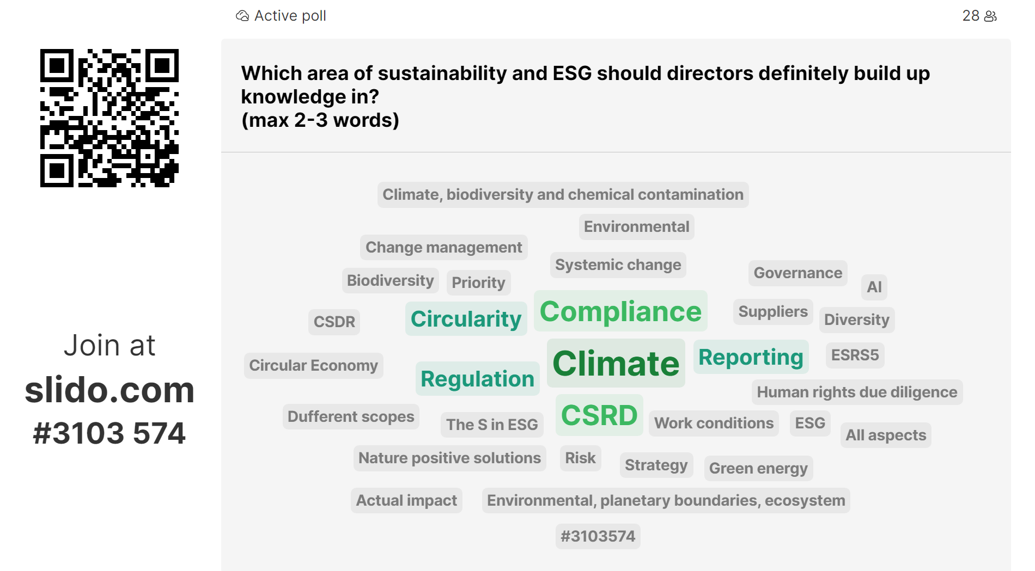
Slido from the online webinar:

Slide 5
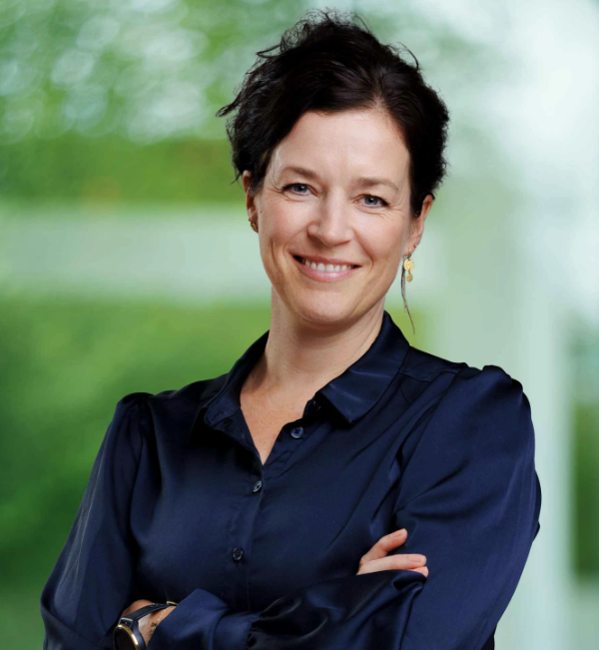
New Sustainable leadership & transformation program
Link
10 days program running from January to May 2025​
7 days face-to-face & 3 days online
World-class & interdisciplinary faculty from CBS, INSEAD, Oxford and many more.
Program overview
Program Modules
Kick-off
Cultivating the Sustainable Leadership Mindset
Aligning the Strategy & Organization
Leading the Transformation
Community of Practice
Virtual Learning
Virtual Team Coaching
Contact for more information​
Program Manager, Mette Amdi​
ma@cbs-executive.dk​ Phone: 2674 5815
Link
Interested??? Join our online info session Thursday 08:30-09:00
In partnership with IMD Business School
Double degree certificate available

